Slide 1
Control System Components
By: Nafees Ahamad,
AP, EECE, Dept.
DIT University, Dehradun

Slide 2
Control System Components
The following devices are used in control system
Potentiometers
DC Servomotors
AC Servomotors
Synchros
Stepper Motors
Magnetic Amplifier
Tachogenerators
Gyroscope
Differential transformer

Slide 3
Servomotors
Servomotors are used in feedback control system
They have low rotor inertia
They have high speed of response (Fast)
Torque speed characteristic is linear
Types of servomotors
AC servomotors
DC servomotors
Special servomotors
We will study only AC servomotors

Slide 4
AC Servomotors
They are two phase induction motor.
They have two parts namely stator and rotor.
Stator has two distributed windings, which are displaced from each other by 90⁰ electrical.
One stator winding is called main (or reference) winding whereas other winding is called control winding.
The rotor of AC servomotor is of two types
Squirrel cage rotor
Drag cup type rotor

Slide 5
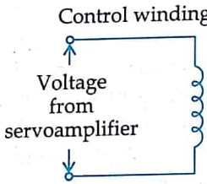
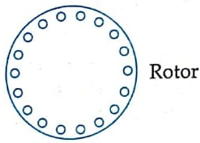
AC Servomotors …

Slide 6
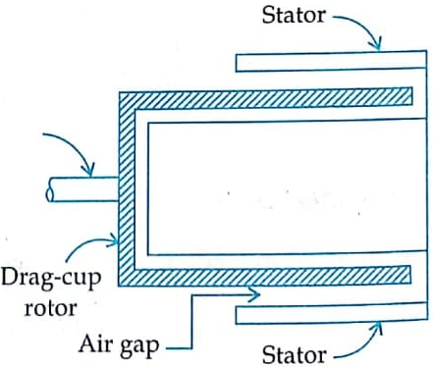
AC Servomotors …
Iron Core
(Al)
Squirrel Cage Rotor
Drag Cup Type Rotor

Slide 7
AC Servomotors …
Squirrel Cage Rotor
These rotors have large length and small diameter.
Their rotor resistance is very high.
Air-gap is kept small.
Drag Cup Type Rotor
It has two air gaps
Drag cup is made of non-magnetic materials like Aluminum.
Both rotors has high rotor resistance which results in high starting torque

Slide 8
Torque-speed characteristics
Torque-speed characteristics for AC servomotor depends upon the ratio of rotor reactance(X) to rotor resistance (R)
If $\frac{X}{R}$ is large $⇒$Non linear characteristics
If $\frac{X}{R}$ is small $⇒$Linear characteristics (Used in Servomotors)
In case of servomotors, torque-speed characteristics for various control voltage are made almost linear as shown on next slide.

Slide 9
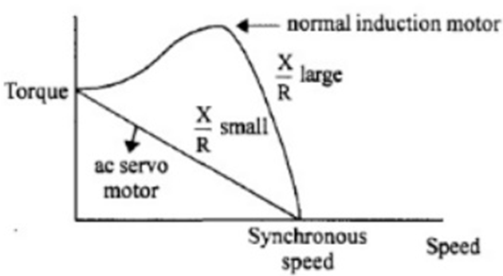
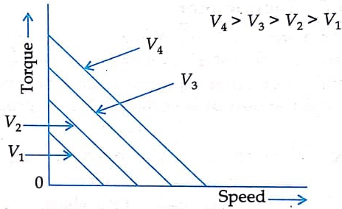
Torque-speed characteristic

Slide 10
Applications of servomotors
They are used in
Radar
Electromechanical actuators
Computers
Machine tools
Tracking and guidance

Slide 11
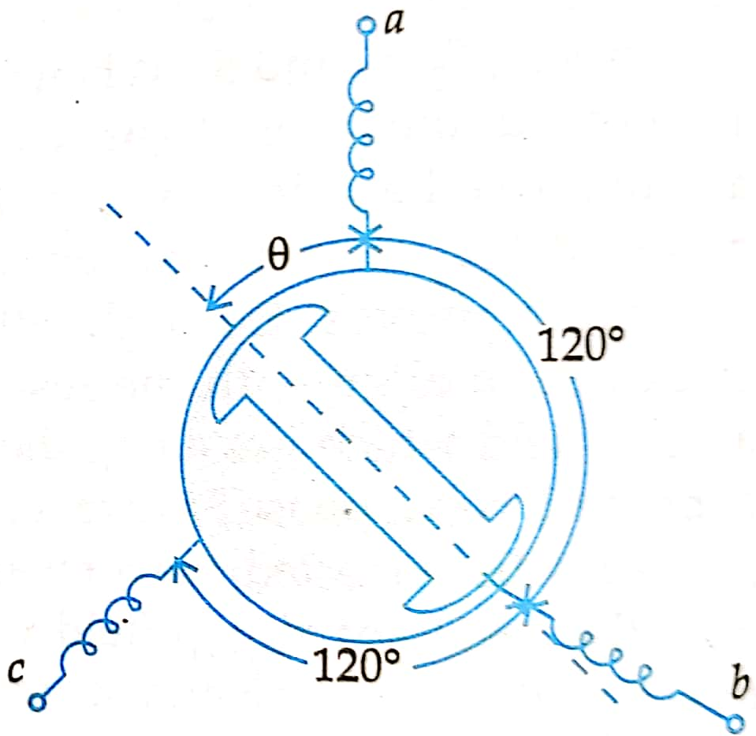
Synchros
It is an electromagnetic transducer.
It converts the angular position of a shaft into an electric signal.

Slide 12
Synchro Transmitter
The construction of synchro transmitter is similar to that of 3-phase alternator.
Stator is made of laminated silicon steel and carries 3-phase star connected windings.
The rotor is a rotating part, dumbbell shaped magnet with a single winding.
Let the single phase AC voltage applied to rotor is
$e_{r}\left(t\right)=E_{r}Sinω_{0}t$
Due to this, a magnetizing current will flow in the rotor coil which produces sinusoidally varying flux in the air gap.
Because of this flux voltages are induced in all stator coil by transformer action.

Slide 13
Synchro Transmitter …
The induced voltages in all stator coil is proportional to cosine of angle between stator and rotor coil axes.
Let the rotor of synchro transmitter is at an angle $θ$, then voltages in each stator coil with respect to neutral are
$E_{an}=KE_{r}Sinω_{0}t Cosθ$
$E_{bn}=KE_{r}Sinω_{0}t Cos\left(θ+{120}^{0}\right)$
$E_{cn}=KE_{r}Sinω_{0}t Cos\left(θ+{240}^{0}\right)$

Slide 14
Synchro Transmitter …
Magnitude of stator terminal voltages are
$E_{cb}=E_{cn}−E_{bn}$
$=KE_{r}Sinω_{0}t\left[Cos\left(θ+{240}^{0}\right)−Cos\left(θ+{120}^{0}\right)\right]$
$=KE_{r}Sinω_{0}t\sqrt{3} Sinθ$
$E_{cb}=KE_{r}Sinω_{0}t\sqrt{3} Sinθ$
Similarly
$E_{ac}=KE_{r}Sinω_{0}t Sin\left(θ+{120}^{0}\right)$
$E_{ba}=KE_{r}Sinω_{0}t Sin\left(θ+{240}^{0}\right)$

Slide 15
Synchro Transmitter …
When $θ=0$, then
$E_{an}=KE_{r}Sinω_{0}t Cosθ=KE_{r}Sinω_{0}t$ (Maximum)
$E_{cb}=KE_{r}Sinω_{0}t\sqrt{3} Sinθ=0$ (Minimum)
This position is defined as electrical zero of the transmitter and used as the reference for indicating the angular position of the rotor.
Thus, the input to the synchro transmitter is the angular position of the shaft and the output are the three phase voltages which are the function of the shaft position.

Slide 16
Stepper Motors
It is an electromechanical device (motor).
In this type of motor, rotor moves in discrete steps.
It is of following 3-types
Variable reluctance motors
Permanent magnet motors
Hybrid type motors

Slide 17
Variable reluctance stepper motors
It is of two types
Single stack Variable reluctance stepper motors
Multi stack Variable reluctance stepper motors

Slide 18
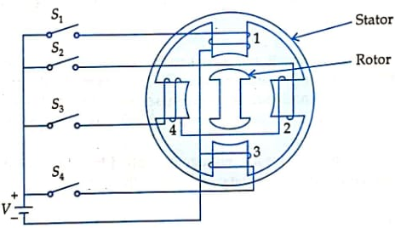
Single stack Variable reluctance stepper motors
A 4-phase, 4-stator pole, 2-teeth rotor Single stack Variable reluctance stepper motors is shown in side figure
When phase 1 is excited (switch S₁ is closed), the rotor aligns with the axis of phase 1 as shown in side figure.
If S₁ OFF & S₂ ON, rotor moves 90⁰ clockwise to align with the axis of phase 2.

Slide 19
Single stack Variable reluctance stepper motors
If S₂ OFF & S₃ ON, rotor moves further 90⁰ clockwise to align with the axis of phase 3 and so on.
So, if the windings of stator are energized in the sequence of 1-2-3-4-1, the rotor moves in clockwise direction with a step angle of 90⁰.
And, if the windings of stator are energized in the sequence of 1-4-3-2-1, the rotor moves in anti clockwise direction with a step angle of 90⁰.
The step angle can be change by increasing the number of stator poles and phases.
Step angle can also be decreased by energizing the multiple number of phases.

Slide 20
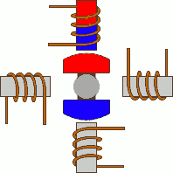
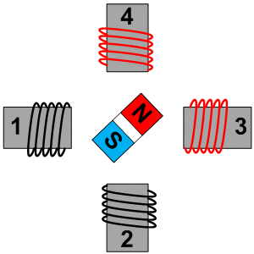
Single stack Variable reluctance stepper motors
Reference: https://prezi.com/y6bcoth8blho/stepper-motor/

Slide 21
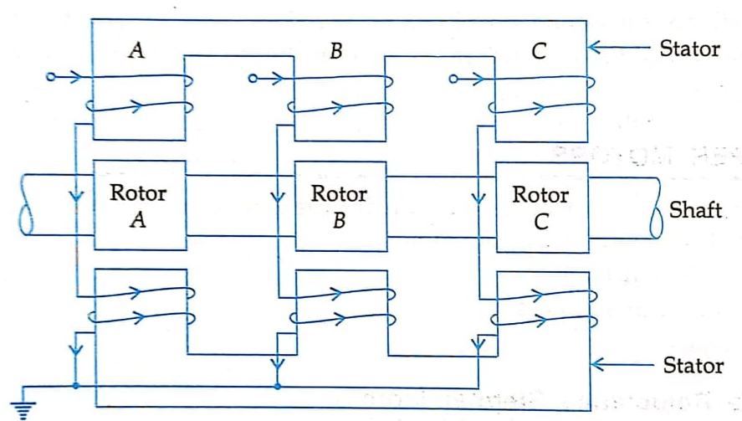
Multi-stack Variable Reluctance Stepper Motors

Slide 22
Multi-stack Variable Reluctance Stepper Motors …
In this motor, rotor has a common shaft and stator has a common frame.
Stator and rotor has same no of poles with same teeth size.
The stator are pulse excited while rotors are unexcited.
The winding of all stator poles are excited simultaneously.
Since, stator and rotor has same no of poles, therefore pole pitch is also same.
If T_{r} is the number of rotor teeth and “n” is the number of stack or phases, then
$Tooth pitch=\frac{{360}^{0}}{T_{r}}$
$Angular displacement or step angle=\frac{{360}^{0}}{nT_{r}}$

Slide 23
Thanks ?

