Slide 1
Stability & Root Locus
Nafees Ahamad
AP, Department of Electrical, Electronics & Communication, DIT University, Dehradun

Slide 2
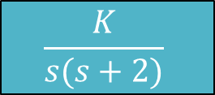
Root Locus
The locus of the roots of the characteristic equation when gain (K) is varied from zero to infinity is called root locus.
Consider a unity feedback system as shown
Its characteristic equation 1+G(s)H(s)=0
${⇒s}^{2}+2s+K=0$
$$\frac{K}{s(s+2)}$$
R(s)
E(s)
C(s)
H(s)=1

Slide 3
Root Locus…
So, roots of characteristic equation are
$s_{1}=−1+\sqrt{1−K}$ and
$s_{2}=−1−\sqrt{1−K}$
When K is increased from 0 to $∞$ the path of s₁ and s₂ is know as root locus which is shown on next slide

Slide 4
Im
$$K=∞$$
s₂, K=0
s₁, K=0
Re
-2
-1
0
Break Away Point
$$K=∞$$

Slide 5
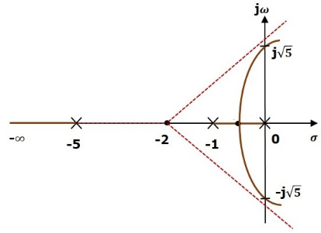
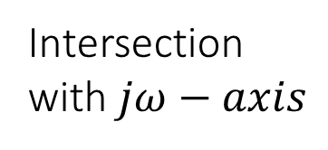
Terminology of root locus
Intersection with $jω−axis$
The root locus of
$G\left(s\right)H\left(s\right)=\frac{K}{s(s+1)(s+5)}$
Break away point
Centroid
Asymptote

Slide 6
Rules to Construct Root Locus
Rule 1: The roots locus is symmetrical about the real axis.
Rule 2: The root loci starts from an open loop pole with K = 0.
Ex: If $G\left(s\right)H\left(s\right)=\frac{K(s+3)}{(s+2)}−−−(1)$
find starting point of root loci.
Sol: Root locus starts at s = -2
Rule 3: The root locus terminates either on an open loop zero or on infinity with $K=∞$ .
Ex: In above problem root locus will terminate at s = -3.

Slide 7

Rules to Construct Root Locus …
Rule 4: If
N = No of separate loci
P = No of finite poles
Z = No of finite zeros then,
$N=P if P>Z$
$N=Z if Z>P$
$N=P=Z if Z=P$
Ex: In above example 1, P =1, Z =1 So, N = 1

Slide 8
Rules to Construct Root Locus …
Rule 5: Root locus on real axis.
Any point on real axis is a part of root locus if only if the number of poles and zeros to its right is odd.
Rule 6: Asymptotes
The branches of root locus tend to infinity along a set of straight line called asymptotes. These asymptotes making an angle with real axis and given by
$∅=\frac{(2K+1){180}^{0}}{P−Z}$ Where K = 0, 1, 2, …
Total number of asymptotes = P-Z

Slide 9

Rules to Construct Root Locus …
Im
Ex: If $G\left(s\right)H\left(s\right)=\frac{K}{s(s^{2}+6s+10)}−−−(2)$
P = 3 & Z = 0
No of asymptotes = P – Z = 3
$K=0 ∅_{1}=\frac{(2×0+1){180}^{0}}{3−0}={60}^{0}$
$K=1 ∅_{2}=\frac{(2×1+1){180}^{0}}{3−0}={180}^{0}$
$K=2 ∅_{1}=\frac{(2×2+1){180}^{0}}{3−0}={300}^{0}$
$${60}^{0}$$
$${180}^{0}$$
Re
$$σ_{A}$$
$${300}^{0}$$

Slide 10
Rules to Construct Root Locus …
Rule 7: Centroid of asymptotes.
The point of intersection of asymptotes with real axis is called centroid of asymptotes and is given by
$σ_{A}=\frac{Sum of poles−Sum of zeros}{P−Z}$
Ex: The centroid of example given by equ (2) is calculated as
$σ_{A}=\frac{0+\left(−3+j\right)+(−3−j)−0}{3−0}=−2$ (Poles = 0, -3+j, -3-j; No Zeros)

Slide 11
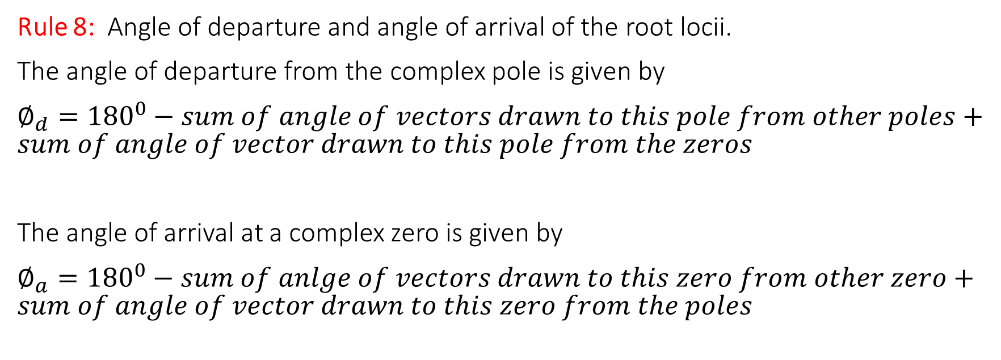
Rules to Construct Root Locus …
Rule 8: Angle of departure and angle of arrival of the root locii.
The angle of departure from the complex pole is given by
$∅_{d}={180}^{0}−sum of angle of vectors drawn to this pole from other poles+sum of angle of vector drawn to this pole from the zeros$
The angle of arrival at a complex zero is given by
$∅_{a}={180}^{0}−sum of anlge of vectors drawn to this zero from other zero+sum of angle of vector drawn to this zero from the poles$

Slide 12
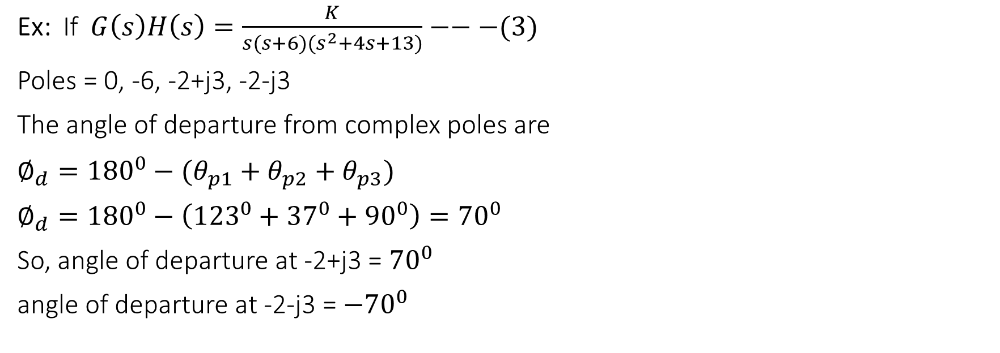
Rules to Construct Root Locus …
-2+j3
Im
Ex: If $G\left(s\right)H\left(s\right)=\frac{K}{s(s+6)(s^{2}+4s+13)}−−−(3)$
Poles = 0, -6, -2+j3, -2-j3
The angle of departure from complex poles are
$∅_{d}={180}^{0}−(θ_{p1}+θ_{p2}+θ_{p3})$
$∅_{d}={180}^{0}−\left({123}^{0}+{37}^{0}+{90}^{0}\right)={70}^{0}$
So, angle of departure at -2+j3 = ${70}^{0}$
angle of departure at -2-j3 = ${−70}^{0}$
$$θ_{p1}$$
$$θ_{p2}$$
Re
-6
$$θ_{p3}$$
-2-j3

Slide 13
Rules to Construct Root Locus …
Rule 9: Breakaway and break in point on real axis.
If the root locus lies between two adjacent open loop poles on the real axis then there will be at least one breakaway point.
Similarly, If root locus lies between two adjacent zeros on real axis, then there will be at least one break in point.
If root locus lies between an open loop pole and zero, then there will be no breakaway or break in point or may be both occur.
The breakaway and break in points can be determined from the roots of $\frac{dK}{ds}=0$.

Slide 14
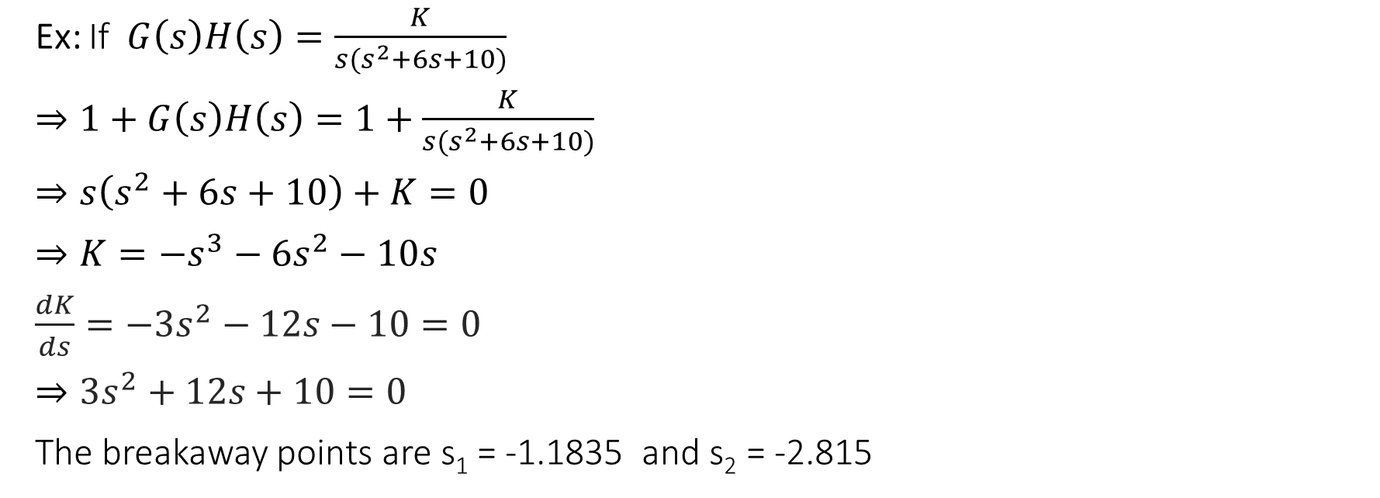
Rules to Construct Root Locus …
Ex: If $G\left(s\right)H\left(s\right)=\frac{K}{s(s^{2}+6s+10)}$
$⇒1+G\left(s\right)H\left(s\right)=1+\frac{K}{s(s^{2}+6s+10)}$
$⇒s\left(s^{2}+6s+10\right)+K=0$
$⇒K=−s^{3}−{6s}^{2}−10s$
$\frac{dK}{ds}=−3s^{2}−12s−10=0$
$⇒3s^{2}+12s+10=0$
The breakaway points are s₁ = -1.1835 and s₂ = -2.815

Slide 15
Rules to Construct Root Locus …
Rule 10: Intersection of root locus branches with $jω$-axis can be determined through Routh Hurwitz criterion.
Ex: If $G\left(s\right)H\left(s\right)=\frac{K}{s(s^{2}+6s+10)}$
Its characteristic equation $s^{3}+6s^{2}+10s+K=0$
Hence, we get a zero row if K = 60
s³ | 1 | 10
s² | 6 | K
s¹ | (60-K)/6 | 0
s⁰ | K

Slide 16
Rules to Construct Root Locus …
The auxiliary equation $A\left(s\right)=6s^{2}+K$
$⇒6s^{2}+K=0$
$⇒6s^{2}+60=0$
$⇒s=±j3.16$
The root locus branches cross the imaginary axis at $s=±j3.16$ for K = 60.

Slide 17
Example
Example 1: The forward path transfer function of a unity feedback system is given by
$G\left(s\right)=\frac{K}{s(s+4)(s+5)}$.
Sketch the root locus as K is varied from zero to infinity.

Slide 18
Example…
Solution:
Rule 1: The roots locus is symmetrical about the real axis.
Rule 2: Open loop poles are 0, -4, -5
So, Root locus starts at s = 0, -4, -5
Rule 3: There are No zeros. So, root locus terminates on infinity.
Rule 4: P = 3 & Z = 0
N = No of separate loci = P = 3 $∵ P>Z$

Slide 19
Example…
Rule 5: Root locus on real axis.
Root locus exists between 0 & -4 and to the left of -5
Rule 6: Asymptotes
Total number of asymptotes = P-Z = 3 and angles are
$K=0 ∅_{1}=\frac{(2×0+1){180}^{0}}{3−0}={60}^{0}$
$K=1 ∅_{2}=\frac{(2×1+1){180}^{0}}{3−0}={180}^{0}$
$K=2 ∅_{1}=\frac{(2×2+1){180}^{0}}{3−0}={300}^{0}$

Slide 20

Example…
Im
Rule 7: Centroid of asymptotes.
$σ_{A}=\frac{Sum of poles−Sum of zeros}{P−Z}$
$σ_{A}=\frac{0+\left(−4\right)+(−5)−0}{3−0}=−3$
$${180}^{0}$$
$${60}^{0}$$
Re
-3
-5
-4
0
$${300}^{0}$$

Slide 21
Example…
Rule 8: Angle of departure and angle of arrival of the root locii.
There are no complex poles and zeros so, no angle of departure from the complex pole and no angle of arrival at a complex zero.
Rule 9: Breakaway and break in point on real axis.
Its characteristic equation
$⇒1+G\left(s\right)H\left(s\right)=1+\frac{K}{s(s+4)(s+5)}$
$⇒s\left(s^{2}+9s+20\right)+K=0$
$⇒K=−s^{3}−{9s}^{2}−20s$

Slide 22
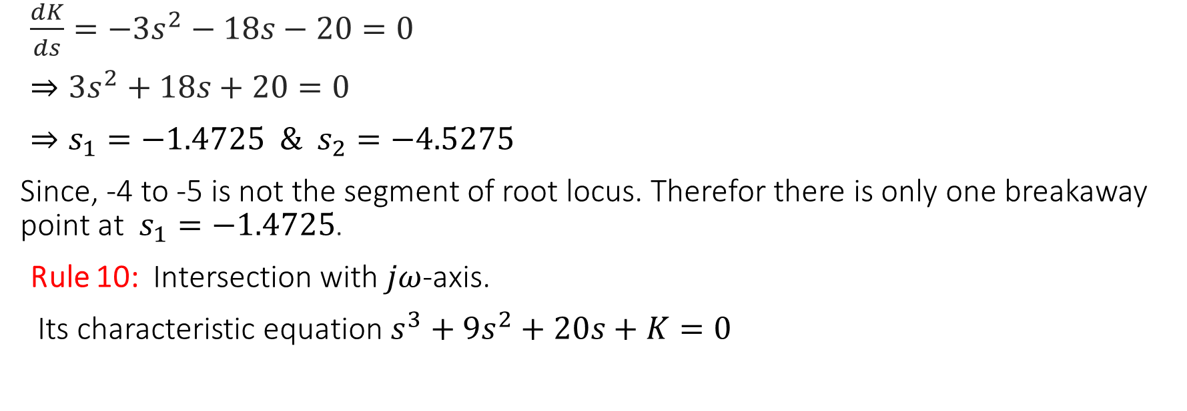
Example…
$\frac{dK}{ds}=−3s^{2}−18s−20=0$
$⇒3s^{2}+18s+20=0$
$⇒s_{1}=−1.4725 \& s_{2}=−4.5275$
Since, -4 to -5 is not the segment of root locus. Therefor there is only one breakaway point at $s_{1}=−1.4725$.
Rule 10: Intersection with $jω$-axis.
Its characteristic equation $s^{3}+9s^{2}+20s+K=0$

Slide 23
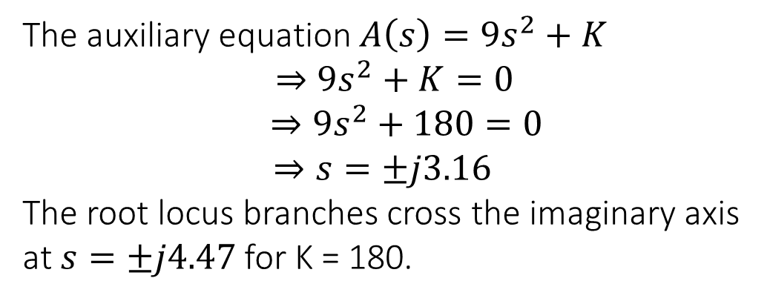
Example…
s³ | 1 | 20
s² | 9 | K
s¹ | (180-K)/9 | 0
s⁰ | K
Hence, we get a zero row if K = 180
The auxiliary equation $A\left(s\right)=9s^{2}+K$
$$⇒9s^{2}+K=0$$
$$⇒9s^{2}+180=0$$
$$⇒s=±j3.16$$
The root locus branches cross the imaginary axis at $s=±j4.47$ for K = 180.

Slide 24
Im
-j4.47
-3
-1.4725
Re
-5
-4
0
+j4.47
Root Locus

Slide 25
Thank You

