Slide 1
Nyquist Stability Criterion
By: Nafees Ahmed
Asstt. Prof., EE Deptt,
DIT, Dehradun

Slide 2
Introduction
Nyquist criterion is used to identify the presence of roots of a characteristic equation of a control system in a specified region of s-plane.
A closed loop system will be stable if pole of closed loop transfer function (roots of characteristic equation) are on LHS of s-plane
From the stability view point the specified region being the entire right hand side of complex s-plane.
Note:
An open loop unstable system may become stable if it is a closed loop system

Slide 3
Introduction…
Although the purpose of using Nyquist criterion is similar to Routh-Hurwitz criterion but the approach differ in following respects:
The open loop transfer function G(s)H(s) is considered instead of closed loop characteristic equation
Inspection of graphical plot of G(s)H(s) enables to get more than Yes or No answer of Routh-Hurwitz method pertaining to stability of control systems.
Nyquist stability criterion is based on the principle of argument. The principle of argument is related with the theory of mapping .

Slide 4
Mapping
Mapping from s-plane to G(s)H(s) plane
1.Consider a single valued function G(s)H(s) of s
s is being traversed along a line though points s_{a}=1+j1 & s_{b}=2.8+j0.5

Slide 5
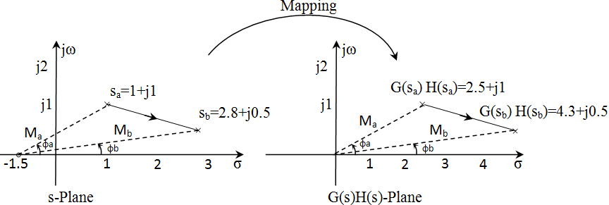
Mapping…

Slide 6
Mapping…
Note:
For s-plane
The zero of the transfer function is at s=-1.5 in s-plane
A Phasor M_{a} is drawn from the point s=-1.5 to the point s_{a}.
The magnitude M_{a} & Phase φ_{a} of this phasor gives the value of the G(s)H(s) at s_{a} in polar form.
Similarly the magnitude M_{b} & Phase φ_{b} of the phasor gives the value of the G(s)H(s) at s_{b} in polar form
For G(s)H(s)-plane
The magnitude & phasor of the transfer function G(s)H(s)=s+1.5 at a point in G(s)H(s) plane is given by the magnitude and the phase of the phasor drawn from the origin of G(s)H(s)-plane.

Slide 7
Mapping…
2. Consider another single valued function G(s)H(s) of s
Here s is varied along a closed path (s_{a}→s_{b}→s_{c}→s_{d}→s_{a}) in clockwise direction as shown in figure.
Zero z₁ is inside while z₂ is outside the specified path

Slide 8
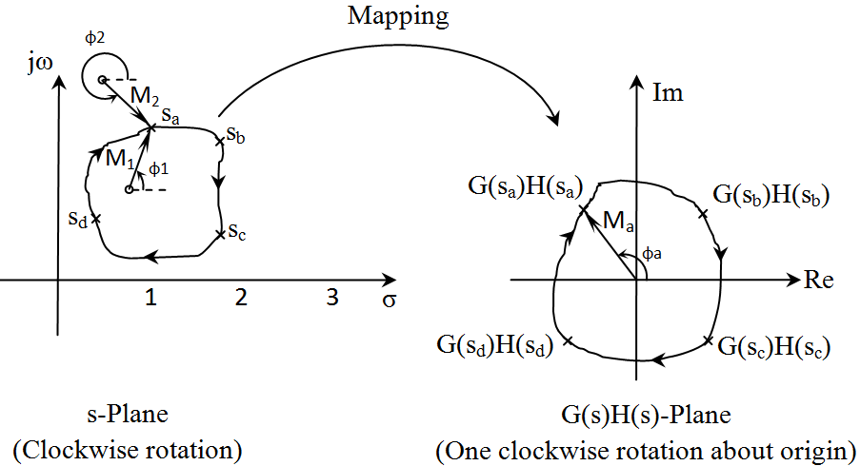
Mapping…

Slide 9
Mapping…
Note: From above s-plane
φ₁ is the phase angle of phasor M₁ (=s_{a}-z₁) at s_{a}
φ₂ is the phase angle of phasor M₂ (=s_{a}-z₂) at s_{a}
The phasor M₁ undergoes a change of -2π i.e. one clockwise rotation
The phase M₂ undergoes a changes of zero i.e. No rotation

Slide 10
Mapping…
Note: From above G(s)H(s) plane
While traversing s_{a}→s_{b}→s_{c}→s_{d}→s_{a}, corresponding change in Phasor $\left|G\left(s\right)H(s)\right|$ will be along the path M_{a}→M_{b}→M_{c}→M_{d}→M_{a}, i.e. one complete rotation w.r.t origin
So, the phasor change in function [G(s)H(s)=(s+z1)(s+z2)] is also -2π i.e. one clockwise rotation in G(s)H(s) plane.

Slide 11
Mapping…
Therefore, if the number of zeros of G(s)H(s) in a specified region in s-plane is Z and the independent variable s is varied along a path closing the boundary of such a region in clockwise direction the corresponding change in the argument (Phase) of G(s)H(s) in G(s)H(s)-plane is -2πZ (clockwise)
On similar reasoning, if the number of poles of G(s)H(s) in a specified region in s-plane is P and the independent variable s is varied along a path closing the boundary of such a region in clockwise direction the corresponding change in the argument (Phase) of G(s)H(s) in G(s)H(s)-plane is +2πP (anti clockwise)

Slide 12
Mapping…
Consider Z zeros & P Poles of G(s)H(s) together as located inside a specified region in s-plane and s being varied as mentioned above, the mathematical expression for corresponding change in the argument of G(s)H(s) in G(s)H(s) plane is
It is know as principle of argument
Note: $2π(P−Z)⇒$ (P-Z) rotation about origin.

Slide 13
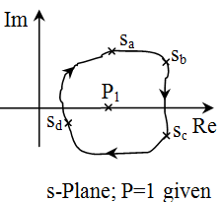
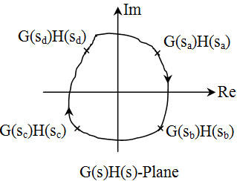
Determination of Zeros of G(s)H(s) which are located inside a specified region in s-plane
s is varied along closed path s_{a}-s_{b}-s_{c}-s_{d}-s_{a} | Mapping in G(s)H(s) Plane | Conclusion
1. Clockwise rotation | Clockwise rotation | Note: P & Z are the poles & Zeros in specified region

Slide 14
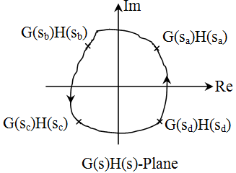
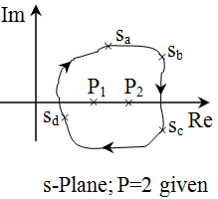
Determination of Zeros of G(s)H(s) which are located inside a specified region in s-plane…
s is varied along closed path s_{a}-s_{b}-s_{c}-s_{d}-s_{a} | Mapping in G(s)H(s) Plane | Conclusion
2. Clockwise rotation | Anticlockwise rotation

Slide 15
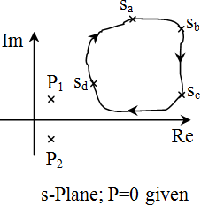
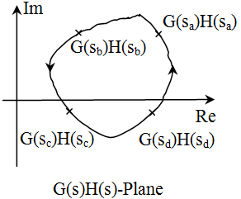
Determination of Zeros of G(s)H(s) which are located inside a specified region in s-plane…
s is varied along closed path s_{a}-s_{b}-s_{c}-s_{d}-s_{a} | Mapping in G(s)H(s) Plane | Conclusion
3. Clockwise rotation | Anticlockwise rotation

Slide 16
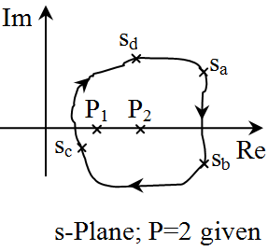
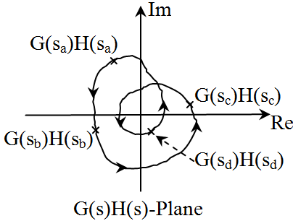
Determination of Zeros of G(s)H(s) which are located inside a specified region in s-plane…
s is varied along closed path s_{a}-s_{b}-s_{c}-s_{d}-s_{a} | Mapping in G(s)H(s) Plane | Conclusion
4. Clockwise rotation | Anticlockwise rotation

Slide 17
Application of Nyquist Criterion to determine the stability of closed loop system
The overall T.F of a closed loop sys
G(s)H(s) is open loop T.F.
1+ G(s)H(s)=0 is the characteristic equation
Let

Slide 18
Application of Nyquist Criterion to determine the stability of closed loop system…
So G(s)H(s) & 1+ G(s)H(s)=0 are having same poles but different zeros
Zeros of 1+ G(s)H(s)=0 =>roots of it
For stable system roots(zeros) of characteristic equation should not be on RHS of s-plane.
Thus the basis of applying Nyquist criterion for ascertaining stability of a control system is that, the specified region for identifying the presence of zeros of 1+ G(s)H(s)=0 should be the entire RHS of s-plane

Slide 19
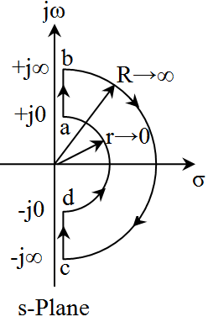
Application of Nyquist Criterion to determine the stability of closed loop system…
The path along which s is varied is shown bellow (called Nyquist Contour)

Slide 20
Application of Nyquist Criterion to determine the stability of closed loop system…
For the above path, mapping is done in G(s)H(s) and change in argument of G(s)H(s) plane is noted
So no of zeros of G(s)H(s) on RHS of s-plane is calculated by
Note:
Above procedure calculates the no of roots of G(s)H(s) not the 1+G(s)H(s)=0
However the no of roots of 1+ G(s)H(s)=0 can be find out if the origin (0,0) of G(s)H(s) pane is shifted to the point (-1,0) in G(s)H(s) plane.
Origin is avoided from the path

Slide 21
Application of Nyquist Criterion to determine the stability of closed loop system…
So no of zeros and poles of 1+G(s)H(s)=0 on RHS of s-plane is related with the following expression
Where
N=No of encirclement of (-1+j0) by G(s)H(s) plot.
(The -ve direction of encirclement is clockwise)
P₊=No of poles of G(s)H(s) with + real part
Z₊=No of zeros of G(s)H(s) with + real part
For stable control system Z₊=0
And generally P₊=0 => N=0
=> No encirclement of point -1+j0

Slide 22
Closing Nyquist plot from s=-j0 to s=+j0
Consider the following example
Draw its polar plot
Put ω=+0
Assuming 1>>j0T
Put ω=+∞
Assuming 1<<j ∞ T
Separate the real & imj parts
So, No intersection with jω axis other then at origin and infinity

Slide 23
Closing Nyquist plot from s=-j0 to s=+j0…
Im
Polar plot ⇒ω=+0 to ω=+∞
Plot for variation from ω=-0 to ω=-∞ is mirror image of the plot from ω=+0 to ω=+∞. As shown by doted line.
From ω=-0 to ω=+0 the plot is not complete. The completion of plot depends on the no of poles of G(s)H(s) at origin(Type of the G(s)H(s)).
$$ω=−0$$
$$ω=−∞$$
$$ω=+∞$$
Re
$$ω=+0$$
Nyquist Plot

Slide 24
Closing Nyquist plot from s=-j0 to s=+j0…
For closing ω=-0 to ω=+0
Consider a general transfer function
As s→0

Slide 25
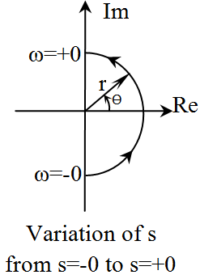
Closing Nyquist plot from s=-j0 to s=+j0…
s is varied in s-plane from s=-0 to s=+0 in anti clockwise direction as shown above such that r→0.

Slide 26
Closing Nyquist plot from s=-j0 to s=+j0…
The equation of phasor along the semi-circular arc will be
Put the value of s in equ (2)
In s-plane
At s=-j0 ϴ=-π/2
At s=+j0 ϴ=+π/2
So change in ϴ =(+π/2)-(-π/2)= +π

Slide 27
Closing Nyquist plot from s=-j0 to s=+j0…
The corresponding change in phase of G(s)H(s) in G(s)H(s) plane is determined below:
At s=-j0, ϴ=-π/2; put in equation (3)
At s=+j0, ϴ=+π/2; put in equation (3)
So corresponding change

Slide 28
Closing Nyquist plot from s=-j0 to s=+j0…
Hence, if in the s-plane s changes from s=-j0 to s=+j0 by π radian (anti-clockwise) then the corresponding change in phase of G(s)H(s) in G(s)H(s) plane is –nπ (clockwise) and the magnitude of G(s)H(s) during this phase change is infinite.
Where
n=Type of the system i.e. no of poles at origin

Slide 29
Closing Nyquist plot from s=-j0 to s=+j0…
The closing angle for different type of sys
Type of G(s)H(s) (n) | Angle through which Nyquist plot is to be closed from ω=-0 to ω=+0 | Magnitude of G(s)H(s)
0 | 0 | The points ω=-0 & ω=+0 are coincident
1 | -π | ∞
2 | -2π | ∞
3 | -3π | ∞
.
.
n | -nπ | ∞

Slide 30
Examples:
Example 1: Examine the closed loop stability using Nyquist Stability criterion of a closed loop system whose open loop transfer function is given by
Sol: As discussed previously it Polar (Nyquist) plot will be as shown on next slide.
System is type 1=> plot is closed from ω=-0 to ω=+0 through an angle of –π (clockwise) with an infinite radius

Slide 31
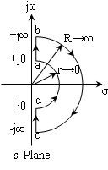
Example1…
Im
$$ω=−0$$
$$ω=−∞$$
$$ω=+∞$$
Re
$$ω=+0$$
Nyquist Plot

Slide 32
Example1…
No of roots of characteristic equation having + real part(Z₊) are given by
N=0 As point -1+j0 is not encircled by the plot
P₊=0 (Poles of G(s)H(s) having + real parts)
Hence, closed loop system is stable

Slide 33
Example 2:The open loop transfer function of a unity feedback control is given below
Determine the closed loop stability by applying Nyquist criterion.
Sol: Draw it Polar plot, put s=jω, H(jω)=1

Slide 34
Example 2…
Put ω=+0
Put ω=+∞
Separate the real & imj parts
intersection with real axis, put Imj=0
Real part

Slide 35
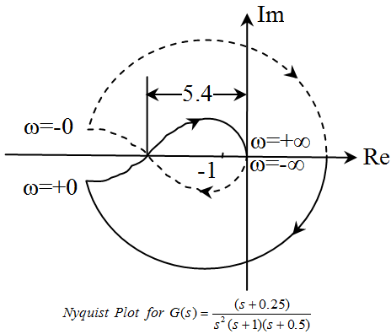
Example 2…
As the system is type 2 the Nyquist plot from ω=-0 to ω=+0 is closed through an angle of 2π in clockwise direction

Slide 36
Example 2…
N=-2 (as point (-1+j0) is encircled twice clockwise)
P₊=0 (No poles with +real part)
So By
N=P₊-Z₊=> -2=0-Z+ =>Z₊=2
No of roots having + real parts are 2
=> Closed loop unstable system

Slide 37
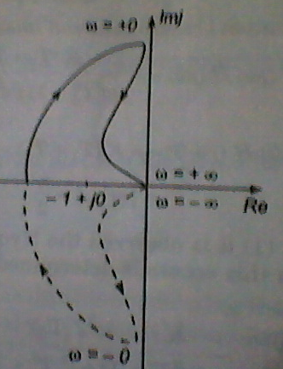
Example 3
Determine the stability by Nyquist stability criterion of the system
Sol:
As it is type 1 system so
Nyquist plot from ω=-0
to ω=+0 is closed
through an angle of
π in clockwise direction

Slide 38
Example 3…
N=-1, P₊=1
N=P₊-Z₊ =>Z₊=2 (Two roots on RHS of s-plane)
So closed loop system will be unstable

Slide 39
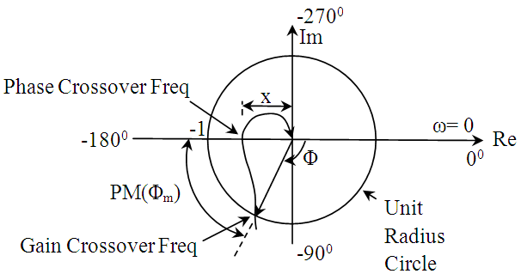
Gain Margin, Phase Margin, Gain crossover freq, Phase crossover freq

Slide 40
Gain Margin, Phase Margin, Gain crossover freq, Phase crossover freq…
Phase Crossover Frequency (ωp) : The frequency where a polar plot intersects the –ve real axis is called phase crossover frequency
Gain Crossover Frequency (ω_{g}) : The frequency where a polar plot intersects the unit circle is called gain crossover frequency
So at ω_{g}

Slide 41
Gain Margin, Phase Margin, Gain crossover freq, Phase crossover freq…
Phase Margin (PM):
Phase margin is that amount of additional phase lag at the gain crossover frequency required to bring the system to the verge of instability (marginally stabile)
Φ_{m}=180⁰+Φ
Where
Φ=∠G(jω_{g})
if Φ_{m}>0 => +PM (Stable System)
if Φ_{m}<0 => -PM (Unstable System)

Slide 42
Gain Margin, Phase Margin, Gain crossover freq, Phase crossover freq…
Gain Margin (GM):
The gain margin is the reciprocal of magnitude at the frequency at which the phase angle is -180⁰.
In terms of dB

Slide 43
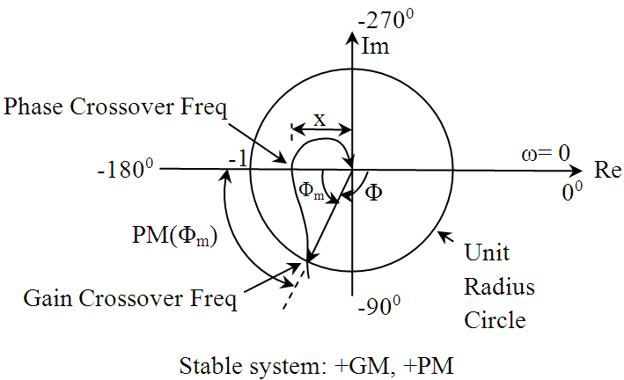
Stability
Stable: If critical point (-1+j0) is within the plot as shown, Both GM & PM are +ve
GM=20log₁₀(1/x) dB

Slide 44
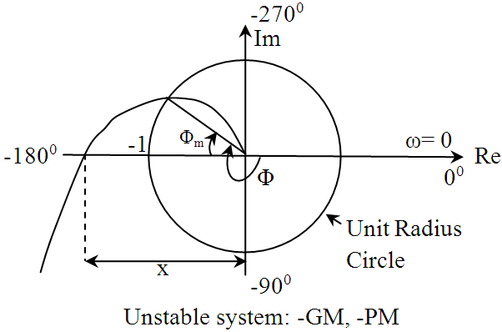
Stability …
Unstable: If critical point (-1+j0) is outside the plot as shown, Both GM & PM are -ve
GM=20log₁₀(1 /x) dB

Slide 45
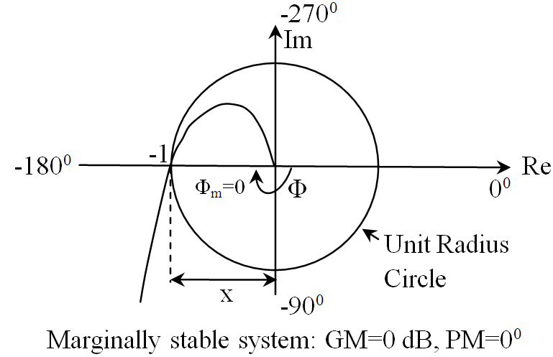
Stability …
Marginally Stable System: If critical point (-1+j0) is on the plot as shown, Both GM & PM are ZERO GM=20log₁₀(1 /1)=0 dB

Slide 46
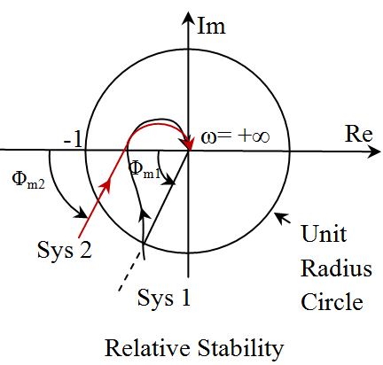
Relative stability
GM_{system1}=GM_{system2}
But
PM_{system1}>PM_{system2}
So
system 1
is more stable

Slide 47
Books
Linear Control System By B.S. Manke; Khanna Publication

