Slide 1
Nyquist Stability Criterion
By: Nafees Ahamad
AP, Department of EECE, DIT University,
Dehradun

Slide 2
Introduction
Nyquist stability criterion is based on the principle of argument.
The principle of argument is related with the theory of mapping.

Slide 3
Mapping
Consider a function D(s) = s² + 1
Let s₁ = 2+4j
So, D(s₁) = (2+4j)²+1 = -11+j16 = u+jv
Therefore any point s₁ in s-plane can be mapped in D(s) plane by locating the values of ‘u’ and ‘v’.

Slide 4
Mapped
Im
Im
s₁= 2+j4
D(s₁)= -11+j16
4
16
2
Re
-11
Re
S-plane
D(s)-plane

Slide 5
Mapping…
Therefore, every point in s-plane maps into one and only one point in D(s) plane.
Any closed contour in s-plane maps into the closed contour in D(s) plane.

Slide 6
Mapping of closed contour and principle of argument
Consider the characteristic equation
$D\left(s\right)=1+G\left(s\right)H\left(s\right)=\frac{K\left(s−a_{1}\right)\left(s−a_{2}\right)…}{\left(s−b_{1}\right)\left(s−b_{2}\right)…}−−−(1)$
Where $a_{1},a_{2},…$are zeros and ${ b}_{1},b_{2},…$ are poles.
Let $s=σ+jω$ then D(s) will also be complex $D\left(s\right)=u+jv$.
Now a arbitrary closed ‘C’ in s-plane maps onto the D(s) plane as contour $Γ$ as shown on next slide

Slide 7
Mapped
Im
Im
C
$$Γ$$
Re
Re
S-plane
D(s)-plane
No Poles & Zeros inside the contour ‘C’

Slide 8
Mapping of closed contour and principle of argument…
Consider this contour ‘C’ in s-plane.
This contour encircles neither zeros nor poles, then the contour ‘$Γ$’ in D(s) plane can’t encircle the origin or the point at infinity.
If we trace the contour ‘C’ in clockwise direction then the inside region will be on right of the contour.
The corresponding region in D(s) plane which contains neither origin nor the point at infinity should also be to the right of the contour $Γ$

Slide 9
Mapping of closed contour and principle of argument…
If the contour ‘C’ encircles zero but not poles then the point D₁(s) is given by
$D_{1}\left(s\right)=r∠∅$
Where
$r=\left|D_{1}(s)\right|=\frac{\left|s−a_{1}\right|\left|s−a_{2}\right|…}{\left|s−b_{1}\right|\left|s−b_{2}\right|…}$
$∅=∠D_{1}\left(s\right)=∠\left(s−a_{1}\right)+∠\left(s−a_{1}\right)…∠\left(s−b_{1}\right)+∠\left(s−b_{1}\right)…$
IT means that the trip of $D_{1}\left(s\right)$ forms a close contour about the origin in clockwise direction as shown on next slide.

Slide 10
Mapped
Im
C
Im
$$Γ$$
Re
Zeros
Re
S-plane
D(s)-plane
One Zero inside the contour ‘C’

Slide 11
Mapping of closed contour and principle of argument…
From previous slide we can say that the tip of $D_{1}(s)$ forms a closed counter about the origin in clockwise direction.
Similarly, if the contour ‘C’ encircles ‘z’ zeros in clockwise direction then the contour in D(s) plane encircles the origin of D(s) plane ‘z’ times in clockwise direction.
This is shown on next slide for z = 2.

Slide 12
Mapped
Im
C
Im
$$Γ$$
Re
Re
S-plane
D(s)-plane
Two Zero inside the contour ‘C’

Slide 13
Mapping of closed contour and principle of argument…
Consider another case when the contour ‘C’ encircles ‘P’ number of poles in clockwise direction then the corresponding contour ‘$Γ$’ will encircle the origin ‘P’ time in anti-clockwise direction.
Next two slides show this situation when P =1 and P = 2.

Slide 14
Mapped
Im
C
Im
$$Γ$$
Re
Re
S-plane
D(s)-plane
One pole inside the contour ‘C’

Slide 15
Mapped
Im
C
Im
$$Γ$$
Re
Re
S-plane
D(s)-plane
Two poles inside the contour ‘C’

Slide 16
Mapping of closed contour and principle of argument…
Now, if contour ‘C’ encircles both zeros and poles in clockwise direction then corresponding contour ‘$Γ$’ encircles the origin of D(s) plane N (=Z-P) time in clockwise direction.
This relationship between enclosure of poles and zeros by the contour in s-plane and encirclement of origin of the contour ‘$Γ$’ in D(s) plane is known as principle of argument.

Slide 17
Nyquist path or Nyquist Contour
The overall transfer function of a given system is given by
$\frac{C(s)}{R(s)}=\frac{G(s)}{1+G\left(s\right)H(s)}$ , Its characteristic equation
$1+G\left(s\right)H\left(s\right)=0$
For stability of closed loop system this characteristic equation should not have any root (Pole of T.F) on right half of s-plane.
For this purpose, we use a contour in s-plane which enclosed the entire right half of s-plane with clockwise encirclement and radios $R→∞$.
This contour is know as Nyquist Contour. (See on next slide)

Slide 18
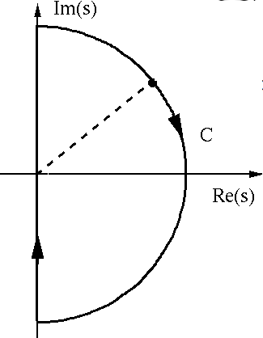
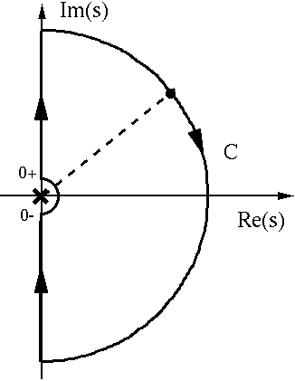
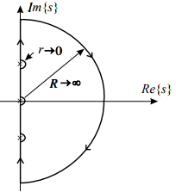
Nyquist path or Nyquist Contour …
$$R→∞$$
$$R→∞$$
$$r→0$$
No Poles on $jω$ axis
One Poles at origin
Poles at origin and $jω$ axis

Slide 19
Nyquist Criterion
The characteristic equation is given by
$D\left(s\right)=1+G\left(s\right)H\left(s\right)$
Let there are ‘Z’ zeros and ‘P’ poles of D(s) in the right hand side of s-plane.
If this contour is mapped in D(s) plane as $Γ_{D}$ then $Γ_{D}$ encloses the origin N times (N = Z – P) in clockwise direction.
Then the system becomes unstable because the clockwise encirclement is possible only when there are zeros of D(s) in right half of s-plane

Slide 20
Nyquist Criterion …
A feedback system (closed loop system) is stable if and only if there is no zeros of D(s) in the right half of s-plane. i.e., Z = 0
N = Z – P = - P
Therefore, for a closed loop system to be stable, the number of counter clockwise encirclement of the origin of D(s) plane by $Γ_{D}$ should equal the number of right half s-plane poles of D(s) [which are the poles of open loop transfer function G(s)H(s)].

Slide 21
Nyquist Criterion …
Since $D\left(s\right)=1+G\left(s\right)H\left(s\right)$
Or $G\left(s\right)H\left(s\right)=D\left(s\right)−1$
The contour $Γ_{D}$ in D(s) plane can be mapped in G(s)H(s) plane $Γ_{GH}$ by shifting horizontally to the left by one unit.
Im
$Γ_{D}$ Contour
-1
$Γ_{GH}$ Contour
Re

Slide 22
Nyquist Criterion …
Thus the encirclement of the origin by the contour $Γ_{D}$ is equivalent to the encirclement of the point (-1+j0) by the contour $Γ_{GH}$ as shown on previous slide.
In most, single loop feedback system G(s)H(s) has no poles in the right half plane i.e. P = 0 then close loop system is stable if N = P = 0.
So, we can say that a closed loop system with P = 0 is stable if the net encirclement of the origin of D(s) plane by $Γ_{D}$ contour is zero.

Slide 23
Nyquist Stability Criterion: Statement
A feedback system is stable if the contour $Γ_{GH}$ of the open loop transfer function G(s)H(s) corresponding to the Nyquist contour in the s-plane encircles the point (-1+j0) in counter clockwise direction and the number of counter clockwise encirclement about the (-1+j0) equals the number of poles of G(s)H(s) in the right half of the s-plane i.e. with positive real parts.
In common case, the closed loop system is stable if the contour $Γ_{GH}$ of G(s)H(s) does not pass through or does not encircle (-1+j0) point, i.e. net encirclement is zero

Slide 24
Example
Consider the following example
Draw the polar plot:
Put ω=+0
Assuming 1>>j0T
Put ω=+∞
Assuming 1<<j ∞ T
Separate the real & Im parts
So, No intersection with jω axis other then at origin and infinity

Slide 25
Example …
Im
Polar plot ⇒ω=+0 to ω=+∞
Plot for variation from ω=-0 to ω=-∞ is mirror image of the plot from ω=+0 to ω=+∞. As shown by doted line.
From ω=-0 to ω=+0 the plot is not complete. The completion of plot depends on the no of poles of G(s)H(s) at origin(Type of the G(s)H(s)).
$$ω=−0$$
$$ω=−∞$$
$$ω=+∞$$
Re
$$ω=+0$$
Nyquist Plot

Slide 26
Closing Nyquist plot from s=-j0 to s=+j0…
The closing angle for different type of sys
Type of G(s)H(s) (n) | Angle through which Nyquist plot is to be closed from ω=-0 to ω=+0 | Magnitude of G(s)H(s)
0 | 0 | The points ω=-0 & ω=+0 are coincident
1 | -π | ∞
2 | -2π | ∞
3 | -3π | ∞
.
.
n | -nπ | ∞

Slide 27
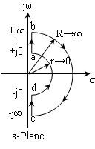
Example…
Im
$$ω=−0$$
$$ω=−∞$$
$$ω=+∞$$
Re
$$ω=+0$$
Nyquist Plot

Slide 28
Example…
No of roots of characteristic equation having + real part(Z) are given by
N=0 As point -1+j0 is not encircled by the plot
P=0 (Poles of G(s)H(s) having + real parts)
No of roots of characteristic equation (Z) with +ve real part = 0
Hence, closed loop system is stable

Slide 29
Thanks

