Slide 1
Artificial Neural Network
By: Nafees Ahamad,
AP, EECE Deptt, DIT University
Dehradun

Slide 2
References
Book: Principles of soft computing 2nd edition By S. N. Sivanadan & S.N. Deepa, Wiley Publication
NPTEL: Online Course on “ Introduction to soft computing” by Prof Debasis Samanta, IIT Kharagpur.

Slide 3
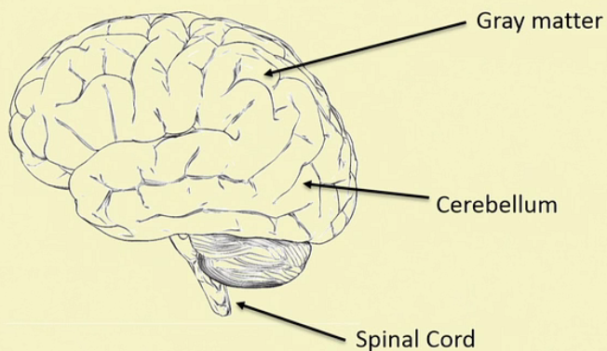
Brain: Centre of Nervous system

Slide 4
Biological nervous system
Biological nervous system is the most important part of many living things, in particular, human being.
There is part called brain at the center of human nervous system.
In fact, any biological nervous system consists of a large number of interconnected processing units called Neurons.
Each Neurons is approximately 10 microns long and they can operate in parallel.
Typically, a human brain consists of approximately 10¹¹ neurons communicating with each other with the help of electrical pulses.

Slide 5
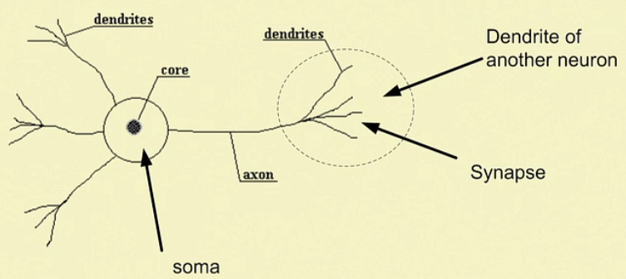
Neuron: Basic unit of nervous system
(Junction point where other neurons are connected )
Head
Connector
Tail

Slide 6
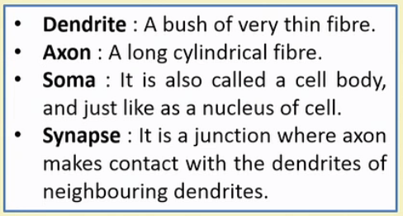
Neuron: The different parts

Slide 7
Neuron and its working

Slide 8
Neuron and its working…

Slide 9
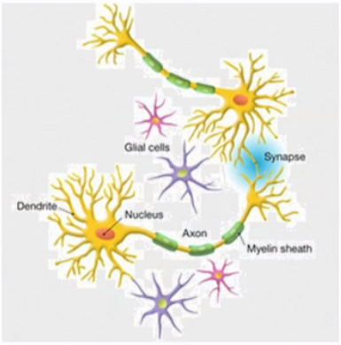
Neuron and its working…

Slide 10
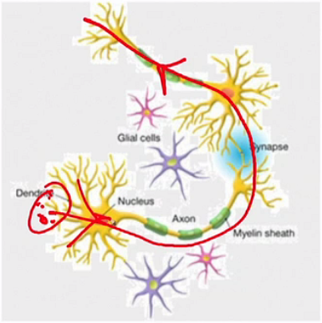
Neuron and its working…
Direction of transmission of signal
(If sum > Threshold value)
$$\sum{sum}$$

Slide 11
Artificial neural network (ANN)

Slide 12
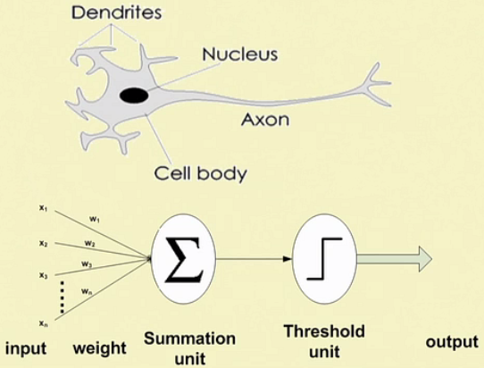
Analogy between bnn & ann

Slide 13
Artificial neural network (ANN)

Slide 14
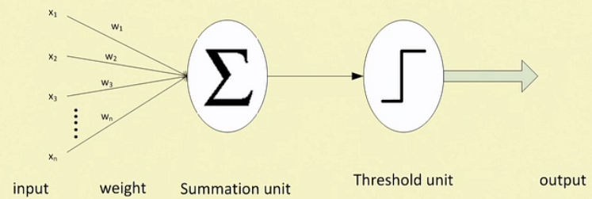
Artificial neural network (ANN)

Slide 15
Artificial neural network (ANN)…

Slide 16
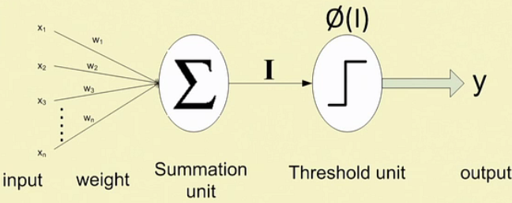
Artificial neural network (ANN)…

Slide 17
Ann: transfer function

Slide 18
Ann: transfer function…

Slide 19
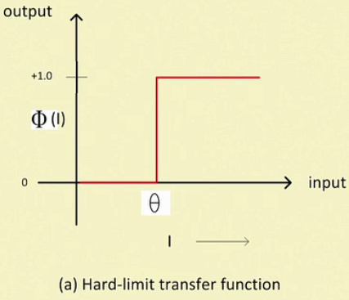
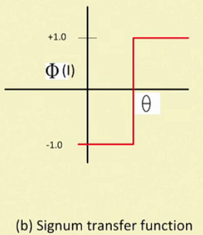
Ann: transfer function…

Slide 20
Ann: transfer function…

Slide 21
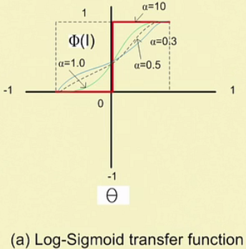
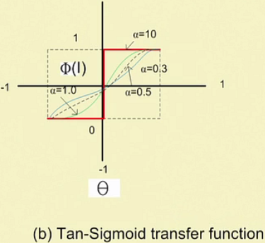
Ann: transfer function…

Slide 22
Advantages of ann

Slide 23
Advantages of ann…

Slide 24
Thank you

