Slide 1
Artificial Neural Network learning
By: Nafees Ahamad,
AP, EECE Deptt, DIT University
Dehradun

Slide 2
Learning of Neural Network: Topics
Concept of learning
Types of learning
Learning in
Single layer feedforward neural network
Multi layer feedforward neural network
Recurrent neural network

Slide 3
Concept of learning
The learning is an important feature of computational ability.
Learning may be viewed as change in behavior acquire due to practice or exercise, and it last for relatively long time.
As it occurs, the effective coupling between neurons is modified.
In case of artificial neural networks, it is a process of modifying neural network by updating its weights, biases and other parameters if any.
During the learning, the parameters of the networks are optimized and a result process of curve fitting.
It is then said that the neural network has pass through a learning phase.

Slide 4
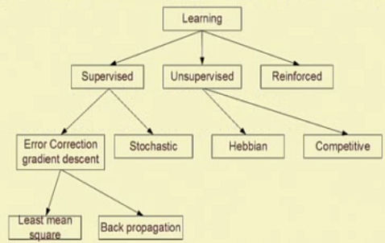
Types of learning
There are several learning techniques
The taxonomy of well learning techniques show below

Slide 5
Supervised learning

Slide 6
unsupervised learning

Slide 7
Hebbian learning

Slide 8
Reinforced learning

Slide 9
Gradient Descent Learning

Slide 10
Gradient Descent Learning…

Slide 11
Stochastic learning

Slide 12
Competitive learning

Slide 13
Training single layer feedforward neural network (SLFFNN)

Slide 14
Training SLFFNN…

Slide 15
Training SLFFNN…
Algorithm
Note: f is step transfer function
Observed Output

Slide 16
Training SLFFNN…

Slide 17
Training SLFFNN…

Slide 18
Thank you

