Slide 1
Signal flow graphs
By: Nafees Ahamad,
AP, EECE, Dept.
DIT University, Dehradun

Slide 2
Signal Flow Graphs (SFG)
Signal flow graph is a graphical representation of algebraic equations.

Slide 3
Basic Elements of SFG
Node: A point which represents either a variable or a signal. There are three types of nodes
Input Node − It is a node, which has only outgoing branches.
Output Node − It is a node, which has only incoming branches.
Mixed Node − It is a node, which has both incoming and outgoing branches.
Branch: It is a line segment which joins two nodes. It has both gain and direction.

Slide 4
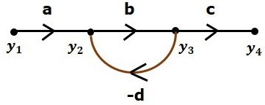
Basic Elements of SFG …
Mixed Node
Input Node
Output Node
Branch with gain -d
Branch with gain a
Example for Nodes

Slide 5
Construction of Signal Flow Graph
Let us construct a signal flow graph by considering the following algebraic equations −
$y_{2}=a_{12}y_{1}+a_{42}y_{4}$
$y_{3}=a_{23}y_{2}+a_{53}y_{5}$
$y_{4}=a_{34}y_{3}$
$y_{5}=a_{45}y_{4}+a_{35}y_{3}$
$y_{6}=a_{56}y_{5}$

Slide 6
Construction of SFG …
No of Nodes = 6 Nodes (y₁, y₂, y₃, y₄, y₅ and y₆)
No of branches = 8 Gains (a₁₂, a₂₃, a₃₄, a₄₅, a₅₆, a₄₂, a₅₃ and a₃₅)
To get the overall SFG, draw the SFG for each equation, then combine all these SFG

Slide 7
Construction of SFG …
Step 1 − Signal flow graph for $y_{2}=a_{12}y_{1}+a_{42}y_{4}$ is shown in the following figure.

Slide 8
Construction of SFG …
Step 2 − Signal flow graph for $y_{3}=a_{23}y_{2}+a_{53}y_{5}$ is shown in the following figure.

Slide 9
Construction of SFG …
Step 3 − Signal flow graph for $y_{4}=a_{34}y_{3}$ is shown in the following figure.

Slide 10
Construction of SFG …
Step 4 − Signal flow graph for $y_{5}=a_{45}y_{4}+a_{35}y_{3}$ is shown in the following figure.

Slide 11
Construction of SFG …
Step 5 − Signal flow graph for $y_{6}=a_{56}y_{5}$ is shown in the following figure.

Slide 12
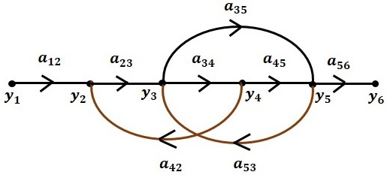
Construction of SFG …
Step 6 − Combine all and the Signal flow graph of overall system is shown in the following figure.

Slide 13
Conversion of Block Diagrams into Signal Flow Graphs
Represent all the signals, variables, summing points and take-off points of block diagram as nodes in signal flow graph.
Represent the blocks of block diagram as branches in signal flow graph.
Represent the transfer functions inside the blocks of block diagram as gains of the branches in signal flow graph.

Slide 14
Conversion of Block Diagrams into SFG…
Connect the nodes as per the block diagram. If there is connection between two nodes (but there is no block in between), then represent the gain of the branch as one.
For example, between summing points, between summing point and takeoff point, between input and summing point, between take-off point and output.

Slide 15
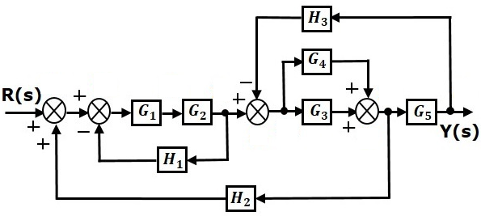
Example: Block Diagram to SFG
Let us consider following block diagram
y₁
y₂
y₃
y₄
y₉
y₈
y₆
y₅
y₇

Slide 16
Example: Block Diagram to SFG…
Represent the input signal R(s) and output signal C(s) of block diagram as input node R(s) and output node C(s) of signal flow graph.
There are nine nodes other than input and output nodes.

Slide 17
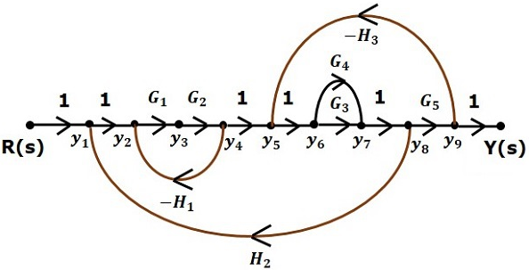
Example: Block Diagram to SFG…
Signal flow graph

Slide 18
Example: Block Diagram to SFG…
With the help of Mason’s gain formula (discussed in the next), you can calculate the transfer function of this signal flow graph.
This is the advantage of signal flow graphs. Here, we no need to simplify (reduce) the signal flow graphs for calculating the transfer function.

Slide 19
Thanks

