Slide 1
Artificial Neural Network Learning…
By: Nafees Ahamad,
AP, EECE Deptt, DIT University
Dehradun

Slide 2
Learning of Neural Network: Topics
Concept of learning
Types of learning
Learning in
Single layer feedforward neural network
Multi layer feedforward neural network
Recurrent neural network

Slide 3
Training multi layer feedforward neural network (mLFFNN)

Slide 4
Specifying mLFFNn
$$\left[I\right]$$
$$\left[O^{I}\right]$$
$$\left[V\right]$$
$$\left[I^{H}\right]$$
$$\left[O^{H}\right]$$
$$\left[W\right]$$
$$\left[I^{o}\right]$$
$$\left[O\right]$$
v₁₁
21
$$I_{1}^{I}$$
11
31
v_{1j}
v_{1m}
......
w_{j1}
......
......
v_{i1}
w_{jk}
1i
v_{ij}
2j
$$I_{i}^{I}$$
3k
v_{im}
w_{jn}
......
v_{l1}
......
......
v_{lj}
$$I_{\text{l} }^{I}$$
1l
3n
v_{lm}
2m
Input Layer
l Neurons
Hidden Layer
m Neurons
Output Layer
n Neurons

Slide 5
Specifying mLFFNN…
$$\left[V\right]$$
$$\left[W\right]$$
$$\left[O^{I}\right]$$
$$\left[I^{H}\right]$$
$$\left[O^{H}\right]$$
$$\left[I^{o}\right]$$
$$I$$
N1
N2
N3
$$O$$
Input Layer
Hidden Layer
Output Layer
$$\left|N_{1}\right|=l$$
$$\left|N_{2}\right|=m$$
$$\left|N_{3}\right|=n$$
Linear Transfer function
Log-Sigmoid Transfer function
Tan-Sigmoid Transfer function
$$f_{i}^{I}=\left(I_{i}, θ_{i}\right)$$
$$f_{j}^{H}=\left(I_{j}^{H}, α_{j}\right)=\frac{1}{1+e^{{−I}_{j}^{H} α_{j}}}$$
$$f_{k}^{o}=\left(I_{k}^{o}, α_{k}\right)=\frac{e^{I_{k}^{o} α_{k}}−e^{{−I}_{k}^{o} α_{k}}}{e^{I_{k}^{o} α_{k}}+e^{{−I}_{k}^{o} α_{k}}}$$

Slide 6
Specifying mLFFNN…

Slide 7
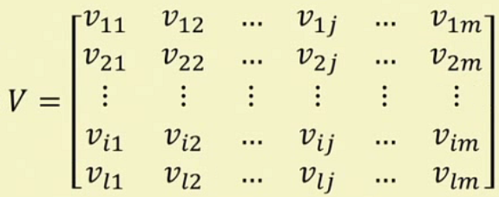
Specifying mLFFNN…

Slide 8
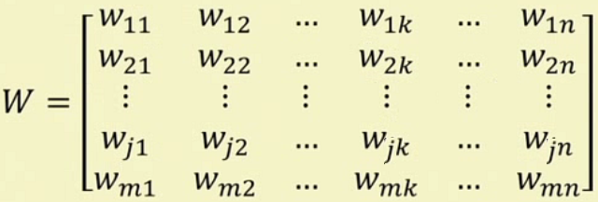
Specifying mLFFNN…

Slide 9
Learning MLFFNN
T_{o} = Output Data Training Set
T_{I} = Input Data Training Set

Slide 10
Learning MLFFNN: Input layer computation
Size of 0^{I} matric
Size of I^{I} matric

Slide 11
Learning MLFFNN: Input layer computation
Size of matrices

Slide 12
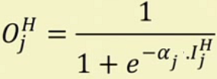
Learning MLFFNN: Hidden layer computation

Slide 13
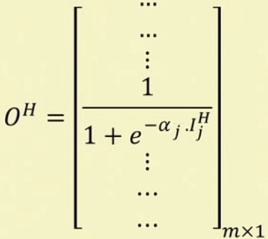
Learning MLFFNN: Hidden layer computation

Slide 14
Learning MLFFNN: output layer computation

Slide 15
Learning MLFFNN: output layer computation

Slide 16
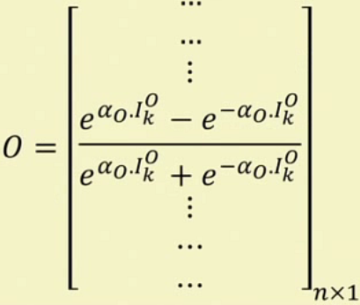
Learning MLFFNN: output layer computation

Slide 17
Thank you

