Slide 1
&
Types of Feedback
Its Effects
By: Nafees Ahamad,
AP, EECE, Dept.
DIT University, Dehradun

Slide 2
Types of Feedback
There are two types of feedback −
Positive feedback
Negative feedback: Its effects are
Error is reduced
Sensitivity of the system due to parameter variations and unwanted internal and external disturbances are reduced
Response becomes fast (Time constant reduces)
System may become more stable or Unstable
Overall gain is reduced

Slide 3
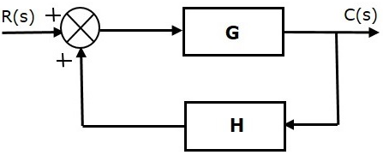
Positive feedback
Its Transfer function
$$T\left(s\right)=\frac{C(s)}{R(s)}=\frac{G(s)}{1−G\left(s\right)H(s)}$$

Slide 4
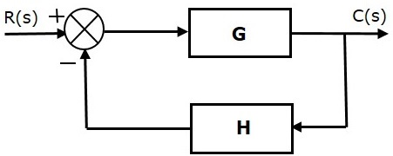
Negative feedback
Its Transfer function
$$T\left(s\right)=\frac{C(s)}{R(s)}=\frac{G(s)}{1+G\left(s\right)H(s)}$$

Slide 5
Effect of parameter variation in an open loop system
Its transfer function $\frac{C(s)}{R(s)}=G\left(s\right)$
or $C\left(s\right)=G\left(s\right)R(s)$
Let $∆G(s)$ be the change in G(s) due to parameter variation, and let the corresponding change in output be $∆C(s)$ , we can write
$C\left(s\right)+∆C(s)=\left\{G\left(s\right)+∆G(s)\right\}R(s)$
$=G\left(s\right)R(s)+∆G(s)R(s)$
Input
G(s)
Output
R(s)
C(s)
$$G\left(s\right)+∆G(s)$$
$$C\left(s\right)+∆C(s)$$
$$⟹∆C(s)=∆G(s)R(s)$$

Slide 6
Effect of parameter variation in a closed loop system
The over all transfer function
Let $∆G(s)$ be the change in G(s) due to parameter variation, and let the corresponding change in output be $∆C(s)$ , we can write
$C\left(s\right)+∆C\left(s\right)=\frac{\left\{G\left(s\right)+∆G\left(s\right)\right\}}{1+\left\{G\left(s\right)+∆G\left(s\right)\right\}H\left(s\right)}R\left(s\right)$
G(s)
$$\frac{C(s)}{R(s)}=\frac{G(s)}{1+G\left(s\right)H(s)}$$
R(s)
E(s)
C(s)
H(s)
O/P $C\left(s\right)=\frac{G(s)}{1+G\left(s\right)H(s)}R(s)$

Slide 7
Effect of parameter variation in a closed loop system…
$C\left(s\right)+∆C\left(s\right)=\frac{G\left(s\right)}{1+G\left(s\right)H\left(s\right)}R\left(s\right)+\frac{∆G\left(s\right)}{1+G\left(s\right)H\left(s\right)}R\left(s\right)$
$C\left(s\right)+∆C\left(s\right)=C\left(s\right)+\frac{∆G\left(s\right)}{1+G\left(s\right)H\left(s\right)}R\left(s\right)$
$∆C\left(s\right)=\frac{∆G\left(s\right)}{1+G\left(s\right)H\left(s\right)}R\left(s\right)$
This change in output is less as compared to change in output of open loop system.
($1+G\left(s\right)H\left(s\right)$ time less.

Slide 8
Sensitivity
Let overall transfer function of a control system be T(s) and its forward path gain G(s) be varying.
The sensitivity of overall transfer function T(s) w. r. t. the variation in G(s) is given by
$S_{G}^{T}=\frac{\% Change in T(s)}{\% Change in G(s)}=\frac{\frac{∂T(s)}{T(s)}}{\frac{∂G(s)}{G(s)}}$
$S_{G}^{T}=\frac{G(s)}{T(s)}\frac{∂T(s)}{∂G(s)}$

Slide 9
Sensitivity in Open loop system
In open loop system T(s) = G(s)
So, Sensitivity
$S_{G}^{T}=\frac{G(s)}{T(s)}\frac{∂T(s)}{∂G(s)}=1$

Slide 10

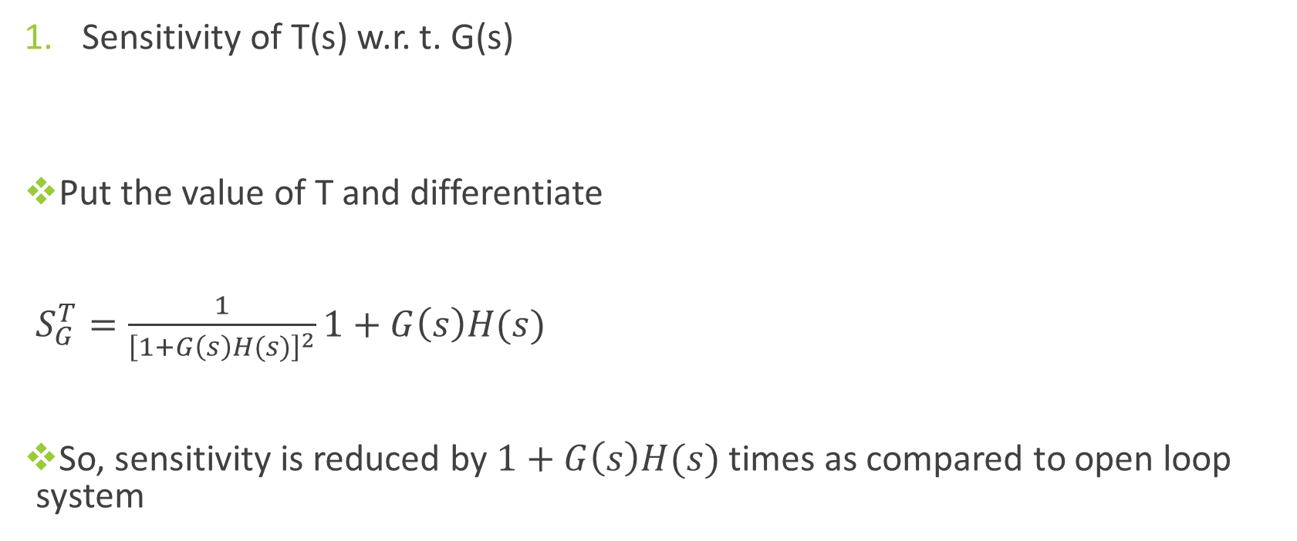
Sensitivity in closed loop system
Sensitivity of T(s) w.r. t. G(s)
Put the value of T and differentiate
$S_{G}^{T}=\frac{1}{{\left[1+G\left(s\right)H(s)\right]}^{2}}1+G\left(s\right)H(s)$
So, sensitivity is reduced by $1+G\left(s\right)H(s)$ times as compared to open loop system
$$S_{G}^{T}=\frac{G(s)}{T(s)}\frac{∂T(s)}{∂G(s)}$$
$$T(s)=\frac{G(s)}{1+G\left(s\right)H(s)}$$
$${⟹S}_{G}^{T}=\frac{1}{1+G\left(s\right)H(s)}$$

Slide 11

Sensitivity in closed loop system…
Sensitivity of T(s) w.r. t. H(s)
Put the value of T and differentiate
$\frac{∂T(s)}{∂H(s)}=\frac{\left[1+G\left(s\right)H(s)\right]×0−G\left(s\right)×G(s)}{{\left[1+G\left(s\right)H(s)\right]}^{2}}=−\frac{{\left[G\left(s\right)\right]}^{2}}{{\left[1+G\left(s\right)H(s)\right]}^{2}}$
So, sensitivity is given as
$$S_{H}^{T}=\frac{H(s)}{T(s)}\frac{∂T(s)}{∂H(s)}$$
$$T(s)=\frac{G(s)}{1+G\left(s\right)H(s)}$$
$$S_{H}^{T}=\frac{H(s)}{\frac{G(s)}{1+G\left(s\right)H(s)}}×−\frac{{\left[G\left(s\right)\right]}^{2}}{{\left[1+G\left(s\right)H\left(s\right)\right]}^{2}}=−\frac{G\left(s\right)H(s)}{1+G\left(s\right)H(s)}$$

Slide 12
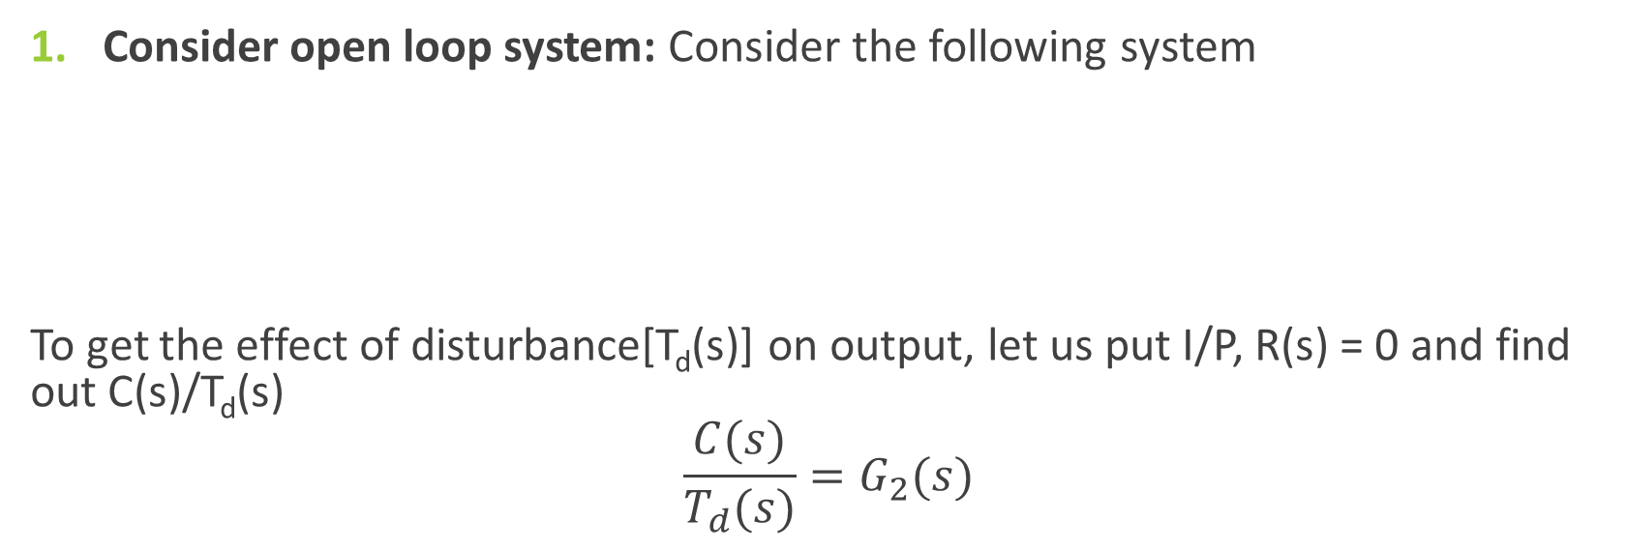
Effect of feedback on Disturbance
Consider open loop system: Consider the following system
To get the effect of disturbance[T_{d}(s)] on output, let us put I/P, R(s) = 0 and find out C(s)/T_{d}(s)
$$\frac{C(s)}{T_{d}(s)}=G_{2}(s)$$

Slide 13
Effect of feedback on Disturbance
Consider closed loop system:
Consider disturbance in the forward path as shown below
Again, to get the effect of disturbance[T_{d}(s)] on output, let us put I/P, R(s) = 0, as shown on next slide

Slide 14
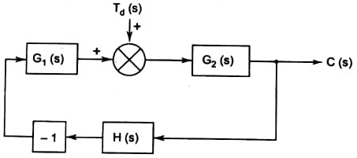
Effect of feedback on Disturbance…
Find out C(s)/T_{d}(s)
$\frac{C(s)}{T_{d}(s)}=\frac{G_{2}(s)}{1+G_{1}\left(s\right)G_{2}\left(s\right)H(s)}$

Slide 15
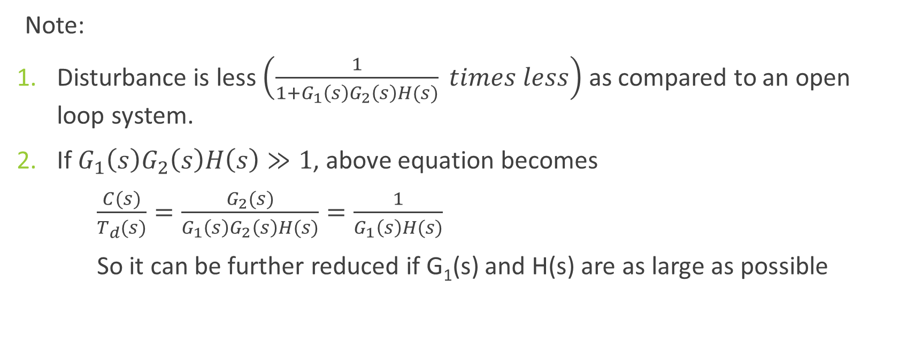
Effect of feedback on Disturbance…
Note:
Disturbance is less $\left(\frac{1}{1+G_{1}\left(s\right)G_{2}\left(s\right)H(s)} times less\right)$ as compared to an open loop system.
If $G_{1}\left(s\right)G_{2}\left(s\right)H\left(s\right)≫1$, above equation becomes
$\frac{C(s)}{T_{d}(s)}=\frac{G_{2}(s)}{G_{1}\left(s\right)G_{2}\left(s\right)H(s)}=\frac{1}{G_{1}\left(s\right)H(s)}$
So it can be further reduced if G₁(s) and H(s) are as large as possible

Slide 16
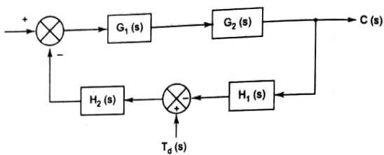
Effect of feedback on Disturbance…
Consider disturbance in the feedback path as shown below
To get the effect of disturbance[T_{d}(s)] on output, let us put I/P, R(s) = 0, as shown on next slide

Slide 17
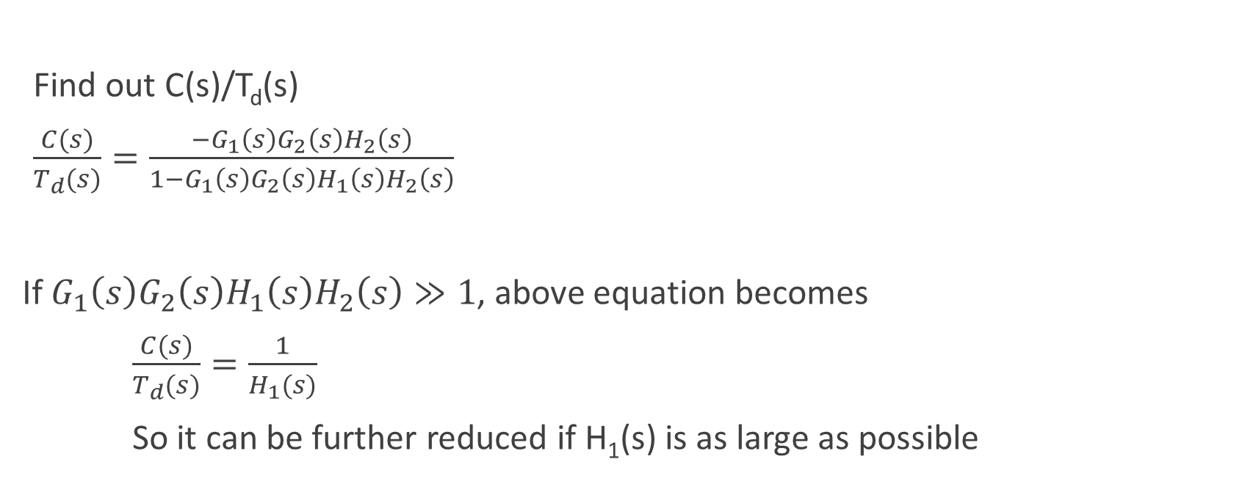
Effect of feedback on Disturbance…
Find out C(s)/T_{d}(s)
$\frac{C(s)}{T_{d}(s)}=\frac{{−G}_{1}\left(s\right)G_{2}\left(s\right)H_{2}\left(s\right)}{1{−G}_{1}\left(s\right)G_{2}\left(s\right)H_{1}\left(s\right)H_{2}\left(s\right)}$
If $G_{1}\left(s\right)G_{2}\left(s\right)H_{1}\left(s\right)H_{2}\left(s\right)≫1$, above equation becomes
$\frac{C(s)}{T_{d}(s)}=\frac{1}{H_{1}(s)}$
So it can be further reduced if H₁(s) is as large as possible

Slide 18
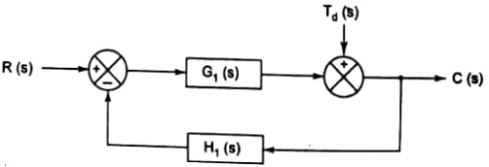
Effect of feedback on Disturbance…
Consider disturbance in the output as shown below
To get the effect of disturbance[T_{d}(s)] on output, let us put I/P, R(s) = 0, as shown on next slide

Slide 19
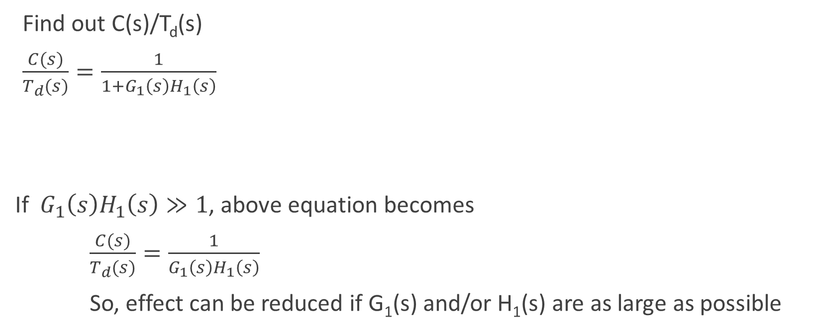
Effect of feedback on Disturbance…
Find out C(s)/T_{d}(s)
$\frac{C(s)}{T_{d}(s)}=\frac{1}{1{+G}_{1}\left(s\right)H_{1}\left(s\right)}$
If $G_{1}\left(s\right)H_{1}\left(s\right)≫1$, above equation becomes
$\frac{C(s)}{T_{d}(s)}=\frac{1}{G_{1}\left(s\right)H_{1}\left(s\right)}$
So, effect can be reduced if G₁(s) and/or H₁(s) are as large as possible

Slide 20
Thanks

