Slide 1
P, PD,PI & PID Controllers
By: Nafees Ahamad,
AP, EECE, Dept.
DIT University, Dehradun

Slide 2
Controllers
A device or system or program for improving transient and steady state response of a control system.

Slide 3
Proportional Controller
Actuating Signal
E_{a}(s)
Error Signal E(s)
Actuating Signal e_{a}(t) $∞$
Error Signal e(t)
E_{a}(s) = K_{p} E(s)
Kp
G(s)
R(s)
C(s)
H(s)
If value of K_{p} is increased
System becomes fast (Advantage )
Steady State Error reduces (Advantage )
Maxi Overshoot increases (Disadvantage )

Slide 4
Derivative Controller
Actually it is proportional + derivative controller
Actuating signal is given as
$e_{a}\left(t\right)=e\left(t\right)+T_{d}\frac{de(t)}{dt}$
Laplace transformation of above equ
$E_{a}\left(s\right)=E\left(s\right)+T_{d}sE(s)$
Constant

Slide 5
Derivative Controller …
sT_{d}
1
G(s)
1+sT_{d}
G(s)
R(s)
E(s)
C(s)
R(s)
E(s)
E_{a}(s)
C(s)
E_{a}(s)
$$⇒$$
H(s)
H(s)
$Let us consider 2nd order system i.e. G\left(s\right)=\frac{ω_{n}^{2}}{s(s+2ξω_{n})}, H\left(s\right)=1$

Slide 6
Derivative Controller …
From the block diagram, overall transfer function is given as
$\frac{C(s)}{R(s)}=\frac{(1+T_{d}s)\frac{ω_{n}^{2}}{s(s+2ξω_{n})}}{1+(1+T_{d}s)\frac{ω_{n}^{2}}{s(s+2ξω_{n})}}$
$⇒\frac{C(s)}{R(s)}=\frac{(1+T_{d}s)ω_{n}^{2}}{s^{2}+\left(2ξω_{n}+ω_{n}^{2}T_{d}\right)s+ω_{n}^{2}}$
Its characteristic equation
$s^{2}+\left(2ξω_{n}+ω_{n}^{2}T_{d}\right)s+ω_{n}^{2}=0−−−(1)$
Overall transfer function without D controller
$\frac{C(s)}{R\left(s\right)}=\frac{ω_{n}^{2}}{s^{2}+2{ξω}_{n}s+ω_{n}^{2}}$
Its characteristic equation
$s^{2}+2{ξω}_{n}s+ω_{n}^{2}=0−−−(2)$
Note: With D Controller, A zero
(s = -1/T_{d}) is added in the $\frac{C(s)}{R(s)}$

Slide 7
Derivative Controller …
Note: $ω_{n}$ is the same in both cases [Equ (1) & (2)]
New Damping ratio
$ξ^{′}=\frac{2ξω_{n}+ω_{n}^{2}T_{d}}{2ω_{n}}$
${⇒ξ}^{′}=ξ+\frac{ω_{n}T_{d}}{2}$
$⇒$Damping ratio increased
Thus with derivative controller
Damping ratio ($ξ^{′}$) increased and so
Rise time (t_{r}) reduces
Peak time (t_{p}) reduces
Maxi overshoot (M_{p}) reduces

Slide 8
Derivative Controller …
For given system with D controller, We know
$G\left(s\right)=\left(1+T_{d}s\right)\frac{ω_{n}^{2}}{s\left(s+2ξω_{n}\right)}$ & H(s) =1
The transfer function relating E(s) and R(s) is given as
$\frac{E(s)}{R(s)}=\frac{1}{1+G\left(s\right)H(s)}$ Put the values of G(s) & H(s)
$⇒\frac{E(s)}{R(s)}=\frac{s(s+2ξω_{n}) }{s^{2}+\left(2ξω_{n}+ω_{n}^{2}T_{d}\right)s+ω_{n}^{2}}$

Slide 9
Derivative Controller …
For unit ramp input, $R\left(s\right)=\frac{1}{s^{2}},$ So, E(s)
$⇒E(s)=\frac{1}{s^{2}}×\frac{s(s+2ξω_{n}) }{s^{2}+\left(2ξω_{n}+ω_{n}^{2}T_{d}\right)s+ω_{n}^{2}}$
Steady state error for unit ramp input
$e_{ss}=\lim_{s→0}{sE(s)}$
${⇒e}_{ss}=\lim_{s→0}{s\frac{1}{s^{2}}×\frac{s(s+2ξω_{n}) }{s^{2}+\left(2ξω_{n}+ω_{n}^{2}T_{d}\right)s+ω_{n}^{2}}}$
${⇒e}_{ss}=\frac{2ξ}{ω_{n}}$ Unchanged (Same as without D Controller)

Slide 10
Integral Controller
Actually it is proportional + Integral controller
Actuating signal is given as
$e_{a}\left(t\right)=e\left(t\right)+K_{i}\int{e\left(t\right)dt}$
Laplace transformation of above equ
$E_{a}\left(s\right)=E\left(s\right)+K_{i}\frac{E(s) }{s}$
Constant

Slide 11
Integral Controller …
_{Ki/s}
1
G(s)
_{1+Ki/s}
G(s)
R(s)
E(s)
C(s)
R(s)
E(s)
E_{a}(s)
C(s)
E_{a}(s)
$$⇒$$
H(s)
H(s)
$Let us consider 2nd order system i.e. G\left(s\right)=\frac{ω_{n}^{2}}{s(s+2ξω_{n})}$, H(s)=1

Slide 12
Integral Controller …
From the block diagram, overall transfer function is given as
$\frac{C(s)}{R(s)}=\frac{\left(1+\frac{K_{i}}{s}\right)\frac{ω_{n}^{2}}{s(s+2ξω_{n})}}{1+\left(1+\frac{K_{i}}{s}\right)\frac{ω_{n}^{2}}{s(s+2ξω_{n})}}$
$⇒\frac{C(s)}{R(s)}=\frac{(s+K_{i})ω_{n}^{2}}{s^{3}+2ξω_{n}s^{2}+ω_{n}^{2}s+{K_{i}ω}_{n}^{2}}$
Its characteristic equation
$s^{3}+2ξω_{n}s^{2}+ω_{n}^{2}s+{K_{i}ω}_{n}^{2}=0−−−(1)$
Overall transfer function without controller
$\frac{C(s)}{R\left(s\right)}=\frac{ω_{n}^{2}}{s^{2}+2{ξω}_{n}s+ω_{n}^{2}}$
Its characteristic equation
$s^{2}+2{ξω}_{n}s+ω_{n}^{2}=0−−−(2)$
Note:
With P Controller, A zero (s = -K_{i}) is added in the $\frac{C(s)}{R(s)}.$
System becomes of 3rd order .

Slide 13
Integral Controller …
For given system with P controller, We know
$G\left(s\right)=\left(1+\frac{K_{i}}{s}\right)\frac{ω_{n}^{2}}{s(s+2ξω_{n})}$& H(s) =1
The transfer function relating E(s) and R(s) is given as
$\frac{E(s)}{R(s)}=\frac{1}{1+G\left(s\right)H(s)}$ Put the values of G(s) & H(s)
$⇒\frac{E(s)}{R(s)}=\frac{s^{2}(s+2ξω_{n}) }{s^{3}+2ξω_{n}s^{2}+ω_{n}^{2}s+{K_{i}ω}_{n}^{2}}$

Slide 14
Integral Controller …
For unit ramp input, $R\left(s\right)=\frac{1}{s^{2}},$ So, E(s)
$⇒E(s)=\frac{1}{s^{2}}×\frac{s^{2}(s+2ξω_{n}) }{s^{3}+2ξω_{n}s^{2}+ω_{n}^{2}s+{K_{i}ω}_{n}^{2}}$
Steady state error for unit ramp input
$e_{ss}=\lim_{s→0}{sE(s)}$
${⇒e}_{ss}=\lim_{s→0}{s\frac{1}{s^{2}}×\frac{s^{2}(s+2ξω_{n}) }{s^{3}+2ξω_{n}s^{2}+ω_{n}^{2}s+{K_{i}ω}_{n}^{2}}}$
${⇒e}_{ss}=0$ changed (Without controller${ e}_{ss}=\frac{2ξ}{ω_{n}}$ )

Slide 15
Integral Controller …
For unit parabolic input, $R\left(s\right)=\frac{1}{s^{3}},$ So, E(s)
$⇒E(s)=\frac{1}{s^{3}}×\frac{s^{2}(s+2ξω_{n}) }{s^{3}+2ξω_{n}s^{2}+ω_{n}^{2}s+{K_{i}ω}_{n}^{2}}$
Steady state error for unit parabolic input
$e_{ss}=\lim_{s→0}{sE(s)}$
${⇒e}_{ss}=\lim_{s→0}{s\frac{1}{s^{3}}×\frac{s^{2}(s+2ξω_{n}) }{s^{3}+2ξω_{n}s^{2}+ω_{n}^{2}s+{K_{i}ω}_{n}^{2}}}$
${⇒e}_{ss}=\frac{2ξ}{{K_{i}ω}_{n}}$

Slide 16
PID Controller
Actuating signal is given as
$e_{a}\left(t\right)=e\left(t\right)+K_{i}\int{e\left(t\right)dt}+T_{d}\frac{de(t)}{dt}$
Laplace transformation of above equ
$E_{a}\left(s\right)=E\left(s\right)+K_{i}\frac{E(s) }{s}+sT_{d}E(s)$
$E_{a}\left(s\right)=E\left(s\right)\left[1+K_{i}\frac{\text{1} }{s}+sT_{d} \right]$
Constants

Slide 17
Integral Controller …
E(s)
E_{a}(s)
$$1+K_{i}\frac{\text{1} }{s}+sT_{d}$$
G(s)
R(s)
C(s)
H(s)
$PID controller combines the advantages of proportional, derivative$
$$and integral controller$$

Slide 18
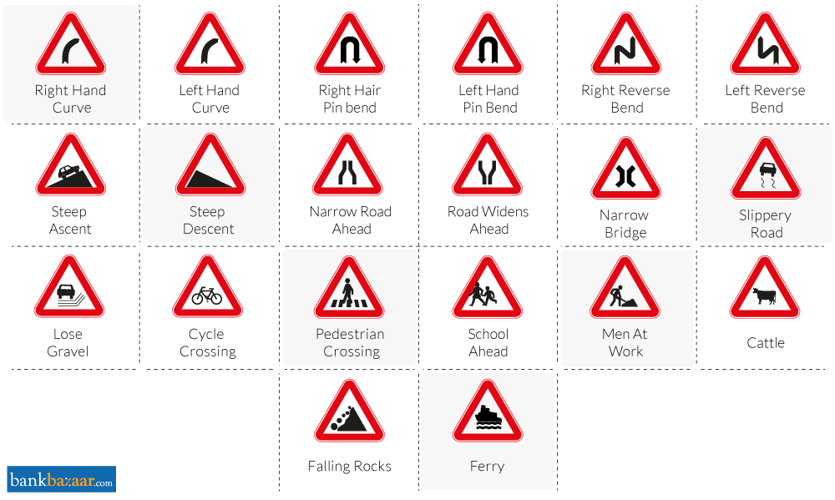
Thanks

Slide 19
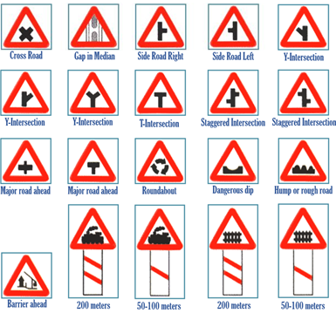
Thanks U very much

