Slide 1
Performance indices,
LQR Problem
Lecture 37

Slide 2
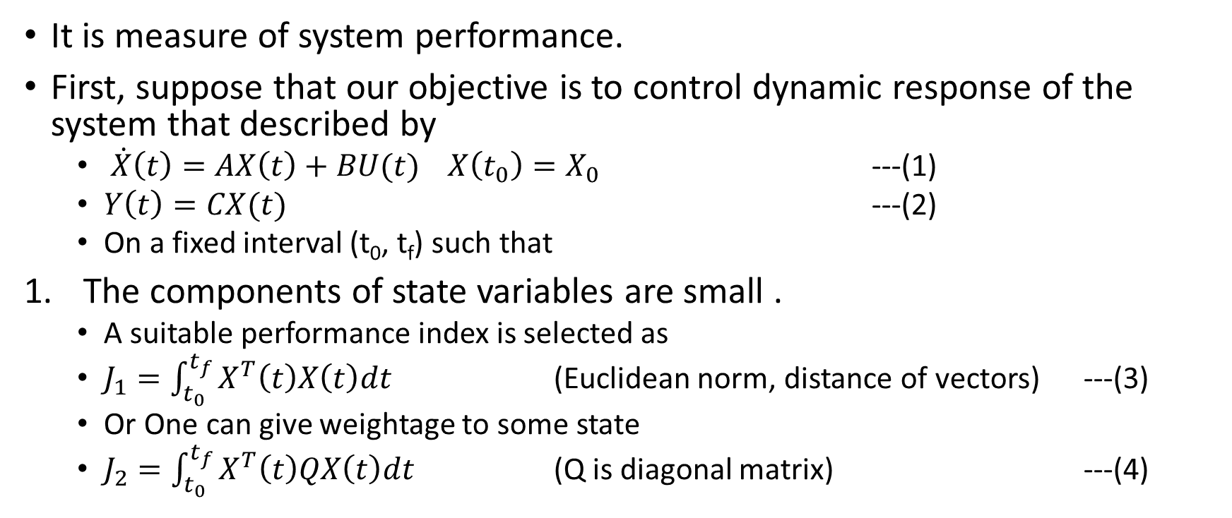
Performance Indices
It is measure of system performance.
First, suppose that our objective is to control dynamic response of the system that described by
  $\dot{X}\left(t\right)=AX\left(t\right)+BU(t)$ $X\left(t_{0}\right)=X_{0}$ ---(1)
  $Y\left(t\right)=CX(t)$ ---(2)
  On a fixed interval (t₀, t_{f}) such that
The components of state variables are small .
  A suitable performance index is selected as
  $J_{1}=\int_{t_{0}}^{t_{f}}{X^{T}\left(t\right)X\left(t\right)dt}$ (Euclidean norm, distance of vectors) ---(3)
  Or One can give weightage to some state
  $J_{2}=\int_{t_{0}}^{t_{f}}{X^{T}\left(t\right)QX\left(t\right)dt}$ (Q is diagonal matrix) ---(4)

Slide 3
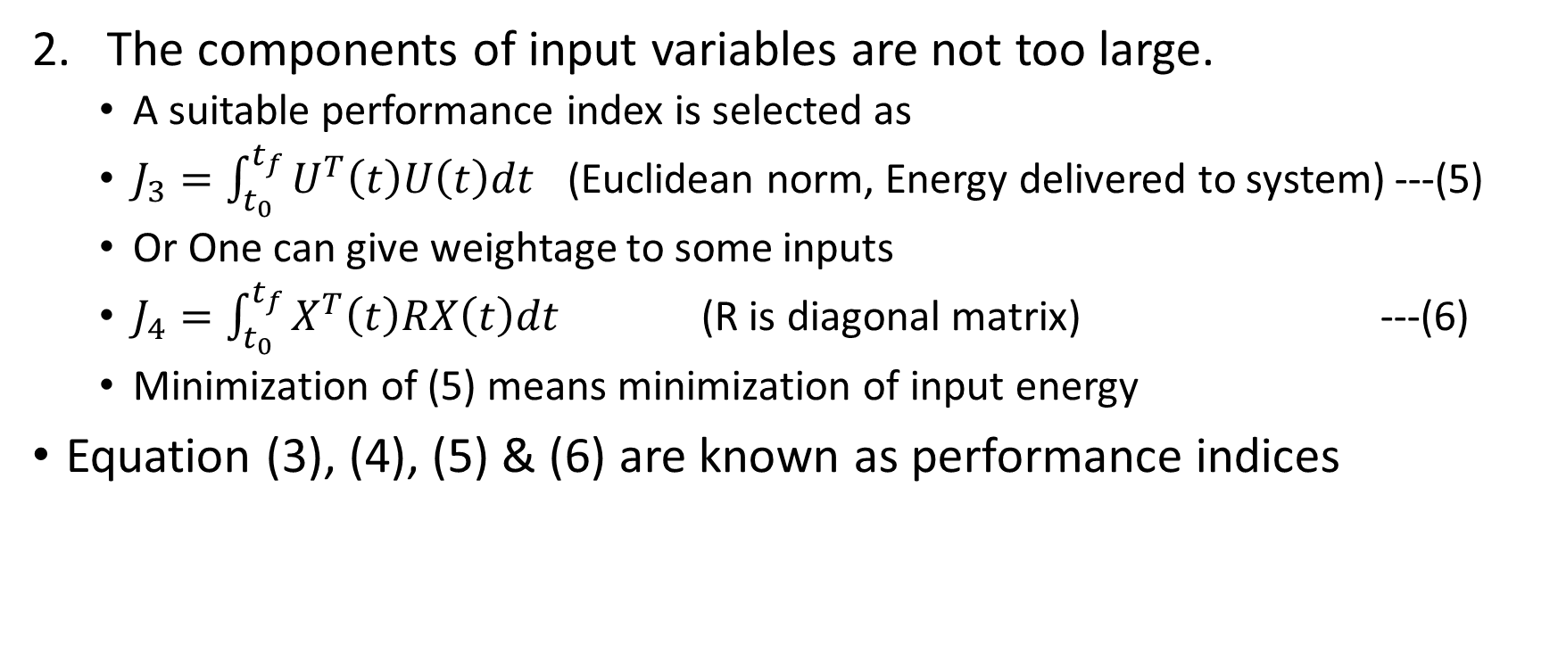
Performance Indices…
The components of input variables are not too large.
  A suitable performance index is selected as
  $J_{3}=\int_{t_{0}}^{t_{f}}{U^{T}\left(t\right)U\left(t\right)dt}$ (Euclidean norm, Energy delivered to system) ---(5)
  Or One can give weightage to some inputs
  $J_{4}=\int_{t_{0}}^{t_{f}}{X^{T}\left(t\right)RX\left(t\right)dt}$ (R is diagonal matrix) ---(6)
  Minimization of (5) means minimization of input energy
Equation (3), (4), (5) & (6) are known as performance indices

Slide 4
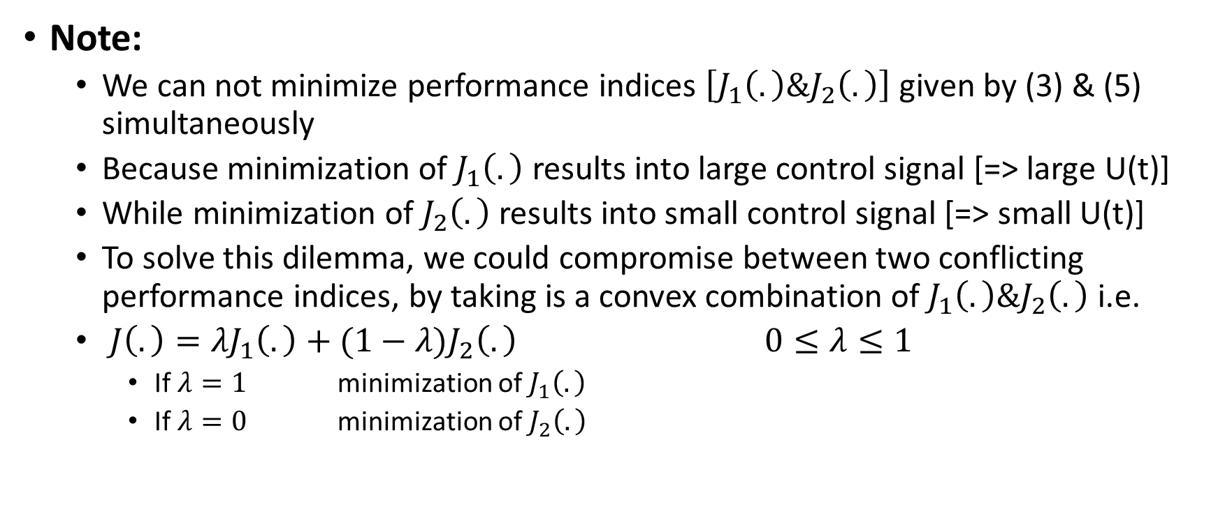
Performance Indices...
Note:
  We can not minimize performance indices $\left[J_{1}\left(.\right)\&J_{2}\left(.\right)\right]$ given by (3) & (5) simultaneously
  Because minimization of $J_{1}\left(.\right)$ results into large control signal [=> large U(t)]
  While minimization of $J_{2}\left(.\right)$ results into small control signal [=> small U(t)]
  To solve this dilemma, we could compromise between two conflicting performance indices, by taking is a convex combination of $J_{1}\left(.\right)\&J_{2}\left(.\right)$ i.e.
  $J\left(.\right)=λJ_{1}\left(.\right)+(1−λ)J_{2}\left(.\right)$ $0≤λ≤1$
    If $λ=1$ minimization of $J_{1}\left(.\right)$
    If $λ=0$ minimization of $J_{2}\left(.\right)$

Slide 5
LQR problem
Linear Quadratic Regulator Problem (Regulator=> Optimal Control)
Two types
  Finite time LQR problem
  Infinite time LQR Problem

Slide 6
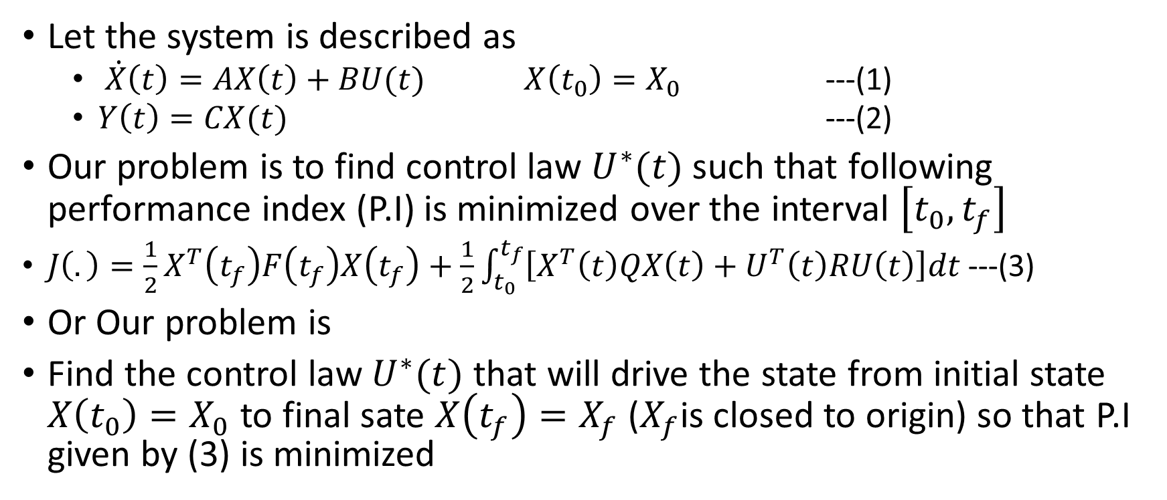
finite time LQR problem…
Let the system is described as
  $\dot{X}\left(t\right)=AX\left(t\right)+BU(t)$ $X\left(t_{0}\right)=X_{0}$ ---(1)
  $Y\left(t\right)=CX(t)$ ---(2)
Our problem is to find control law $U^{∗}(t)$ such that following performance index (P.I) is minimized over the interval $\left[t_{0},t_{f}\right]$
${J\left(.\right)=\frac{1}{2}X}^{T}\left(t_{f}\right)F\left(t_{f}\right)X\left(t_{f}\right)+\frac{1}{2}\int_{t_{0}}^{t_{f}}{\left[X^{T}\left(t\right)QX\left(t\right)+U^{T}\left(t\right)RU\left(t\right)\right]dt}$---(3)
Or Our problem is
Find the control law $U^{∗}(t)$ that will drive the state from initial state $X\left(t_{0}\right)=X_{0}$ to final sate $X\left(t_{f}\right)=X_{f}$ ($X_{f}$is closed to origin) so that P.I given by (3) is minimized

Slide 7
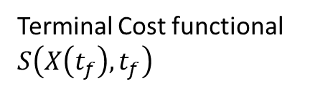
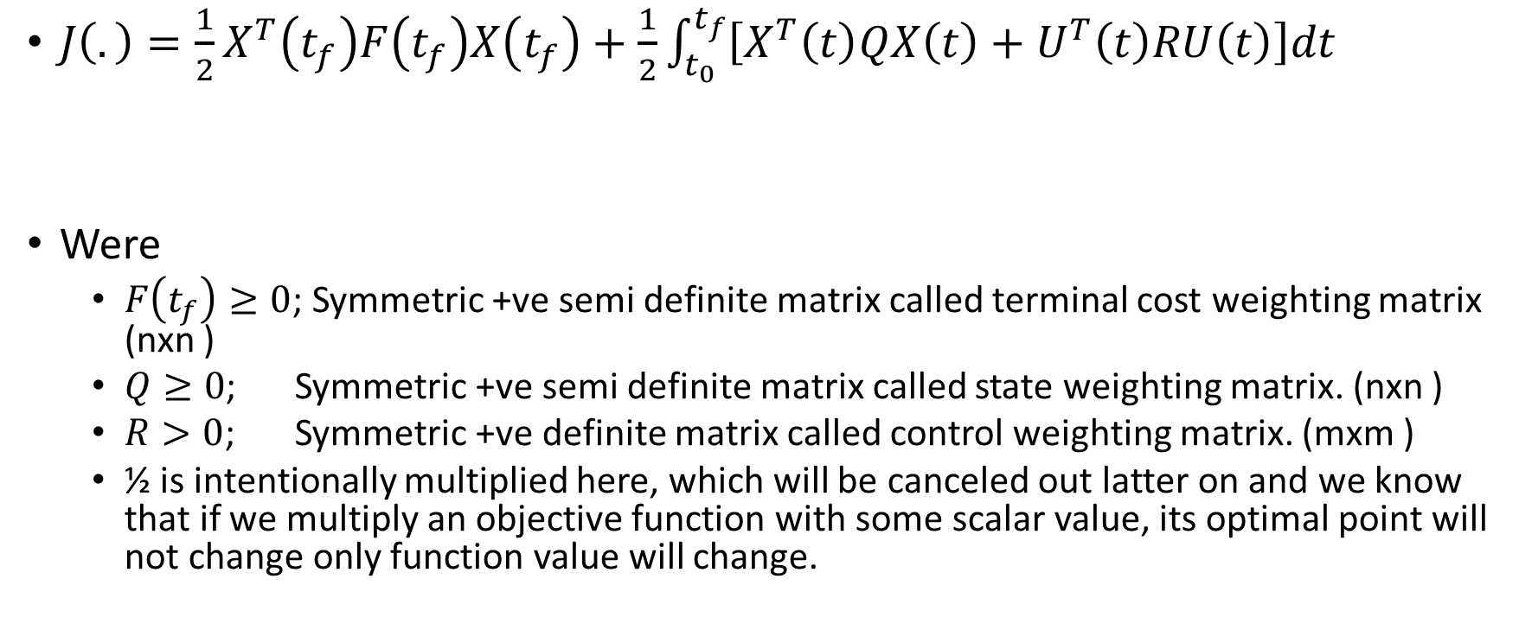
finite time LQR problem…
${J\left(.\right)=\frac{1}{2}X}^{T}\left(t_{f}\right)F\left(t_{f}\right)X\left(t_{f}\right)+\frac{1}{2}\int_{t_{0}}^{t_{f}}{\left[X^{T}\left(t\right)QX\left(t\right)+U^{T}\left(t\right)RU\left(t\right)\right]dt}$
Were
  $F\left(t_{f}\right)≥0$; Symmetric +ve semi definite matrix called terminal cost weighting matrix (nxn )
  $Q≥0$; Symmetric +ve semi definite matrix called state weighting matrix. (nxn )
  $R>0$; Symmetric +ve definite matrix called control weighting matrix. (mxm )
  ½ is intentionally multiplied here, which will be canceled out latter on and we know that if we multiply an objective function with some scalar value, its optimal point will not change only function value will change.
Terminal Cost functional $S\left(X\left(t_{f}\right),t_{f}\right)$
Integral Cost functional

Slide 8
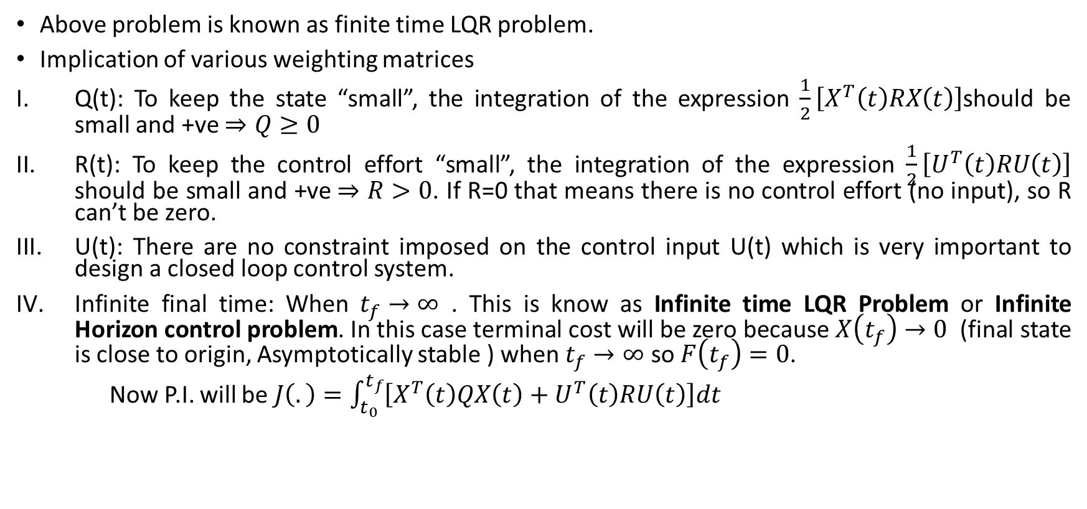
finite time LQR problem…
Above problem is known as finite time LQR problem.
Implication of various weighting matrices
Q(t): To keep the state “small”, the integration of the expression $\frac{1}{2}\left[X^{T}\left(t\right)RX\left(t\right)\right]$should be small and +ve $⇒Q≥0$
R(t): To keep the control effort “small”, the integration of the expression $\frac{1}{2}\left[U^{T}\left(t\right)RU\left(t\right)\right]$ should be small and +ve $⇒R>0$. If R=0 that means there is no control effort (no input), so R can’t be zero.
U(t): There are no constraint imposed on the control input U(t) which is very important to design a closed loop control system.
Infinite final time: When $t_{f}→∞$ . This is know as Infinite time LQR Problem or Infinite Horizon control problem. In this case terminal cost will be zero because $X\left(t_{f}\right)→0$ (final state is close to origin, Asymptotically stable ) when $t_{f}→∞$ so $F\left(t_{f}\right)=0$.
Now P.I. will be $J\left(.\right)=\int_{t_{0}}^{t_{f}}{\left[X^{T}\left(t\right)QX\left(t\right)+U^{T}\left(t\right)RU\left(t\right)\right]dt}$

Slide 9

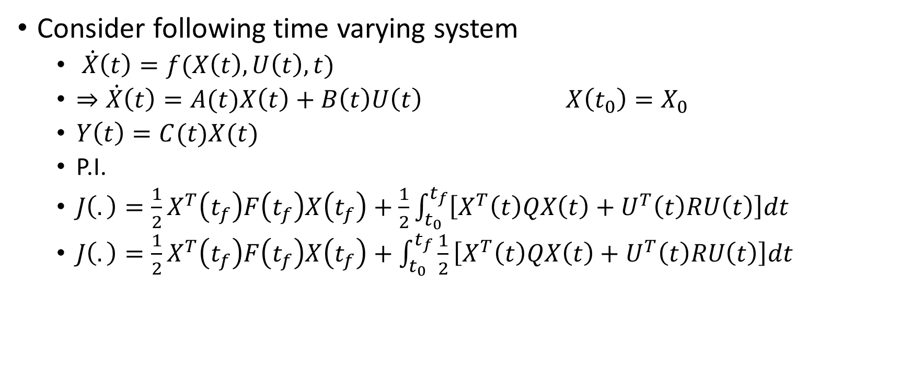

Solution of finite time LQR Problem
Consider following time varying system
  $\dot{X}\left(t\right)=f(X\left(t\right),U\left(t\right),t)$
  $⇒\dot{X}\left(t\right)=A(t)X\left(t\right)+B\left(t\right)U\left(t\right)$ $X\left(t_{0}\right)=X_{0}$
  $Y\left(t\right)=C(t)X(t)$
  P.I.
  ${J\left(.\right)=\frac{1}{2}X}^{T}\left(t_{f}\right)F\left(t_{f}\right)X\left(t_{f}\right)+\frac{1}{2}\int_{t_{0}}^{t_{f}}{\left[X^{T}\left(t\right)QX\left(t\right)+U^{T}\left(t\right)RU\left(t\right)\right]dt}$
  ${J\left(.\right)=\frac{1}{2}X}^{T}\left(t_{f}\right)F\left(t_{f}\right)X\left(t_{f}\right)+\int_{t_{0}}^{t_{f}}{\frac{1}{2}\left[X^{T}\left(t\right)QX\left(t\right)+U^{T}\left(t\right)RU\left(t\right)\right]dt}$
$$S(X\left(t_{f}\right),t_{f})$$
$$V(X\left(t\right),U\left(t\right),t)$$

Slide 10
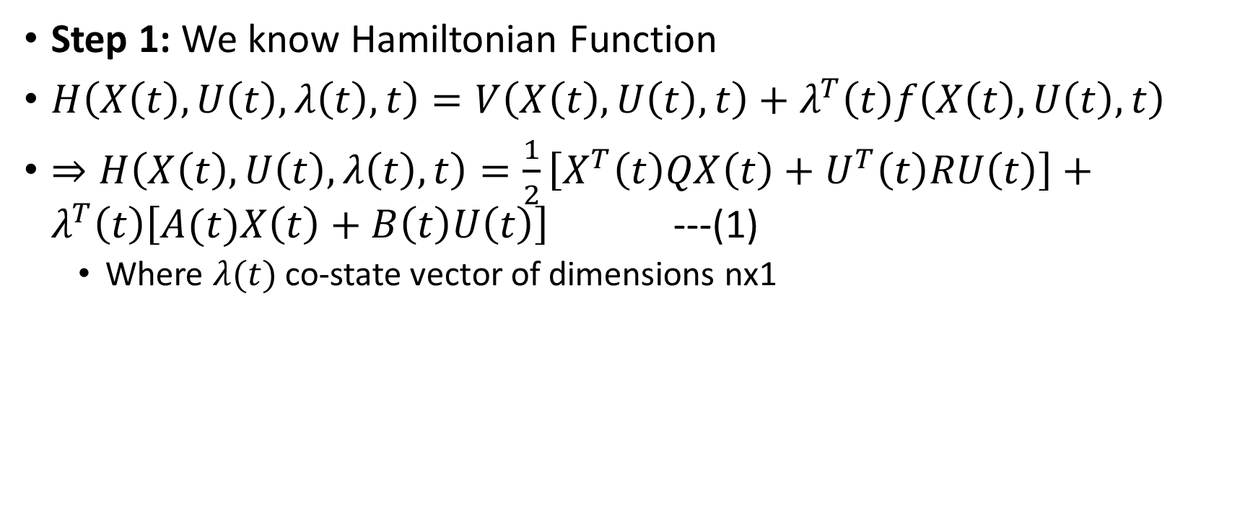
Solution of finite time LQR Problem…
Step 1: We know Hamiltonian Function
$H\left(X\left(t\right),U\left(t\right),λ\left(t\right),t\right)=V\left(X\left(t\right),U\left(t\right),t\right)+λ^{T}\left(t\right)f\left(X\left(t\right),U\left(t\right),t\right)$
$⇒H\left(X\left(t\right),U\left(t\right),λ\left(t\right),t\right)=\frac{1}{2}\left[X^{T}\left(t\right)QX\left(t\right)+U^{T}\left(t\right)RU\left(t\right)\right]+λ^{T}\left(t\right)\left[A(t)X\left(t\right)+B\left(t\right)U\left(t\right)\right]$ ---(1)
  Where $λ(t)$ co-state vector of dimensions nx1

Slide 11
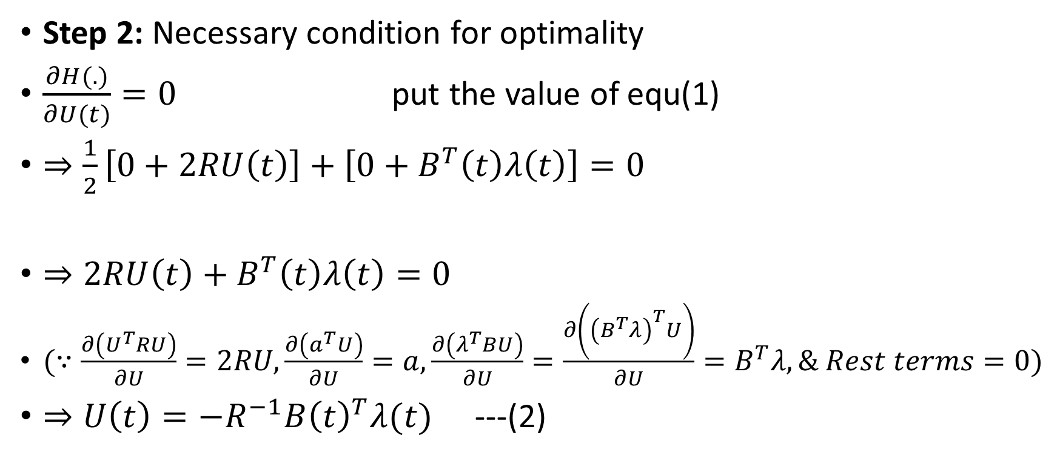
Solution of finite time LQR Problem…
Step 2: Necessary condition for optimality
$\frac{∂H(.)}{∂U(t)}=0$ put the value of equ(1)
$⇒\frac{1}{2}\left[0+2RU\left(t\right)\right]+\left[0+B^{T}\left(t\right)λ\left(t\right)\right]=0$
$⇒2RU\left(t\right)+B^{T}\left(t\right)λ\left(t\right)=0$
$(∵\frac{∂\left(U^{T}RU\right)}{∂U}=2RU,\frac{∂\left(a^{T}U\right)}{∂U}=a, \frac{∂\left(λ^{T}BU\right)}{∂U}=\frac{∂\left({\left(B^{T}λ\right)}^{T}U\right)}{∂U}=B^{T}λ, \& Rest terms=0)$
$⇒U\left(t\right)=−R^{−1}{B\left(t\right)}^{T}λ(t)$ ---(2)

Slide 12
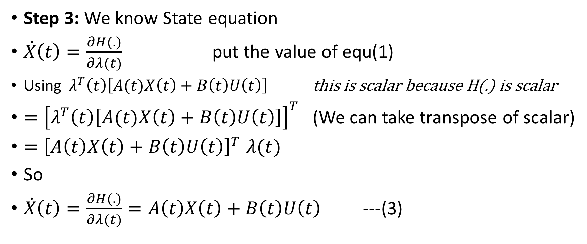
Solution of finite time LQR Problem…
Step 3: We know State equation
$\dot{X}\left(t\right)=\frac{∂H(.)}{∂λ(t)}$ put the value of equ(1)
Using $λ^{T}\left(t\right)\left[A(t)X\left(t\right)+B\left(t\right)U\left(t\right)\right]$ this is scalar because H(.) is scalar
$={\left[λ^{T}\left(t\right)\left[A(t)X\left(t\right)+B\left(t\right)U\left(t\right)\right]\right]}^{T}$ (We can take transpose of scalar)
${=\left[A\left(t\right)X\left(t\right)+B\left(t\right)U\left(t\right)\right]}^{T}λ(t)$
So
$\dot{X}\left(t\right)=\frac{∂H(.)}{∂λ(t)}=A\left(t\right)X\left(t\right)+B\left(t\right)U\left(t\right)$ ---(3)

Slide 13
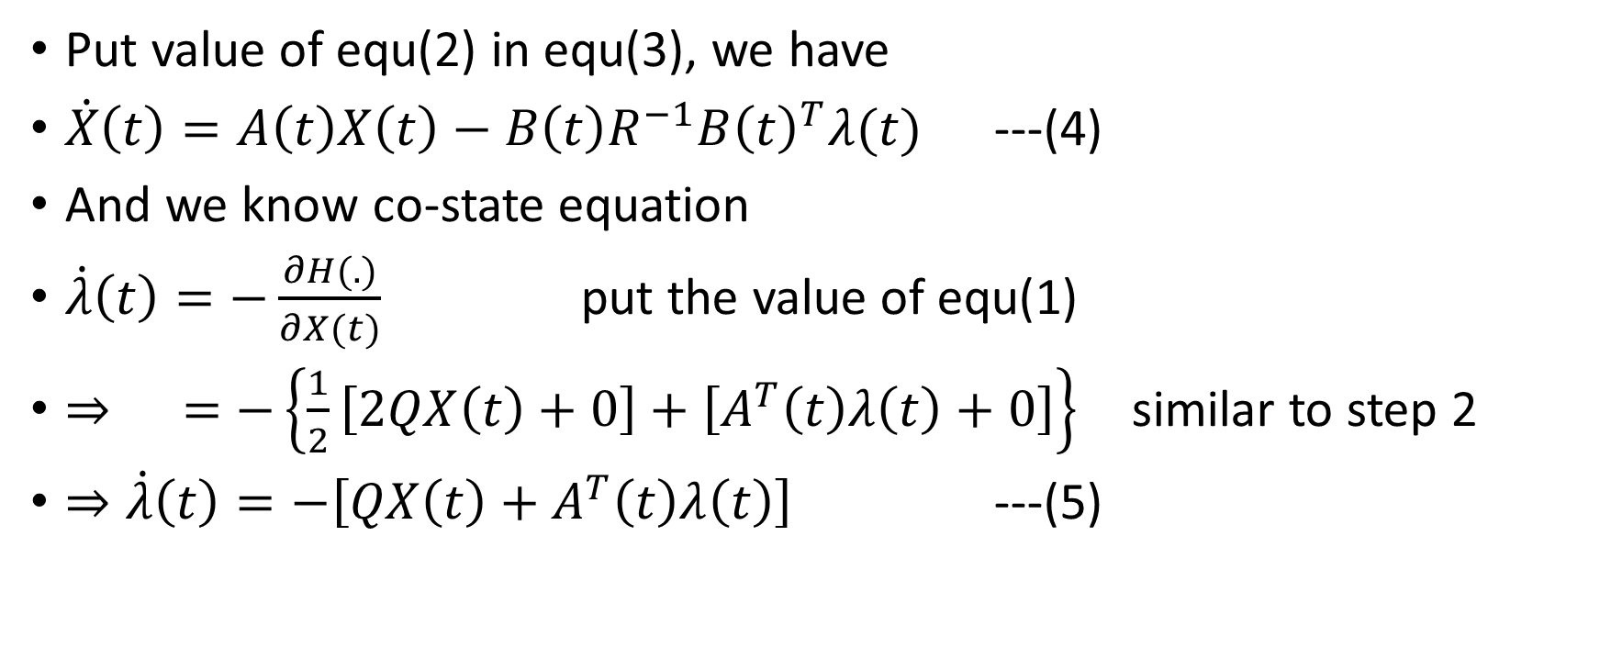
Solution of finite time LQR Problem…
Put value of equ(2) in equ(3), we have
$\dot{X}\left(t\right)=A\left(t\right)X\left(t\right)−B\left(t\right)R^{−1}{B\left(t\right)}^{T}λ(t)$ ---(4)
And we know co-state equation
$\dot{λ}\left(t\right)=−\frac{∂H(.)}{∂X(t)}$ put the value of equ(1)
$⇒ =−\left\{\frac{1}{2}\left[2QX\left(t\right)+0\right]+\left[A^{T}\left(t\right)λ\left(t\right)+0\right]\right\}$ similar to step 2
$⇒\dot{λ}\left(t\right)=−\left[{QX\left(t\right)+A}^{T}\left(t\right)λ\left(t\right)\right]$ ---(5)

Slide 14
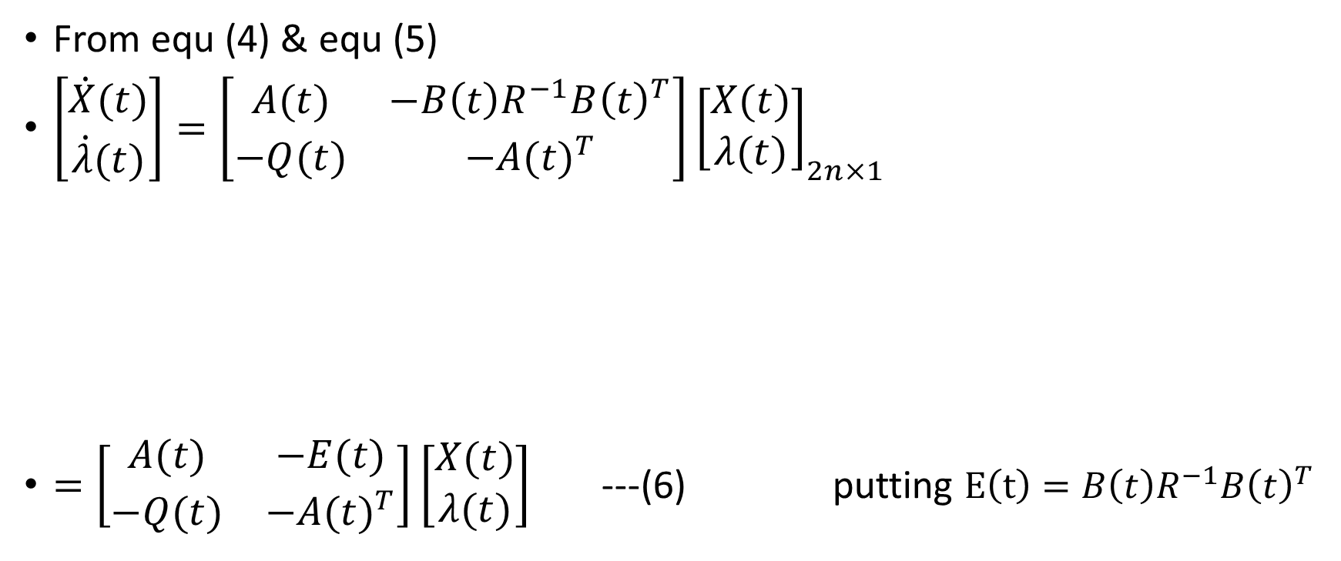
Solution of finite time LQR Problem…
From equ (4) & equ (5)
$\left[\begin{matrix}\dot{X}(t) \\ \dot{λ}(t)\end{matrix}\right]=\left[\begin{matrix}A(t) & −B\left(t\right)R^{−1}{B\left(t\right)}^{T} \\ −Q(t) & −{A(t)}^{T}\end{matrix}\right]{\left[\begin{matrix}X(t) \\ λ(t)\end{matrix}\right]}_{2n×1}$
$=\left[\begin{matrix}A(t) & −E(t) \\ −Q(t) & −{A(t)}^{T}\end{matrix}\right]\left[\begin{matrix}X(t) \\ λ(t)\end{matrix}\right]$ ---(6) putting $E\left(t\right)=B\left(t\right)R^{−1}{B\left(t\right)}^{T}$
Hamiltonian Matrix of 2nx2n and it is known
Hamiltonian System

Slide 15
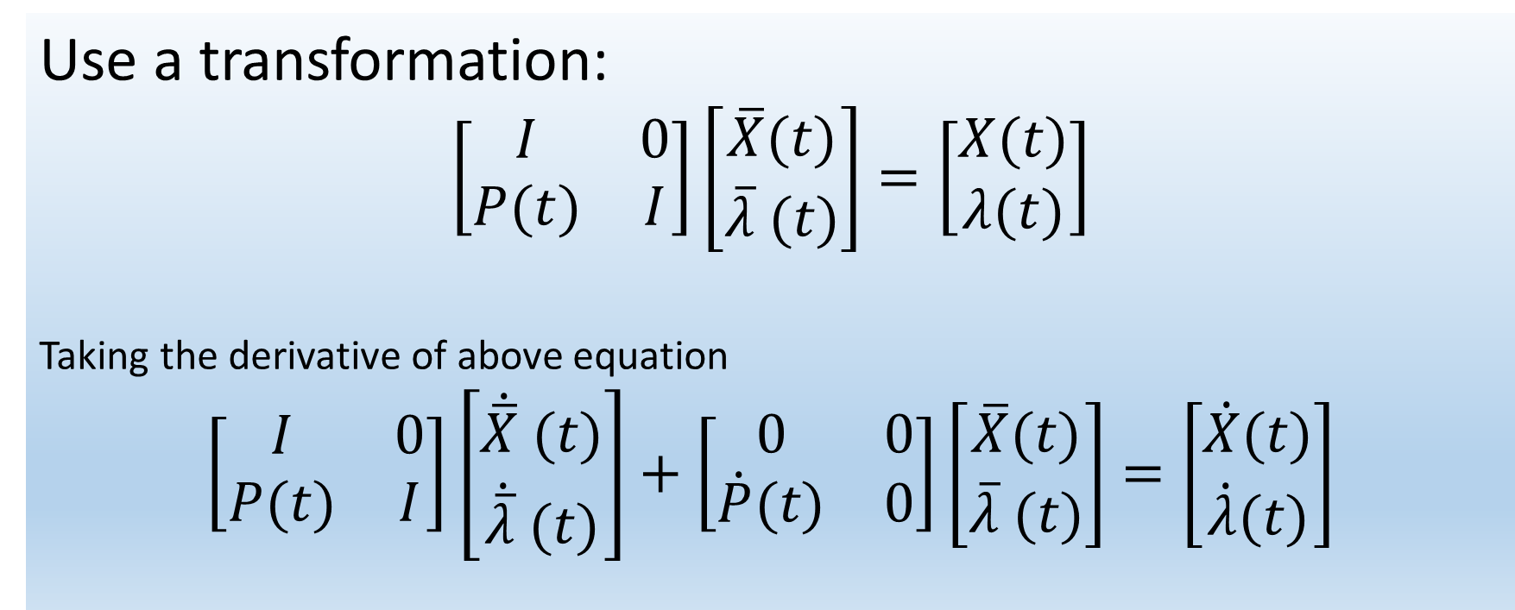
Use a transformation:
$$\left[\begin{matrix}I & 0 \\ P(t) & I\end{matrix}\right]\left[\begin{matrix}\overline{X}(t) \\ \overline{λ} (t)\end{matrix}\right]=\left[\begin{matrix}X(t) \\ λ(t)\end{matrix}\right]$$
Taking the derivative of above equation
$$\left[\begin{matrix}I & 0 \\ P(t) & I\end{matrix}\right]\left[\begin{matrix}\dot{\overline{X}} (t) \\ \dot{\overline{λ}} (t)\end{matrix}\right]+\left[\begin{matrix}0 & 0 \\ \dot{P}(t) & 0\end{matrix}\right]\left[\begin{matrix}\overline{X}(t) \\ \overline{λ} (t)\end{matrix}\right]=\left[\begin{matrix}\dot{X}(t) \\ \dot{λ}(t)\end{matrix}\right]$$
2nx2n and all sub matrices are of nxn

Slide 16
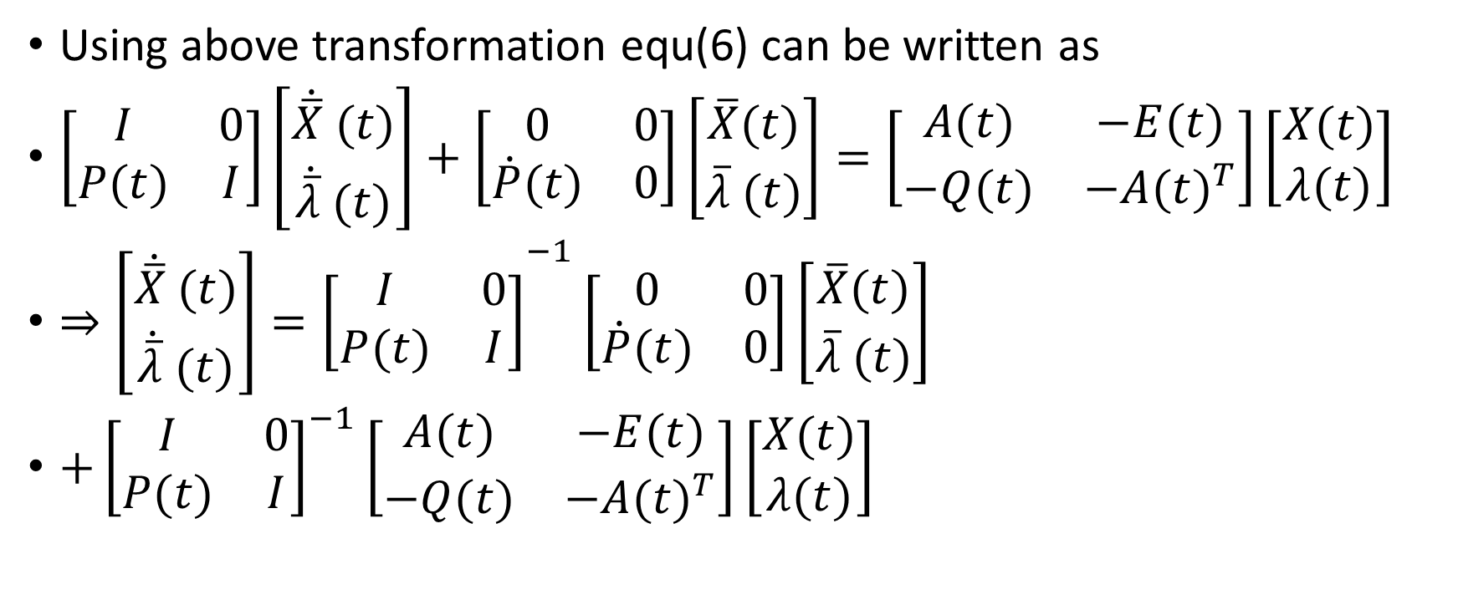
Solution of finite time LQR Problem…
Using above transformation equ(6) can be written as
$\left[\begin{matrix}I & 0 \\ P(t) & I\end{matrix}\right]\left[\begin{matrix}\dot{\overline{X}} (t) \\ \dot{\overline{λ}} (t)\end{matrix}\right]+\left[\begin{matrix}0 & 0 \\ \dot{P}(t) & 0\end{matrix}\right]\left[\begin{matrix}\overline{X}(t) \\ \overline{λ} (t)\end{matrix}\right]=\left[\begin{matrix}A(t) & −E(t) \\ −Q(t) & −{A(t)}^{T}\end{matrix}\right]\left[\begin{matrix}X(t) \\ λ(t)\end{matrix}\right]$
$⇒{\left[\begin{matrix}\dot{\overline{X}} (t) \\ \dot{\overline{λ}} (t)\end{matrix}\right]=\left[\begin{matrix}I & 0 \\ P(t) & I\end{matrix}\right]}^{−1}\left[\begin{matrix}0 & 0 \\ \dot{P}(t) & 0\end{matrix}\right]\left[\begin{matrix}\overline{X}(t) \\ \overline{λ} (t)\end{matrix}\right]$
$+{\left[\begin{matrix}I & 0 \\ P(t) & I\end{matrix}\right]}^{−1}\left[\begin{matrix}A(t) & −E(t) \\ −Q(t) & −{A(t)}^{T}\end{matrix}\right]\left[\begin{matrix}X(t) \\ λ(t)\end{matrix}\right]$
Putting the value of this from above transformation

Slide 17
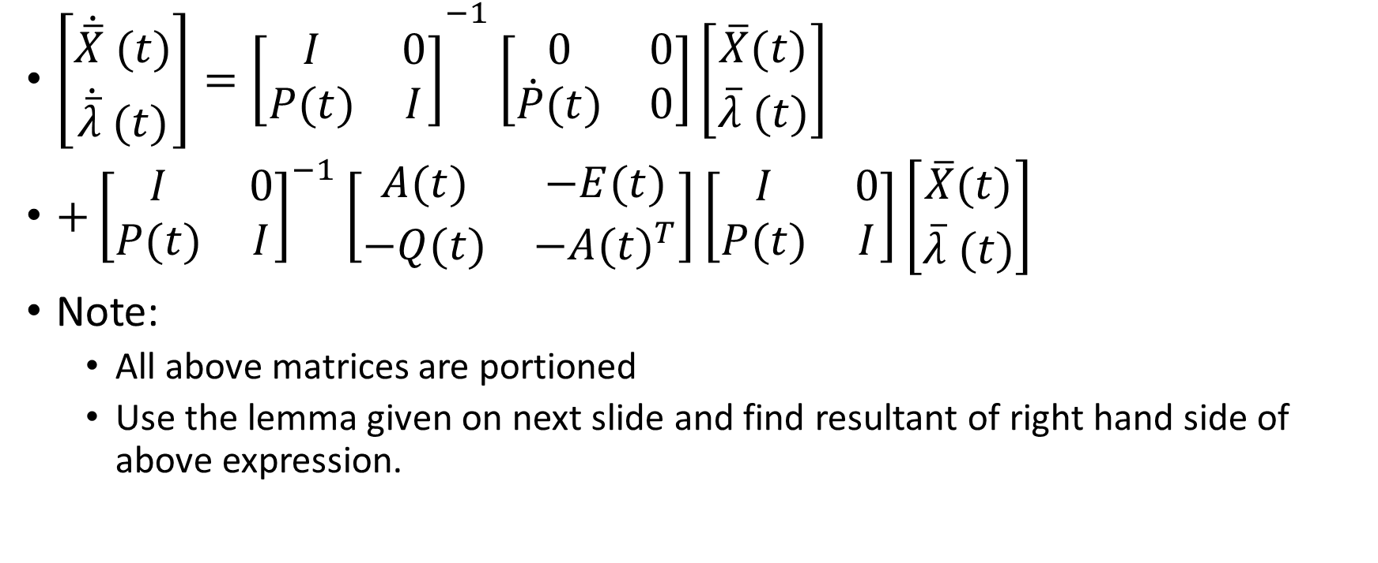
Solution of finite time LQR Problem…
${\left[\begin{matrix}\dot{\overline{X}} (t) \\ \dot{\overline{λ}} (t)\end{matrix}\right]=\left[\begin{matrix}I & 0 \\ P(t) & I\end{matrix}\right]}^{−1}\left[\begin{matrix}0 & 0 \\ \dot{P}(t) & 0\end{matrix}\right]\left[\begin{matrix}\overline{X}(t) \\ \overline{λ} (t)\end{matrix}\right]$
$+{\left[\begin{matrix}I & 0 \\ P(t) & I\end{matrix}\right]}^{−1}\left[\begin{matrix}A(t) & −E(t) \\ −Q(t) & −{A(t)}^{T}\end{matrix}\right]\left[\begin{matrix}I & 0 \\ P(t) & I\end{matrix}\right]\left[\begin{matrix}\overline{X}(t) \\ \overline{λ} (t)\end{matrix}\right]$
Note:
  All above matrices are portioned
  Use the lemma given on next slide and find resultant of right hand side of above expression.

Slide 18
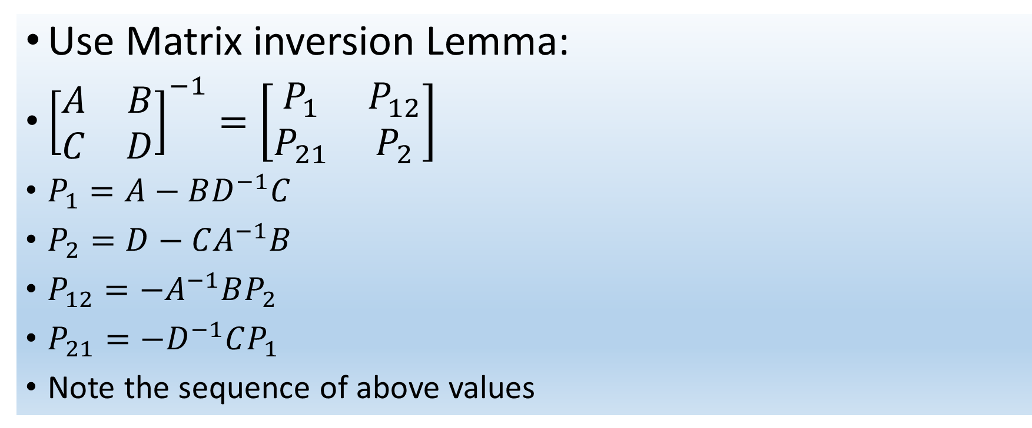
Use Matrix inversion Lemma:
${\left[\begin{matrix}A & B \\ C & D\end{matrix}\right]}^{−1}=\left[\begin{matrix}P_{1} & P_{12} \\ P_{21} & P_{2}\end{matrix}\right]$
$P_{1}=A−BD^{−1}C$
$P_{2}=D−CA^{−1}B$
$P_{12}=−A^{−1}BP_{2}$
$P_{21}=−D^{−1}CP_{1}$
Note the sequence of above values

Slide 19
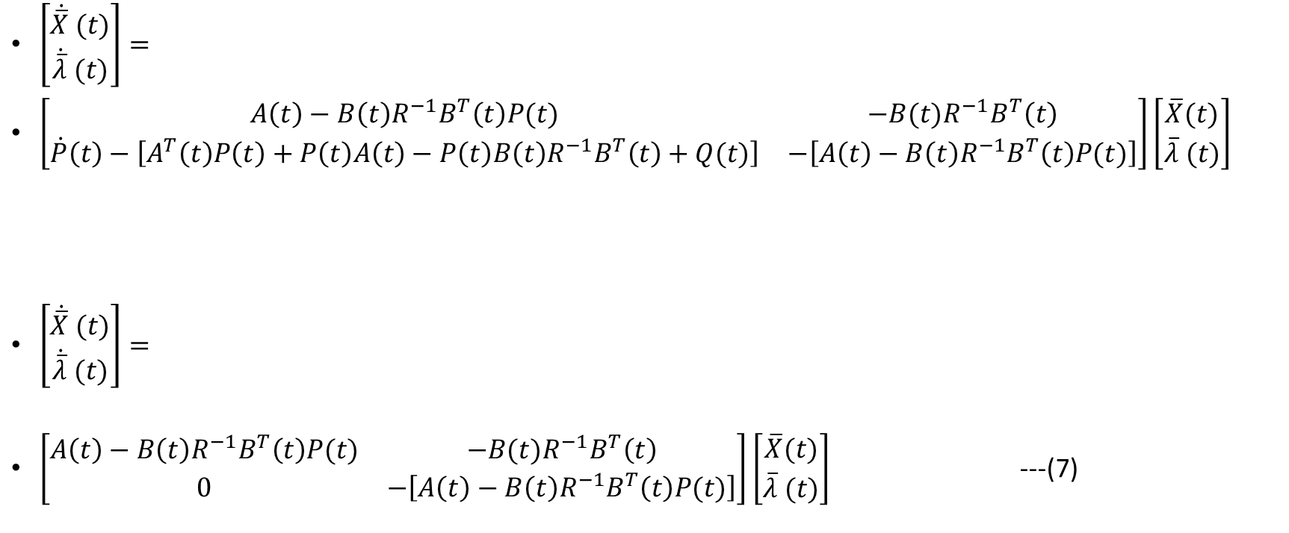
Solution of finite time LQR Problem…
$\left[\begin{matrix}\dot{\overline{X}} (t) \\ \dot{\overline{λ}} (t)\end{matrix}\right]=$
$\left[\begin{matrix}A\left(t\right)−B\left(t\right)R^{−1}B^{T}\left(t\right)P(t) & −B(t)R^{−1}B^{T}\left(t\right) \\ \dot{P}\left(t\right)−\left[A^{T}\left(t\right)P\left(t\right)+P\left(t\right)A\left(t\right)−P\left(t\right)B\left(t\right)R^{−1}B^{T}\left(t\right)+Q(t)\right] & −\left[A\left(t\right)−B\left(t\right)R^{−1}B^{T}\left(t\right)P(t)\right]\end{matrix}\right]\left[\begin{matrix}\overline{X}(t) \\ \overline{λ} (t)\end{matrix}\right]$
$\left[\begin{matrix}\dot{\overline{X}} (t) \\ \dot{\overline{λ}} (t)\end{matrix}\right]=$
$\left[\begin{matrix}A\left(t\right)−B\left(t\right)R^{−1}B^{T}\left(t\right)P(t) & −B(t)R^{−1}B^{T}\left(t\right) \\ 0 & −\left[A\left(t\right)−B\left(t\right)R^{−1}B^{T}\left(t\right)P(t)\right]\end{matrix}\right]\left[\begin{matrix}\overline{X}(t) \\ \overline{λ} (t)\end{matrix}\right]$ ---(7)
Put this equal to zero & find value of P(t)

Slide 20
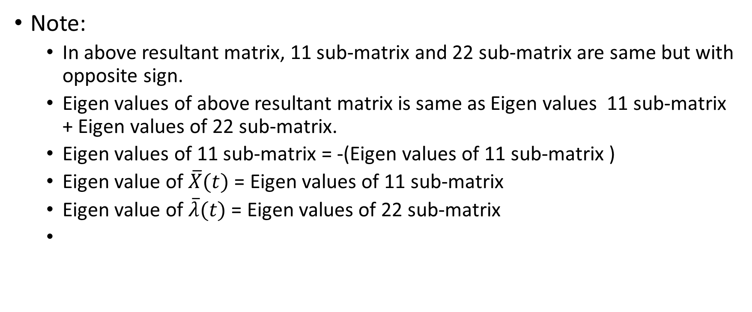
Solution of finite time LQR Problem…
Note:
  In above resultant matrix, 11 sub-matrix and 22 sub-matrix are same but with opposite sign.
  Eigen values of above resultant matrix is same as Eigen values 11 sub-matrix + Eigen values of 22 sub-matrix.
  Eigen values of 11 sub-matrix = -(Eigen values of 11 sub-matrix )
  Eigen value of $\overline{X}(t)$ = Eigen values of 11 sub-matrix
  Eigen value of $\overline{λ}(t)$ = Eigen values of 22 sub-matrix

Slide 21
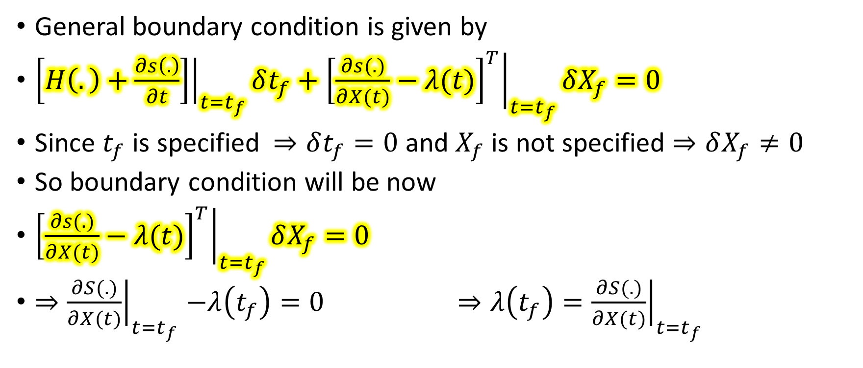
Solution of finite time LQR Problem…
General boundary condition is given by
${\left.\left[H\left(.\right)+\frac{∂s\left(.\right)}{∂t}\right]\right|}_{t=t_{f}}δt_{f}+{\left.{\left[\frac{∂s(.)}{∂X(t)}−λ(t)\right]}^{T}\right|}_{t=t_{f}}δX_{f}=0$
Since $t_{f}$ is specified $⇒δt_{f}=0$ and $X_{f}$ is not specified $⇒δX_{f}≠0$
So boundary condition will be now
${\left.{\left[\frac{∂s(.)}{∂X(t)}−λ(t)\right]}^{T}\right|}_{t=t_{f}}δX_{f}=0$
${⇒\left.\frac{∂S(.)}{∂X(t)}\right|}_{t=t_{f}}−λ\left(t_{f}\right)=0$ $⇒λ\left(t_{f}\right)={\left.\frac{∂S(.)}{∂X(t)}\right|}_{t=t_{f}}$

Slide 22

Solution of finite time LQR Problem…
put this value of S(.) (see slide no 7)
$⇒λ\left(t_{f}\right)=\frac{1}{2}×2×F\left(t_{f}\right)X\left(t_{f}\right)$
$⇒λ\left(t_{f}\right)=F\left(t_{f}\right)X\left(t_{f}\right)$ ---(8)

Slide 23





Solution of finite time LQR Problem…
$$X\left(t_{0}\right)=X_{0}$$
State Equation
r = 0
U(t)
$$\dot{X}(t)$$
X(t)
B(t)
∫
_
A(t)
$$λ\left(t_{f}\right)=F\left(t_{f}\right)X(t_{f})$$
Co State System
_
R⁻¹(t)
∫
Q(t)
$$λ(t)$$
$$\dot{λ}(t)$$
_
A^{T}(t)
Block Diagram

Slide 24
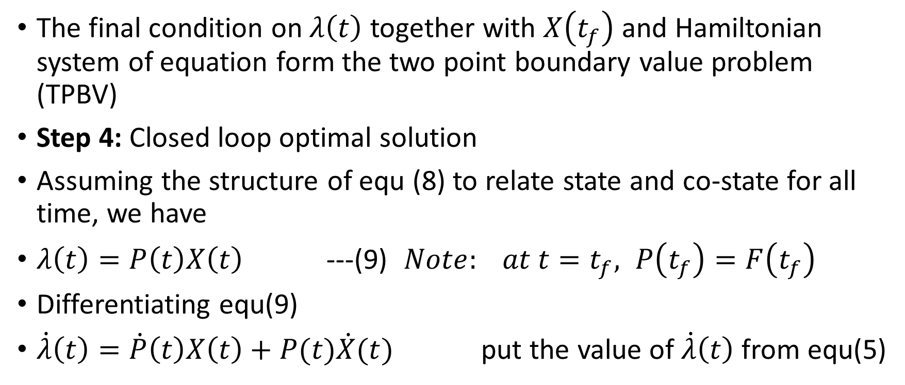
Solution of finite time LQR Problem…
The final condition on $λ\left(t\right)$ together with $X\left(t_{f}\right)$ and Hamiltonian system of equation form the two point boundary value problem (TPBV)
Step 4: Closed loop optimal solution
Assuming the structure of equ (8) to relate state and co-state for all time, we have
$λ\left(t\right)=P\left(t\right)X\left(t\right)$ ---(9) $Note: at t=t_{f}, P\left(t_{f}\right)=F\left(t_{f}\right)$
Differentiating equ(9)
$\dot{λ}\left(t\right)=\dot{P}\left(t\right)X\left(t\right)+P(t)\dot{X}(t)$ put the value of $\dot{λ}\left(t\right)$ from equ(5)

Slide 25
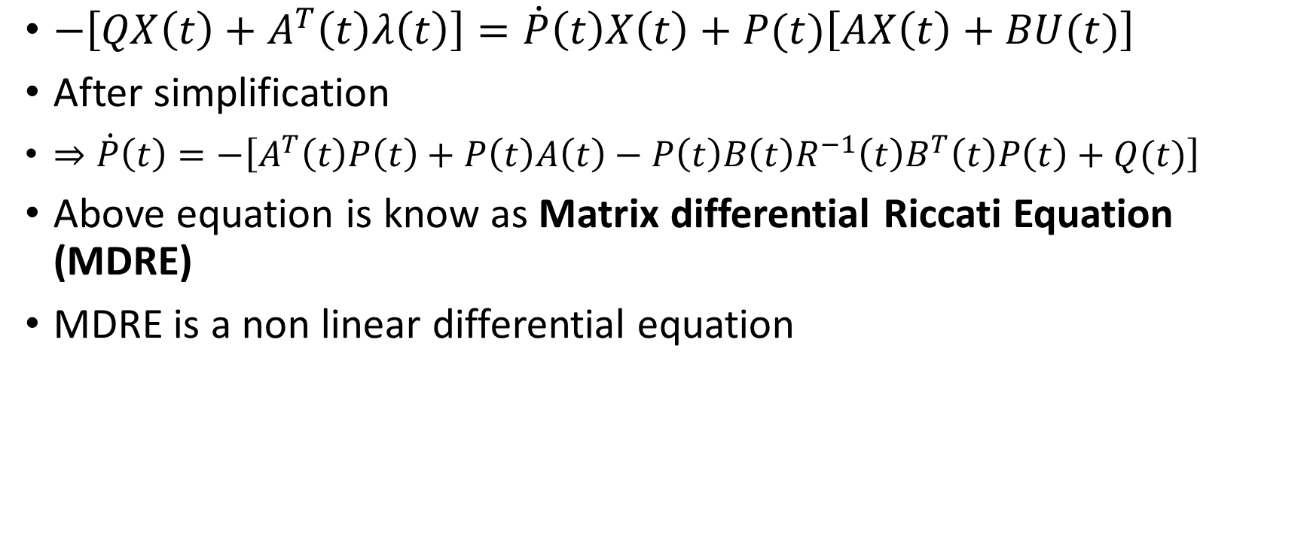
Solution of finite time LQR Problem…
$−\left[{QX\left(t\right)+A}^{T}\left(t\right)λ\left(t\right)\right]=\dot{P}\left(t\right)X\left(t\right)+P(t)\left[AX\left(t\right)+BU(t)\right]$
After simplification
$⇒\dot{P}\left(t\right)=−\left[A^{T}\left(t\right)P\left(t\right)+P\left(t\right)A\left(t\right)−P\left(t\right)B\left(t\right)R^{−1}\left(t\right)B^{T}\left(t\right)P\left(t\right)+Q(t)\right]$
Above equation is know as Matrix differential Riccati Equation (MDRE)
MDRE is a non linear differential equation

Slide 26
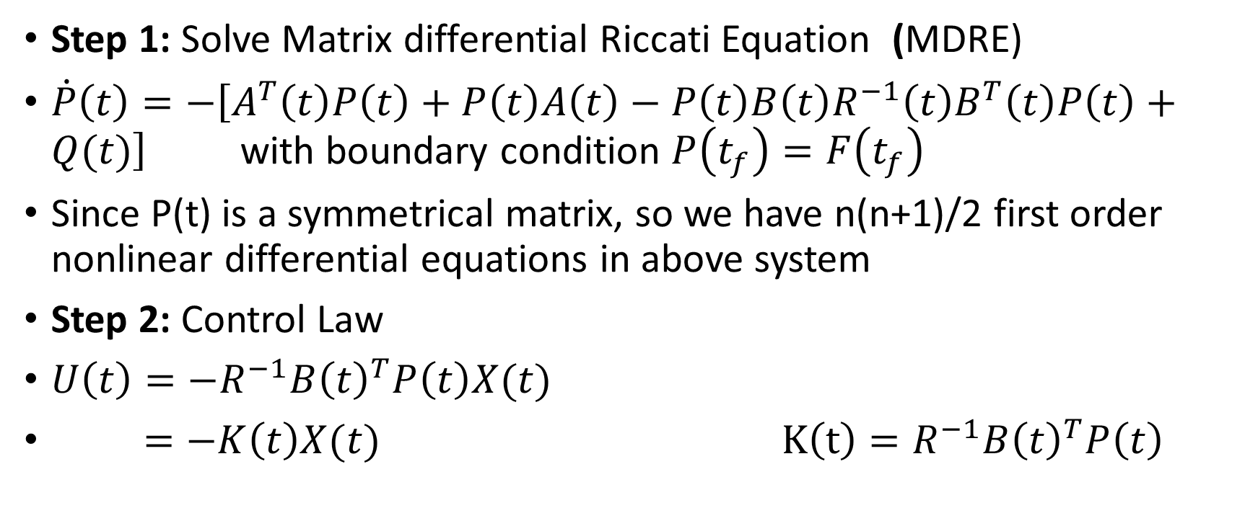
Algorithmic step to solve finite time LQR Problem
Step 1: Solve Matrix differential Riccati Equation (MDRE)
$\dot{P}\left(t\right)=−\left[A^{T}\left(t\right)P\left(t\right)+P\left(t\right)A\left(t\right)−P\left(t\right)B\left(t\right)R^{−1}\left(t\right)B^{T}\left(t\right)P\left(t\right)+Q(t)\right]$ with boundary condition $P\left(t_{f}\right)=F\left(t_{f}\right)$
Since P(t) is a symmetrical matrix, so we have n(n+1)/2 first order nonlinear differential equations in above system
Step 2: Control Law
$U\left(t\right)=−R^{−1}{B\left(t\right)}^{T}P\left(t\right)X(t)$
$=−K\left(t\right)X(t)$ $K\left(t\right)=R^{−1}{B\left(t\right)}^{T}P\left(t\right)$

Slide 27
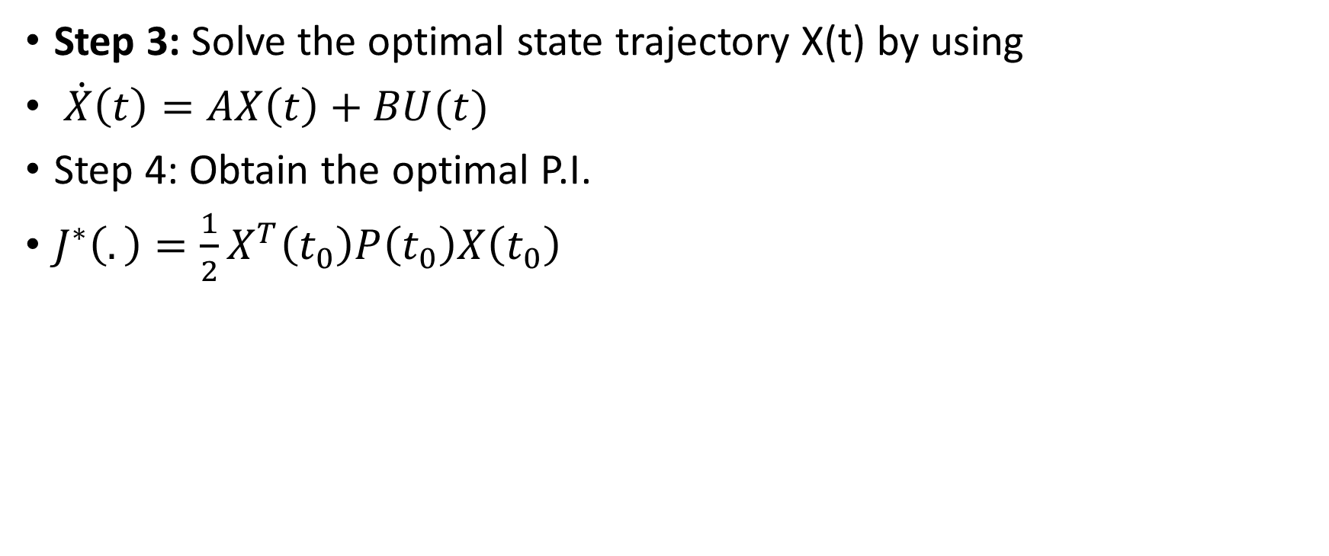
Algorithmic step to solve finite time LQR Problem…
Step 3: Solve the optimal state trajectory X(t) by using
$\dot{X}\left(t\right)=AX\left(t\right)+BU(t)$
Step 4: Obtain the optimal P.I.
${J^{∗}\left(.\right)=\frac{1}{2}X}^{T}\left(t_{0}\right)P\left(t_{0}\right)X\left(t_{0}\right)$

Slide 28
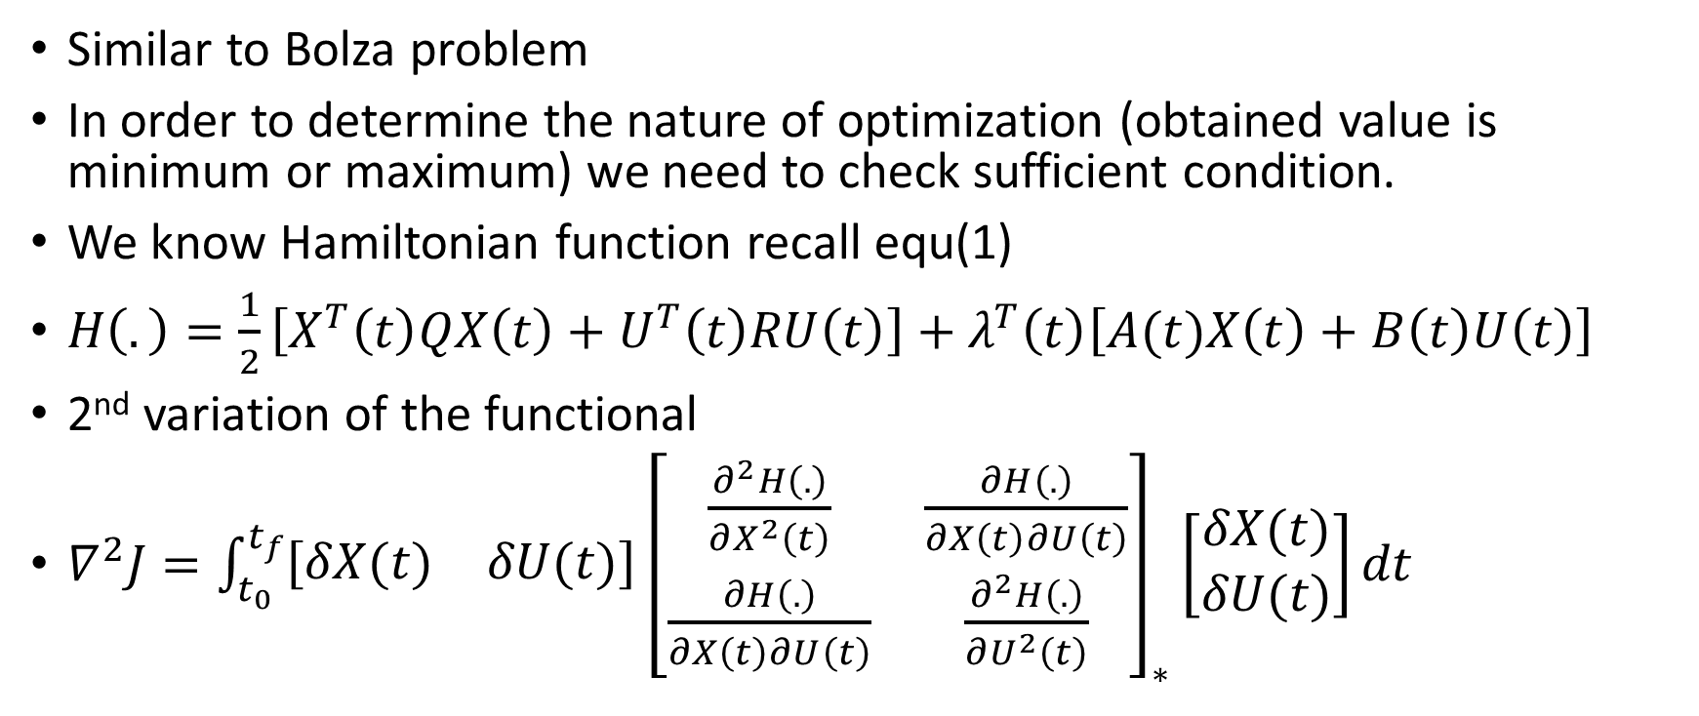
Sufficient condition for finite LQR problem
Similar to Bolza problem
In order to determine the nature of optimization (obtained value is minimum or maximum) we need to check sufficient condition.
We know Hamiltonian function recall equ(1)
$H\left(.\right)=\frac{1}{2}\left[X^{T}\left(t\right)QX\left(t\right)+U^{T}\left(t\right)RU\left(t\right)\right]+λ^{T}\left(t\right)\left[A(t)X\left(t\right)+B\left(t\right)U\left(t\right)\right]$
2nd variation of the functional
$∇^{2}J=\int_{t_{0}}^{t_{f}}{\left[\begin{matrix}δX(t) & δU(t)\end{matrix}\right]{\left[\begin{matrix}\frac{∂^{2}H\left(.\right)}{∂X^{2}\left(t\right)} & \frac{∂H\left(.\right)}{∂X\left(t\right)∂U\left(t\right)} \\ \frac{∂H\left(.\right)}{∂X\left(t\right)∂U\left(t\right)} & \frac{∂^{2}H\left(.\right)}{∂U^{2}\left(t\right)}\end{matrix}\right]}_{∗}}\left[\begin{matrix}δX(t) \\ δU(t)\end{matrix}\right]dt$
Say P which is a (n+m)x(n+m) matrix

Slide 29
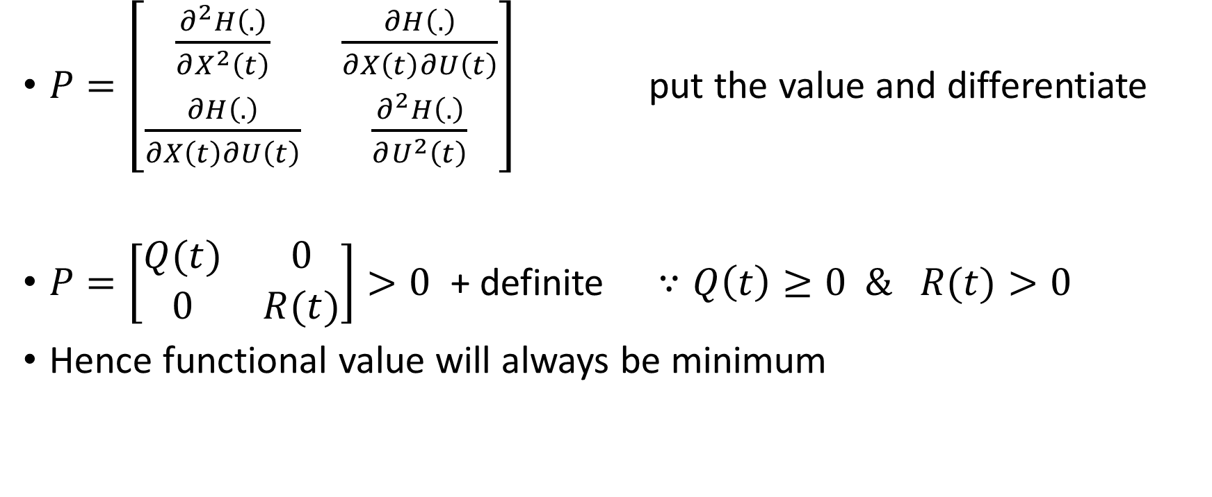
Sufficient condition for finite LQR problem…
$P=\left[\begin{matrix}\frac{∂^{2}H\left(.\right)}{∂X^{2}\left(t\right)} & \frac{∂H\left(.\right)}{∂X\left(t\right)∂U\left(t\right)} \\ \frac{∂H\left(.\right)}{∂X\left(t\right)∂U\left(t\right)} & \frac{∂^{2}H\left(.\right)}{∂U^{2}\left(t\right)}\end{matrix}\right]$ put the value and differentiate
$P=\left[\begin{matrix}Q(t) & 0 \\ 0 & R(t)\end{matrix}\right]>0$ + definite $∵Q\left(t\right)≥0 \& R(t)>0$
Hence functional value will always be minimum

Slide 30
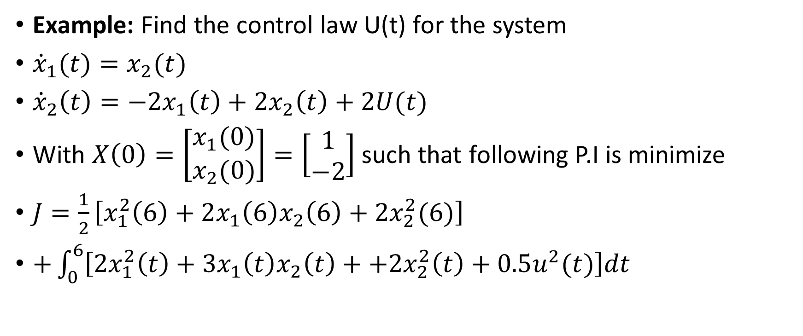
Example: finite time LQR Problem (Lect39)
Example: Find the control law U(t) for the system
${\dot{x}}_{1}(t)=x_{2}(t)$
${\dot{x}}_{2}\left(t\right)={−2x}_{1}\left(t\right)+2x_{2}\left(t\right)+2U(t)$
With $X\left(0\right)=\left[\begin{matrix}x_{1}(0) \\ x_{2}(0)\end{matrix}\right]=\left[\begin{matrix}1 \\ −2\end{matrix}\right]$ such that following P.I is minimize
$J=\frac{1}{2}\left[x_{1}^{2}\left(6\right)+2x_{1}\left(6\right)x_{2}\left(6\right)+2x_{2}^{2}(6)\right]$
$+\int_{0}^{6}{\left[{2x}_{1}^{2}\left(t\right)+3x_{1}\left(t\right)x_{2}\left(t\right)++{2x}_{2}^{2}\left(t\right)+0.5u^{2}(t)\right]dt}$

Slide 31
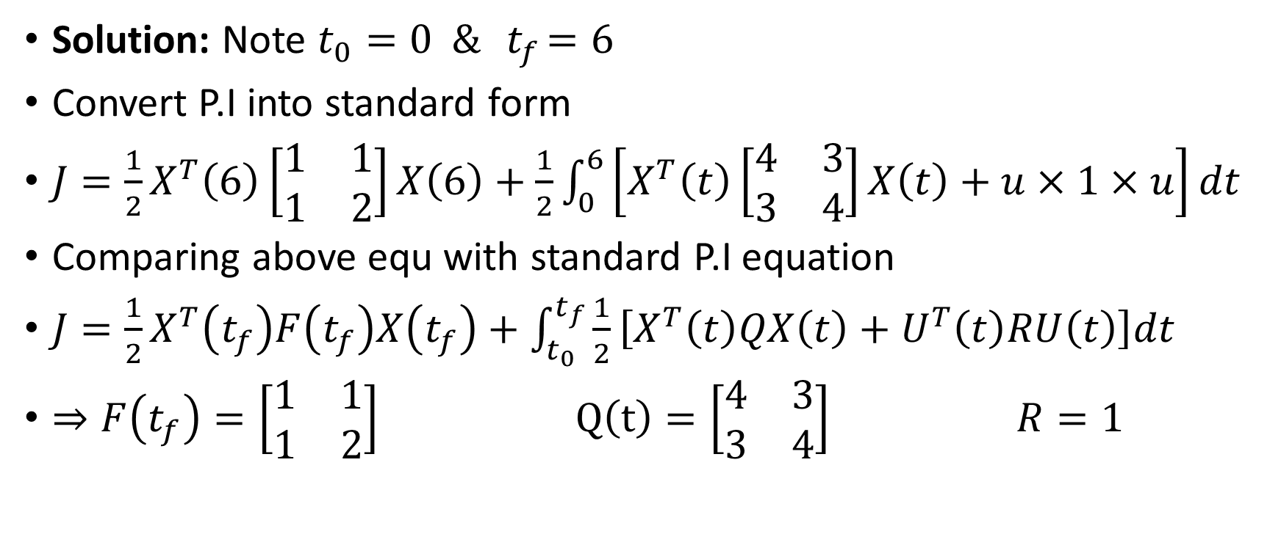
Example: finite time LQR Problem (Lect39)
Solution: Note $t_{0}=0 \& { t}_{f}=6$
Convert P.I into standard form
$J=\frac{1}{2}X^{T}\left(6\right)\left[\begin{matrix}1 & 1 \\ 1 & 2\end{matrix}\right]X\left(6\right)+\frac{1}{2}\int_{0}^{6}{\left[X^{T}\left(t\right)\left[\begin{matrix}4 & 3 \\ 3 & 4\end{matrix}\right]X\left(t\right)+u×1×u\right]dt}$
Comparing above equ with standard P.I equation
${J=\frac{1}{2}X}^{T}\left(t_{f}\right)F\left(t_{f}\right)X\left(t_{f}\right)+\int_{t_{0}}^{t_{f}}{\frac{1}{2}\left[X^{T}\left(t\right)QX\left(t\right)+U^{T}\left(t\right)RU\left(t\right)\right]dt}$
$⇒F\left(t_{f}\right)=\left[\begin{matrix}1 & 1 \\ 1 & 2\end{matrix}\right]$ $Q\left(t\right)=\left[\begin{matrix}4 & 3 \\ 3 & 4\end{matrix}\right]$ $R=1$

Slide 32
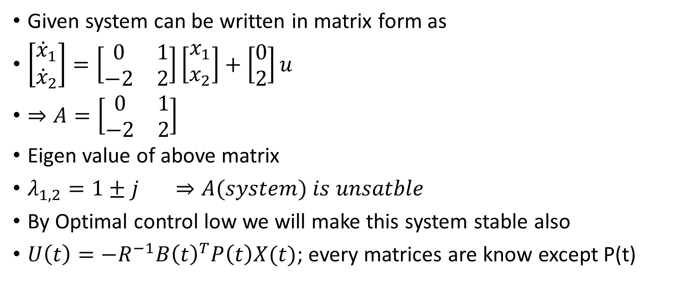
Given system can be written in matrix form as
$\left[\begin{matrix}{\dot{x}}_{1} \\ {\dot{x}}_{2}\end{matrix}\right]=\left[\begin{matrix}0 & 1 \\ −2 & 2\end{matrix}\right]\left[\begin{matrix}x_{1} \\ x_{2}\end{matrix}\right]+\left[\begin{matrix}0 \\ 2\end{matrix}\right]u$
$⇒A=\left[\begin{matrix}0 & 1 \\ −2 & 2\end{matrix}\right]$
Eigen value of above matrix
$λ_{1,2}=1±j ⇒A(system) is unsatble$
By Optimal control low we will make this system stable also
$U\left(t\right)=−R^{−1}{B\left(t\right)}^{T}P\left(t\right)X(t)$; every matrices are know except P(t)

Slide 33
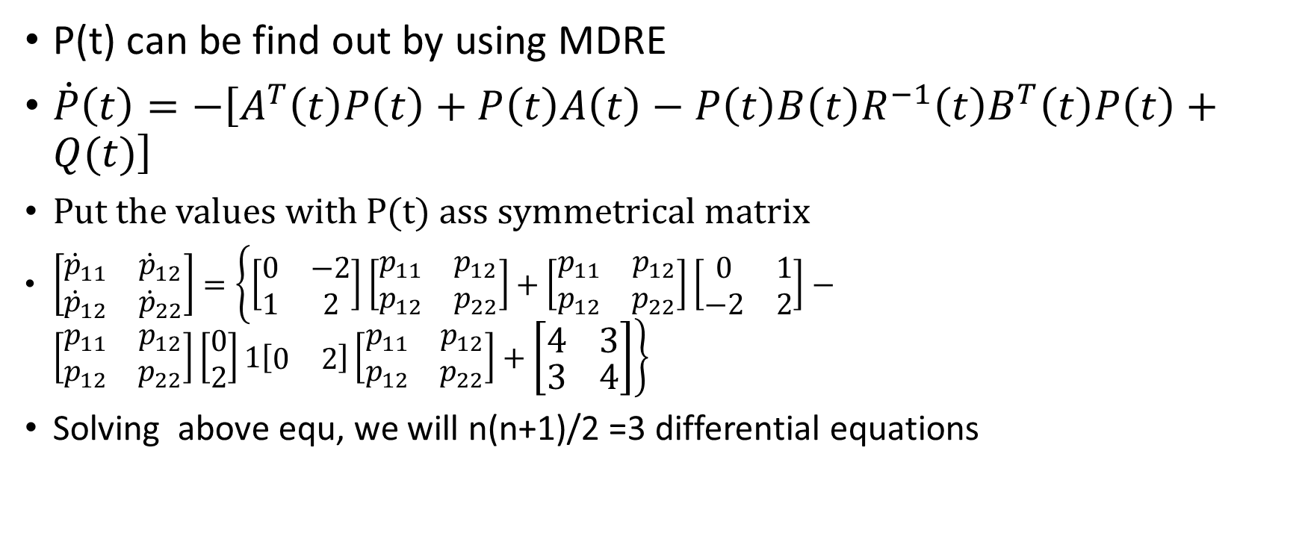
P(t) can be find out by using MDRE
$\dot{P}\left(t\right)=−\left[A^{T}\left(t\right)P\left(t\right)+P\left(t\right)A\left(t\right)−P\left(t\right)B\left(t\right)R^{−1}\left(t\right)B^{T}\left(t\right)P\left(t\right)+Q(t)\right]$
Put the values with P(t) ass symmetrical matrix
$\left[\begin{matrix}{\dot{p}}_{11} & {\dot{p}}_{12} \\ {\dot{p}}_{12} & {\dot{p}}_{22}\end{matrix}\right]=\left\{\left[\begin{matrix}0 & −2 \\ 1 & 2\end{matrix}\right]\left[\begin{matrix}p_{11} & p_{12} \\ p_{12} & p_{22}\end{matrix}\right]+\left[\begin{matrix}p_{11} & p_{12} \\ p_{12} & p_{22}\end{matrix}\right]\left[\begin{matrix}0 & 1 \\ −2 & 2\end{matrix}\right]−\left[\begin{matrix}p_{11} & p_{12} \\ p_{12} & p_{22}\end{matrix}\right]\left[\begin{matrix}0 \\ 2\end{matrix}\right]1\left[\begin{matrix}0 & 2\end{matrix}\right]\left[\begin{matrix}p_{11} & p_{12} \\ p_{12} & p_{22}\end{matrix}\right]+\left[\begin{matrix}4 & 3 \\ 3 & 4\end{matrix}\right]\right\}$
Solving above equ, we will n(n+1)/2 =3 differential equations

Slide 34
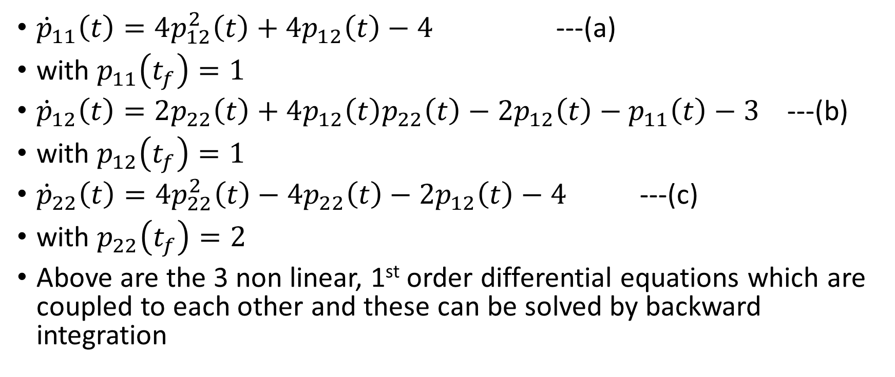
${\dot{p}}_{11}\left(t\right)=4p_{12}^{2}\left(t\right)+4p_{12}\left(t\right)−4$ ---(a)
with $p_{11}\left(t_{f}\right)=1$
${\dot{p}}_{12}\left(t\right)=2p_{22}\left(t\right)+4p_{12}\left(t\right)p_{22}\left(t\right)−2p_{12}\left(t\right)−p_{11}\left(t\right)−3$ ---(b)
with $p_{12}\left(t_{f}\right)=1$
${\dot{p}}_{22}\left(t\right)=4p_{22}^{2}\left(t\right)−4p_{22}\left(t\right)−2p_{12}\left(t\right)−4$ ---(c)
with $p_{22}\left(t_{f}\right)=2$
Above are the 3 non linear, 1st order differential equations which are coupled to each other and these can be solved by backward integration

Slide 35

Solving non-linear differential equations (a), (b) & (c) backward intime integration (Numerical Solution) with the given final conditions $P\left(t_{f}\right)=F\left(t_{f}\right)=\left[\begin{matrix}1 & 1 \\ 1 & 2\end{matrix}\right]$

Slide 36
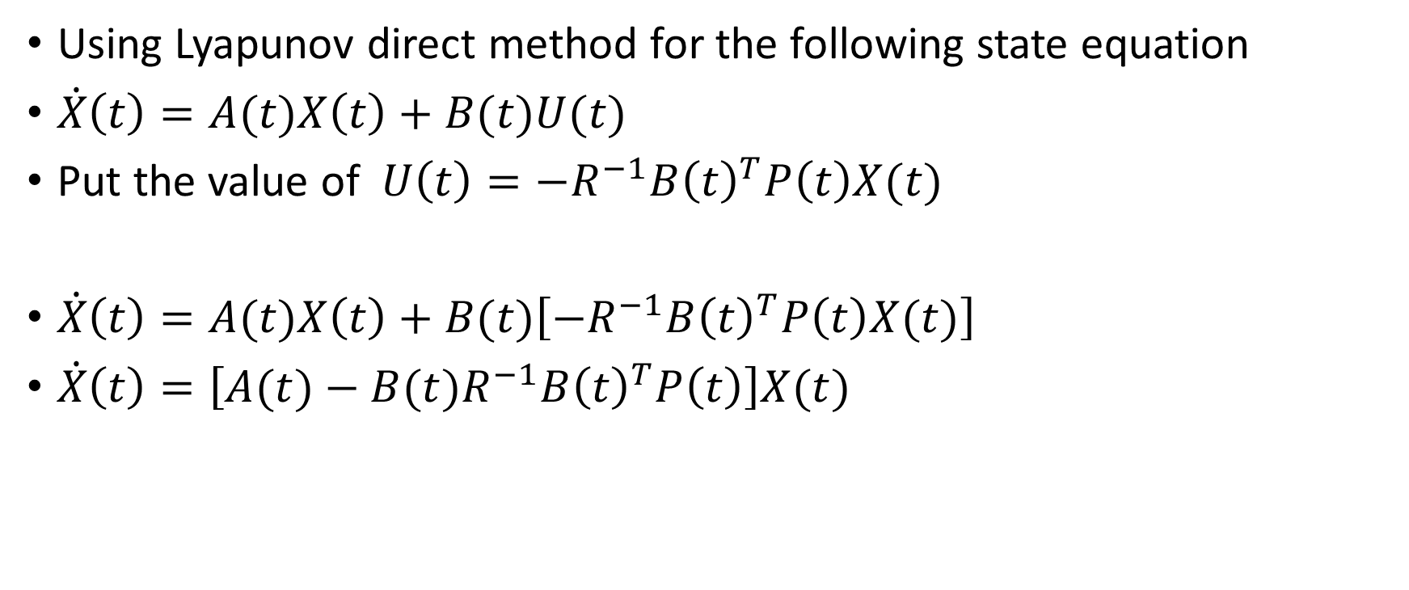
Stability Analysis of finite time LQR Problem
Using Lyapunov direct method for the following state equation
$\dot{X}\left(t\right)=A(t)X\left(t\right)+B(t)U(t)$
Put the value of $U\left(t\right)=−R^{−1}{B\left(t\right)}^{T}P\left(t\right)X(t)$
$\dot{X}\left(t\right)=A(t)X\left(t\right)+B(t)\left[−R^{−1}{B\left(t\right)}^{T}P\left(t\right)X(t)\right]$
$\dot{X}\left(t\right)=\left[A(t)−B(t)R^{−1}{B\left(t\right)}^{T}P\left(t\right)\right]X(t)$
Closed loop System Matrix

Slide 37
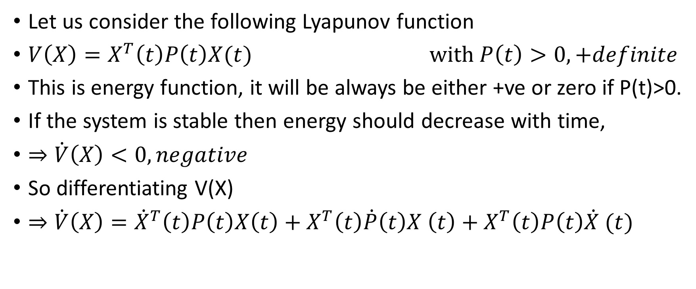
Let us consider the following Lyapunov function
$V\left(X\right)=X^{T}\left(t\right)P\left(t\right)X(t)$ $with P\left(t\right)>0, +definite$
This is energy function, it will be always be either +ve or zero if P(t)>0.
If the system is stable then energy should decrease with time,
$⇒\dot{V}\left(X\right)<0, negative$
So differentiating V(X)
$⇒\dot{V}\left(X\right)={\dot{X}}^{T}\left(t\right)P\left(t\right)X\left(t\right)+X^{T}\left(t\right)\dot{P}\left(t\right)X \left(t\right)+X^{T}\left(t\right)P\left(t\right)\dot{X} (t)$

Slide 38
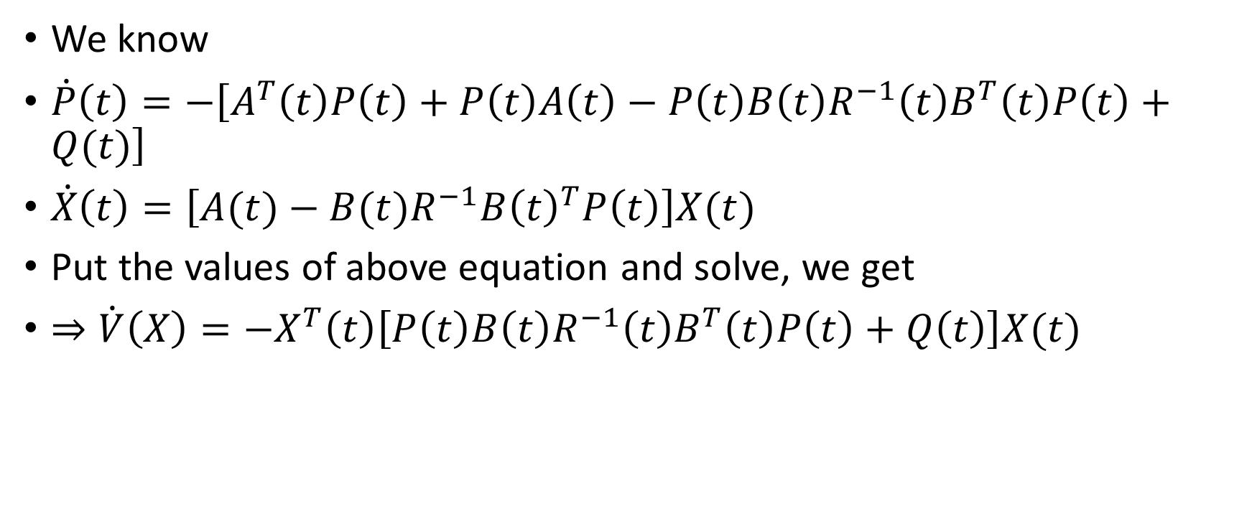
We know
$\dot{P}\left(t\right)=−\left[A^{T}\left(t\right)P\left(t\right)+P\left(t\right)A\left(t\right)−P\left(t\right)B\left(t\right)R^{−1}\left(t\right)B^{T}\left(t\right)P\left(t\right)+Q(t)\right]$
$\dot{X}\left(t\right)=\left[A(t)−B(t)R^{−1}{B\left(t\right)}^{T}P\left(t\right)\right]X(t)$
Put the values of above equation and solve, we get
$⇒\dot{V}\left(X\right)={−X}^{T}\left(t\right)\left[P\left(t\right)B\left(t\right)R^{−1}\left(t\right)B^{T}\left(t\right)P\left(t\right)+Q\left(t\right)\right]X(t)$
This is >0, + Definite , so $\dot{V}\left(X\right)<0, −ve definite$

Slide 39





Why $\left[P\left(t\right)B\left(t\right)R^{−1}\left(t\right)B^{T}\left(t\right)P\left(t\right)+Q\left(t\right)\right]$ is +ve definite ??????
$\left[P\left(t\right)B\left(t\right)R^{−1}\left(t\right)B^{T}\left(t\right)P\left(t\right)+Q\left(t\right)\right]$
Say M^{T}
> 0, +ve definite ,
Because R(t)>0, +ve definite
$≥$ 0, +ve semi definite
M
$M^{T}R^{−1}\left(t\right)M>0$, +ve definite as $R^{−1}\left(t\right)>0$
$>0$
$≥$ 0
$>0$

Slide 40

Clearly if $R\left(t\right)>0$and $Q(t)≥0$ , then Lyapunov condition is satisfied and the LQR controller or closed loop system is stable.

Slide 41
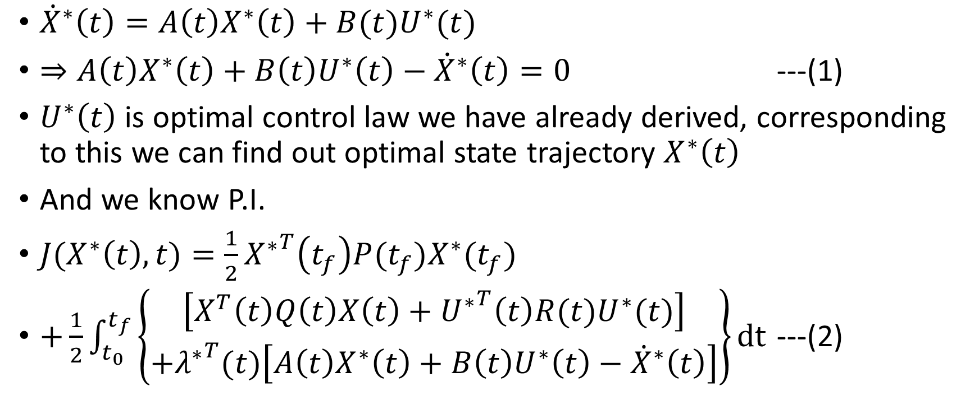
Computation of Optimal Cost (Objective function):
${\dot{X}}^{∗}\left(t\right)=A\left(t\right)X^{∗}\left(t\right)+B(t)U^{∗}(t)$
$⇒A\left(t\right)X^{∗}\left(t\right)+B\left(t\right)U^{∗}\left(t\right)−{\dot{X}}^{∗}\left(t\right)=0$ ---(1)
$U^{∗}\left(t\right)$ is optimal control law we have already derived, corresponding to this we can find out optimal state trajectory $X^{∗}\left(t\right)$
And we know P.I.
$J(X^{∗}\left(t\right),t)=\frac{1}{2}{X^{∗}}^{T}\left(t_{f}\right)P(t_{f})X^{∗}(t_{f})$
$+\frac{1}{2}\int_{t_{0}}^{t_{f}}{\left\{\begin{aligned}\left[X^{T}\left(t\right)Q\left(t\right)X\left(t\right)+{U^{∗}}^{T}\left(t\right)R(t)U^{∗}(t)\right] \\ +{λ^{∗}}^{T}(t)\left[A\left(t\right)X^{∗}\left(t\right)+B\left(t\right)U^{∗}\left(t\right)−{\dot{X}}^{∗}\left(t\right)\right]\end{aligned}\right\}}dt$ ---(2)
Zero from equ(1)

Slide 42
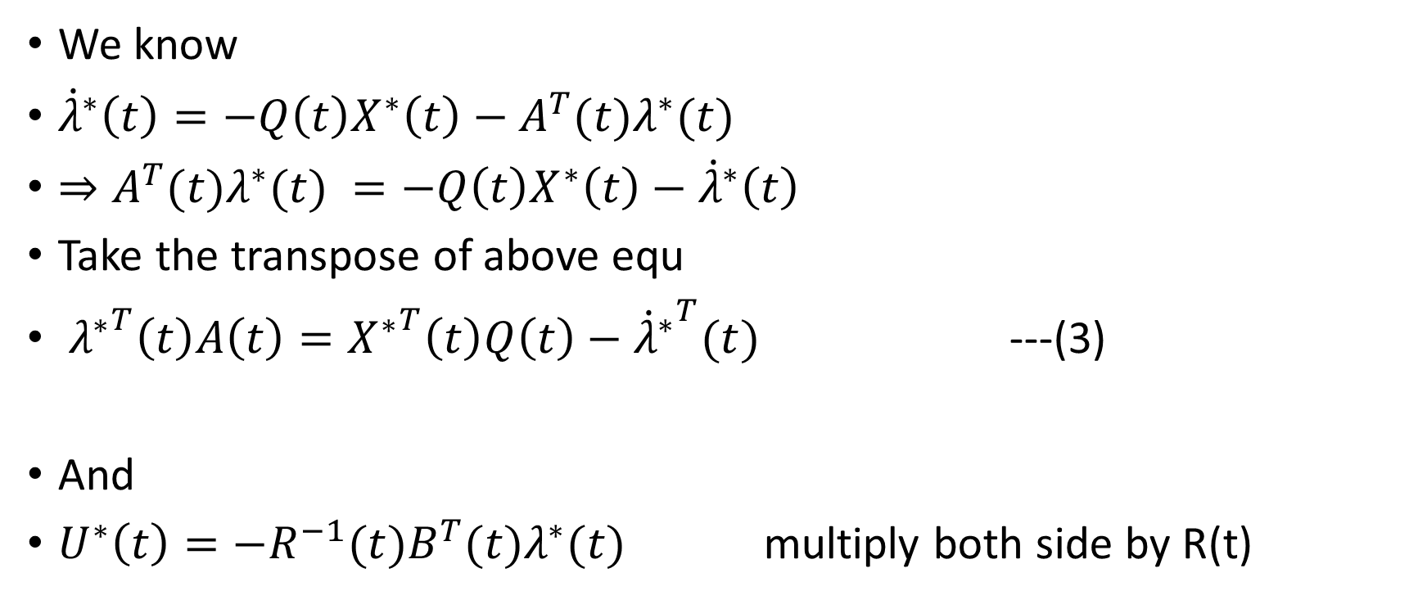
We know
${\dot{λ}}^{∗}\left(t\right)=−Q\left(t\right)X^{∗}\left(t\right)−A^{T}(t)λ^{∗}(t)$
$⇒A^{T}(t)λ^{∗}(t) =−Q\left(t\right)X^{∗}\left(t\right)−{\dot{λ}}^{∗}\left(t\right)$
Take the transpose of above equ
${λ^{∗}}^{T}\left(t\right)A\left(t\right)={X^{∗}}^{T}\left(t\right)Q\left(t\right)−{{\dot{λ}}^{∗}}^{T}(t)$ ---(3)
And
$U^{∗}\left(t\right)=−R^{−1}(t)B^{T}(t)λ^{∗}(t)$ multiply both side by R(t)
Note: $Q^{T}\left(t\right)=Q\left(t\right), ∵Q\left(t\right) is symmetrical$

Slide 43

$⇒R\left(t\right)U^{∗}\left(t\right)=−B^{T}\left(t\right)λ^{∗}\left(t\right)$
Take the transpose of above equation
${λ^{∗}}^{T}\left(t\right)B\left(t\right)={U^{∗}}^{T}\left(t\right)R(t)$ ---(4)
Note: $R^{T}\left(t\right)=R\left(t\right), ∵R\left(t\right) is symmetrical$

Slide 44
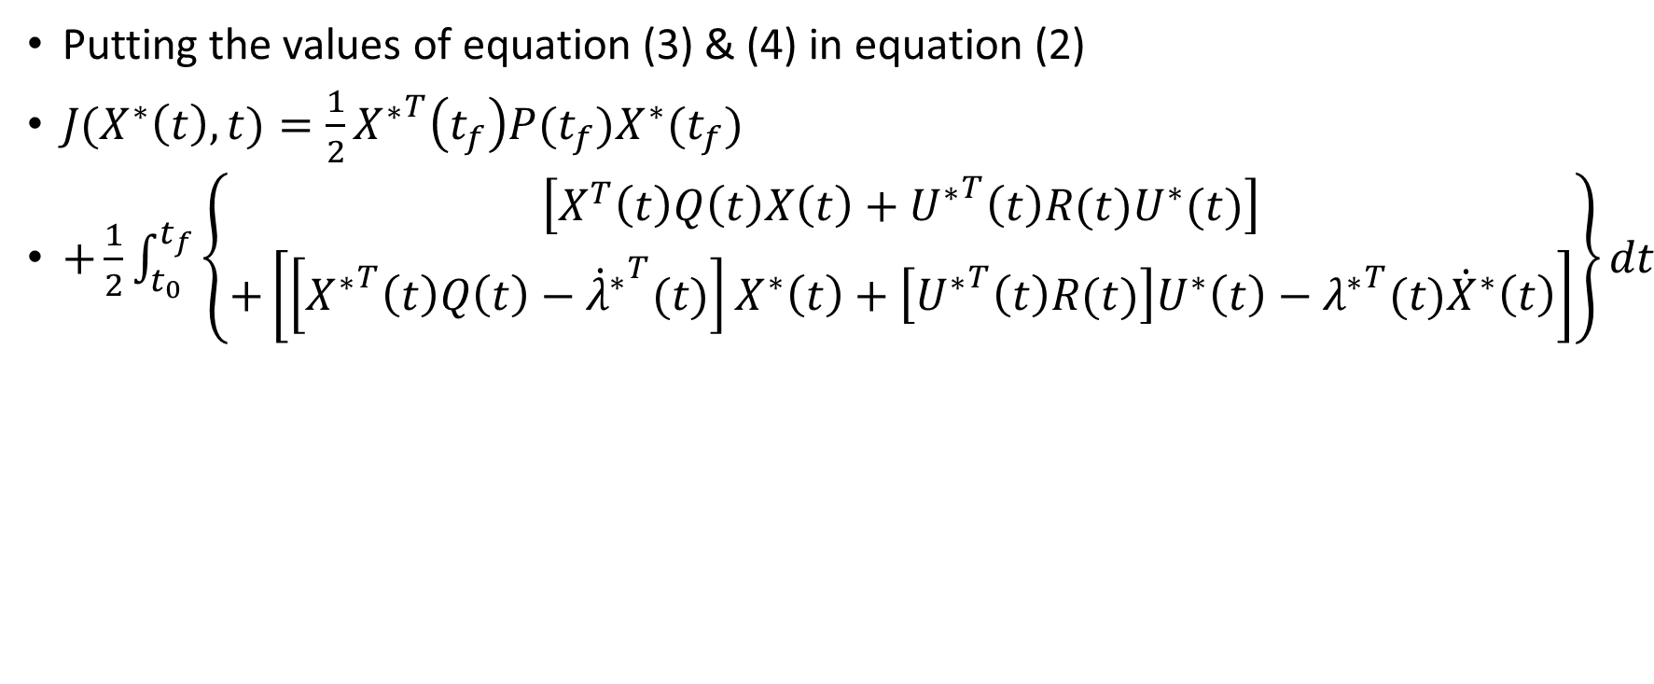
Putting the values of equation (3) & (4) in equation (2)
$J(X^{∗}\left(t\right),t)=\frac{1}{2}{X^{∗}}^{T}\left(t_{f}\right)P(t_{f})X^{∗}(t_{f})$
$+\frac{1}{2}\int_{t_{0}}^{t_{f}}{\left\{\begin{aligned}\left[X^{T}\left(t\right)Q\left(t\right)X\left(t\right)+{U^{∗}}^{T}\left(t\right)R(t)U^{∗}(t)\right] \\ +\left[\left[{X^{∗}}^{T}\left(t\right)Q\left(t\right)−{{\dot{λ}}^{∗}}^{T}(t) \right]X^{∗}\left(t\right)+\left[{U^{∗}}^{T}\left(t\right)R(t)\right]U^{∗}\left(t\right)−{λ^{∗}}^{T}(t){\dot{X}}^{∗}\left(t\right)\right]\end{aligned}\right\}}dt$

Slide 45
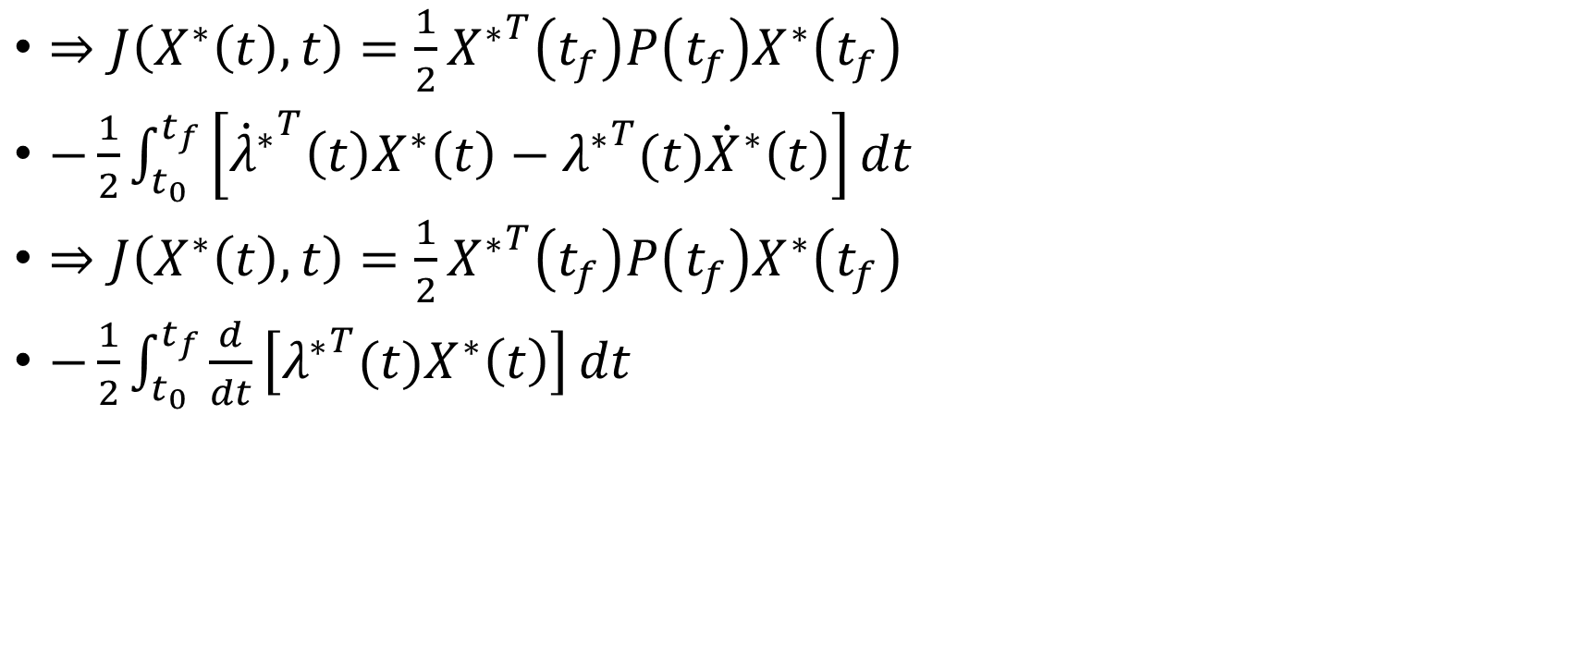
$⇒J\left(X^{∗}\left(t\right),t\right)=\frac{1}{2}{X^{∗}}^{T}\left(t_{f}\right)P\left(t_{f}\right)X^{∗}\left(t_{f}\right)$
$−\frac{1}{2}\int_{t_{0}}^{t_{f}}{\left[{{\dot{λ}}^{∗}}^{T}\left(t\right)X^{∗}\left(t\right)−{λ^{∗}}^{T}(t){\dot{X}}^{∗}\left(t\right)\right]}dt$
$⇒J\left(X^{∗}\left(t\right),t\right)=\frac{1}{2}{X^{∗}}^{T}\left(t_{f}\right)P\left(t_{f}\right)X^{∗}\left(t_{f}\right)$
$−\frac{1}{2}\int_{t_{0}}^{t_{f}}{\frac{d}{dt}\left[{λ^{∗}}^{T}(t)X^{∗}\left(t\right)\right]}dt$

Slide 46
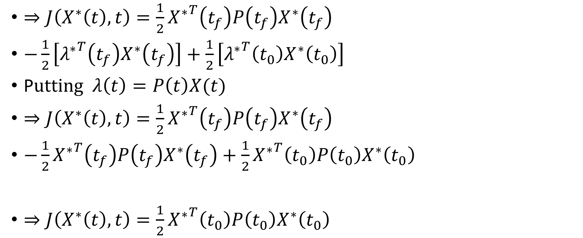
$⇒J\left(X^{∗}\left(t\right),t\right)=\frac{1}{2}{X^{∗}}^{T}\left(t_{f}\right)P\left(t_{f}\right)X^{∗}\left(t_{f}\right)$
$−\frac{1}{2}\left[{λ^{∗}}^{T}\left(t_{f}\right)X^{∗}\left(t_{f}\right)\right]+\frac{1}{2}\left[{λ^{∗}}^{T}\left(t_{0}\right)X^{∗}\left(t_{0}\right)\right]$
P$utting λ\left(t\right)=P\left(t\right)X(t)$
$⇒J\left(X^{∗}\left(t\right),t\right)=\frac{1}{2}{X^{∗}}^{T}\left(t_{f}\right)P\left(t_{f}\right)X^{∗}\left(t_{f}\right)$
$−\frac{1}{2}{X^{∗}}^{T}\left(t_{f}\right)P\left(t_{f}\right)X^{∗}\left(t_{f}\right)+\frac{1}{2}{X^{∗}}^{T}\left(t_{0}\right)P\left(t_{0}\right)X^{∗}\left(t_{0}\right)$
$⇒J\left(X^{∗}\left(t\right),t\right)=\frac{1}{2}{X^{∗}}^{T}\left(t_{0}\right)P\left(t_{0}\right)X^{∗}\left(t_{0}\right)$

Slide 47
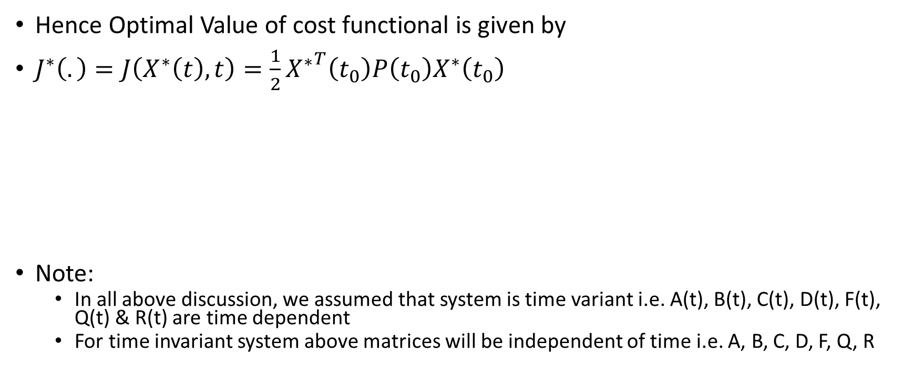
Hence Optimal Value of cost functional is given by
$J^{∗}\left(.\right)=J\left(X^{∗}\left(t\right),t\right)=\frac{1}{2}{X^{∗}}^{T}\left(t_{0}\right)P\left(t_{0}\right)X^{∗}\left(t_{0}\right)$
Note:
  In all above discussion, we assumed that system is time variant i.e. A(t), B(t), C(t), D(t), F(t), Q(t) & R(t) are time dependent
  For time invariant system above matrices will be independent of time i.e. A, B, C, D, F, Q, R

Slide 48
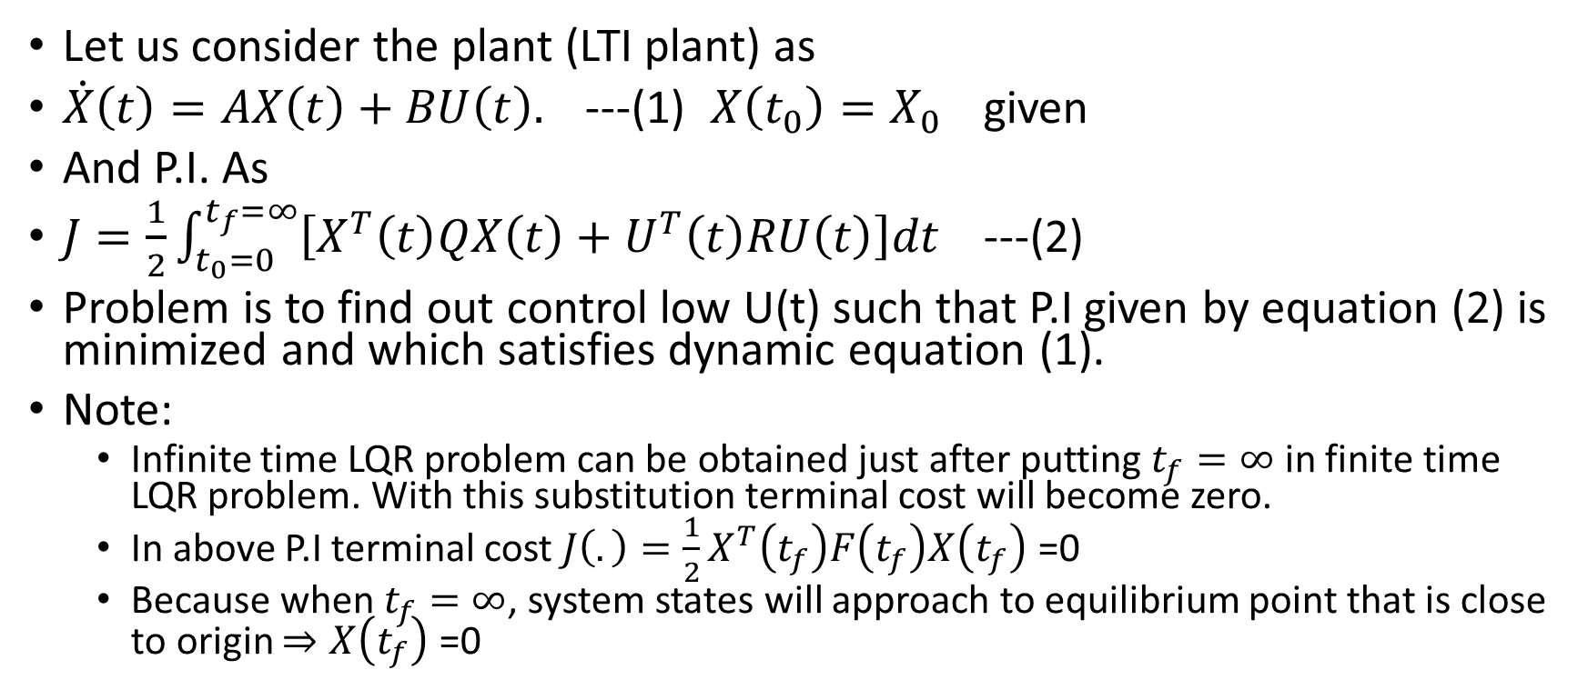
Infinite time LQR problem for time invariant system: (Infinite Horizon LQR Problem) Lect:40
Let us consider the plant (LTI plant) as
$\dot{X}\left(t\right)=AX\left(t\right)+BU\left(t\right).$ ---(1) $X\left(t_{0}\right)=X_{0}$ given
And P.I. As
$J=\frac{1}{2}\int_{t_{0}=0}^{t_{f}=∞}{\left[X^{T}\left(t\right)QX\left(t\right)+U^{T}\left(t\right)RU\left(t\right)\right]dt}$ ---(2)
Problem is to find out control low U(t) such that P.I given by equation (2) is minimized and which satisfies dynamic equation (1).
Note:
  Infinite time LQR problem can be obtained just after putting $t_{f}=∞$ in finite time LQR problem. With this substitution terminal cost will become zero.
  In above P.I terminal cost ${J\left(.\right)=\frac{1}{2}X}^{T}\left(t_{f}\right)F\left(t_{f}\right)X\left(t_{f}\right)$ =0
  Because when $t_{f}=∞$, system states will approach to equilibrium point that is close to origin $⇒X\left(t_{f}\right)$ =0

Slide 49
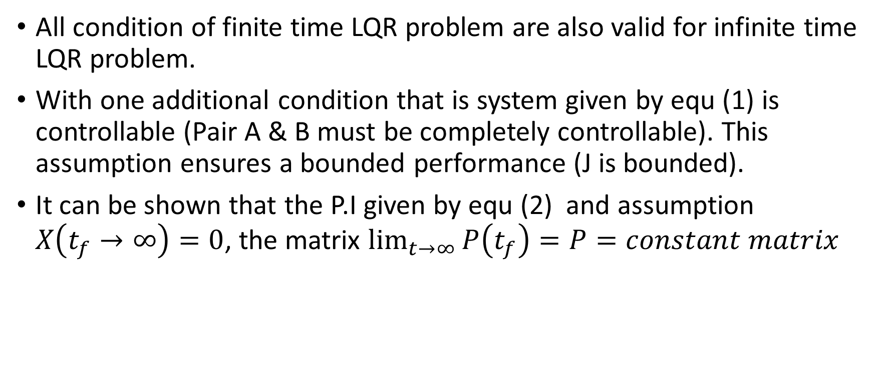
Infinite time LQR problem for time invariant system: (Infinite Horizon LQR Problem)
All condition of finite time LQR problem are also valid for infinite time LQR problem.
With one additional condition that is system given by equ (1) is controllable (Pair A & B must be completely controllable). This assumption ensures a bounded performance (J is bounded).
It can be shown that the P.I given by equ (2) and assumption $X\left(t_{f}→∞\right)=0$, the matrix $\lim_{t→∞}{P\left(t_{f}\right)}=P=constant matrix$

Slide 50
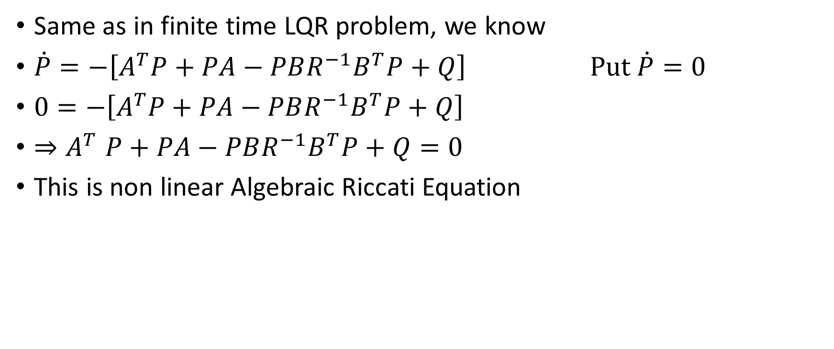
Infinite time LQR problem for time invariant system: (Infinite Horizon LQR Problem)
Same as in finite time LQR problem, we know
$\dot{P}=−\left[A^{T}P+PA−PBR^{−1}B^{T}P+Q\right]$ $Put \dot{P}=0$
$0=−\left[A^{T}P+PA−PBR^{−1}B^{T}P+Q\right]$
${⇒A}^{T}P+PA−PBR^{−1}B^{T}P+Q=0$
This is non linear Algebraic Riccati Equation

Slide 51
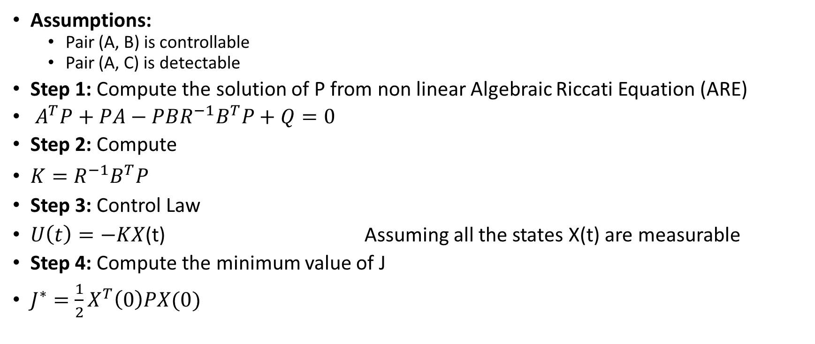
Algorithmic steps for solution of infinite time LQR problem:
Assumptions:
  Pair (A, B) is controllable
  Pair (A, C) is detectable
Step 1: Compute the solution of P from non linear Algebraic Riccati Equation (ARE)
$A^{T}P+PA−PBR^{−1}B^{T}P+Q=0$
Step 2: Compute
$K=R^{−1}B^{T}P$
Step 3: Control Law
$U\left(t\right)=−KX \text{(}\text{t}\text{)}$ Assuming all the states X(t) are measurable
Step 4: Compute the minimum value of J
$J^{∗}=\frac{1}{2}X^{T}\left(0\right)PX(0)$

Slide 52

Stability analysis of the closed loop system for infinite time LQR problem:
Similar to finite time LQR Problem
A closed loop Infinite time LQR controller is always asymptotically stable if $R>0$and $Q≥0$

Slide 53

Example: Infinite time LQR problem (Lect 41)
Example: Consider following system
${\dot{x}}_{1}\left(t\right)=x_{2}\left(t\right)$
${\dot{x}}_{2}\left(t\right)={−2x}_{1}\left(t\right)+{2x}_{2}\left(t\right)+u(t)$ $X\left(t_{0}\right)=X_{0}$
Determine the optimal control law $U\left(t\right)=−KX\left(t\right)$ such that P.I.
$J=\int_{0}^{∞}{\left[x_{1}^{2}\left(t\right)+x_{2}^{2}\left(t\right)+2u(t)\right]}dt$ is minimized
Check the stability of closed loop system
Simulate the system with and without controller (U(t)=0)using the designed LQR controller with initial state $X\left(0\right)=\left[\begin{matrix}4 \\ 2\end{matrix}\right]$

Slide 54

Solution: Above system can be written as
$\left[\begin{matrix}{\dot{x}}_{1} \\ {\dot{x}}_{2}\end{matrix}\right]=\left[\begin{matrix}0 & 1 \\ −2 & 2\end{matrix}\right]\left[\begin{matrix}x_{1}(t) \\ x_{2}(t)\end{matrix}\right]+\left[\begin{matrix}0 \\ 1\end{matrix}\right]u(t)$
$⇒A=\left[\begin{matrix}0 & 1 \\ −2 & 2\end{matrix}\right] \& B=\left[\begin{matrix}0 \\ 1\end{matrix}\right]$
P.I. can be written in standard form
$J=\frac{1}{2}\int_{0}^{∞}{\left[2x_{1}^{2}\left(t\right)+2x_{2}^{2}\left(t\right)+4u(t)\right]}dt$
$J=\frac{1}{2}\int_{0}^{∞}{\left\{X^{T}\left(t\right)\left[\begin{matrix}2 & 0 \\ 0 & 2\end{matrix}\right]X\left(t\right)+u^{T}\left(t\right)4u(t)\right\}}dt$

Slide 55

Comparing above equation with following standard equation
$J=\frac{1}{2}\int_{t_{0}=0}^{t_{f}=∞}{\left[X^{T}\left(t\right)QX\left(t\right)+U^{T}\left(t\right)RU\left(t\right)\right]dt}$
$⇒Q=\left[\begin{matrix}2 & 0 \\ 0 & 2\end{matrix}\right] \& R=4$
Check controllability condition
Find the rank of matrix $W=\left[\begin{matrix}B & AB\end{matrix}\right]$
$det⁡(W)=\left[\begin{matrix}\begin{matrix}0 \\ 1\end{matrix} & \left[\begin{matrix}0 & 1 \\ −2 & 2\end{matrix}\right]\left[\begin{matrix}0 \\ 1\end{matrix}\right]\end{matrix}\right]=\left[\begin{matrix}0 & 1 \\ 1 & 2\end{matrix}\right]≠0$
So rank of matrix W = 2 =n, Hence system is completely controllable

Slide 56

(i) Control law
Solve Algebraic Riccati Eqation
$A^{T}P+PA−PBR^{−1}B^{T}P+Q=0$
$\left[\begin{matrix}0 & −2 \\ 1 & 2\end{matrix}\right]\left[\begin{matrix}p_{11} & p_{12} \\ p_{12} & p_{22}\end{matrix}\right]+\left[\begin{matrix}p_{11} & p_{12} \\ p_{12} & p_{22}\end{matrix}\right]\left[\begin{matrix}0 & 1 \\ −2 & 2\end{matrix}\right]$
$−\left[\begin{matrix}p_{11} & p_{12} \\ p_{12} & p_{22}\end{matrix}\right]\left[\begin{matrix}0 \\ 1\end{matrix}\right]\frac{1}{4}\left[\begin{matrix}0 & 1\end{matrix}\right]\left[\begin{matrix}p_{11} & p_{12} \\ p_{12} & p_{22}\end{matrix}\right]+\left[\begin{matrix}2 & 0 \\ 0 & 2\end{matrix}\right]=\left[\begin{matrix}0 & 0 \\ 0 & 0\end{matrix}\right]$

Slide 57

$⇒\left[\begin{matrix}{−2p}_{12} & {−2p}_{22} \\ p_{11}+{2p}_{12} & {p_{12}+2p}_{22}\end{matrix}\right]+\left[\begin{matrix}{−2p}_{12} & p_{11}+{2p}_{12} \\ {−2p}_{22} & {p_{12}+2p}_{22}\end{matrix}\right]$
$−\left[\begin{matrix}p_{12} \\ p_{22}\end{matrix}\right]0.25\left[\begin{matrix}p_{12} & p_{22}\end{matrix}\right]+\left[\begin{matrix}2 & 0 \\ 0 & 2\end{matrix}\right]=\left[\begin{matrix}0 & 0 \\ 0 & 0\end{matrix}\right]$
A^{T}P
Transpose to each other,
as P^{T}=P , for symmetrical matrix
PA
PB
B^{T}P
Transpose to each other,
as P^{T}=P , for symmetrical matrix

Slide 58

$\left[\begin{matrix}{−2p}_{12} & {−2p}_{22} \\ p_{11}+{2p}_{12} & {p_{12}+2p}_{22}\end{matrix}\right]+\left[\begin{matrix}{−2p}_{12} & p_{11}+{2p}_{12} \\ {−2p}_{22} & {p_{12}+2p}_{22}\end{matrix}\right]$
$−0.25\left[\begin{matrix}p_{12}^{2} & p_{12}p_{22} \\ p_{12}p_{22} & p_{22}^{2}\end{matrix}\right]+\left[\begin{matrix}2 & 0 \\ 0 & 2\end{matrix}\right]=\left[\begin{matrix}0 & 0 \\ 0 & 0\end{matrix}\right]$
${{−0.25p}_{12}^{2}−4p}_{12}+2=0$ (1,1) element
${−0.25p}_{12}p_{22}{−2p}_{22}+p_{11}+{2p}_{12}=0$ (1,2)=(2,1) element
$−0.25p_{22}^{2}+{2p_{12}+4p}_{22}+2=0$ (2,2) element

Slide 59

Solve above 3 equations
From equ (1,1)
${⇒p}_{12}=0.485 \& −16.485$
$\left(p_{12} ≠−ve quantity because it wil give p_{22} complex value\right)$
Put$p_{12}=0.485$in equ (2,2)
${⇒p}_{22}=16.711 \& −ve quantity$
$\left(p_{11} \&p_{22}≠−ve quantity because Matrix P is+ve definite and by Silvester^{′}s theorem{ p}_{11} \&p_{22} must be+ve\right)$

Slide 60

Put $p_{12}=0.485 \& p_{22}=16.711$ in equ(1,2)
${⇒p}_{11}=34.48$
So
$P=\left[\begin{matrix}p_{11} & p_{12} \\ p_{21} & p_{22}\end{matrix}\right]=\left[\begin{matrix}34.48 & 0.485 \\ 0.485 & 16.71\end{matrix}\right]$
We can show $P>0;$+ve definite matrix either by Silvester’s theorem or by finding the Eigen value,(all Eigen values will be +ve)

Slide 61

Controller gain
$K=R^{−1}B^{T}P$
$=0.25\left[\begin{matrix}0 & 1\end{matrix}\right]\left[\begin{matrix}34.48 & 0.485 \\ 0.485 & 16.71\end{matrix}\right]$
$=0.25\left[\begin{matrix}0.485 & 16.71\end{matrix}\right]$
$=\left[\begin{matrix}0.121 & 4.178\end{matrix}\right]$
Control law
$U\left(t\right)=−KX(t)$
$=\left[\begin{matrix}0.121 & 4.178\end{matrix}\right]\left[\begin{matrix}x_{1}(t) \\ x_{2}(t)\end{matrix}\right]$
$⇒$ if we apply above control law it will stabilize the system, not only stabilize the system but will drive the state from any initial condition X₀ to some equilibrium state in an optimum path by minimizing the performance index (J)

Slide 62

(ii) Closed loop stability
$\dot{X}\left(t\right)=A(t)X\left(t\right)+B(t)U(t)$
Put the value of $U\left(t\right)=−KX(t)$
$\dot{X}\left(t\right)=\left[A(t)−B\left(t\right)K\right]X(t)$
$\dot{X}\left(t\right)=A_{C}(t)X(t)$ $A_{C}(t)$ is closed loop system matrix
Find out the Eigen value of matrix $A_{C}(t)$, if real part of Eigen values are –ve then system is stable ($⇒$ Poles are on LHS of s-plane )
$\left|A_{C}\left(t\right)−λI\right|=0$

Slide 63

$A_{C}\left(t\right)=\left[\begin{matrix}0 & 1 \\ −2 & 2\end{matrix}\right]−\left[\begin{matrix}0 \\ 1\end{matrix}\right]\left[\begin{matrix}0.121 & 4.178\end{matrix}\right]=\left[\begin{matrix}0 & 1 \\ −2.121 & −2.178\end{matrix}\right]$
$\left|\left[\begin{matrix}0 & 1 \\ −2.121 & −2.178\end{matrix}\right]−λ\left[\begin{matrix}1 & 0 \\ 0 & 1\end{matrix}\right]\right|=0$
$⇒λ^{2}+2.178λ+2.121=0$
$⇒λ_{1,2}=−1.09±j0.967$
Real part of Eigen values are –ve $⇒$ Poles are on LHS of s-plane $⇒$ closed loop system design with this LQR approach will stabilize the system

Slide 64



(iii) Simulate the system with and without controller (U(t)=0)using the designed LQR controller with initial state $X\left(0\right)=\left[\begin{matrix}4 \\ 2\end{matrix}\right]$
It will look something like this
$$x_{1}\left(0\right)=4$$
$$x_{2}\left(0\right)=2$$
t
1
2
3
4
5
6
7
8
9
10
11

Slide 65



(iv) Block Diagram: We can tune LQR controller by changing the values of R & Q matricies
U(t)
$${\dot{x}}_{2}(t)$$
$$x_{2}\left(t\right)={\dot{x}}_{1}(t)$$
$$x_{1}\left(t\right)$$
∫
∫
System
2
_
-2
4.178
0.121
LQR Controller
-1

