Slide 1
DC Machines(Motor)
By: Nafees Ahamad,
Asstt. Prof., EECE Deptt,
DIT University, Dehradun

Slide 2
Power Relationship in DC motor
From the figure
$V_{L}=E_{b}+I_{a}R_{a}−−−(1)$
$Eq(1)×I_{a}$
$V_{L}I_{a}=E_{b}I_{a}+I_{a}^{2}R_{a}−−−(2)$
$$I_{a}$$
$$R_{a}$$
Power Loss in Armature
$$V_{L}$$
$$E_{b}$$
Mechanical Power developed in armature (P_{m})
Input Power
Motor Armature

Slide 3
Power Relationship in DC motor…
So, from eq(2), Mechanical power developed
$P_{m}=V_{L}I_{a}−I_{a}^{2}R_{a}−−−(3)$
Condition for maximum power developed
Differentiate eq(3) w.r.t. $I_{a}$ and put $\frac{dP_{m}}{dI_{a}}=0$
$\frac{dP_{m}}{dI_{a}}=V_{L}−{2I}_{a}R_{a}=0$
${⟹I}_{a}R_{a}=\frac{V_{L}}{2}$
Put this in eq(1) ${⟹E}_{b}=\frac{V_{L}}{2}$

Slide 4
Types of DC motors
Permanent magnet DC motor:
Used for small power applications i.e. CD players, toys etc.
Separately excited DC motor:
Field winding is excited by some external battery
According to connection of field winding
Series motor
Shunt motor
Compound motor

Slide 5
Separately excited DC motor
$$I$$
Rheostat
$$R_{a}$$
$$V_{L}$$
$$R_{f}$$
Battery
$$E_{b}$$
Armature
Field Winding

Slide 6
Separately excited DC motor…
From the figure
$Line current I_{L}=armature current I_{a}=I \left(say\right)$
$V_{L}=E_{b}+IR_{a}−−−(1)$
Power drawn from main supply
${P=V}_{L}I$
Mechanical power developed in armature
$P_{m}=Input power −losses in armature resistnce$
$P_{m}=V_{L}I−I^{2}R_{a}=I\left(V_{L}−IR_{a}\right)=IE_{b}$

Slide 7
Series motor
$$I$$
$$R_{se}$$
Series Field Winding
$$V_{L}$$
$$R_{a}$$
$$E_{b}$$

Slide 8
Series motor …
From the figure
$Line current I_{L}=armature current I_{a}=Series field current I_{se}=I \left(say\right)$
$V_{L}=E_{b}+IR_{a}+IR_{se}−−−(1)$
Power drawn from main supply
${P=V}_{L}I$
Mechanical power developed in armature
$P_{m}=Input power −losses in armature \& field resistnce$
$P_{m}=V_{L}I−I^{2}R_{a}−I^{2}R_{se}=I\left(V_{L}−IR_{a}−IR_{se}\right)=IE_{b}$

Slide 9
Shunt Motor
$$I_{L}$$
$$I_{sh}$$
$$I_{a}$$
$$R_{a}$$
$$V_{L}$$
$$R_{sh}$$
Shunt Field Winding
$$E_{b}$$

Slide 10
Shunt Motor…
From the figure
$I_{L}=I_{a}+I_{sh}$ & $I_{sh}=\frac{V_{L}}{R_{sh}}$
$V_{L}=E_{b}+I_{a}R_{a}−−−(1)$
Power drawn from main supply ${P=V}_{L}I_{L}$
Mechanical power developed in armature
$P_{m}=Input power −losses in armature \& field resistnce$
$P_{m}=V_{L}I_{L}−I_{a}^{2}R_{a}−V_{L}I_{sh}=V_{L}\left(I_{L}−I_{sh}\right)−I_{a}^{2}R_{a}$
$=V_{L}I_{a}−I_{a}^{2}R_{a}{=I_{a}\left(V_{L}−I_{a}R_{a}\right)=E}_{b}I_{a}$

Slide 11
Compound Motor
Compound motor
Short shunt compound motor
Long shunt compound motor
Cumulative
Differential

Slide 12
Compound Motor …
$$I_{L}$$
$$R_{se}$$
$$I_{sh}$$
$$I_{L}$$
$$R_{se}$$
$$I_{sh}$$
$$I_{a}$$
$$I_{a}$$
$$R_{a}$$
$$R_{a}$$
$$V_{L}$$
$$R_{sh}$$
$$V_{L}$$
$$R_{sh}$$
$$E_{b}$$
$$E_{b}$$
Cumulative Short Shunt Compound Motor
Differential Short Shunt Compound Motor

Slide 13
Direction of rotation of DC motor
The direction of rotation can be reversed by
Either by reversing the current through armature winding
Or By reversing the current through field winding

Slide 14
Speed Equation
We know back EMF of a dc motor
$E_{b}=\frac{PNφZ}{60A}$ $⇒N=\frac{E_{b}60A}{PφZ}−−−(1)$
For a given system P, N, Z & A are constant, so
$N∞\frac{E_{b}}{φ}$ $⇒N=k\frac{E_{b}}{φ}−−−(2)$
If $N_{1},E_{b1},φ_{1} \&{ I}_{a1}$are initial values and $N_{2},E_{b2},φ_{2} \&{ I}_{a2}$are final values, then
$\frac{N_{2}}{N_{1}}=\frac{E_{b2}}{E_{b1}}×\frac{φ_{1}}{φ_{2}}=\frac{{V−I}_{a2}R_{a}}{{V−I}_{a1}R_{a}}×\frac{φ_{1}}{φ_{2}}−−−(3)$ $\left(∵E_{b}=V−I_{a}R_{a}\right)$

Slide 15
Speed Equation…
For DC shunt motor
Flux $φ$ is constant, so $φ_{1}=φ_{2}$ put in eq(3)
$\frac{N_{2}}{N_{1}}=\frac{{V−I}_{a2}R_{a}}{{V−I}_{a1}R_{a}}$
if we neglect $I_{a}R_{a}$ drop, we can write
$\frac{N_{2}}{N_{1}}=\frac{V}{V}=1 ⇒N_{2}=N_{1}$
So DC shunt motor is constant speed motor

Slide 16
Speed Equation…
For DC series motor
Before saturation flux $φ ∞ I_{se} \&{ I}_{se}=I_{a}$ So $φ ∞ I_{a}$, put in eq(3)
$\frac{N_{2}}{N_{1}}=\frac{E_{b2}}{E_{b1}}×\frac{I_{a1}}{I_{a2}}$
After saturation flux $φ$ is constant, so $φ_{1}=φ_{2}$ put in eq(3)
$\frac{N_{2}}{N_{1}}=\frac{E_{b2}}{E_{b1}}$

Slide 17
Speed Regulation
It is defined as the change in speed when the load on motor is reduced from full load to zero and expressed in percentage of rated full load speed.
$\% Speed Regulation=\frac{No load speed −full load speed}{No load speed}×100$
$\% Speed Regulation=\frac{N_{o} −N_{f}}{N_{o}}×100$

Slide 18
Torque
Torque $T=F×r$ N-meter
Work done per revolution $=F×Distance Moved$
$=F×2πr$
Work done per second $=F×2πr×n$
$=F×r×2πn$
$=T×ω$
$=Power developed(P)$
n (rps)
r
F
T
$$ω$$
Pulley of Radius ‘r’, acting a force ‘F’ & rotating with ‘n’ revolution per second (rps)
$ω$= $2πn$= Angular velocity

Slide 19
Torque…
So $P=T×ω$
$P=T×\frac{2πN}{60}$
$N=Speed in RPM$
$n=Speed in RP$S

Slide 20
Armature Torque (T_{a} or T_{e})
We know
Mechanical power developed = Work done per second
$⇒E_{b}I_{a}=T_{a}ω$
$⇒T_{a} =\frac{E_{b}I_{a}}{ω}−−−(1)$
$⇒T_{a} =\frac{E_{b}I_{a}}{2πn}−−−(2)$
$⇒T_{a} =\frac{E_{b}I_{a}}{2π\frac{N}{60}}−−−(3)$
$⇒T_{a} =9.55\frac{E_{b}I_{a}}{N}−−−(4)$

Slide 21
Armature Torque (T_{a} or T_{e}) …
We know $E_{b}=\frac{PNφZ}{60A}$ put in eq(3)
$T_{a} =\frac{\left(\frac{PNφZ}{60A}\right)I_{a}}{2π\frac{N}{60}}$
$⇒T_{a}=0.159\frac{PφZI_{a}}{A}−−−(5)$
$⇒T_{a}∝φI_{a}$ (Other terms are constants)

Slide 22
Shaft Torque (T_{sh})
$T_{sh}=T_{a}−T_{f}$
Torque to overcome Iron and Friction & Windage losses
Armature Torque
Shaft Torque

Slide 23
Shaft Torque (T_{sh})…
Where
$T_{a} =\frac{E_{b}I_{a}}{ω}=\frac{E_{b}I_{a}}{2πn}=9.55\frac{E_{b}I_{a}}{N}$
$T_{f} =9.55\frac{Iron+ Friction \& Windage losses(Watt)}{N}$
So
$T_{sh} =9.55\frac{\left(E_{b}I_{a}−Iron+ Friction \& Windage losses\right)}{N}$
$T_{sh} =9.55\frac{\text{Motor} \text{O}\text{/}\text{P} \text{in} \text{Watt} }{N}$
Motor Output Power in Watt

Slide 24
Characteristic of DC Motor:
T-I
N-I
N-T
There are 3 characteristics
Torque Vs. Armature current characteristics
Speed Vs. Armature current characteristics
Speed Vs. Torque characteristics
Following results will be used
$T_{a}∝φI_{a}−−−(1)$
$N=k\frac{E_{b}}{φ}−−−(2)$

Slide 25
Characteristic of DC Series Motor
Torque Vs. Armature current characteristics: Use eq(1)
Before saturation $φ∝I_{a}$ ${⇒T}_{a}∝I_{a}^{2}$
After saturation $φ=constant$ ${⇒T}_{a}∝I_{a}$
Speed Vs. Armature current characteristics: Use eq(2)
$N=k\frac{E_{b}}{φ}$
Before saturation $φ∝I_{a}$
After saturation $φ=constant$
Speed Vs. Torque characteristics: Use eq(1) & (2)

Slide 26
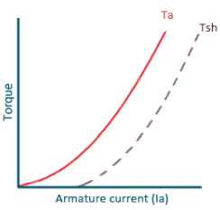
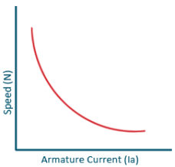
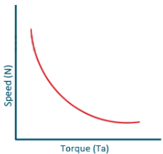
Characteristic of DC Series Motor …
$T_{a}∝I_{a}^{2}$
Gives high starting torque
Series motor should never be started without some mechanical load
1. Torque Vs. Ia
2. Speed Vs. Ia
3. Speed Vs. Torque
Note: 2nd & 3rd characteristics are same

Slide 27
Characteristics Of DC Shunt Motors
Torque Vs. Armature current characteristics: Use eq(1)
$φ=constant$ ${⇒T}_{a}∝I_{a}$
Speed Vs. Armature current characteristics: Use eq(2)
$N=k\frac{E_{b}}{φ}$ $φ=constant$
Speed Vs. Torque characteristics: Use eq(1) & (2)

Slide 28
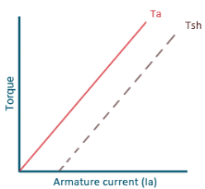
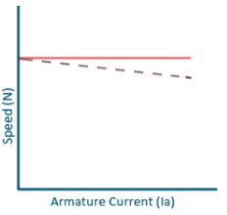
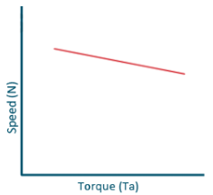
Characteristics Of DC Shunt Motors…
No load speed
N
1. Torque Vs. Ia
2. Speed Vs. Ia
3. Speed Vs. Torque
Note: 2nd & 3rd characteristics are same

Slide 29
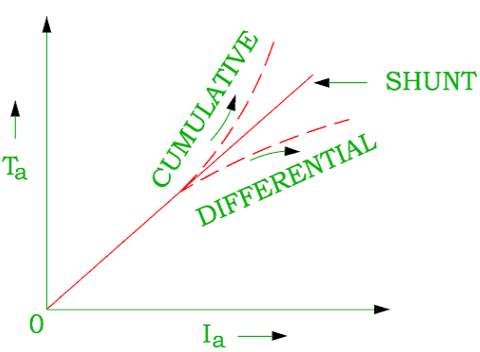
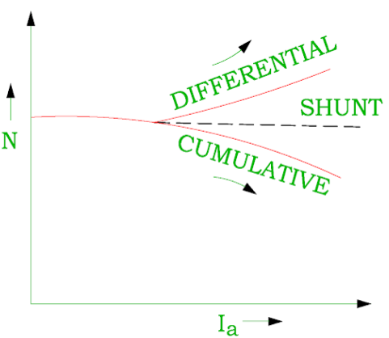
Characteristics Of DC Compound Motor
1. Torque Vs. Ia
2. Speed Vs. Ia

Slide 30
Losses in DC Machines (Motor & Generator)
Useful O/p Power
Copper Loss:
Cu loss in field winding ($I_{se}^{2}R_{se}$, $I_{sh}^{2}R_{sh}$)
Cu loss in armature ($I_{a}^{2}R_{a}$)
Input Power
Losses
Iron Loss:
Hysteresis loss
Eddy current loss
Mechanical Loss
Friction loss
Windage loss

Slide 31
Efficiency in DC Machines
For DC generator
Mechanical Efficiency:
$η_{m}=\frac{Electrical power developed by armature }{Total mechanical power input}×100$
$η_{m}=\frac{E_{g}I_{a}}{Total mechanical power input}×100$

Slide 32
Efficiency in DC Machines…
Electrical efficiency:
$η_{e}=\frac{Total Electrical power output}{Electrical power developed by armature}×100$
$η_{e}=\frac{V_{L}I_{L}}{E_{g}I_{a}}×100$
Overall efficiency:
$η_{G}=\frac{Total Electrical power output}{Total mechanical power input}×100$
$η_{G}=\frac{V_{L}I_{L}}{Total mechanical power input}×100$
Note: $η_{G}=η_{m}η_{e}$

Slide 33
Efficiency in DC Machines…
For DC Motor
Mechanical Efficiency:
$η_{m}=\frac{Total mechanical power output}{Mechanical power developed by armature}×100$
$η_{m}=\frac{Total mechanical power output}{E_{b}I_{a}}×100$

Slide 34
Efficiency in DC Machines…
Electrical efficiency:
$η_{e}=\frac{Mechanical pwoer developed by armature}{Total electrical power input}×100$
$η_{e}=\frac{E_{b}I_{a}}{V_{L}I_{L}}×100$
Overall efficiency:
$η_{M}=\frac{Total mechanical power output}{Total electrical power input}×100$
$η_{M}=\frac{Total mechanical power output}{V_{L}I_{L}}×100$
Note: $η_{M}=η_{m}η_{e}$

Slide 35
Need of a Starter in DC Motors
We know
$I_{a}=\frac{V_{L}−E_{b}}{R_{a}}$ $\left({∵V}_{L}=E_{b}+I_{a}R_{a}\right)$
$R_{a}$ is very less and at time of starting $E_{b}=0 {∵E}_{b}=\frac{PNφZ}{60A}$
So $I_{a}=Very High$
Therefore when the motor is directly connected to the supply lines a heavy current will flow through the armature conductors. This heavy current is very dangerous.
In order to limit this heavy current, we use the starter in a DC motor.

Slide 36
Some Questions
A d.c. generator has an armature emf of 100 V when the useful flux per pole is 20 mWb, and the speed is 800 rpm. Calculate the generated emf (i) with the same flux and a speed of 1000 rpm, (ii) with a flux per pole of 24 mWb and a speed of 90 rpm. (Ans.:- (i) 125 V, (ii) 135 V)
An 8 pole dc generator has 500 armature conductors and a useful flux of 0.05 Wb. What will be the emf generated, if it lap connected and runs at 1200 rpm? What must be the speed at which it is to be driven to produce the same emf, if it is wave wound? (Ans.:- 500V, 300 rpm)

Slide 37
Some Questions…
A d.c. shunt machine connected to 230 V supply has resistance of armature as 0.115 Ω and of field winding as 115 Ω. Find the ratio of the speed as a generator to the speed as a motor with the line current in each case being 100 A. (Ans.:- 1.1052:1)
A d.c. shunt motor draws 10 A at no load from 230 V mains and runs at 1500 rpm. At full load, armature current is 100 A and speed is 1470 rpm. Armature resistance of the motor is 0.1 Ω and field current negligible. Find (a) back emf at no – load and full load (b) speed at which armature should be run to make it deliver 100 A at 220 V as a generator. Assume same flux as with motor operation at full load of 10 A. (Ans.:- (a) 229 V , 220 V (b) 1536.8 rpm)

Slide 38
Some Questions…
A d.c. series motor has an armature resistance of 0.12 Ω and field resistance of 0.08 Ω. The supply voltage across the motor terminals is 230 V. Determine the back emf and power developed by the motor when line current drawn by motor is 30 A. (Ans.:- 224 V, 6.72 kW)

Slide 39
Thanks

