Slide 1
Fuzzy logic: Relations
By: nafees Ahamad,
Ap, EECE deptt, Dit university, dehradun

Slide 2
Fuzzy Relations

Slide 3
Crips Relations

Slide 4
Crips Relations …

Slide 5
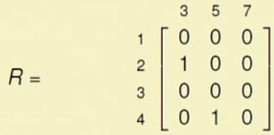
Crips Relations …

Slide 6
Operations on crisp relations

Slide 7
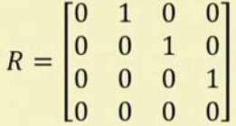
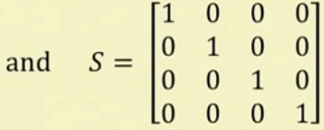
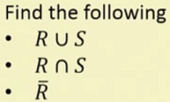
Example: Operations on crisp relations
$$R∪S=\left[\begin{matrix}1 & 1 & \begin{matrix}0 & 0\end{matrix} \\ 0 & 1 & \begin{matrix}1 & 0\end{matrix} \\ \begin{aligned}0 \\ 0\end{aligned} & \begin{aligned}0 \\ 0\end{aligned} & \begin{aligned}\begin{matrix}1 & 1\end{matrix} \\ \begin{matrix}0 & 1\end{matrix}\end{aligned}\end{matrix}\right]$$
$$\overline{R}=\left[\begin{matrix}1 & 0 & \begin{matrix}1 & 1\end{matrix} \\ 0 & 0 & \begin{matrix}0 & 1\end{matrix} \\ \begin{aligned}1 \\ 1\end{aligned} & \begin{aligned}1 \\ 1\end{aligned} & \begin{aligned}\begin{matrix}1 & 0\end{matrix} \\ \begin{matrix}1 & 1\end{matrix}\end{aligned}\end{matrix}\right]$$

Slide 8
Composition of two crisp relations

Slide 9
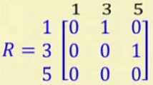
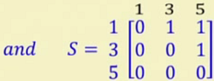
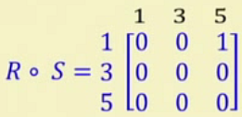
Composition of two crisp relations …
It is like matrix multiplication
Row x Column
$$First Element= max\left\{min\left(0,0\right),min\left(1,0\right),min\left(0,0\right)\right\}$$
=$max\left\{0, 0,0\right\}$
=$0$

Slide 10
Fuzzy Relations

Slide 11
Fuzzy Relations: Example

Slide 12
Fuzzy Cartesian Product

Slide 13
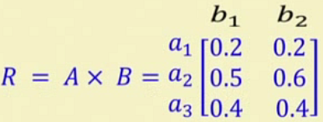
Fuzzy Cartesian Product : Example

Slide 14
Operations of Fuzzy relations

Slide 15
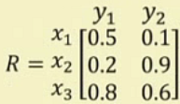
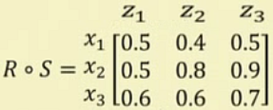
Operations of Fuzzy relations : Example

Slide 16
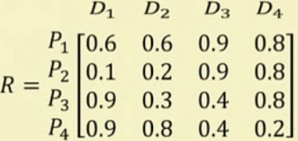
Fuzzy Relations : Example

Slide 17
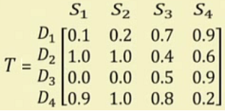
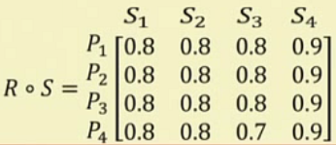
Fuzzy Relations : Example …

Slide 18
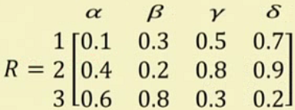
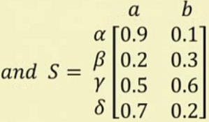
Fuzzy Relations : Another Example

Slide 19
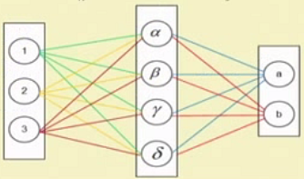
Fuzzy Relations : Another Example…

Slide 20
Thank you

