Slide 1
Fuzzy logic: Implications
By: nafees Ahamad,
Ap, EECE deptt, Dit university, dehradun

Slide 2
Fuzzy Implications

Slide 3
Fuzzy Rule
x is A is one Proposition,
y is B is another Proposition

Slide 4
Fuzzy Implication : Example 1

Slide 5
Fuzzy Implication : Example 2

Slide 6
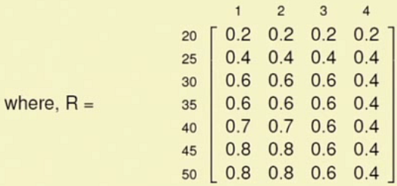
Fuzzy Implication : Example 2…
min
R = Relation
P_{Low} = {(1,0.7), (2,0.7), (3,0.6), (4,0.4),}

Slide 7
Interpretation of fuzzy rules
Methods to find out Relation (R) of implication

Slide 8
Interpretation as A coupled with B
This is done on slide previous slide No 6

Slide 9
Interpretation as A coupled with B …

Slide 10
T-Norm Operator

Slide 11
T-Norm Operator …

Slide 12
Interpretation of A entails B

Slide 13
Interpretation of A entails B…

Slide 14
Interpretation of A entails B…

Slide 15
Example 3: Zadeh’s Max-Min Rule
Also there which is other than shown on slide 13

Slide 16
Example 3: Zadeh’s Max-Min Rule …
min
min
Note: Y = {(1,1), (2,1), (3,1), (4,1)} all having membership function =1

Slide 17
Example 4:
Zadeh’s Max-Min rule can be extended to another type of rule like this

Slide 18
Example 4: …

Slide 19
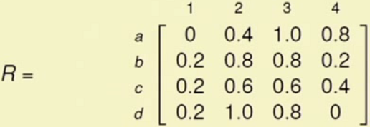
Example 4: …

Slide 20
Thank you

