Slide 1
Three Phase Induction Motor (Asynchronous Motor)
By: Nafees Ahamad,
Asstt. Prof., EECE Deptt,
DIT University, Dehradun

Slide 2
Types of 3-phase Induction Motor
Squirrel Cage Induction motor
Types
Wound Rotor Induction Motor
(Or Slip Ring Induction Motor)

Slide 3
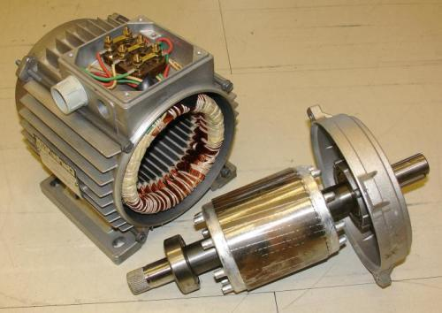
Actual 3-phase Squirrel Cage Induction motor

Slide 4
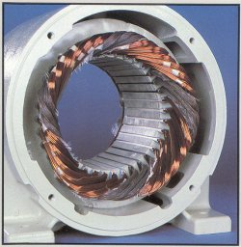
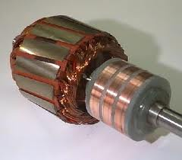
Actual 3-phase Wound Rotor Induction Motor

Slide 5
Introduction
Three-phase induction motors are the most common and frequently encountered machines in industry
Simple design, rugged, low-price, easy maintenance
Wide range of power ratings: fractional horsepower to 10 MW
Run essentially as constant speed from no-load to full load
It’s speed depends on the frequency of the power source

Slide 6
Construction of 3-phase IM
An induction motor has two main parts:
Stator & Rotor
Stator: stationary part
consisting of a steel frame that supports a hollow, cylindrical core
Laminated core, having a number of evenly spaced slots.
3-phase stator winding in the slots.

Slide 7
Construction of 3-phase IM…
R Y B
Frame
Or
Yoke
Stator Teeth
3 phase Stator winding
(star/Delta)
Core
(Laminated)
Schematic Diagram of stator

Slide 8
Construction of 3-phase IM…
Rotor: Rotating part, two types
Squirrel cage rotor:
Cu or Aluminum bars are inserted slots (holes) of rotor, which are being short circuited by end rings.
Wound rotor:
Three phase windings ( Similar to stator) is done in the slots of rotor.
Terminals are brought out through slips rings.

Slide 9
Construction of 3-phase IM…
End Ring
Al or Cu bars
End Ring
Squirrel cage rotor

Slide 10
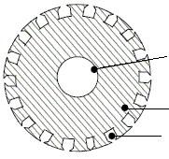
Construction of 3-phase IM…
Shaft
Laminated core
Slots for 3 phase rotor winding
Wound rotor

Slide 11
Construction of 3-phase IM…
Slip rings:
Squirrel cage rotor: No slip rings
Wound rotor: Three slip rings at rotor shaft to insert external resistance to rotor winding.
Brushes:
Squirrel cage rotor: No Brushes
Wound rotor: Three Brushes

Slide 12
Construction of 3-phase IM…
Shaft:
Mild steel shaft with maximum breaking strength.
Bearings:
Ball bearing or roller bearing.

Slide 13
Types of 3 phase IM
Two Types
Squirrel-cage induction motor : conducting bars laid into slots and shorted at both ends by shorting rings.
Wound-rotor (or slip ring ) induction motor: Complete set of three-phase windings exactly as the stator. Usually Y-connected, the ends of the three rotor wires are connected to 3 slip rings on the rotor shaft. In this way, the rotor circuit is accessible.

Slide 14
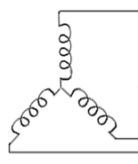
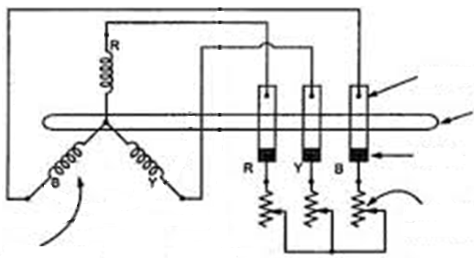
Types of 3 phase IM…
3-$Φ$ Stator windings
Slip Ring
Shaft
Brush
External Star Connected Rheostat
3-$Φ$ Rotor windings
wound-rotor (or slip ring IM)

Slide 15
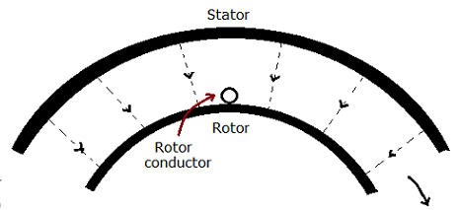
Principle of Operation of IM
Three-phase AC current will produce rotating magnetic filed, which will rotate with a speed known as synchronous speed(see figure) given by $N_{s}=\frac{120f}{P}$
Stator Rotating magnetic field
N_{s}

Slide 16
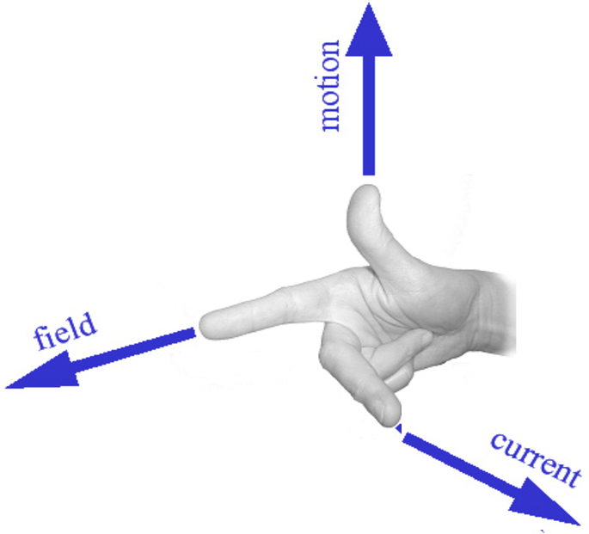
Principle of Operation of IM …
Rotating magnetic field induces voltages in rotor windings resulting in rotor currents. The direction of induced EMF in rotor can be find out by Fleming’s right hand rule(see figure)
Motion
Flux
Current in armature conductor by Fleming’s left hand rule
Fleming’s Right hand rule

Slide 17
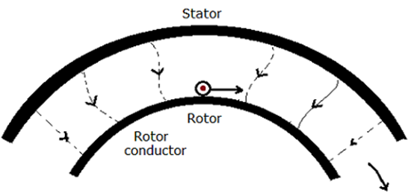
Principle of Operation of IM …
Now situation is like, a current carrying conductor is placed in magnetic field (See figure).
So a force will act on it.
N_{s}
Stator Rotating magnetic field

Slide 18
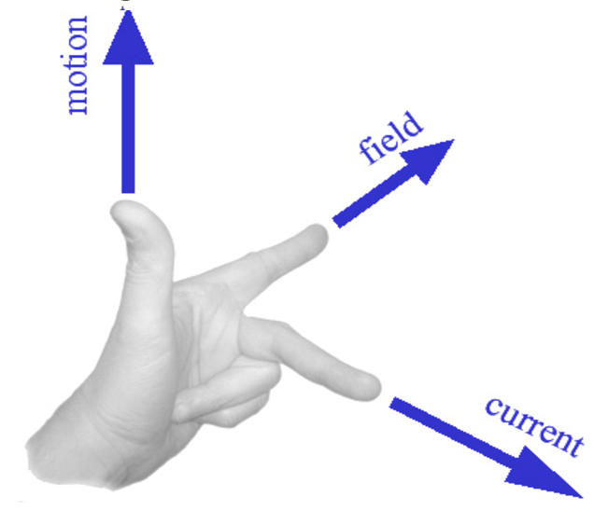
Principle of Operation of IM …
The direction of force can be found out by Fleming’s right hand rule.
Due to this force, rotor will move continuously in the direction of rotating magnetic field of stator.
Force
Flux
Force on armature conductor by Fleming’s Right hand rule
Fleming’s Left hand rule

Slide 19
Why induction motor can’t run at synchrony speed
The magnitude of rotor induced emf, current and the torque developed, depends upon the relative motion between stator magnetic filed and rotor conductor.
In case the relative speed is zero i.e rotor rotates with synchronous speed, rotor induced emf, current & torque developed will become zero.
So rotor will not rotate.
Induction motor (rotor) rotates with a speed which slightly less then the synchronous speed.

Slide 20
How to reverse direction of rotation of 3-$φ$ induction motor?
The direction of rotation of 3-$φ$ induction motor depends upon the directing of rotation of stator magnetic field.
The direction of rotation of stator magnetic field depends upon the phase sequence applied to stator winding.
If phase sequence is changed (by interchanging any two terminals of stator), the direction of rotation of stator magnetic field will also change.
So direction of rotation of induction motor will change.

Slide 21
Synchronous speed
The speed given by following relationship is know as synchronous speed
$$N_{s}=\frac{120f}{P} RPM$$
f = frequency (Hz)
P = Number of poles
This is the speed of stator rotating magnetic field.

Slide 22
Slip (s)
It is defined as the difference between synchronous speed and the rotor speed divided by synchronous speed.
% slip $s=\frac{N_{s}−N}{N_{s}}×100$ $(2\% to 5\%)$
${ N}_{s}=Synchronus Speed \left(RPM\right)$
$$N=Rotor Speed (RPM)$$
Note:
if the rotor runs at synchronous speed s = 0
if the rotor is stationary s = 1

Slide 23
Induction Motors and Transformers
Both IM and transformer works on the principle of induced voltage
Transformer: voltage applied to the primary windings produce an induced voltage in the secondary windings
Induction motor: voltage applied to the stator windings produce an induced voltage in the rotor windings
The difference is that, in the case of the induction motor, the secondary windings can move
Due to the rotation of the rotor (the secondary winding of the IM), the induced voltage in it does not have the same frequency of the stator (the primary) voltage

Slide 24
Frequency of rotor induced EMF
The frequency of the voltage induced in the rotor is given by
$$f_{r}=\frac{P\left(N_{s}−N\right)}{120}$$
$$f_{r}=\frac{P\left(sN_{s}\right)}{120}=s\frac{PN_{s}}{120}=sf$$
$$f_{r}=sf$$
$$f=Stator frequency$$
When the rotor is blocked s=1 , ${⇒f}_{r}=f$
if the rotor runs at synchronous speed, s = 0, ${⇒f}_{r}=0$

Slide 25
Rotor Induced EMF
At stand still
$\frac{E_{2}}{E_{1}}=\frac{N_{2}}{N_{1}}$ (similar to transformer)
Where
$E_{2}=Rotor induced EMF$
$E_{1}=Stator Voltage$
$$N_{2}=Rotor Number of truns per phase$$
$$N_{1}=Stator Number of truns per phase$$

Slide 26
Rotor Induced EMF…
So rotor induced EMF per phase
$$E_{2}=\frac{N_{2}}{N_{1}}×E_{1}$$
At any slip ‘s’, induced EMF per phase
$$={sE}_{2}$$

Slide 27
Rotor current and power factor
At standstill
Let
$$R_{2}=Rotor resistance per phase$$
$$X_{2}=Rotor reactance per phase$$
$$E_{2}=Rotor induced EMF per phase$$

Slide 28
Rotor current and power factor …
So rotor equivalent circuit will be
$$R_{2}$$
$$E_{2}$$
$$X_{2}$$
Rotor Equivalent Circuit at Standstill

Slide 29
Rotor current and power factor …
Rotor Impedance per phase
$$Z_{2}=\sqrt{R_{2}^{2}+X_{2}^{2}}−−−(1)$$
Rotor current per phase
$$I_{2}=\frac{E_{2}}{Z_{2}}=\frac{E_{2}}{\sqrt{R_{2}^{2}+X_{2}^{2}}}−−−(2)$$
Rotor power factor
$$cos∅_{2}=\frac{R_{2}}{Z_{2}}=\frac{R_{2}}{\sqrt{R_{2}^{2}+X_{2}^{2}}}−−−(3)$$

Slide 30
Rotor current and power factor …
At any slip ‘s’
$$R_{2}=Rotor resistance per phase$$
$${sX}_{2}=Rotor reactance per phase$$
$${sE}_{2}=Rotor induced EMF per phase$$

Slide 31
Rotor current and power factor …
So rotor equivalent circuit will be
$$R_{2}$$
$${sE}_{2}$$
$${sX}_{2}$$
Rotor Equivalent Circuit at any slip (s)

Slide 32
Rotor current and power factor …
Rotor Impedance per phase
$$Z_{2}=\sqrt{R_{2}^{2}+{\left({sX}_{2}\right)}^{2} }−−−(4)$$
Rotor current per phase
$$I_{2}=\frac{{sE}_{2}}{Z_{2}}=\frac{{sE}_{2}}{\sqrt{R_{2}^{2}+{\left({sX}_{2}\right)}^{2}}}−−−(5)$$
Rotor power factor
$$cos∅_{2}=\frac{R_{2}}{Z_{2}}=\frac{R_{2}}{\sqrt{R_{2}^{2}+{\left({sX}_{2}\right)}^{2}}}−−−(6)$$

Slide 33
Rotor current and power factor …
Equation (5) can be written as
$$I_{2}=\frac{{sE}_{2}}{\sqrt{R_{2}^{2}+{\left({sX}_{2}\right)}^{2}}}$$
$$I_{2}=\frac{E_{2}}{\sqrt{{\left(\frac{R_{2}}{s}\right)}^{2}+{\left(X_{2}\right)}^{2}}}$$
$$I_{2}=\frac{E_{2}}{\sqrt{{\left(\frac{R_{2}}{s}+R_{2}−R_{2}\right)}^{2}+{\left(X_{2}\right)}^{2}}}$$

Slide 34
Rotor current and power factor …
$$I_{2}=\frac{E_{2}}{\sqrt{{\left(\frac{(1−s)}{s}R_{2}+R_{2}\right)}^{2}+{\left(X_{2}\right)}^{2}}}−−−(7)$$
According to eq(7), now the equivalent circuit of rotor will be as shown on next figure, where
$${\frac{(1−s)}{s}R}_{2}=Fictitious Resistance$$
$$I_{2}^{2}{\frac{(1−s)}{s}R}_{2}=Equivalent to Mechanical Load on Motor$$

Slide 35
Rotor current and power factor …
$$R_{2}$$
$$X_{2}$$
$${\frac{(1−s)}{s}R}_{2}$$
$$E_{2}$$
Rotor Equivalent Circuit at any slip (s)

Slide 36
Rotor Torque(T)
Rotor torque will proportional to the followings
Rotor current per phase $\left(I_{2}\right)$
Stator flux per phase $\left(φ\right)$
Rotor power factor $\left(Cos φ_{2}\right)$
$${T∝φI}_{2}Cos φ_{2}$$
$φ∝E_{1}$ (Stator voltage per phase)
$∝E_{2}$ (Rotor voltage per phase, $\frac{E_{2}}{E_{1}}=\frac{N_{2}}{N_{1}}=k$)

Slide 37
Rotor Torque(T) …
$${T=k E_{2}I}_{2}Cos φ_{2}−−−(1)$$
Torque under running condition (at any slip ‘s’):
We know
$$I_{2}=\frac{{sE}_{2}}{\sqrt{R_{2}^{2}+{\left({sX}_{2}\right)}^{2}}}$$
$$cos∅_{2}=\frac{R_{2}}{\sqrt{R_{2}^{2}+{\left({sX}_{2}\right)}^{2}}}$$
Put these values in eq(1)

Slide 38
Rotor Torque(T) …
$$T=kE_{2}\left(\frac{{sE}_{2}}{\sqrt{R_{2}^{2}+{\left({sX}_{2}\right)}^{2}}}\right)\left(\left(\frac{R_{2}}{\sqrt{R_{2}^{2}+{\left({sX}_{2}\right)}^{2}}}\right)\right)$$
$$⇒T=\frac{ksR_{2}E_{2}^{2}}{R_{2}^{2}+s^{2}X_{2}^{2}}−−−\left(2\right)$$
Starting torque:
At starting slip s=1, put in eq(2)
$$⇒T_{st}=\frac{kR_{2}E_{2}^{2}}{R_{2}^{2}+X_{2}^{2}}−−−\left(3\right)$$

Slide 39
Rotor Torque(T) …
Condition for maximum running torque:
Rearrange eq(2)
$$T=\frac{ksR_{2}E_{2}^{2}}{s\left(\frac{R_{2}^{2}}{s}+sX_{2}^{2}\right)}$$
$$⇒T=\frac{kR_{2}E_{2}^{2}}{\left(\frac{R_{2}^{2}}{s}+sX_{2}^{2}\right)}$$

Slide 40
Rotor Torque(T) …
$T=\frac{kR_{2}E_{2}^{2}}{{\left(\frac{R_{2}}{\sqrt{s}}−\sqrt{s}X_{2}\right)}^{2}+2R_{2}X_{2}}$ ----(4)
0, for maxi torque
So $\frac{R_{2}}{\sqrt{s}}−\sqrt{s}X_{2}=0$
$$⇒s=\frac{R_{2}}{X_{2}}−−−(5)$$

Slide 41
Rotor Torque(T) …
So maximum torque
$$T_{max}=\frac{kR_{2}E_{2}^{2}}{2R_{2}X_{2}}$$
$T_{max}=\frac{kE_{2}^{2}}{2X_{2}}−−−(6)$
It is independent of $R_{2}$
Condition for maximum starting torque: put s=1 in eq(5)
$s=\frac{R_{2}}{X_{2}}=1$ ${⇒R}_{2}=X_{2}$

Slide 42
Torque-Speed & Torque-Slip Characteristics
We know
$T=\frac{ksR_{2}E_{2}^{2}}{R_{2}^{2}+s^{2}X_{2}^{2}}$
When s = 0, T = 0
When s is low $T∝s$ ${Neglecting s}^{2}X_{2}^{2} \left(∵s^{2}X_{2}^{2}≪R_{2}\right)$
When s is high $T∝\frac{1}{s}$ $Neglecting R_{2}\left(∵s^{2}X_{2}^{2}≫R_{2}\right)$
So torque-slip characteristic will be

Slide 43
Torque-Speed & Torque-Slip Characteristics…
Operating Region
Unstable Region
Torque
Torque
$$R_{2}^{′′′}$$
Maxi Torque
$$R_{2}^{′′}$$
$$R_{2}^{′}$$
$$R_{2}$$
Starting Torque
$$R_{2}^{′′′}>R_{2}^{′′}>R_{2}^{′}>R_{2}$$
0
Slip s $→$
1
$$N_{s}$$
$←$Speed
0

Slide 44
Need of starter in 3 phase IM
At the instant of starting, a 3-phase induction motor is like a transformer whose secondary side is short circuited (slip s=1).
Induced EMF in rotor winding $={sE}_{2}=E_{2}$ (Very large)
Large voltage in rotor will results in large current in rotor winding.
This is circulate large current in stator winding (4 to 5 times of rated current).
That is why it draws a heavy current at the time of starting.
The aim of starter is to reduce this heavy starting current.
This can be achieved by reducing the applied voltage at the time of starting.

Slide 45
Questions
Q1. A 3-phase induction motor runs at 1140 rpm at full load when supplied with power from a 60 Hz, 3-phase line, calculate
No of poles.
Slip at full load.
Frequency of rotor voltage.
Speed of rotor field with respect to rotor.
Speed of rotor field with respect to stator and stator field.
Speed of rotor at a slip of 10% and rotor frequency at this speed.
If the applied voltage per phase is 230 V, find the rotor induced emf at stand still and at 10% slip, with stator to rotor turn ration of 1: 0.5
(Ans: - (i) 1200 rpm, (ii) 5% (iii) 3 Hz (iv) 60 rpm (v) 0 rpm (vi) 1080 rpm, (vii) 11.5 V)

Slide 46
Thanks

