Slide 1
Compensation Techniques
By: Nafees Ahamad
AP, Department of EECE, DIT University,
Dehradun

Slide 2
Introduction
Control system compensation is the strategy used by the control system designer to improve system dynamic performance through the addition of dynamic elements in order to mitigate some of the undesirable features of the control elements present in the system.

Slide 3
Need of Compensation
In order to obtain the desired performance of the system, we use compensating networks.
Compensate a unstable system to make it stable.
A compensating network is used to minimize overshoot.
These compensating networks increase the steady state accuracy of the system. An important point to be noted here is that the increase in the steady state accuracy brings instability to the system.
Compensating networks also introduces poles and zeros in the system thereby causes changes in the transfer function of the system. Due to this, performance specifications of the system change.

Slide 4
Methods of Compensation
Series compensation:
Input
G(s)
Output
Compensator
r(t)
c(t)
H(s)

Slide 5
Methods of Compensation …
Feedback compensation:
Input
G(s)
Output
r(t)
c(t)
Compensator
H(s)

Slide 6
Methods of Compensation …
Load compensation: $⇒$ Series + Feedback
Input
G(s)
Output
Compensator
r(t)
c(t)
Compensator
H(s)

Slide 7
Methods of Compensation …
Now what are compensator?
A compensator or compensating network is one which makes some adjustments in order to make up for deficiencies in the system.
Compensating devices are may be in the form of electrical, mechanical, hydraulic etc.
The simplest compensating networks are lead, lag and lead-lag networks.

Slide 8
Phase Lead Compensation
A system which has one pole and one dominating zero is known as lead network.
If we want to add a dominating zero for compensation in control system then we have to select lead compensation network.
The basic requirement of the phase lead network is that all poles and zeros of the transfer function of the network must lie on (-)ve real axis interlacing each other with a zero located at the origin or nearest origin.

Slide 9
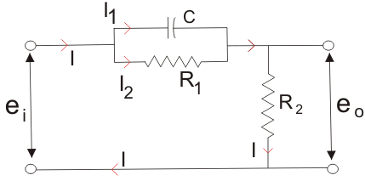
Phase Lead Compensation…
From the circuit diagram
$I_{1}=C\frac{d}{dt}\left(e_{i}−e_{0}\right)$
$I_{2}=\frac{e_{i}−e_{0}}{R_{1}}$
$I=I_{1}+I_{2}=C\frac{d}{dt}\left(e_{i}−e_{0}\right)+\frac{e_{i}−e_{0}}{R_{1}}$
And $I=\frac{e_{0}}{R_{2}}$, So,
$\frac{e_{0}}{R_{2}}=C\frac{d}{dt}\left(e_{i}−e_{0}\right)+\frac{e_{i}−e_{0}}{R_{1}}$

Slide 10
Phase Lead Compensation…
So taking Laplace transform of both side of above equations
$\frac{E_{0}(s)}{R_{2}}=Cs\left(E_{i}(s)−E_{0}(s)\right)+\frac{E_{i}(s)−E_{0}(s)}{R_{1}}$
$⇒\frac{E_{0}(s)}{E_{i}(s)}=\frac{\frac{1+sCR_{1}}{R_{1}}}{\frac{R_{1}+R_{2}+sR_{1}R_{2}C}{R_{1}R_{2}}}$
$⇒\frac{E_{0}(s)}{E_{i}(s)}=\frac{R_{2}}{R_{1}+R_{2}}\left[\frac{1+sCR_{1}}{1+\frac{sR_{1}R_{2}C}{R_{1}+R_{2}}}\right]$
$⇒\frac{E_{0}(s)}{E_{i}(s)}=\frac{1}{α}\left[\frac{1+αsT}{1+sT}\right]−−−(1)$
Put $α=\frac{R_{1}+R_{2}}{R_{2}}>1$ and $T=\frac{R_{1}R_{2}}{R_{1}+R_{2}}C$
$α=Attenuation Constanat$,
T = Time constant

Slide 11
Phase Lead Compensation…
The above network can be visualized as an amplifier with a gain of 1/α.
Clearly -1/T (Zero) is closer to origin than the -1/αT (Pole).
Thus we can say in the lead compensator zero is more dominating than the pole.
Because of this lead network introduces positive phase angle to the system when connected in series.
Im
-1/T
-1/αT
Re
Pole-Zero Plot of Lead Compensating Network

Slide 12
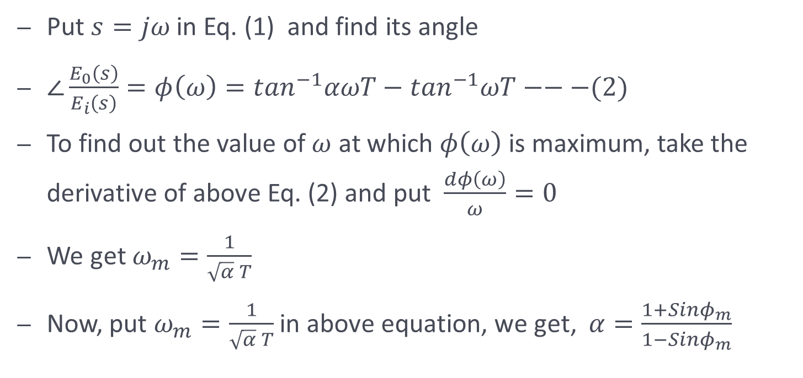
Phase Lead Compensation…
Put $s=jω$ in Eq. (1) and find its angle
$∠\frac{E_{0}\left(s\right)}{E_{i}\left(s\right)}=φ\left(ω\right)=\tan^{−1}αωT−\tan^{−1}ωT−−−(2)$
To find out the value of $ω$ at which $φ\left(ω\right)$ is maximum, take the derivative of above Eq. (2) and put $\frac{dφ\left(ω\right)}{ω}=0$
We get $ω_{m}=\frac{1}{\sqrt{α} T}$
Now, put $ω_{m}=\frac{1}{\sqrt{α} T}$ in above equation, we get, $α=\frac{1+Sinφ_{m}}{1−Sinφ_{m}}$

Slide 13
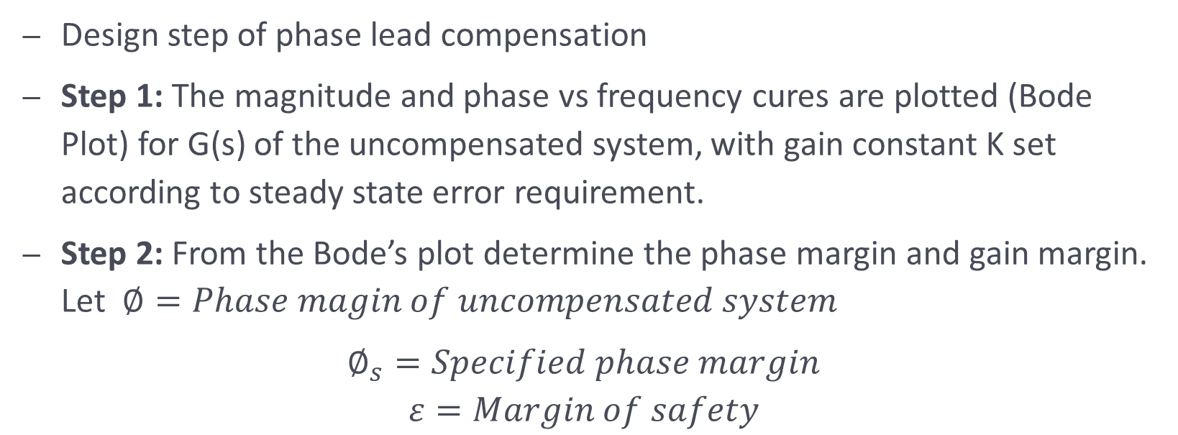
Design steps of Phase Lead Compensation in frequency domain
Design step of phase lead compensation
Step 1: The magnitude and phase vs frequency cures are plotted (Bode Plot) for G(s) of the uncompensated system, with gain constant K set according to steady state error requirement.
Step 2: From the Bode’s plot determine the phase margin and gain margin. Let $∅=Phase magin of uncompensated system$
$∅_{s}=Specified phase margin$
$$ε=Margin of safety$$

Slide 14
Design steps of Phase Lead Compensation in frequency domain …
Then, $∅_{m}=∅_{s}−∅+ε$
If $∅_{m}>{60}^{0}$, two identical network each contributing maximum phase lead of $∅_{m}/2$ are used.
Step 3: Use $α=\frac{1+Sinφ_{m}}{1−Sinφ_{m}}$ and calculate $α$.
Step 4: Calculate $ω_{m}$ at which uncompensated system will have a gain equal to $−10logα$.

Slide 15
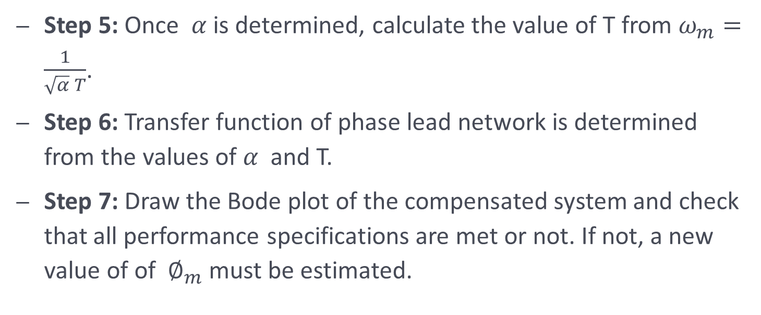
Design steps of Phase Lead Compensation in frequency domain …
Step 5: Once $α$ is determined, calculate the value of T from $ω_{m}=\frac{1}{\sqrt{α} T}$.
Step 6: Transfer function of phase lead network is determined from the values of $α$ and T.
Step 7: Draw the Bode plot of the compensated system and check that all performance specifications are met or not. If not, a new value of of $∅_{m}$ must be estimated.

Slide 16
Effect of Phase Lead Compensation
The velocity constant K_{v} increases.
The slope of the magnitude plot reduces at the gain crossover frequency so that relative stability improves and error decrease due to error is directly proportional to the slope.
Phase margin increases.
Response become faster.

Slide 17
Advantages of Phase Lead Compensation
Let us discuss some of the advantages of the phase lead compensation-
Due to the presence of phase lead network the speed of the system increases because it shifts gain crossover frequency to a higher value.
Due to the presence of phase lead compensation maximum overshoot of the system decreases.
Steady state error is not improved (Disadvantage)

Slide 18
Phase Lag Compensation
Do it yourself
Similar to Phase Lead Compensation

Slide 19
Phase Lead-Lag Compensation
Do it yourself
Similar to Phase Lead Compensation

Slide 20
Referecnes
Automatic control system by S. Hasan Saeed, Katson Publications

Slide 21
Thanks

