Slide 1
Control System and Transfer Function
By: Nafees Ahamad,
AP, EECE, Dept.
DIT University, Dehradun

Slide 2
Open Loop Control System
Input
Control System
Output
r(t)
c(t)
Faithfulness of an open loop control system depends on the accuracy of the input

Slide 3
Closed Loop Control System (Feedback Control System)
Input
Error
Control System
Output
r(t)
e(t)
c(t)
Feedback System
The control action is actuated by an error signal e(t).
A control system without involving human intervention for normal operation is called automatic control system.

Slide 4
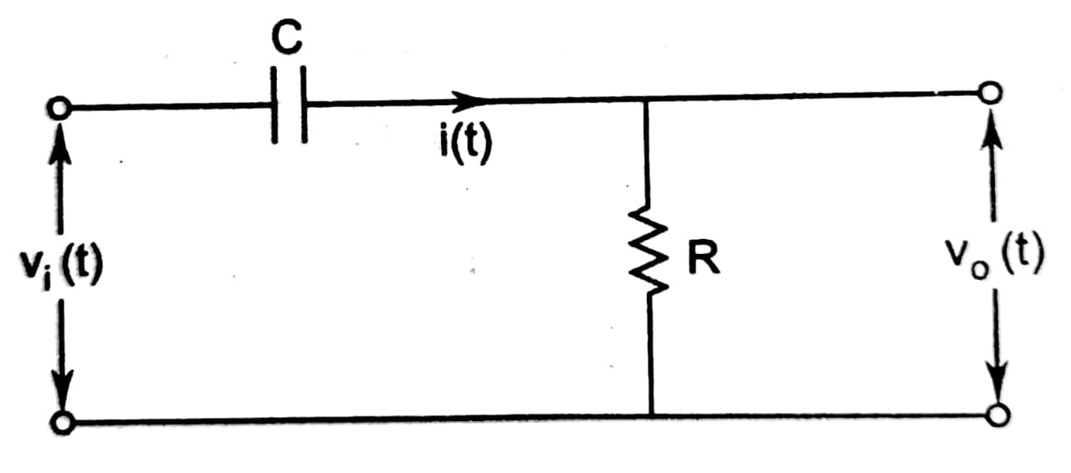
Transfer Function
Example 1: Determine V_{o}(s)/V_{i}(s) of the following circuit.

Slide 5

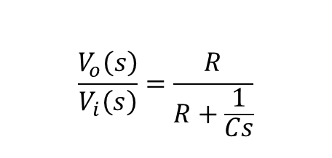

Transfer Function …
$$v_{i}\left(t\right)=Ri\left(t\right)+\frac{1}{C}\int{i\left(t\right)dt}$$
$$V_{i}\left(s\right)=RI\left(s\right)+\frac{1}{Cs}I(s)$$
Laplace Transform
$$\frac{V_{o}\left(s\right)}{V_{i}\left(s\right)}=\frac{R}{R+\frac{1}{Cs}}$$
$$V_{o}\left(s\right)=RI\left(s\right)$$
$$v_{o}\left(t\right)=Ri\left(t\right)$$
$\frac{V_{o}\left(s\right)}{V_{i}\left(s\right)}$ is known as transfer function

Slide 6
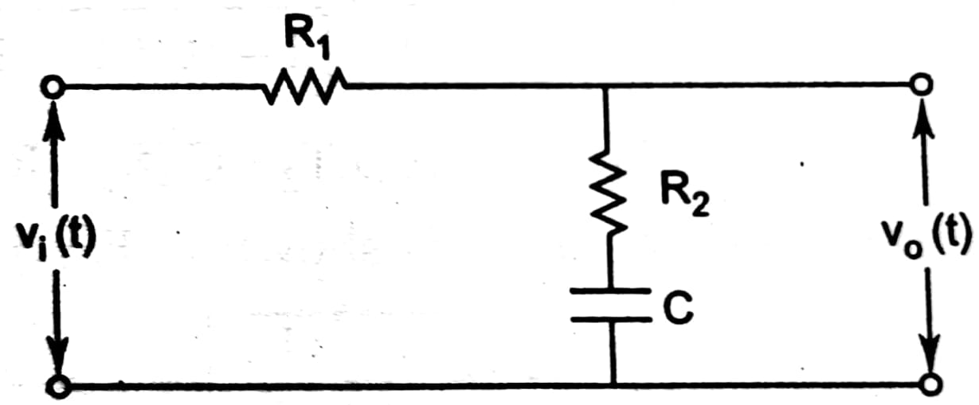
Transfer Function …
Example 2: Determine Vo(s)/V_{i}(s) of the following circuit.

Slide 7
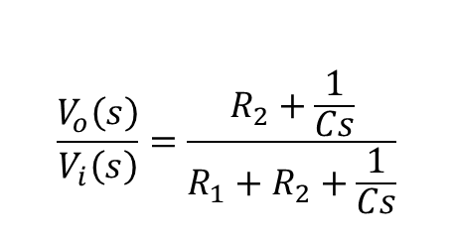
Transfer Function …
$$v_{i}\left(t\right)=R_{1}i\left(t\right)+R_{2}i\left(t\right)+\frac{1}{C}\int{i\left(t\right)dt}$$
$$\frac{V_{o}\left(s\right)}{V_{i}\left(s\right)}=\frac{R_{2}+\frac{1}{Cs}}{{R_{1}+R}_{2}+\frac{1}{Cs}}$$
$$v_{o}\left(t\right)=R_{2}i\left(t\right)+\frac{1}{C}\int{i\left(t\right)dt}$$

Slide 8
Transfer Function
Input
System g(t)
Output
$g\left(t\right)=\frac{c(t)}{r(t)}$
r(t)
c(t)
$In term of Laplace transform$
Input
System G(s)
Output
G$\left(s\right)=\frac{C(s)}{R(s)}$
R(s)
C(s)
So, Tranfer function, $\text{G}\text{(}\text{s}\text{)=}{\left.\frac{ℒ c(t)}{ℒ r(t)}\right|}_{initial conditions=0}$

Slide 9
Poles and Zeros
Let a transfer function is given as
$G\left(s\right)=\frac{7(s+2)(S+4)}{s(s+3)(s+5)(s+2−j4)(s+2+j4)}$
Poles: s = 0, -3, -5, -2+j4, -2-j4 (5 poles)
Zeros: s = -2, -4 (2 zeros)
7 is known as gain factor denoted by K.

Slide 10
Poles and Zeros …
+jω
Note:
If poles and zeros are complex, they will be in conjugate
No of poles = No of zeros
In the above example, three zeros are at $s=∞$
Transient behavior depends on poles and zeros
Poles + Zeros + Gain Constant (K) completely define a system (differential equation)
-2+j4
+j4
-4
-2
-5
-3
0
+σ
-2-j4
-j4
Pole-Zero Diagram

Slide 11
Thanks

