Slide 1
Artificial Neural Network
By: Nafees Ahamad,
AP, EECE Deptt, DIT University
Dehradun

Slide 2
References
Book: Principles of soft computing 2nd edition By S. N. Sivanadan & S.N. Deepa, Wiley Publication
NPTEL: Online Course on “ Introduction to soft computing” by Prof Debasis Samanta, IIT Kharagpur.

Slide 3
NN or ANN architecture

Slide 4
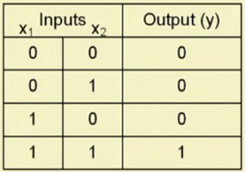
“And” problem and its neural network

Slide 5
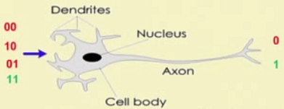
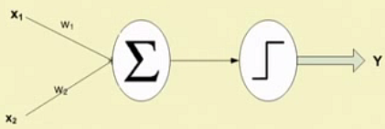
“And” problem and its neural network …

Slide 6
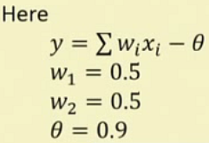
“And” problem and its neural network …
$$I=0.5×x_{1}+0.5×x_{2}$$
0/1
w₁=0.5
$φ$(I)
0/1
w₂=0.5
Threshold Value $θ=0.9$
Single Neuron

Slide 7
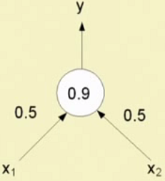
“And” problem and its neural network …
A Single Neuron (Perceptron) for AND Gate can also be represented as follows
How do we select ?
w₁, w₂ & $θ$
(Known as Learning)
Same way, we can design other Gate also

Slide 8
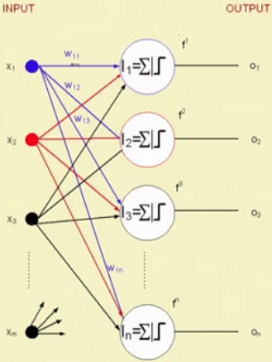
Single layer feedforward neural network (SLFFNN)
n Outputs
m Inputs

Slide 9
SLFFNN…

Slide 10
SLFFNN: Mathematical model
Learning =>
Find out $f_{k},W_{ik} \& θ_{k}$
Matrix calculations

Slide 11
Multilayer feed forward neural network

Slide 12
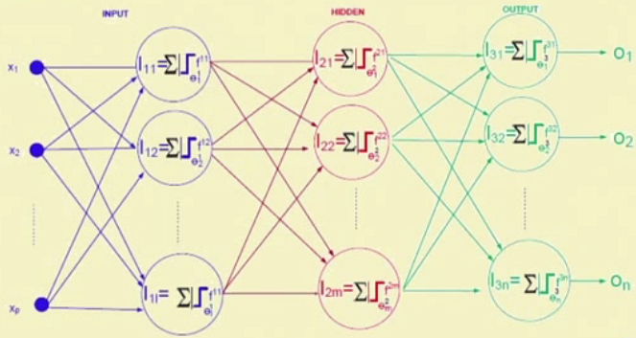
Multilayer feed forward neural network (mlffnn)…

Slide 13
Mlffnn…

Slide 14
Recurrent neural network

Slide 15
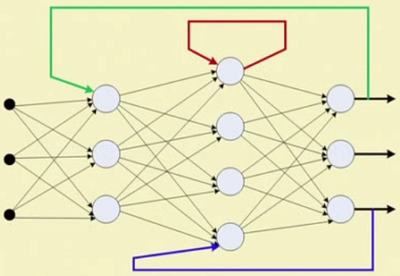
Recurrent neural network…
Note:
No of inputs to each perceptron will increase

Slide 16
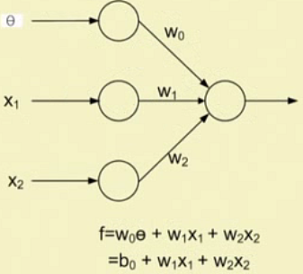
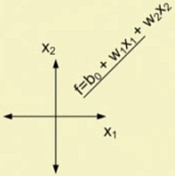
Why different types of nn architecture ?
$$θ=Threshold Input$$
$$b_{0}=Biased Input$$

Slide 17
Revisit of a single neuron network

Slide 18
And problem is linearly separable

Slide 19
Xor problem is linearly non-separable

Slide 20
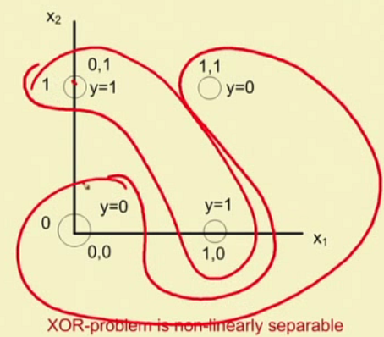
Xor problem is linearly non-separable …

Slide 21
Xor problem is linearly non-separable …

Slide 22
conclusion

Slide 23
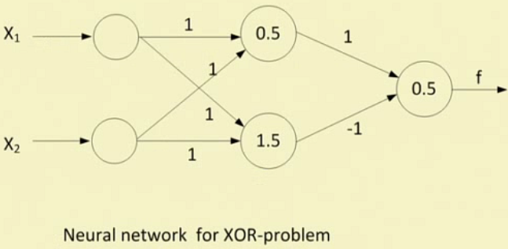
Solving xor problem
It is 2 layer ANN

Slide 24
Dynamic neural network

Slide 25
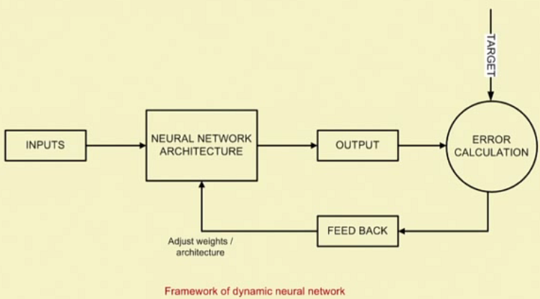
Dynamic neural network…

Slide 26
Dynamic neural network…

Slide 27
MCculloch-pitts neuron
McCulloch-Pitts (MP) neuron was the earliest neuron discovered in 1943 by McCulloch and Pitts.
Activation of MP neuron is binary, that is neuron may fire or may not fire (0 or 1).
The weights may be excitatory (+ve) or inhibitory (-ve).
All excitatory (+ve) weights entering at particular neuron will have same value.
There is a fixed threshold for each neuron, and if the net input to the neurons is greater than the threshold then the neuron fires.
Any nonzero inhibitory (-ve) weight will prevent neuron to be fired.
The MP neurons are most widely used in logic functions (AND, OR etc)

Slide 28
MCculloch-pitts neuron: architecture (MP neuron Model)
x₁
X₁
x₂
X₂
w
w
x_{n}
X_{n}
w
Y
y
-p
x_{n+1}
X_{n+1}
-p
x_{n+m}
X_{n+m}

Slide 29
MCculloch-pitts neuron
Activation function for MP neuron is
And $θ>nw−p$
$$f\left(y\right)=\left\{\begin{matrix}1 if y≥θ \\ 0 if y<θ\end{matrix}\right.$$

Slide 30
Thank you

