Slide 1
Block Diagrams
By: Nafees Ahamad,
AP, EECE, Dept.
DIT University, Dehradun

Slide 2
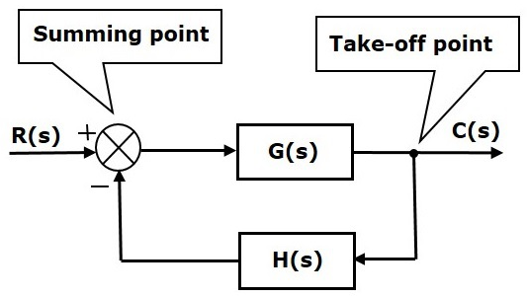
Block Diagrams
Block diagrams consist of a single block or a combination of blocks. These are used to represent the control systems in pictorial form.
Basic Elements of Block Diagram

Slide 3
Block
Transfer function

Slide 4
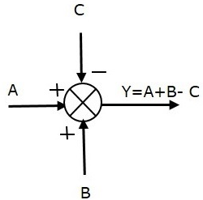
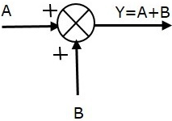
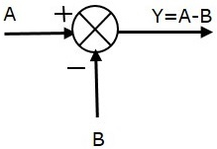
Summing Points
Sum of A & B
Difference of A & B
Combination

Slide 5
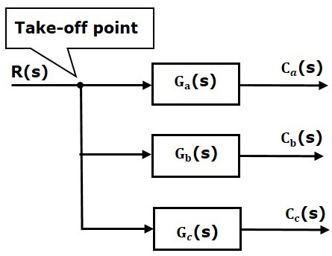
Take-off Point
$$C_{a}\left(s\right)=G_{a}\left(s\right)R(s)$$
$$C_{b}\left(s\right)=G_{b}\left(s\right)R(s)$$
$$C_{c}\left(s\right)=G_{c}\left(s\right)R(s)$$

Slide 6
Take-off Point …
Where is take-off point ?

Slide 7
Basic Connections for Blocks
There are three basic types of connections between two blocks.
Series Connection
Parallel Connection
Feedback Connection

Slide 8
Series Connection

Slide 9
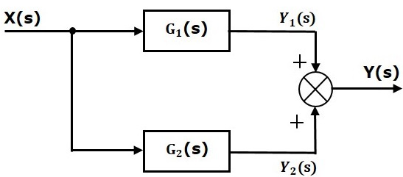
Parallel Connection

Slide 10
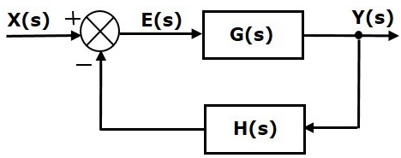
Feedback Connection
Negative feedback connection
E(s)=X(s)−H(s)Y(s)
Y(s)=E(s)G(s)
Substitute E(s) value in the above equation.
Y(s)={X(s)−H(s)Y(s)}G(s)}
Y(s){1+G(s)H(s)}=X(s)G(s)}
$⟹\frac{Y(s)}{X(s)}=\frac{G(s)}{1+G\left(s\right)H(s)}$
What about Positive feedback connection ?

Slide 11
Block Diagram Algebra for Summing Points
There are two possibilities of shifting summing points with respect to blocks
Shifting summing point after the block
Shifting summing point before the block

Slide 12
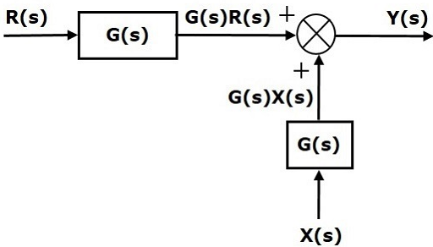
Shifting summing point after the block

Slide 13
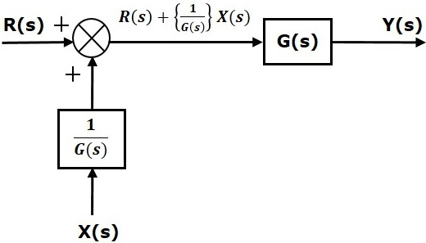
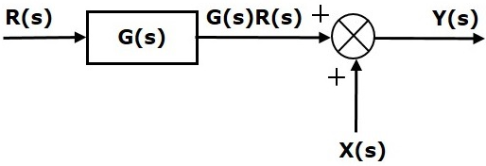
Shifting summing point before the block

Slide 14
Block Diagram Algebra for Take-off Points
There are two possibilities of shifting the take-off points with respect to blocks
Shifting take-off point after the block
Shifting take-off point before the block

Slide 15
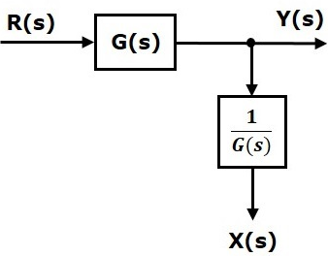
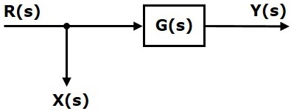
Shifting take-off point after the block

Slide 16
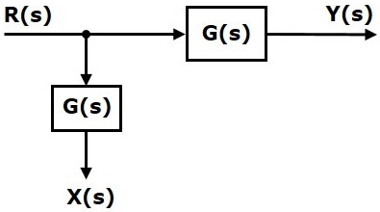
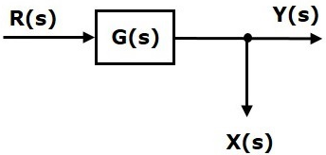
Shifting Take-off Point Before the Block

Slide 17
Block Diagram Reduction Rules
Follow these rules for simplifying (reducing) the block diagram, which is having many blocks, summing points and take-off points.
Rule 1 − Check for the blocks connected in series and simplify.
Rule 2 − Check for the blocks connected in parallel and simplify.
Rule 3 − Check for the blocks connected in feedback loop and simplify.
Rule 4 − If there is difficulty with take-off point while simplifying, shift it towards right.
Rule 5 − If there is difficulty with summing point while simplifying, shift it towards left.
Rule 6 − Repeat the above steps till you get the simplified form, i.e., single block.

Slide 18
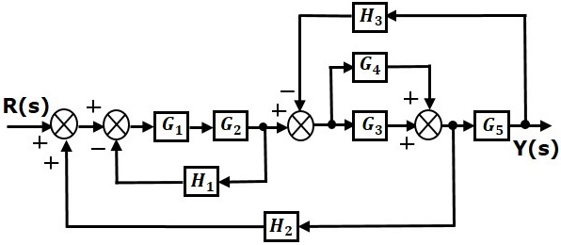
Example
Consider the block diagram shown in the following figure. Let us simplify (reduce) this block diagram using the block diagram reduction rules.
Series
Parallel

Slide 19
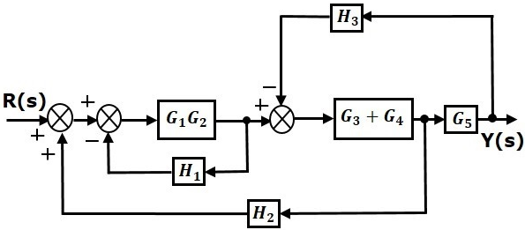
Example …
Step 1: Use Rule 1 for blocks G1 and G2. Use Rule 2 for blocks G3 and G4. The modified block diagram is shown in the following figure.
Feedback
Shift

Slide 20
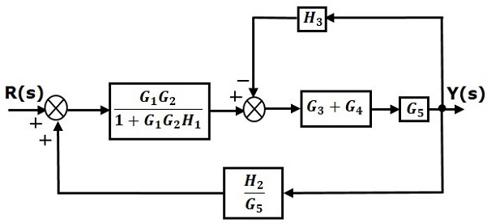
Example …
Step 2 − Use Rule 3 for blocks G1G2 and H1. Use Rule 4 for shifting take-off point after the block G5. The modified block diagram is shown in the following figure.
Series

Slide 21
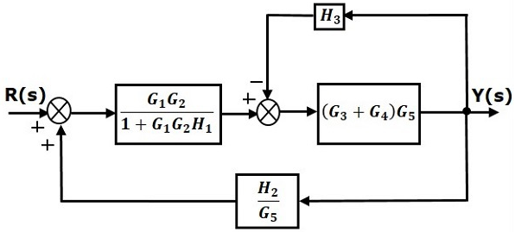
Example …
Step 3 − Use Rule 1 for blocks (G3+G4) and G5. The modified block diagram is shown in the following figure.
Feedback

Slide 22
Example …
Step 4 − Use Rule 3 for blocks (G3+G4)G5 and H3. The modified block diagram is shown in the following figure.
Series

Slide 23
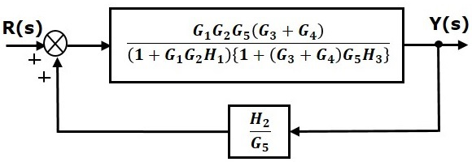
Example …
Step 5 − Use Rule 1 for blocks connected in series. The modified block diagram is shown in the following figure.
+Ve Feedback

Slide 24
Example …
Step 6 − Use Rule 3 for blocks connected in feedback loop. The modified block diagram is shown in the following figure. This is the simplified block diagram.
So, .

Slide 25
Thanks

