Slide 1
Vector Calculus and Quadratic function

Slide 2
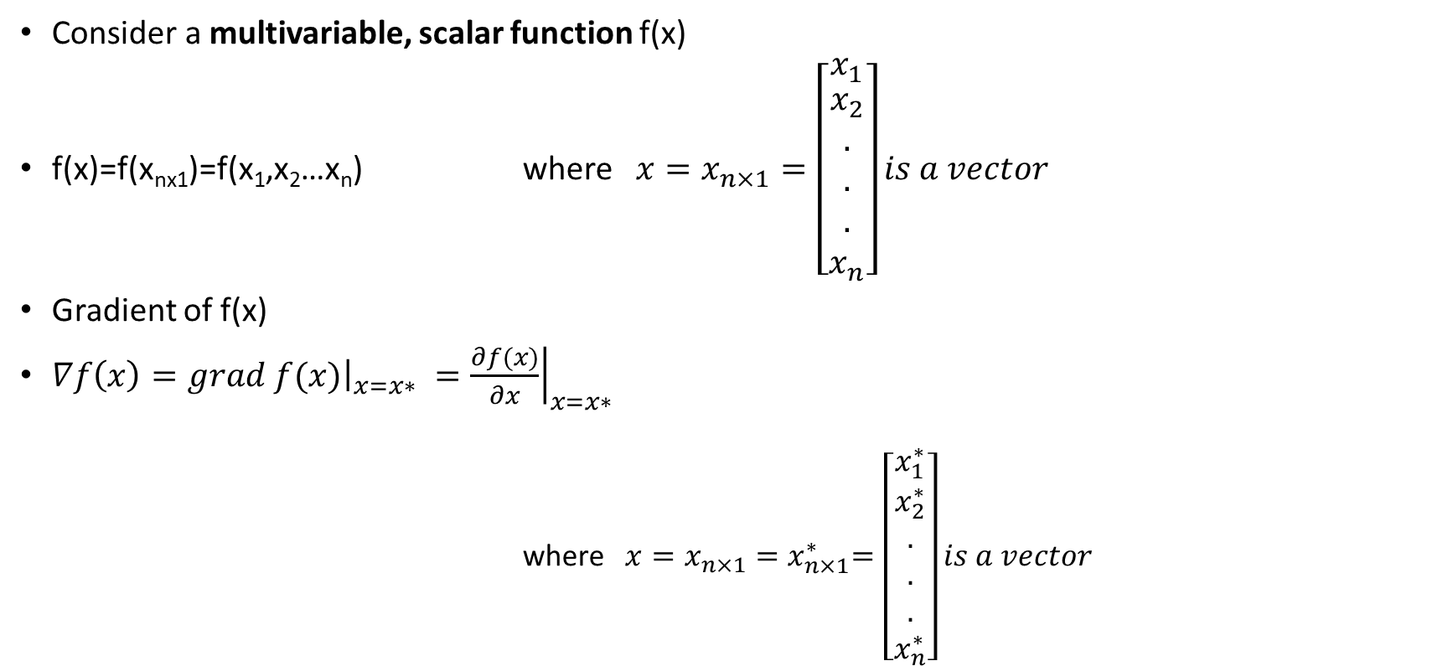
Gradient of a function
Consider a multivariable, scalar function f(x)
f(x)=f(x_{nx1})=f(x₁,x₂…x_{n}) where ${x=x}_{n×1}=\left[\begin{matrix}x_{1} \\ \begin{aligned}x_{2} \\ . \\ . \\ . \\ x_{n}\end{aligned}\end{matrix}\right]is a vector$
Gradient of f(x)
$∇f\left(x\right)={\left.grad f(x)\right|}_{x=x∗ }={\left.\frac{∂f(x)}{∂x}\right|}_{x=x∗ }$
where ${x=x}_{n×1}{=x}_{n×1}^{∗}=\left[\begin{matrix}x_{1}^{∗} \\ \begin{aligned}x_{2}^{∗} \\ . \\ . \\ . \\ x_{n}^{∗}\end{aligned}\end{matrix}\right]is a vector$

Slide 3
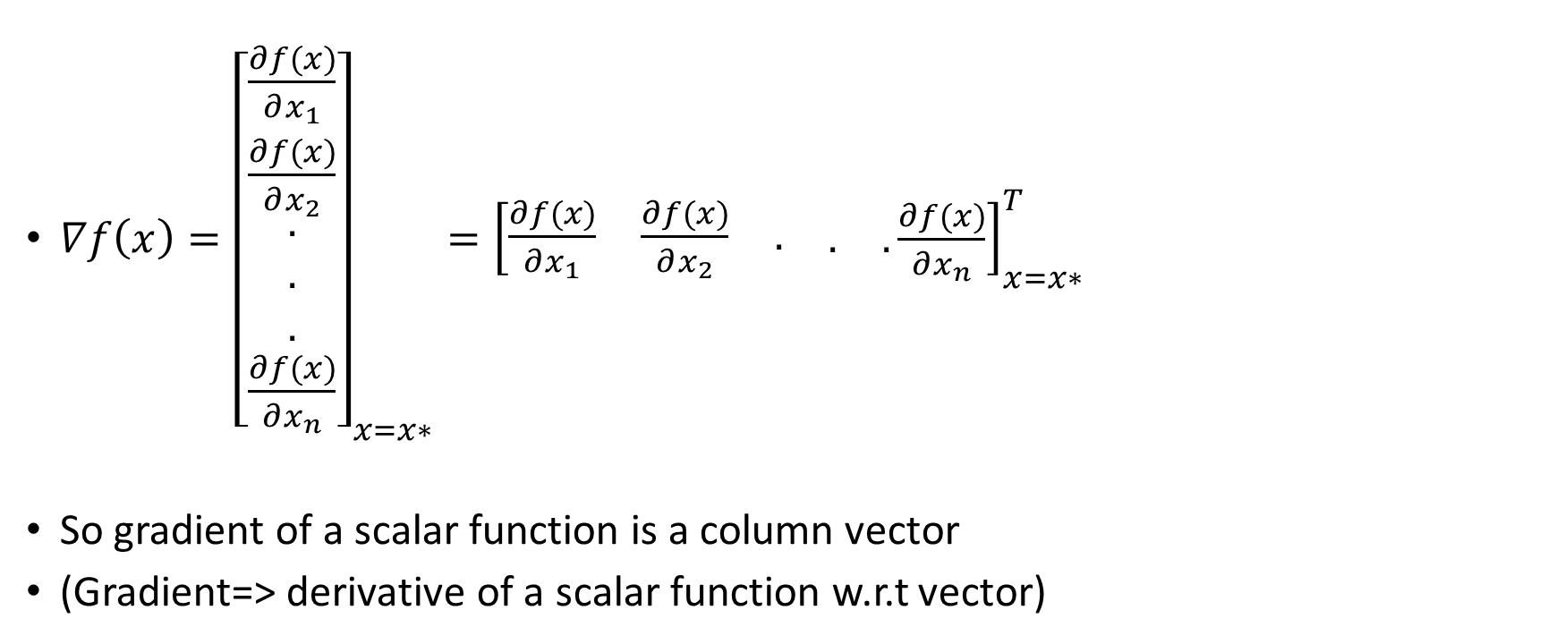
Gradient of a function…
$∇f\left(x\right)={\left[\begin{matrix}\frac{∂f(x)}{∂x_{1}} \\ \frac{∂f(x)}{∂x_{2}} \\ \begin{aligned}. \\ . \\ . \\ \frac{∂f(x)}{∂x_{n}}\end{aligned}\end{matrix}\right]}_{x=x∗}={\left[\begin{matrix}\begin{matrix}\frac{∂f(x)}{∂x_{1}} & \frac{∂f(x)}{∂x_{2}} & .\end{matrix} & . & .\end{matrix}\frac{∂f(x)}{∂x_{n}}\right]}_{x=x∗}^{T}$
So gradient of a scalar function is a column vector
(Gradient=> derivative of a scalar function w.r.t vector)
T→Transpose

Slide 4
Example 1:
Calculate the gradient vector for the function
$f\left(x\right)=x_{1}^{2}+2x_{1}x_{2}+{3x}_{2}^{2}+4x_{1}x_{2}x_{3}+x_{3}^{3}$
at $x_{3×1}={\left[\begin{matrix}1 & 2 & 0\end{matrix}\right]}^{T}$
Solution
$\frac{∂f(x)}{∂x_{1}}=2x_{1}+2x_{2}+4x_{2}x_{3}$
$\frac{∂f(x)}{∂x_{2}}=2x_{1}+6x_{2}+4x_{1}x_{3}$
$\frac{∂f(x)}{∂x_{3}}=4x_{1}x_{2}+3x_{3}^{2}$

Slide 5
Example 1…
So gradient
$∇f\left(x\right)={\left[\begin{matrix}\frac{∂f(x)}{∂x_{1}} \\ \frac{∂f(x)}{∂x_{2}} \\ \frac{∂f(x)}{∂x_{3}}\end{matrix}\right]}_{x=x∗}={\left[\begin{matrix}2x_{1}+2x_{2}+4x_{2}x_{3} \\ 2x_{1}+6x_{2}+4x_{1}x_{3} \\ 4x_{1}x_{2}+3x_{3}^{2}\end{matrix}\right]}_{x=x^{∗}=\left[\begin{matrix}1 & 2 & 0\end{matrix}\right]}=\left[\begin{matrix}6 \\ 14 \\ 8\end{matrix}\right]$
Geometrically , the gradient of a function is normal to the tangent plane at the point x=x*

Slide 6
2nd derivative of a real valued function:
First take the derivative of a function (scalar) that means gradient of a function. Which results into a vector. Now again take the derivate of this vector w.r.t vector which will result into a matrix.
$∇^{2}f\left(x\right)={\left.\frac{∂\frac{∂f(x)}{∂x}}{∂x}\right|}_{x=x∗ }={\left.\frac{∂^{2}f(x)}{{∂x}^{2}}\right|}_{x=x∗}$
$∇^{2}f\left(x\right)=\frac{∂}{∂x}{\left[\begin{matrix}\begin{matrix}\frac{∂f(x)}{∂x_{1}} & \frac{∂f(x)}{∂x_{2}} & .\end{matrix} & . & .\end{matrix}\frac{∂f(x)}{∂x_{n}}\right]}_{x=x∗}^{T}$

Slide 7
2nd derivative of a real valued function…
$∇^{2}f\left(x\right)={\left[\begin{aligned}\begin{matrix}\begin{matrix}\frac{∂^{2}f(x)}{∂x_{1}^{2}} & \frac{∂^{2}f(x)}{∂{x_{1}x}_{2}} & .\end{matrix} & . & .\end{matrix}\frac{∂f(x)}{∂x_{1}x_{n}} \\ \begin{matrix}\begin{matrix}\frac{∂^{2}f(x)}{∂{x_{1}x}_{2}} & \frac{∂^{2}f(x)}{∂x_{2}^{2}} & .\end{matrix} & . & .\end{matrix}\frac{∂f(x)}{∂x_{2}x_{n}} \\ . \\ . \\ . \\ \begin{matrix}\begin{matrix}\frac{∂^{2}f(x)}{∂{x_{1}x}_{n}} & \frac{∂^{2}f(x)}{∂{x_{2}x}_{n}} & .\end{matrix} & . & .\end{matrix}\frac{∂^{2}f(x)}{∂x_{n}^{2}}\end{aligned}\right]}_{x=x^{∗}}$
It is a symmetrical nxn matrix (a_{ij}=a_{ji} i≠j ) and known Hessian Matrix

Slide 8
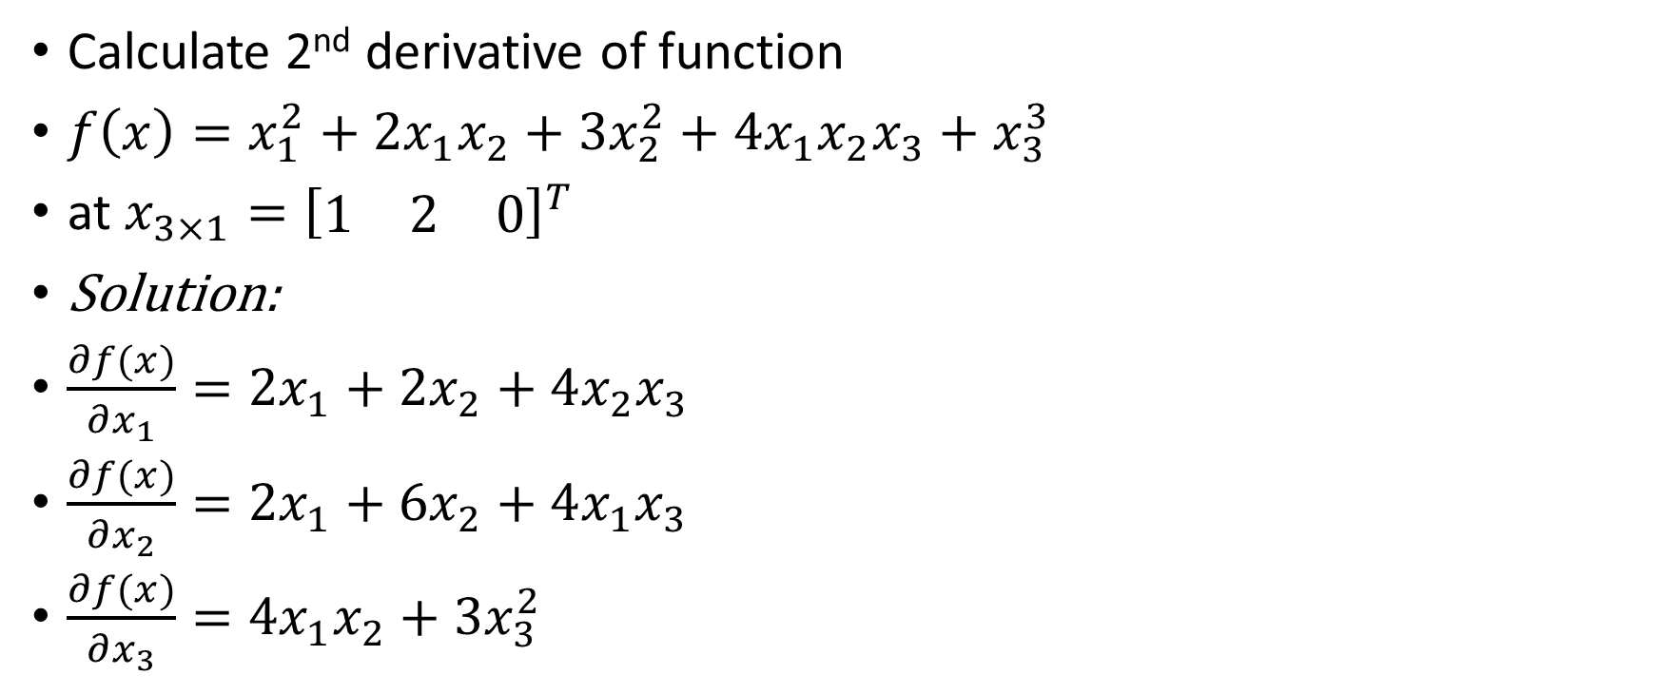
Example 2
Calculate 2nd derivative of function
$f\left(x\right)=x_{1}^{2}+2x_{1}x_{2}+{3x}_{2}^{2}+4x_{1}x_{2}x_{3}+x_{3}^{3}$
at $x_{3×1}={\left[\begin{matrix}1 & 2 & 0\end{matrix}\right]}^{T}$
Solution:
$\frac{∂f(x)}{∂x_{1}}=2x_{1}+2x_{2}+4x_{2}x_{3}$
$\frac{∂f(x)}{∂x_{2}}=2x_{1}+6x_{2}+4x_{1}x_{3}$
$\frac{∂f(x)}{∂x_{3}}=4x_{1}x_{2}+3x_{3}^{2}$

Slide 9

Example 2…
$∇^{2}f\left(x\right)={\left[\begin{aligned}\begin{matrix}\frac{∂^{2}f(x)}{∂x_{1}^{2}} & \frac{∂^{2}f(x)}{∂x_{1}x_{2}} & \frac{∂^{2}f(x)}{∂x_{1}x_{3}}\end{matrix} \\ \begin{matrix}\frac{∂^{2}f(x)}{∂x_{1}x_{2}} & \frac{∂^{2}f(x)}{∂x_{2}^{2}} & \frac{∂^{2}f(x)}{∂x_{2}x_{3}}\end{matrix} \\ \begin{matrix}\frac{∂^{2}f(x)}{∂x_{1}x_{3}} & \frac{∂^{2}f(x)}{∂x_{2}x_{3}} & \frac{∂^{2}f(x)}{∂x_{3}^{2}}\end{matrix}\end{aligned}\right]}_{x=x^{∗}}$

Slide 10

Example 2…
$\frac{∂^{2}f(x)}{∂x_{1}^{2}}=2$
$\frac{∂^{2}f(x)}{∂x_{1}x_{2}}=2+4x_{3}$
$\frac{∂^{2}f(x)}{∂x_{1}x_{3}}=4x_{2}$
$\frac{∂^{2}f(x)}{∂x_{2}^{2}}=6$
$\frac{∂^{2}f(x)}{∂x_{2}x_{3}}=4x_{1}$
$\frac{∂^{2}f(x)}{∂x_{3}^{2}}=6x_{3}$
$$∇^{2}f\left(x\right)={\left[\begin{matrix}2 & 2+4x_{3} & 4x_{2} \\ 2+4x_{3} & 6 & 4x_{1} \\ 4x_{2} & 4x_{1} & 6x_{3}\end{matrix}\right]}_{x=x^{∗}={\left[\begin{matrix}1 & 2 & 0\end{matrix}\right]}^{T}}$$
$$∇^{2}f\left(x\right)=\left[\begin{matrix}2 & 2 & 8 \\ 2 & 6 & 4 \\ 8 & 4 & 0\end{matrix}\right]$$

Slide 11
Quadratic functions
Suppose we have a function of two variables x₁ & x₂
The quadratic function for these variables may be
$f\left(x_{1},x_{2}\right)=ax_{1}^{2}+bx_{1}x_{2}+cx_{2}^{2}−−−(1)$
Above equation (1) may be written as
$f\left(x_{1},x_{2}\right)=\left[\begin{matrix}x_{1} & x_{2}\end{matrix}\right]\left[\begin{matrix}a & b \\ 0 & c\end{matrix}\right]\left[\begin{matrix}x_{1} \\ x_{2}\end{matrix}\right]=x^{T}Px$
Or
$f\left(x_{1},x_{2}\right)=\left[\begin{matrix}x_{1} & x_{2}\end{matrix}\right]\left[\begin{matrix}a & 0 \\ b & c\end{matrix}\right]\left[\begin{matrix}x_{1} \\ x_{2}\end{matrix}\right]=x^{T}Px$
We can change above diagonal elements and get many (infinite) solution
Say Matrix P

Slide 12

Quadratic functions …
$f\left(x_{1},x_{2}\right)=\left[\begin{matrix}x_{1} & x_{2}\end{matrix}\right]\left[\begin{matrix}a & −b \\ 2b & c\end{matrix}\right]\left[\begin{matrix}x_{1} \\ x_{2}\end{matrix}\right]=x^{T}Px$
$f\left(x_{1},x_{2}\right)=\left[\begin{matrix}x_{1} & x_{2}\end{matrix}\right]\left[\begin{matrix}a & b/2 \\ b/2 & c\end{matrix}\right]\left[\begin{matrix}x_{1} \\ x_{2}\end{matrix}\right]=x^{T}Px$
So Matrix P is not unique
P=Symmetrical matrix

Slide 13

General Quadratic function
A quadratic function of ‘n’ variables
$f\left(x_{1},x_{2},x_{3},…x_{n}\right)=f\left(x_{n×1}\right)=x^{T}Px$
Where $x={\left[\begin{matrix}x_{1} \\ x_{2} \\ \begin{aligned}. \\ . \\ . \\ x_{n}\end{aligned}\end{matrix}\right]}_{n×1}$and P_{nxn} symmetric matrix

Slide 14
General Quadratic function…
Suppose P is not a symmetric matrix then
$f\left(x\right)=x^{T}Px=\frac{1}{2}x^{T}Px+\frac{1}{2}x^{T}Px$
$f\left(x\right)=x^{T}Px=\frac{1}{2}x^{T}Px+{\left(\frac{1}{2}x^{T}Px\right)}^{T}$
$f\left(x\right)=x^{T}Px=\frac{1}{2}x^{T}Px+\frac{1}{2}x^{T}P^{T}x$ $\left({∵\left(ABC\right)}^{T}=C^{T}B^{T}A^{T} \&{\left(x^{T}\right)}^{T}=x\right)$
$f\left(x\right)=x^{T}Px=x^{T}\left(\frac{P+P^{T}}{2}\right)x=x^{T}$Qx
f(x) will be scalar function i.e f(x)=10 say, so it may be written as F(x)=5+5
$\frac{1}{2}x^{T}Px$ is scalar so we can take transpose of it
Always Symmetrical matrix

Slide 15
Next:
Now some other concepts like + definite, + semi definite, - definite & - sem definite.

