Slide 1
Mason’s Gain Formula
By: Nafees Ahamad,
AP, EECE, Dept.
DIT University, Dehradun

Slide 2
Mason’s Gain Formula
In SFG, overall transfer function (Gain) can be find out by using Mason’s Gain Formula which is given as
Where
C(s) is the output node
R(s) is the input node

Slide 3
Mason’s Gain Formula …
P_{i} is the i^{th} forward path gain
Δ=1−(sum of all individual loop gains)
+(sum of gain products of all possible two non-touching loops)
−(sum of gain products of all possible three non-touching loops)+...
Δ_{i} is obtained from Δ by removing the loops which are touching the i^{th} forward path.

Slide 4
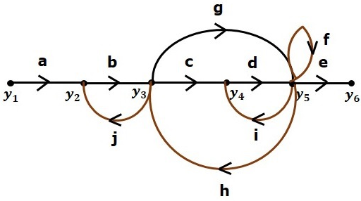
Terminology
Consider following SFG

Slide 5
Terminology…
Path
It is a traversal of branches from one node to any other node in the direction of branch arrows.
It should not traverse any node more than once.
Forward Path:
The path that exists from the input node to the output node.
Forward Path 1: $y_{1}→y_{2}→y_{3}→y_{4}→y_{5}→y_{6}$,
Forward Path 2: $y_{1}→y_{2}→y_{3}→\left(g\right)→y_{5}→y_{6},$
Forward Path Gain = abcde
Forward Path Gain = abge

Slide 6
Terminology…
Loop
The path that starts from one node and ends at the same node is known as loop. Hence, it is a closed path.
Loop 1 $y_{3}→y_{2}→y_{3}$
Loop 2 $y_{4}→y_{5}→y_{4}$
Loop Gain = bj
Loop Gain = di

Slide 7

Terminology…
Non-touching Loops
These are the loops, which should not have any common node.
Examples − The loops, $y_{2}→y_{3}→y_{2}$ and $y_{4}→y_{5}→y_{4}$ are non touching.

Slide 8
Calculation of Transfer Function using Mason’s Gain Formula
Let us consider same example
Number of forward paths, N = 2.
Forward Path 1: $y_{1}→y_{2}→y_{3}→y_{4}→y_{5}→y_{6}$, $P_{1}=abcde$
Forward Path 2: $y_{1}→y_{2}→y_{3}→\left(g\right)→y_{5}→y_{6},$ $P_{2}=abge$

Slide 9
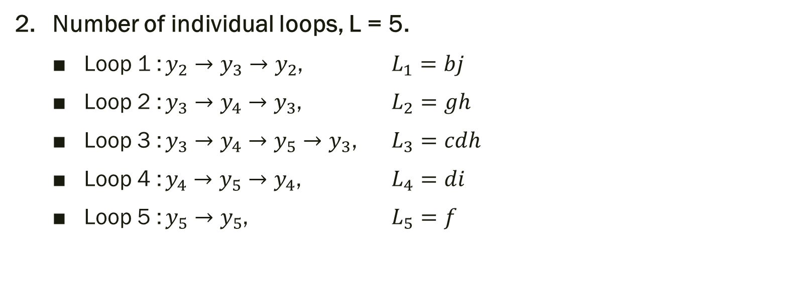
Example …
Number of individual loops, L = 5.
Loop 1 : $y_{2}→y_{3}→y_{2}$, $L_{1}=bj$
Loop 2 : $y_{3}→y_{4}→y_{3}$, $L_{2}=gh$
Loop 3 : $y_{3}→y_{4}→y_{5}→y_{3}$, $L_{3}=cdh$
Loop 4 : $y_{4}→y_{5}→y_{4}$, $L_{4}=di$
Loop 5 : $y_{5}→y_{5}$, $L_{5}=f$

Slide 10
Example …
Number of two non-touching loops = 2.
First non-touching loops: $y_{2}→y_{3}→y_{2}$ and $y_{4}→y_{5}→y_{4}$ , $L_{1}L_{4}=bjdi$
First non-touching loops are $y_{2}→y_{3}→y_{2}$ and $y_{5}→y_{5}$ , $L_{1}L_{5}=bjf$
Higher number of (more than two) non-touching loops are not present in this signal flow graph.

Slide 11
Example …
$∆=1−\left(L_{1}+L_{2}+L_{3}+…\right)+\left(\sum{L_{1}L_{2}+…}\right)+\left(\sum{L_{1}L_{2}L_{3}}\right)+…$
$∆=1−\left(bj+gh+cdh+di+f\right)+\left(bjdi+bjf\right)+\left(0\right)+…$
$∆=1−\left(bj+gh+cdh+di+f\right)+\left(bjdi+bjf\right)+$
$∆_{1}=1, ∵\text{There} \text{is} \text{no} \text{loop} \text{which} \text{is} \text{non}\text{−}\text{touching} \text{to} \text{the} \text{first} \text{forward} \text{path}\text{.}$
$∆_{2}=1, ∵\text{There} \text{is} \text{no} \text{loop} \text{which} \text{is} \text{non}\text{−}\text{touching} \text{to} \text{the} \text{first} \text{forward} \text{path}\text{.}$
Use Manson’s gain formula

Slide 12
Example …
So, overall transfer function

Slide 13
Thanks

