Slide 1
Artificial Neural Network
By: Nafees Ahamad,
AP, EECE Deptt, DIT University
Dehradun

Slide 2
Back propagation algorithm

Slide 3
Back propagation algorithm…

Slide 4
Steepest descent method

Slide 5
Steepest descent method

Slide 6
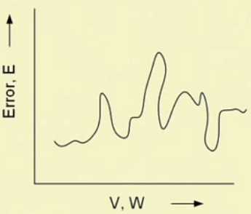
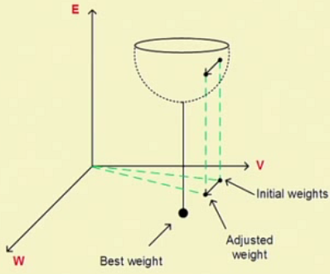
Steepest descent method

Slide 7
Steepest descent method
---(1)
This is Error vector

Slide 8
Back propagation algorithm
---(2)

Slide 9
Back propagation algorithm…
Equation (1) & (2)

Slide 10
Calculations of error in a neural network

Slide 11
Calculations of error in a neural network..

Slide 12
Supervised learning: Back Propagation method

Slide 13
Supervised learning: Back Propagation method

Slide 14
Supervised learning: Back Propagation method

Slide 15
Supervised learning: Back Propagation method

Slide 16
Supervised learning: Back Propagation method

Slide 17
Thank you

