Slide 1
Time Response
By: Nafees Ahamad,
AP, EECE, Dept.
DIT University, Dehradun

Slide 2
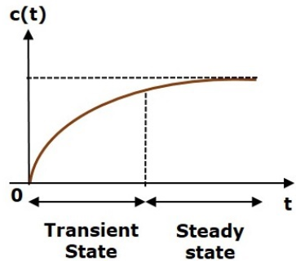
Time Response
System output in time domain
It consists of
Transient response
Steady state response

Slide 3
Time Response …
Time response c(t) is given as
Steady State Response
Overall Response
Transient Response

Slide 4
Transient Response
Response just after applying/removing the input to the system is known as transient response.
It revels the nature of response (i.e. Oscillatory or overdamped).
It also indicates about response speed .
The transient response will be zero for large values of ‘t’. Ideally, this value of ‘t’ is infinity [Practically 3T (on 5% error basis) or 4T (on 2% error basis), T = Time Constant]
Mathematically,

Slide 5
Steady state Response
The response just after transient response is known as Steady State Response.
It revels the accuracy of a control system.
Steady state error is observed if the actual output does not exactly match with the input.
Example
Steady State Response
Transient Response

Slide 6
Standard Test Signals
Standard Test signals are
Step signal
Ramp Signal
Impulse Signal
Parabolic Signal

Slide 7
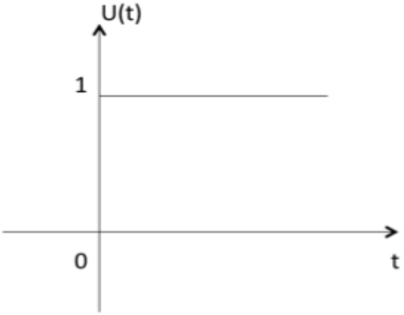
Unit Step Signal
It is defined as
$U\left(t\right)=\left\{\begin{matrix}1 t≥0 \\ 0 t<0\end{matrix}\right.$

Slide 8
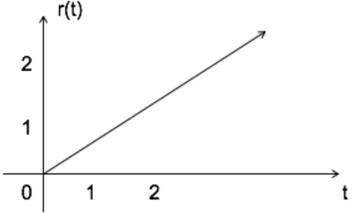
Unit Ramp Signal
It is defined as
r$\left(t\right)=\left\{\begin{matrix}t t≥0 \\ 0 t<0\end{matrix}\right.$

Slide 9
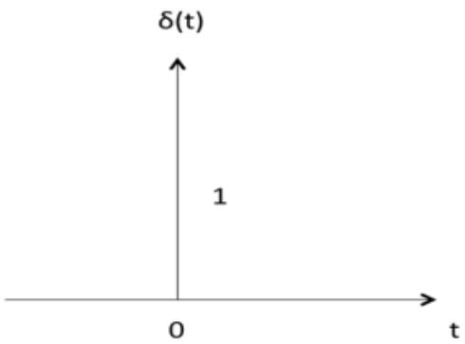
Unit Impulse Signal
It is defined as
$δ\left(t\right)=\left\{\begin{matrix}1 t=0 \\ 0 t≠0\end{matrix}\right.$

Slide 10
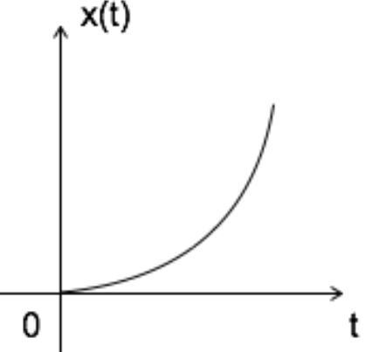
Parabolic Signal
It is defined as
x$\left(t\right)=\left\{\begin{matrix}t^{2}/2 t≥0 \\ 0 t<0\end{matrix}\right.$

Slide 11
Relationship

Slide 12
Time Response of a First Order System
Consider following system with unity feedback
With $G\left(s\right)=\frac{1}{sT}$ and $H\left(s\right)=1$

Slide 13
Time Response of a First Order System…
So, overall transfer function
$\frac{C(s)}{R\left(s\right)}=\frac{G(s)}{1+G\left(s\right)H(s)}$, Put the values of G(s) & H(s)
$\frac{C(s)}{R\left(s\right)}=\frac{\frac{1}{sT}}{1+\frac{1}{sT}}=\frac{1}{sT+1}$
Note: The power of ‘s’ in denominator is one, so it is first order system
So,
$C\left(s\right)=\frac{1}{sT+1}R\left(s\right)−−−(1)$

Slide 14
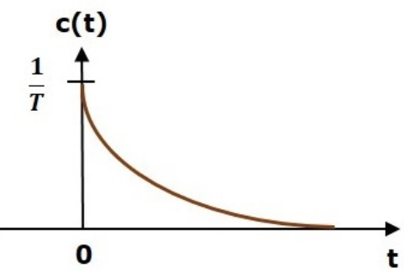
Impulse Response of First Order System
Consider the unit impulse signal as an input
$r\left(t\right)=δ(t)$
Put $R\left(s\right)=1$ in Equ. (1)
$C\left(s\right)=\frac{1}{sT+1}$ $=\frac{1}{T}×\frac{1}{s+\frac{1}{T}}$
Take inverse Laplace transformation
$c\left(t\right)=\frac{1}{T}e^{\left(−\frac{t}{T}\right)}U\left(t\right)−−−(2)$
$$R\left(s\right)=1$$
Take Laplace Transformation

Slide 15
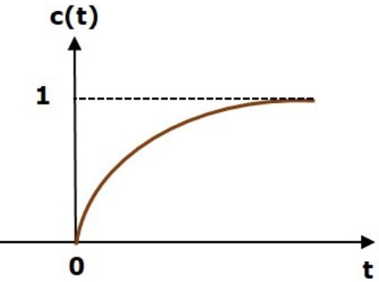
Step Response of First Order System
Consider the Unit Step signal as an input
$r\left(t\right)=U(t)$
Put $R\left(s\right)$ in Equ. (1) and take partial fractions
$C\left(s\right)=\frac{1}{s}×\frac{1}{sT+1}$ $=\frac{A}{s}+\frac{B}{sT+1}=\frac{1}{s}−\frac{1}{sT+1}$
Take inverse Laplace transformation
$c\left(t\right)=\left(1−e^{\left(−\frac{t}{T}\right)}\right)U\left(t\right)−−−(3)$
$$R\left(s\right)=\frac{1}{s}$$
Take Laplace Transformation

Slide 16
Ramp Response of First Order System
Consider the Unit Ramp Signal as an input
$r\left(t\right)=r\left(t\right)=t$
Put $R\left(s\right)$ in Equ. (1) and take partial fractions
$C\left(s\right)=\frac{1}{s^{2}}×\frac{1}{sT+1}$ $=\frac{A}{s^{2}}+\frac{B}{s}+\frac{C}{sT+1}=\frac{1}{s^{2}}−\frac{T}{s}+\frac{T^{2}}{sT+1}$
Take inverse Laplace transformation
$c\left(t\right)=(t−T+Te^{\left(−\frac{t}{T}\right)}) U\left(t\right)−−−(4)$
$$R\left(s\right)=\frac{1}{s^{2}}$$
Take Laplace Transformation

Slide 17
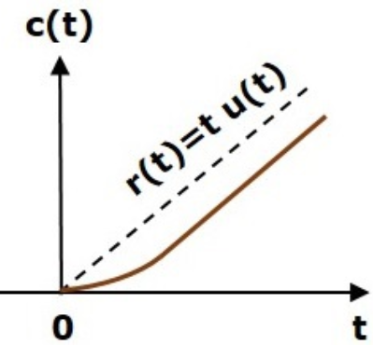
Ramp Response of First Order System…
Equ. (4) has transient as well as steady state response
Transient Response
$c_{tr}\left(t\right)=Te^{\left(−\frac{t}{T}\right)} U\left(t\right)$
Steady State Response
$c_{ss}\left(t\right)=(t−T)U\left(t\right)$
c(t)
T

Slide 18
Response of Second Order System
Consider the following 2nd order control system
With, Open loop transfer function $G\left(s\right)=\frac{ω_{n}^{2}}{s(s+2ξω_{n})}$
And H(s) = 1
So,
$\frac{C(s)}{R\left(s\right)}=\frac{G(s)}{1+G\left(s\right)H(s)}$
$\frac{C(s)}{R\left(s\right)}=\frac{ω_{n}^{2}}{s^{2}+2{ξω}_{n}s+ω_{n}^{2}}−−−(5)$
G(s)
R(s)
E(s)
C(s)
H(s)
$$ξ=Damping Ratio$$
$$ω_{n}=Natural Frequency$$

Slide 19
Response of Second Order System
Its characteristic equation
$s^{2}+2{ξω}_{n}s+ω_{n}^{2}=0$
The roots of characteristic equ are
$s=\frac{−2{ξω}_{n}±\sqrt{{(2{ξω}_{n})}^{2}−{({4ω}_{n})}^{2}}}{2}$
$⇒s={−ξω}_{n}±ω_{n}\sqrt{ξ^{2}−1}$
Note:
$ξ$=0, Two Imaginary Roots
$ξ$=1, Two Real Equal Roots
$ξ>$1, Two Real Unequal Roots
$0<ξ<1$, Two Complex Roots

Slide 20
Step Response of Second Order System…
Consider the Unit Step signal as an input
$r\left(t\right)=U(t)$
Put $R\left(s\right)$ in Equ. (5) and take partial fractions
$C\left(s\right)=\left(\frac{ω_{n}^{2}}{s^{2}+2{ξω}_{n}s+ω_{n}^{2}}\right)R\left(s\right)=\left(\frac{ω_{n}^{2}}{s^{2}+2{ξω}_{n}s+ω_{n}^{2}}\right)\frac{1}{s}−−−(6)$
$⇒C(s)=\frac{1}{s}×\left(\frac{ω_{n}^{2}}{{(s+{ξω}_{n})}^{2}+ω_{n}^{2}(1−ξ^{2})}\right)$
$$R\left(s\right)=\frac{1}{s}$$
Take Laplace Transformation
Let $ω_{d}^{2}$

Slide 21
Step Response of Second Order System…
$⇒C\left(s\right)=\frac{1}{s}×\left(\frac{ω_{n}^{2}}{{\left(s+{ξω}_{n}\right)}^{2}+ω_{d}^{2}}\right)$
$⇒C\left(s\right)=\frac{A}{s}+\frac{B}{{(s+{ξω}_{n})}^{2}+ω_{d}^{2}}$ , Partial Fraction
$A={\left.sC(s)\right|}_{s=0}={\left.\left(\frac{ω_{n}^{2}}{s^{2}+2{ξω}_{n}s+ω_{n}^{2}}\right)\right|}_{s=0}=1$
$B={\left.\left[{(s+{ξω}_{n})}^{2}+ω_{d}^{2}\right]C(s)\right|}_{s=−{ξω}_{n}−{jω}_{d}}={\left.\frac{1}{s}\right|}_{s=−{ξω}_{n}−{jω}_{d}}=−(s+2{ξω}_{n})$
So, $⇒C\left(s\right)=\frac{1}{s}−\frac{(s+2{ξω}_{n}) }{{(s+{ξω}_{n})}^{2}+ω_{d}^{2}}$

Slide 22
Step Response of Second Order System…
$⇒C\left(s\right)=\frac{1}{s}−\left[\frac{(s+{ξω}_{n}+{ξω}_{n}) }{{(s+{ξω}_{n})}^{2}+ω_{d}^{2}}\right]$
$⇒C\left(s\right)=\frac{1}{s}−\left[\frac{(s+{ξω}_{n}) }{{(s+{ξω}_{n})}^{2}+ω_{d}^{2}}+\frac{{ξω}_{n}}{{(s+{ξω}_{n})}^{2}+ω_{d}^{2}}\right]$
$⇒C\left(s\right)=\frac{1}{s}−\left[\frac{(s+{ξω}_{n}) }{{(s+{ξω}_{n})}^{2}+ω_{d}^{2}}+\frac{{ξω}_{n}}{ω_{d}}\frac{ω_{d}}{{(s+{ξω}_{n})}^{2}+ω_{d}^{2}}\right]$
Take inverse Laplace transformation
$c\left(t\right)=1−\left[e^{−ξω_{n}t}cosω_{d}t+\frac{{ξω}_{n}}{ω_{d}}e^{−ξω_{n}t}sinω_{d}t\right]$
Put $ω_{d}=ω_{n}\sqrt{1−ξ^{2}}$

Slide 23
Step Response of Second Order System…
$⇒c\left(t\right)=1−e^{−ξω_{n}t}\left[Cosω_{d}t+\frac{ξ}{\sqrt{1−ξ^{2}}}Sinω_{d}t\right]$
Put $\sqrt{1−ξ^{2}}=Sinφ$
So, $Cosφ=ξ$ and $tanφ=\frac{\sqrt{1−ξ^{2}}}{ξ}$
$⇒c\left(t\right)=1−\frac{e^{−ξω_{n}t}}{\sqrt{1−ξ^{2}}}\left[Sinφ Cosω_{d}t+Cosφ Sinω_{d}t\right]$
$⇒c\left(t\right)=1−\frac{e^{−ξω_{n}t}}{\sqrt{1−ξ^{2}}}Sin\left(ω_{d}t+φ\right)−−−(7)$

Slide 24
Step Response of Second Order System…
Put the values of $ω_{d}$ and $φ$
$ω_{d}=ω_{n}\sqrt{1−ξ^{2}}$ and $φ=\tan^{−1}\frac{\sqrt{1−ξ^{2}}}{ξ}$
$⇒c\left(t\right)=1−\frac{e^{−ξω_{n}t}}{\sqrt{1−ξ^{2}}}Sin\left(ω_{n}\sqrt{1−ξ^{2}}t+\tan^{−1}\frac{\sqrt{1−ξ^{2}}}{ξ}\right)−−−(8)$
The error signal for the system
$e\left(t\right)=r\left(t\right)−c\left(t\right)$
$⇒e\left(t\right)=\frac{e^{−ξω_{n}t}}{\sqrt{1−ξ^{2}}}Sin\left(ω_{n}\sqrt{1−ξ^{2}}t+\tan^{−1}\frac{\sqrt{1−ξ^{2}}}{ξ}\right)−−−(9)$

Slide 25
Step Response of Second Order System…
$ω_{n}$= Natural frequency of oscillation or undammed natural frequency
$ω_{d}$= Dammed frequency
${ξω}_{n}$ = damping factor or actual damping or damping coefficient

Slide 26
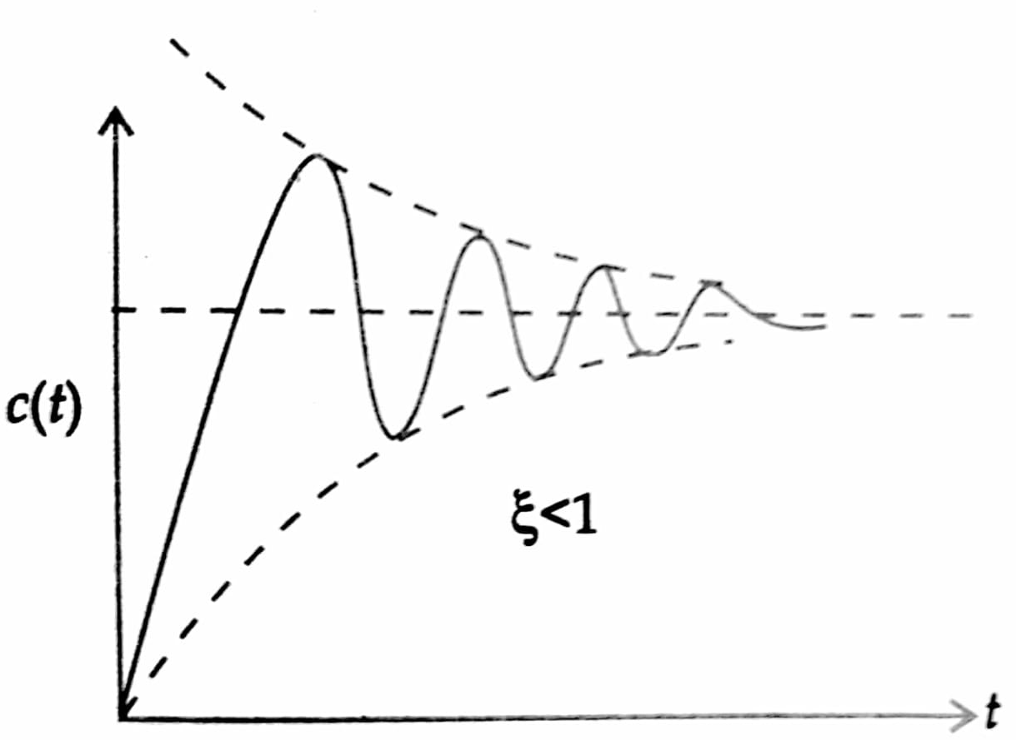
Step Response of Second Order System…
Case 1: Underdamped Case $\left(0<ξ<1\right)$
Response is given by equ. (8). It is under damped having overshoot and undershoot as shown below.

Slide 27
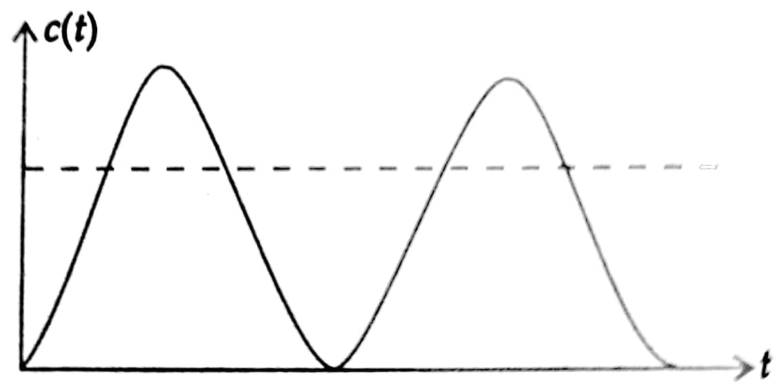
Step Response of Second Order System…
Case 2: Undamped Case $\left(ξ=0\right)$
Response of equ (8) becomes
$⇒c\left(t\right)=1−Sin\left(ω_{n}t+{90}^{0}\right)$
$⇒c\left(t\right)=1−Cos\left(ω_{n}t\right)−−−(10)$

Slide 28
Step Response of Second Order System…
Case 3: Critical damped Case $\left(ξ=1\right)$
Put $ξ=1$ in original equation
$C(s)=\left(\frac{ω_{n}^{2}}{s^{2}+2ω_{n}s+ω_{n}^{2}}\right)\frac{1}{s}$
$C(s)=\left(\frac{ω_{n}^{2}}{{\left(s+ω_{n}\right)}^{2}}\right)\frac{1}{s}$
$C\left(s\right)=\frac{A}{s}+\frac{B}{s+ω_{n}}+\frac{C}{{\left(s+ω_{n}\right)}^{2}}$
$C\left(s\right)=\frac{1}{s}−\frac{1}{s+ω_{n}}−\frac{ω_{n}}{{\left(s+ω_{n}\right)}^{2}}$
$$A={\left.sC(s) \right|}_{s=0}=1$$
$$C={{\left(s+ω_{n}\right)}^{2}\left.C(s) \right|}_{s=−ω_{n}}=−ω_{n}$$
$$B={\left.\frac{d}{ds}\left[{\left(s+ω_{n}\right)}^{2}C(s)\right]\right|}_{s=−ω_{n}} ={\left.\frac{d}{ds}\left[\frac{ω_{n}^{2}}{s}\right]\right|}_{s=−ω_{n}}=−1$$

Slide 29
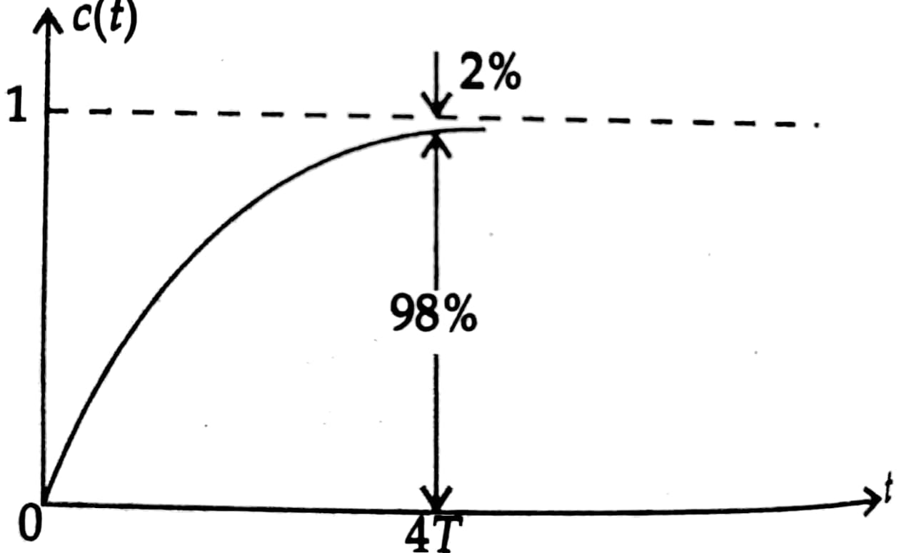
Step Response of Second Order System…
Take inverse Laplace transform
$c\left(t\right)=1−e^{−ω_{n}t}−{tω_{n}e}^{−ω_{n}t}$
$c\left(t\right)=1−e^{−ω_{n}t}\left(1+tω_{n}\right)−−−(11)$

Slide 30
Step Response of Second Order System…
Case 4: Over damped Case $\left(ξ>1\right)$
When $ξ>1$ Equ (6) can be written as
$⇒C(s)=\frac{1}{s}×\left(\frac{ω_{n}^{2}}{{(s+{ξω}_{n})}^{2}−ω_{n}^{2}(ξ^{2}−1)}\right)$
$⇒C(s)=\frac{1}{s}×\left(\frac{ω_{n}^{2}}{{(s+{ξω}_{n})}^{2}−ω_{d}^{2}}\right)$
$⇒C(s)=\frac{1}{s}×\left(\frac{ω_{n}^{2}}{(s+{ξω}_{n}+ω_{d})(s+{ξω}_{n}−ω_{d})}\right)$
Let $ω_{d}^{2}$

Slide 31
Step Response of Second Order System…
$⇒C\left(s\right)=\frac{A}{s}+\frac{B}{(s+{ξω}_{n}+ω_{d})}+\frac{C}{(s+{ξω}_{n}−ω_{d})}$
Put values of A, B, & C and
take inverse Laplace transformation
$c\left(t\right)=1+\frac{e^{\left(ξ+\sqrt{ξ^{2}−1}\right)ω_{n}t}}{2\sqrt{ξ^{2}−1}\left[ξ+\sqrt{ξ^{2}−1}\right]}−\frac{e^{\left(ξ−\sqrt{ξ^{2}−1}\right)ω_{n}t}}{2\sqrt{ξ^{2}−1}\left[ξ−\sqrt{ξ^{2}−1}\right]}$
$−−−(12)$
$$A={\left.sC(s) \right|}_{s=0}=1$$
$$B={(s+{ξω}_{n}+ω_{d})\left.C(s) \right|}_{s=−({ξω}_{n}+ω_{d})}$$
$$=\frac{1}{2\sqrt{ξ^{2}−1}\left[ξ+\sqrt{ξ^{2}−1}\right]}$$
$$C={(s+{ξω}_{n}−ω_{d})\left.C(s) \right|}_{s=−({ξω}_{n}−ω_{d})}$$
$$=\frac{−1}{2\sqrt{ξ^{2}−1}\left[ξ−\sqrt{ξ^{2}−1}\right]}$$

Slide 32
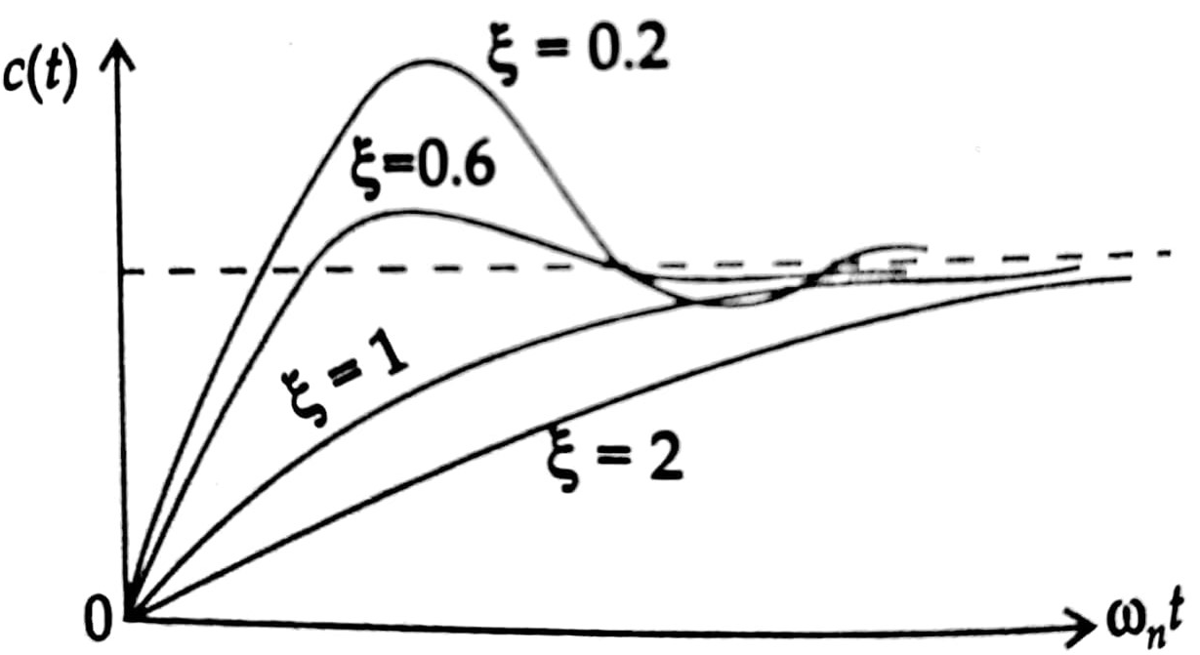
Step Response of Second Order System…
Above equ (12) has two time constant
$T_{1}=\frac{1}{\left(ξ+\sqrt{ξ^{2}−1}\right)ω_{n}}$ and $T_{2}=\frac{1}{\left(ξ−\sqrt{ξ^{2}−1}\right)ω_{n}}$ with $T_{1}<T_{2}$
So, we can neglect terms with time constant $T_{1}$,
Hence response can be approximated as
$c\left(t\right)=1−\frac{e^{\left(ξ−\sqrt{ξ^{2}−1}\right)ω_{n}t}}{2\sqrt{ξ^{2}−1}\left[ξ−\sqrt{ξ^{2}−1}\right]}$
$=1−\frac{e^{−\frac{t}{T_{2}}}}{2\sqrt{ξ^{2}−1}\left[ξ−\sqrt{ξ^{2}−1}\right]}$

Slide 33
Location of roots of characteristic equation and Time response
We know closed loop response of 2nd order system is given as
$\frac{C(s)}{R\left(s\right)}=\frac{ω_{n}^{2}}{s^{2}+2{ξω}_{n}s+ω_{n}^{2}}$
Its characteristic equation
$s^{2}+2{ξω}_{n}s+ω_{n}^{2}=0$
Its roots are
$⇒s_{1}={−ξω}_{n}+ω_{n}\sqrt{ξ^{2}−1}$
$⇒s_{2}={−ξω}_{n}−ω_{n}\sqrt{ξ^{2}−1}$
(${−ξω}_{n}$)Damping
$ω_{n}\sqrt{ξ^{2}−1}$)Damped Frequency

Slide 34
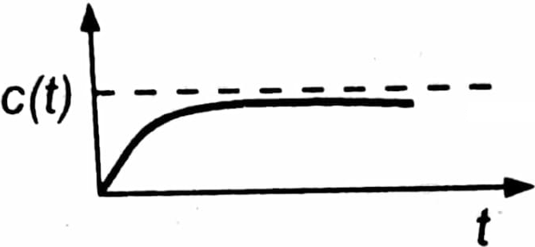
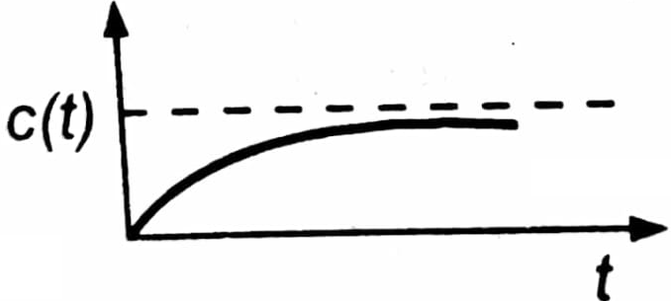
Location of roots of characteristic equation and Time response …
Im
$$ξ=0$$
Underdamped
Undamped
$$ξ<1$$
$$ω_{n}$$
$$ω_{n}\sqrt{ξ^{2}−1}$$
$$ξ=1$$
$$θ$$
Critical damped
Re
$${−ξω}_{n}$$
$$Cosθ=ξ$$
Over damped
$$ξ>1$$

Slide 35
Transient Response Specifications of 2nd Order System
For 2nd order system with unit step input following are the transient response specifications
Delay Time (t_{d})
Rise Time (t_{r})
Peak Time (t_{p})
Maximum Overshoot (M_{p})
Settling Time (t_{s})
Steady-State Error (e_{ss})

Slide 36
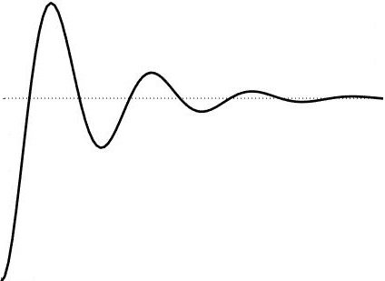
Transient Response Specifications of 2nd Order System …
c(t)
c(t)_{max}
T=1/ $ξω_{n}$
M_{p}
1.0
$$±2\% or ±5\%$$
0.5
Time
t_{d}
t_{r}
t_{p}
t_{s}

Slide 37
Delay time
Delay time (t_{d}) is the time required to reach at 50% of its final value by a time response signal during its first cycle of oscillation.

Slide 38
Rise time
Rise time (t_{r}) is the time required to reach at final value by a under damped time response signal during its first cycle of oscillation. If the output is over damped, then rise time is counted as the time required by the response to rise from 10% to 90% of its final value.
We know the output of 2nd order system with step input is given as
$c\left(t\right)=1−\frac{e^{−ξω_{n}t}}{\sqrt{1−ξ^{2}}}Sin\left(ω_{n}\sqrt{1−ξ^{2}}t+Φ\right)$, Equ (7)
put c(t)=1 and solve for t
$t_{r}=\frac{π−φ}{ω_{n}\sqrt{1−ξ^{2}}}$

Slide 39
Peak time
Peak time (t_{p}) is simply the time required by response to reach its first peak i.e. the peak of first cycle of oscillation, or first overshoot.
For maxi value of c(t), put $\frac{dc(t)}{dt}=0$
$t=\frac{nπ}{ω_{n}\sqrt{1−ξ^{2}}}$
For first overshoot, n=1
$t_{p}=\frac{π}{ω_{n}\sqrt{1−ξ^{2}}}$

Slide 40
Maximum overshoot
Maximum overshoot (M_{p}) is straight way difference between the magnitude of the highest peak of time response and magnitude of its steady state.
Put ${t=t}_{p}=\frac{π}{ω_{n}\sqrt{1−ξ^{2}}}$ in c(t), (equ. (7))
${c(t)}_{max}=1+e^{−\frac{πξ}{\sqrt{1−ξ^{2}}}t}$
$\%M_{p}=\frac{{c(t)}_{max}−1}{1}×100$
$⇒\%M_{p}=e^{−\frac{πξ}{\sqrt{1−ξ^{2}}}t}×100$

Slide 41
Settling time
Settling time (t_{s}) is the time required for a response to become steady. It is defined as the time required by the response to reach and steady within specified range of 2 % to 5 % of its final value.
Time period of the system $T=\frac{1}{ξω_{n}}$
$t_{s}=4T$ on the basis of $±2\%$ error
$t_{s}=3T$ on the basis of $±5\%$ error

Slide 42
Steady-state error
Steady-state error (e_{ss} ) is the difference between actual output and desired output at the infinite range of time.
$e_{ss}=\lim_{t→∞}\left[r\left(t\right)−c(t)\right]$

Slide 43
Assignment
1. Find out time response of 2nd order system subjected to unit impulse input.
2. Find out time response of 2nd order system subjected to unit ramp input.
3. Explain how time response of higher order system is determined?

Slide 44
Thanks

