Slide 1
Errors in Control System
By: Nafees Ahamad,
AP, EECE, Dept.
DIT University, Dehradun

Slide 2
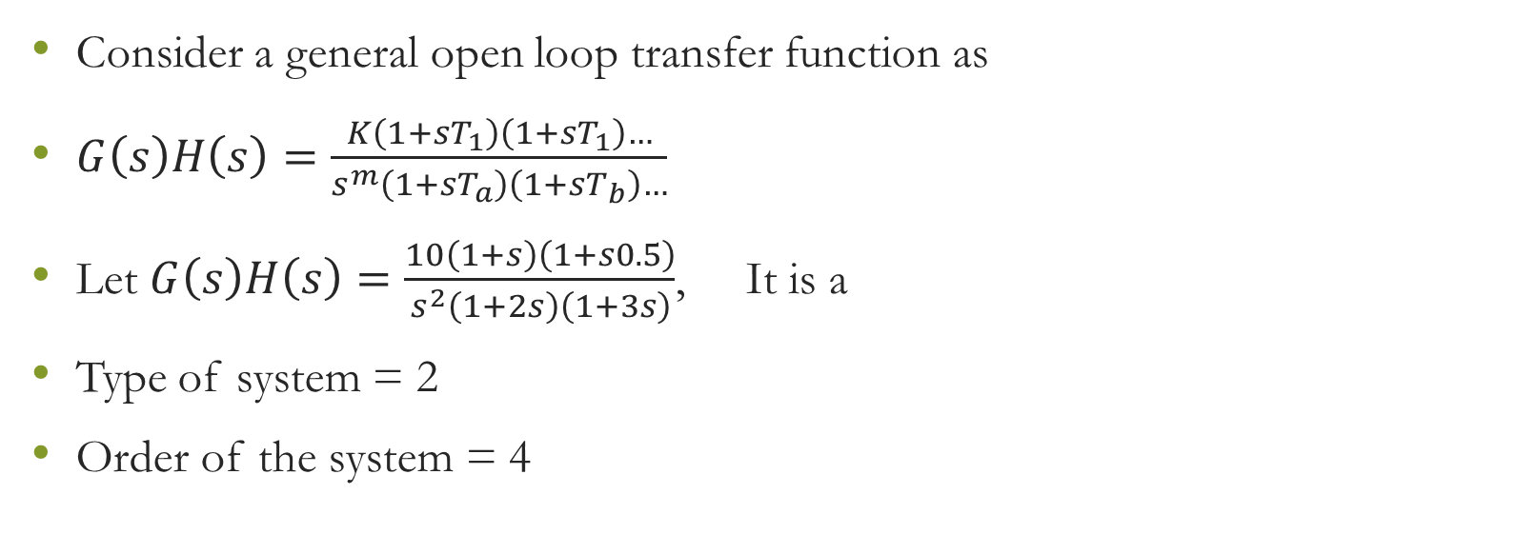
Type and Order of Control System
Consider a general open loop transfer function as
$G\left(s\right)H\left(s\right)=\frac{K\left(1+sT_{1}\right)\left(1+sT_{1}\right)…}{s^{m}\left(1+sT_{a}\right)\left(1+sT_{b}\right)…}$
Let $G\left(s\right)H\left(s\right)=\frac{10\left(1+s\right)\left(1+s0.5\right)}{s^{2}\left(1+2s\right)\left(1+3s\right)}$, It is a
Type of system = 2
Order of the system = 4

Slide 3
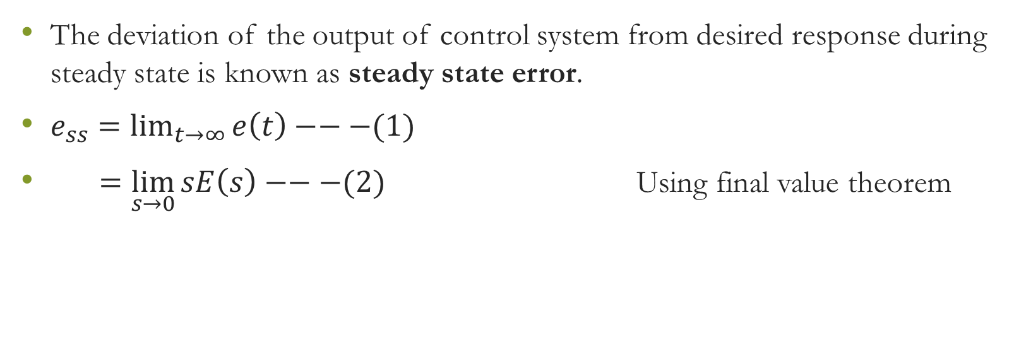
Steady State Errors
The deviation of the output of control system from desired response during steady state is known as steady state error.
$e_{ss}=\lim_{t→∞}{e\left(t\right)}−−−(1)$
$=\lim_{s→0}{sE\left(s\right)−−−(2)}$ Using final value theorem

Slide 4

Steady State Errors for Feedback System
Consider following system
$\frac{C(s)}{R(s)}=\frac{G(s)}{1+G\left(s\right)H(s)}$
$⇒C(s)=\frac{R(s)G(s)}{1+G\left(s\right)H(s)}$
$E\left(s\right)=R\left(s\right)−C\left(s\right)$
$E\left(s\right)=R\left(s\right)−\frac{R(s)G(s)}{1+G\left(s\right)H(s)}$
G(s)
R(s)
E(s)
C(s)
H(s)

Slide 5

Steady State Errors for Feedback System…
$⇒E\left(s\right)=\frac{R\left(s\right)+R\left(s\right)G\left(s\right)−R(s)G(s)}{1+G\left(s\right)H(s)}$
$⇒E\left(s\right)=\frac{R(s)}{1+G(s)H(s)}$
Put in Equ (2),
$e_{ss}=\lim_{s→0}{\frac{sR(s)}{1+G(s)H(s)}−−−(3)}$

Slide 6
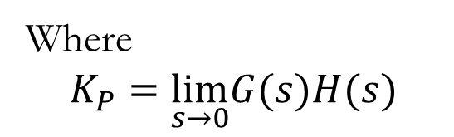

Static Error Coefficients
Static-Position Error Constant (K_{P})
For unit step input, put $R\left(s\right)=\frac{1}{s}$in Equ. (3)
$e_{ss}=\lim_{s→0}{\frac{s×\frac{1}{s}}{1+G(s)H(s)}}$
$e_{ss}=\frac{1}{1+\lim_{s→0}G(s)H(s)}=\frac{1}{1+K_{P}}$
Where
$$K_{P}=\lim_{s→0}G(s)H(s)$$
K_{P} is known as Static-Position Error Constant

Slide 7
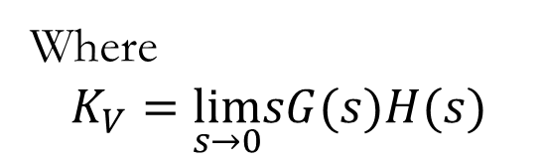
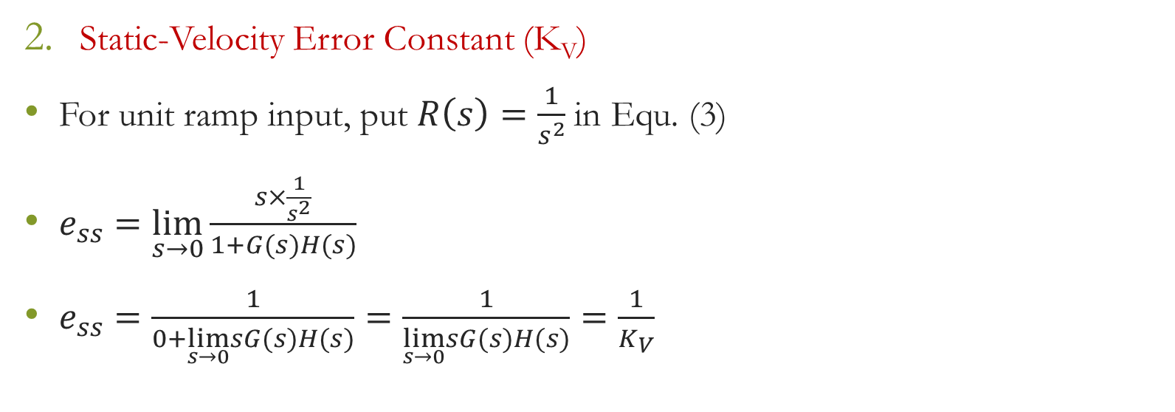
Static Error Coefficients…
Static-Velocity Error Constant (K_{V})
For unit ramp input, put $R\left(s\right)=\frac{1}{s^{2}}$in Equ. (3)
$e_{ss}=\lim_{s→0}{\frac{s×\frac{1}{s^{2}}}{1+G(s)H(s)}}$
$e_{ss}=\frac{1}{0+\lim_{s→0}sG(s)H(s)}=\frac{1}{\lim_{s→0}sG(s)H(s)}=\frac{1}{K_{V}}$
Where
$$K_{V}=\lim_{s→0}sG(s)H(s)$$
K_{V} is known as Static-Velocity Error Constant

Slide 8
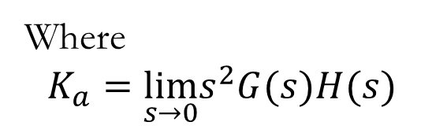
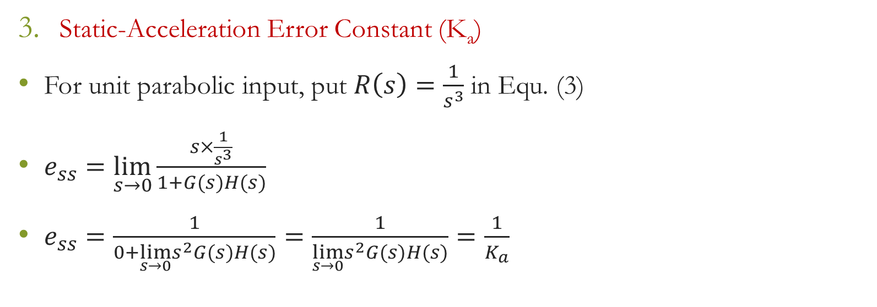
Static Error Coefficients…
Static-Acceleration Error Constant (K_{a})
For unit parabolic input, put $R\left(s\right)=\frac{1}{s^{3}}$in Equ. (3)
$e_{ss}=\lim_{s→0}{\frac{s×\frac{1}{s^{3}}}{1+G(s)H(s)}}$
$e_{ss}=\frac{1}{0+\lim_{s→0}s^{2}G(s)H(s)}=\frac{1}{\lim_{s→0}s^{2}G(s)H(s)}=\frac{1}{K_{a}}$
Where
$$K_{a}=\lim_{s→0}s^{2}G(s)H(s)$$
K_{a} is known as Static-Velocity Error Constant

Slide 9
Assignment
Find out steady state error coefficients (K_{P}, K_{V}, K_{a}) for type 0, type 1 and type 2 systems.

Slide 10
Thanks
Life is beautiful enjoy it with your family and friends.

