Slide 1
Fuzzy logic: Defuzzification…
By: nafees Ahamad,
Ap, EECE deptt, Dit university, dehradun

Slide 2
Defuzzification Methods

Slide 3
1. Maxima Methods

Slide 4
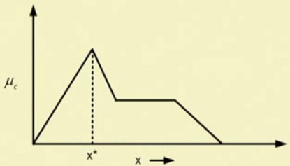
(a) Height Method

Slide 5
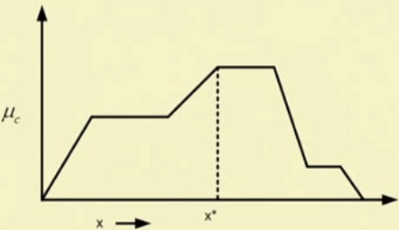
(b) First of Maxima (FoM) Method

Slide 6
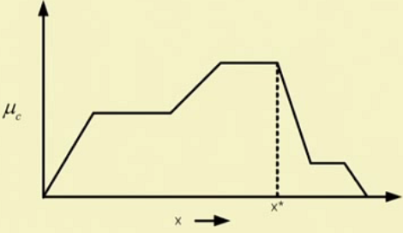
(c) Last of Maxima (LoM) Method

Slide 7
(d) Mean of Maxima (MoM) Method

Slide 8
MoM : Example 1
Note:
Height method can’t be applied
By FoM method x* = 20
By LoM method x* = 25

Slide 9
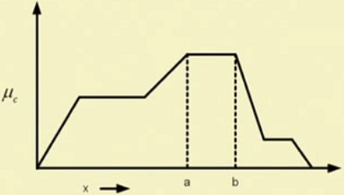
MoM : Example 2

Slide 10
2. Centroid Methods

Slide 11
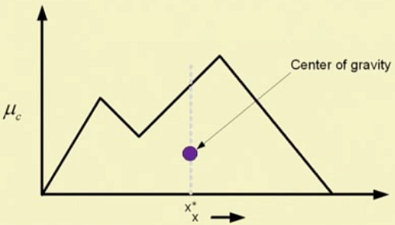
(a) Centre of Gravity (CoG) Method
x * Area
Area

Slide 12
(a) Centre of Gravity (CoG) Method …

Slide 13
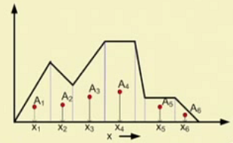
CoG : Geometrical method of calculation

Slide 14
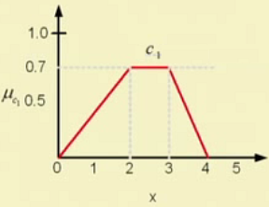
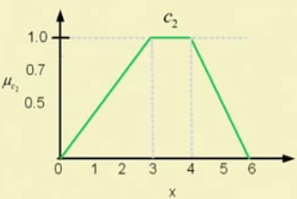
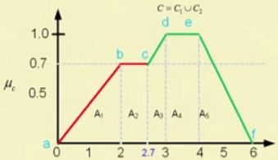
CoG : Integral method of calculation

Slide 15
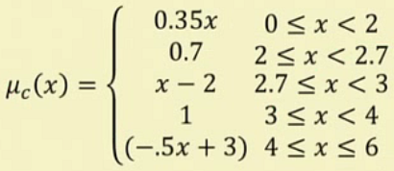
CoG : Integral method of calculation …

Slide 16
CoG : Integral method of calculation …

Slide 17
(b) Centre of Sum (CoS) Method

Slide 18
(b) Centre of Sum (CoS) Method …
Note:
CoS method is computationally less
There is no need to find out Union of C₁, C₂, etc
In CoG method, overlapping area is counted once, whereas, in CoS method, the overlapping is counted twice or so
In CoS we use center of area and hence, its name instead of center of gravity as CoG.

Slide 19
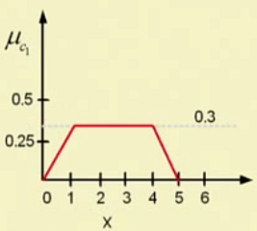
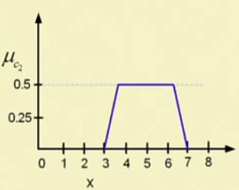
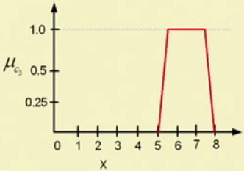
CoS Method : Example

Slide 20
CoS Method : Example …

Slide 21
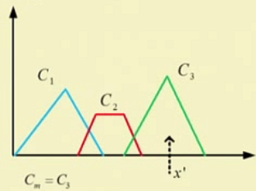
(c) Centre of Largest Area Method

Slide 22
3. Weighted Average Methods

Slide 23
Weighted Average Methods

Slide 24
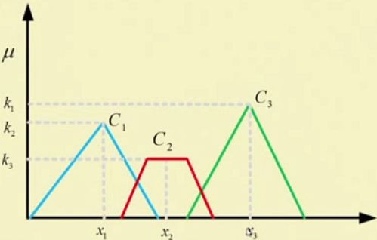
Weighted Average Methods…

Slide 25
Examples

Slide 26
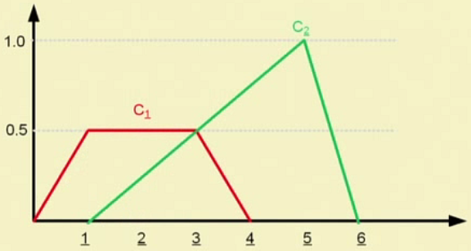
Example 1

Slide 27
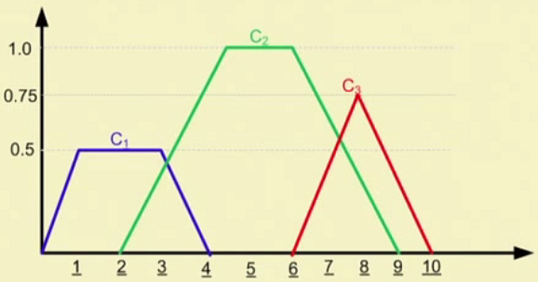
Example 2

Slide 28
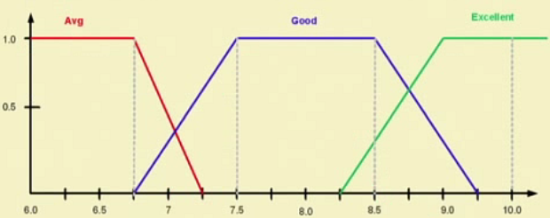

Slide 29
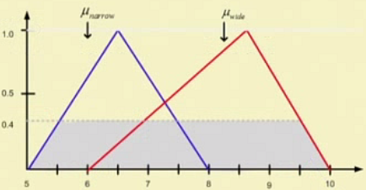
Example 4

Slide 30
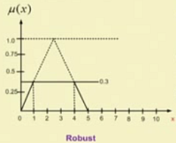
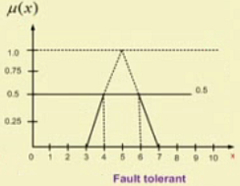
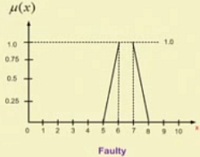
Example 5
0.8

Slide 31
Thank you

