Slide 1
Soft computing & fuzzy logic
By: nafees Ahamad,
Ap, EECE deptt, Dit university, dehradun

Slide 2
Introduction to soft computing
Concept of computing
Hard computing
Soft computing
How soft computing ?
Hard computing vs soft computing
Hybrid computing

Slide 3
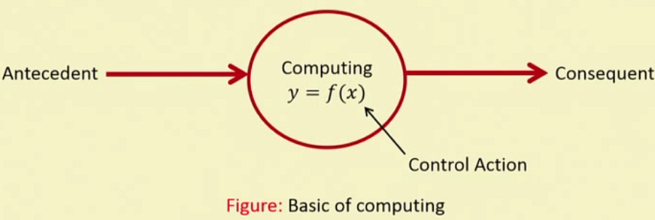
Concept of soft computing

Slide 4
Important characteristics of computing

Slide 5
Hard computing

Slide 6
Examples of hard computing

Slide 7
Soft computing

Slide 8
Characteristics of soft computing

Slide 9
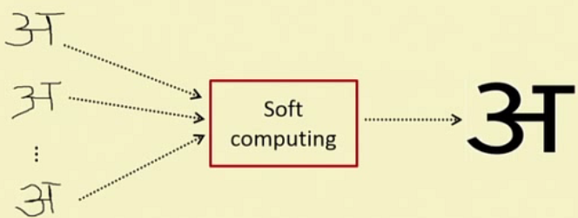
Examples of soft computing

Slide 10
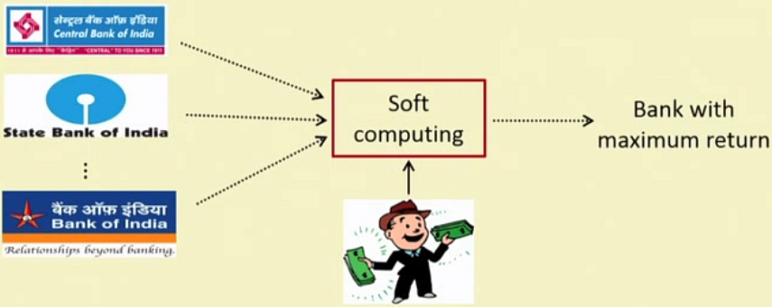
Examples of soft computing…
Genetic Algorithm

Slide 11
Examples of soft computing…

Slide 12
How soft computing?

Slide 13
How soft computing?...

Slide 14
How soft computing?...

Slide 15
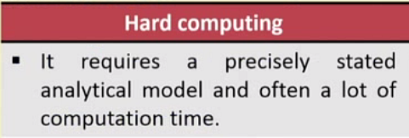
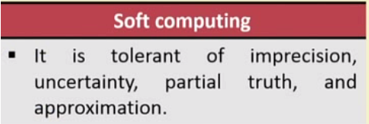
Hard computing vs. soft computing

Slide 16
Hard computing vs. soft computing…

Slide 17
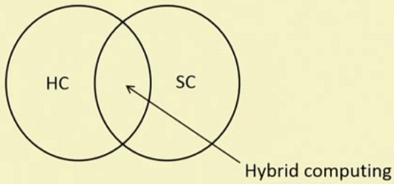
Hybrid computing

Slide 18
Thank you

