Slide 1
fuzzy logic
By: nafees Ahamad,
Ap, EECE deptt, Dit university, dehradun

Slide 2
What is fuzzy logic?
Fuzzy logic is a mathematical language to express something
This means it has grammar, syntax, semantic like a language for communication
There are some other mathematical languages also
Relational algebra (Operations on sets)
Boolean algebra (Operations on Boolean variables)
Predicate algebra (Operations on well formed formulae (wff), also called predicate propositions)
Fuzzy logic deals with fuzzy set or fuzzy algebra.

Slide 3
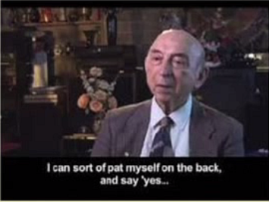
What is fuzzy?

Slide 4
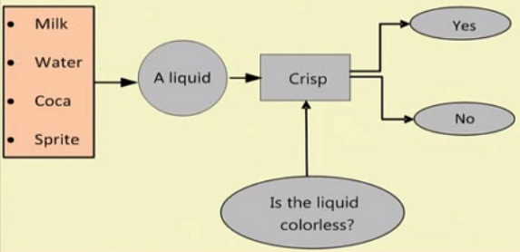
Example: Fuzzy logic vs crisp logic

Slide 5
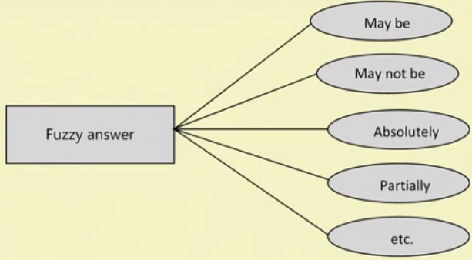
Example: Fuzzy logic vs crisp logic…

Slide 6
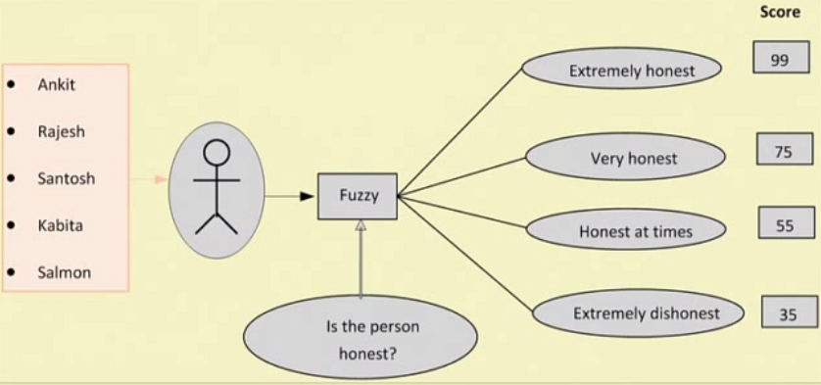
Example: Fuzzy logic vs crisp logic…

Slide 7
World is fuzzy!

Slide 8
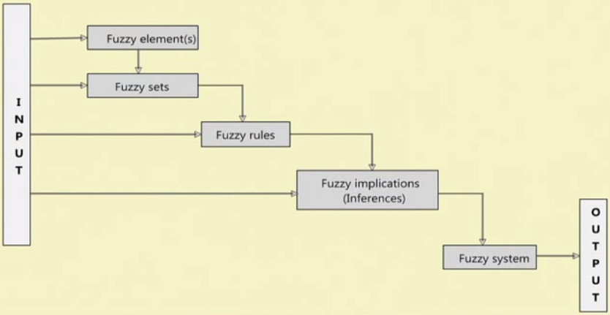
Concept of fuzzy system

Slide 9
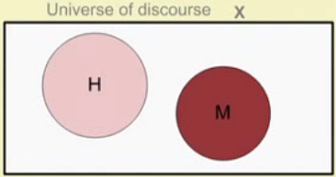
Concept of fuzzy set

Slide 10
Example of fuzzy set

Slide 11
Fuzzy set Vs. Crisp set

Slide 12
Fuzzy set Vs. Crisp set …

Slide 13
Degree of membership

Slide 14
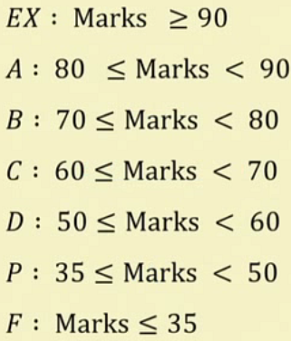
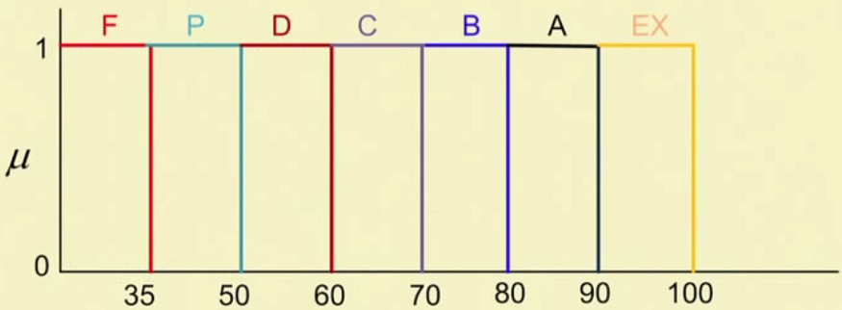
Course evaluation in a crisp way

Slide 15
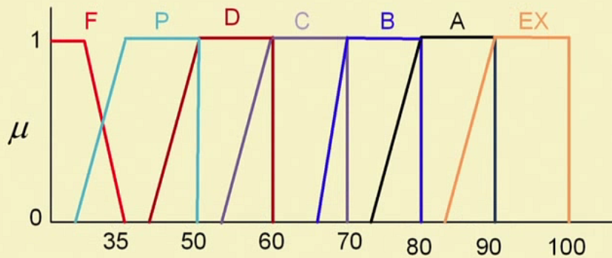
Course evaluation in a Fuzzy way

Slide 16
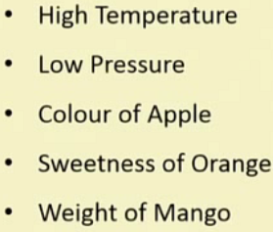
Few examples of fuzzy set

Slide 17
Some basic terminology and notations

Slide 18
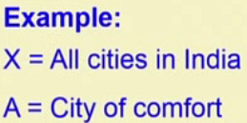
Some basic terminology and notations …

Slide 19
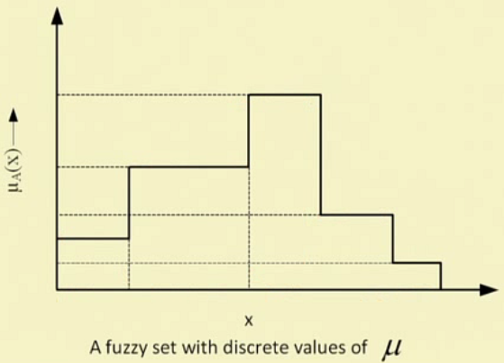
Membership function with discrete membership values

Slide 20
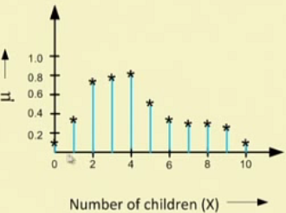
Membership function with discrete membership values

Slide 21
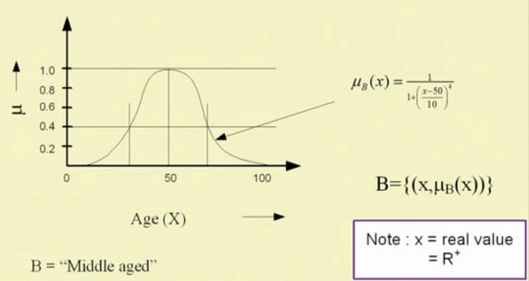
Membership function with continuous membership values

Slide 22
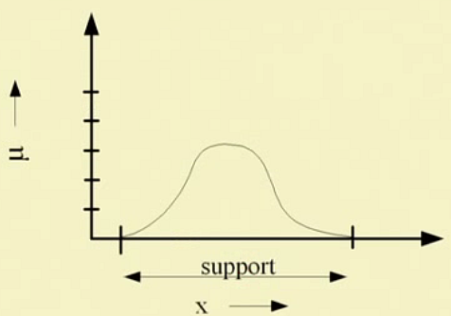
Fuzzy terminologies: Support

Slide 23
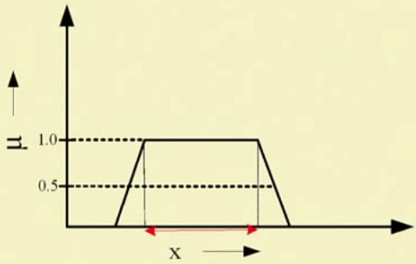
Fuzzy terminologies: Core

Slide 24
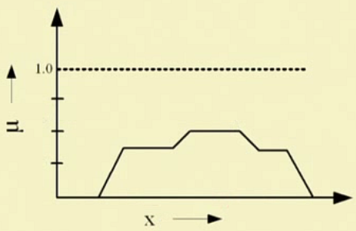
Fuzzy terminologies: Normality
Normality = True or False (1 or 0)

Slide 25
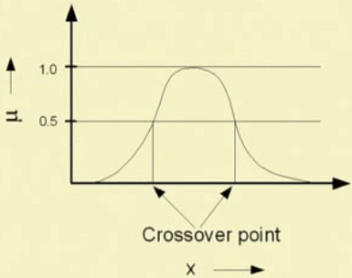
Fuzzy terminologies: Crossover points

Slide 26
Thank you

