Slide 1
fuzzy Membership Functions (MFs)
By: nafees Ahamad,
Ap, EECE deptt, Dit university, dehradun

Slide 2
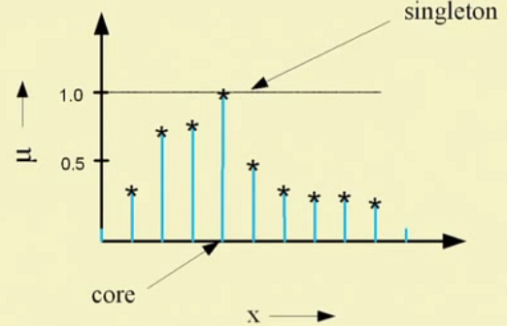
Fuzzy terminology: Fuzzy Singleton

Slide 3
Fuzzy terminology: $α−cut and strong α−cut$
complement

Slide 4
Fuzzy terminology: Bandwidth

Slide 5
Fuzzy terminology: Symmetry

Slide 6
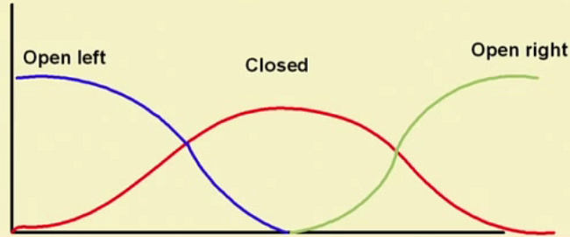
Fuzzy terminology: Open and Closed

Slide 7
Fuzzy Vs. Probability

Slide 8
Prediction Vs. Forecasting

Slide 9
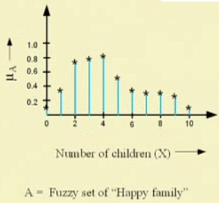
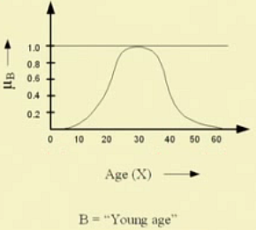
Fuzzy membership function

Slide 10
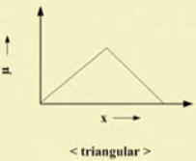
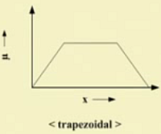
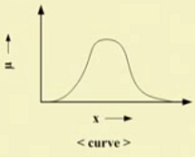
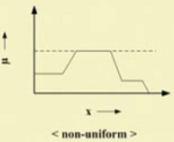
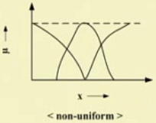
Fuzzy membership function…
Bell Shaped
Which are open or closed ?

Slide 11
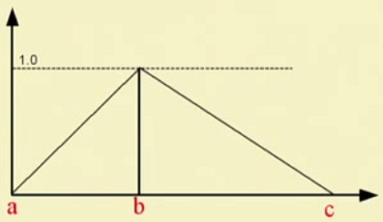
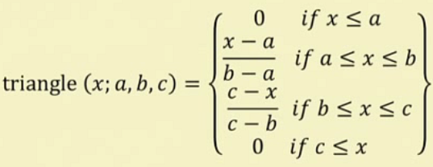
Fuzzy MFs: Formulation and parameterization

Slide 12
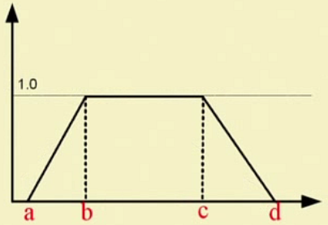
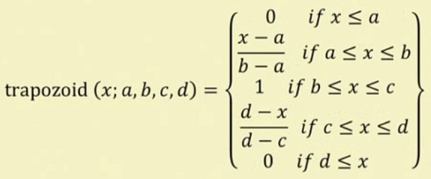
Fuzzy MF: Trapezoidal

Slide 13
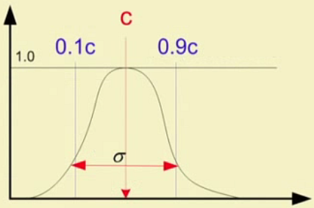
Fuzzy MF: Gaussian (Bell shaped)

Slide 14
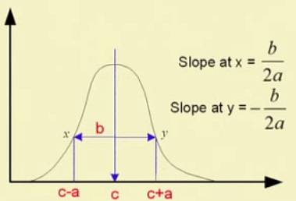
Fuzzy MF: Generalized Bell

Slide 15
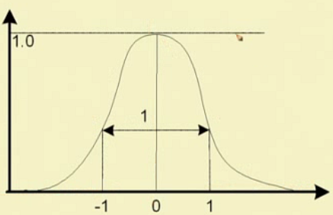
Fuzzy MF: Generalized Bell: Example

Slide 16
Fuzzy MF: Sigmoidal
Note: It is Left closed and right open

Slide 17
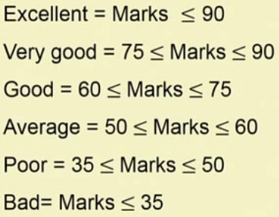
Fuzzy MF: Example Grading System

Slide 18
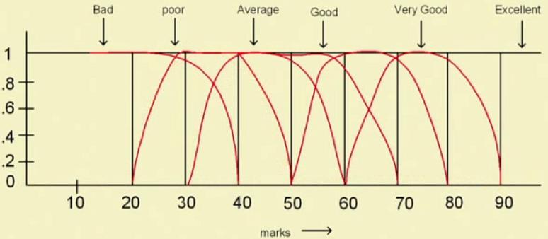
Fuzzy MF: Example Grading System …

Slide 19
Generation of MFs

Slide 20
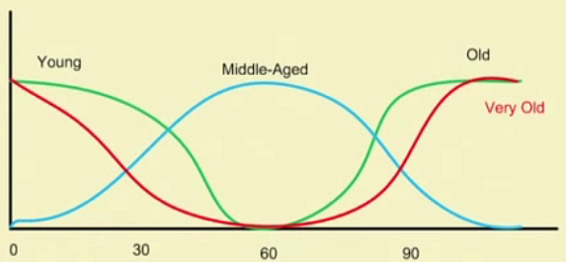
Generation of MFs: Linguistic Variables and Values
Very Young (By Dilation )
Very Old (By Concentration )

Slide 21
Thank you

