Slide 1
Fuzzy logic: Operations
By: nafees Ahamad,
Ap, EECE deptt, Dit university, dehradun

Slide 2
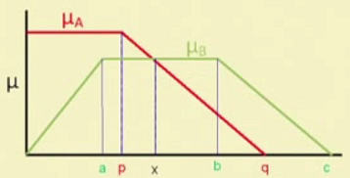
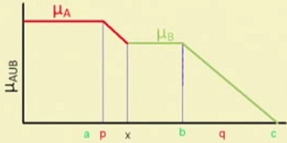
Union
Union $(A∪B)$: $μ_{A∪B}\left(x\right)=max\left(μ_{A}\left(x\right),μ_{B}\left(x\right)\right)$
Example:
$A=\left\{\left(x_{1}, 0.5\right),\left(x_{2}, 0.1\right),\left(x_{3}, 0.4\right)\right\}$
$B=\left\{\left(x_{1}, 0.2\right),\left(x_{2}, 0.3\right),\left(x_{3}, 0.5\right)\right\}$
$C=A∪B=\left\{\left(x_{1}, 0.5\right),\left(x_{2}, 0.3\right),\left(x_{3}, 0.5\right)\right\}$

Slide 3
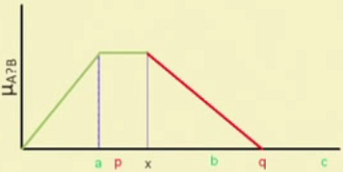
Intersection
Intersection $(A∩B)$: $μ_{A∩B}\left(x\right)=min\left(μ_{A}\left(x\right),μ_{B}\left(x\right)\right)$
Example:
$A=\left\{\left(x_{1}, 0.5\right),\left(x_{2}, 0.1\right),\left(x_{3}, 0.4\right)\right\}$
$B=\left\{\left(x_{1}, 0.2\right),\left(x_{2}, 0.3\right),\left(x_{3}, 0.5\right)\right\}$
$C=A∩B=\left\{\left(x_{1}, 0.2\right),\left(x_{2}, 0.1\right),\left(x_{3}, 0.4\right)\right\}$

Slide 4
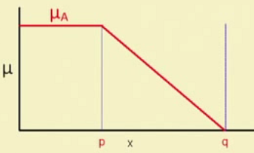
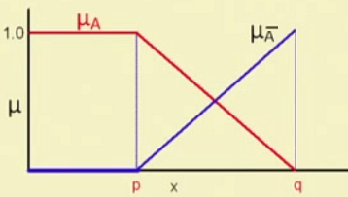
Compliment
Compliment $(A^{c} or \overline{A})$: $μ_{\overline{A}}\left(x\right)={1−μ}_{A}\left(x\right)$
Example:
$A=\left\{\left(x_{1}, 0.5\right),\left(x_{2}, 0.1\right),\left(x_{3}, 0.4\right)\right\}$
$\overline{A}=\left\{\left(x_{1}, 0.5\right),\left(x_{2}, 0.9\right),\left(x_{3}, 0.6\right)\right\}$

Slide 5
Basic Operations on Fuzzy Sets: Product
Algebraic Product or Vector Product $\left(A.B\right)$ :
$μ_{A.B}\left(x\right)=μ_{A}\left(x\right).μ_{B}\left(x\right)$
Scalar Product $\left(α.A\right)$ :
$μ_{α.A}\left(x\right)={α.μ}_{A}\left(x\right)$
Example: If
$A=\left\{\left(x_{1}, 0.5\right),\left(x_{2}, 0.1\right),\left(x_{3}, 0.4\right)\right\}$
$B=\left\{\left(x_{1}, 0.2\right),\left(x_{2}, 0.3\right),\left(x_{3}, 0.5\right)\right\}$ Find $A.B$ and 0.2A
$$A.B=\left\{\left(x_{1}, 0.1\right),\left(x_{2}, 0.03\right),\left(x_{3}, 0.2\right)\right\}$$
$$0.2A=\left\{\left(x_{1}, 0.1\right),\left(x_{2}, 0.02\right),\left(x_{3}, 0.08\right)\right\}$$

Slide 6
Basic Operations on Fuzzy Sets: Sum and Difference
Sum $\left(A+B\right)$: $μ_{A+B}\left(x\right)=μ_{A}\left(x\right)+μ_{B}\left(x\right)−μ_{A}\left(x\right)μ_{B}\left(x\right)$
Difference $\left(A−B\right)$: $A−B=A∩\overline{B}$; $μ_{A−B}\left(x\right)=μ_{A∩\overline{B}}\left(x\right)$
Disjunctive Sum $\left(A⊕B\right)$: $A⊕B=\left(\overline{A}∩B\right)∪\left(A∩\overline{B}\right)$
Bounded Sum $\left|A(x)⊕B(x)\right|$:
$\left|A(x)⊕B(x)\right|=μ_{\left|A(x)⊕B(x)\right|}=min\left\{1,μ_{A}\left(x\right)+μ_{B}\left(x\right)\right\}$
Bounded Difference $\left|A(x)⊖B(x)\right|$:
$\left|A(x)⊖B(x)\right|=μ_{\left|A(x)⊖B(x)\right|}=max\left\{0,μ_{A}\left(x\right)+μ_{B}\left(x\right)−1\right\}$

Slide 7
Basic Operations on Fuzzy Sets: Equality and Power
Equality $\left(A=B\right)$ : $μ_{A}\left(x\right)=μ_{B}\left(x\right)$
Power of fuzzy set $\left(A^{α}\right)$: $μ_{A^{α}}\left(x\right)={\left(μ_{A}\left(x\right)\right)}^{α}$
If $α<1$, it is called dilation
If $α>1,$ it is called concentration

Slide 8
Basic Operations on Fuzzy Sets: Cartesian Product
Cartesian Product $\left(A×B\right)$ : $μ_{A×B}\left(x,y\right)=min\left\{μ_{A}\left(x\right), μ_{B}\left(x\right)\right\}$
Example
$A(x)=\left\{\left(x_{1}, 0.2\right),\left(x_{2}, 0.3\right),\left(x_{3}, 0.5\right),\left(x_{4}, 0.6\right)\right\}$
$B(y)=\left\{\left(y_{1}, 0.2\right),\left(y_{2}, 0.3\right),\left(y_{3}, 0.5\right)\right\}$
$A×B=min\left\{μ_{A}\left(x\right), μ_{B}\left(x\right)\right\}=\begin{matrix}x_{1} \\ x_{2} \\ \begin{aligned}x_{3} \\ x_{4}\end{aligned}\end{matrix}\left[\begin{matrix}0.2 & 0.2 & 0.2 \\ 0.3 & 0.3 & 0.3 \\ \begin{aligned}0.5 \\ 0.6\end{aligned} & \begin{aligned}0.5 \\ 0.6\end{aligned} & \begin{aligned}0.3 \\ 0.3\end{aligned}\end{matrix}\right]$
$$\begin{matrix}y_{1} & y_{2} & y_{3}\end{matrix}$$

Slide 9
Properties of Fuzzy Sets
Commutativity: $A∪B=B∪A$ and $A∩B=B∩A$
Associativity:
$A∪\left(B∪C\right)=\left(A∪B\right)∪C$
$A∩\left(B∩C\right)=\left(A∩B\right)∩C$
Distributivity:
$A∪\left(B∩C\right)=\left(A∪B\right)∩\left(A∪C\right)$
$A∩\left(B∪C\right)=\left(A∩B\right)∪\left(A∩C\right)$

Slide 10
Properties of Fuzzy Sets…
Idempotence: $A∪A=A$; $A∩A=∅$; $A∪∅=A$; $A∩∅=∅$
Transitivity: If $A⊆B$; $B⊆C$ then $A⊆C$
Involution: $\overline{\left(\overline{A}\right)}=A$
De Morgan’s law:
$\overline{A∪B}=\overline{A}∩\overline{B}$
$\overline{A∩B}=\overline{A}∪\overline{B}$

Slide 11
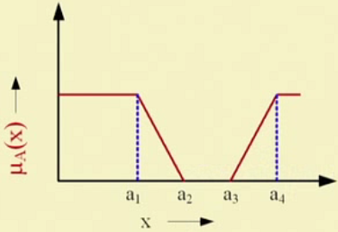
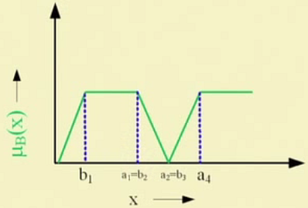
Example 1: Fuzzy Set Operation
Let A and B are two fuzzy sets defined over a universe of discourse X with membership functions $μ_{A}\left(x\right)$ and $μ_{B}\left(x\right)$, respectively.
These are shown below graphically

Slide 12
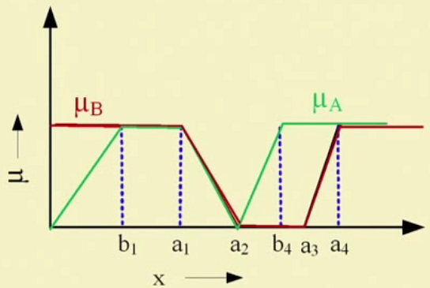
Example 1: Fuzzy Set Operation …
Let us plot two membership function on the same graph

Slide 13
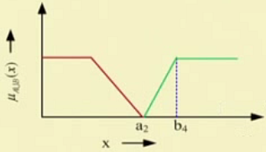
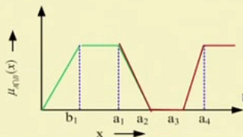
Example 1: Fuzzy Set Operation: Union & Intersection
$$A∪B$$
$$⇒$$
$$A∩B$$

Slide 14
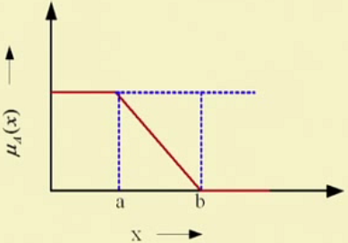
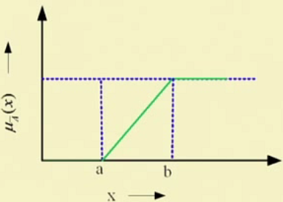
Example 1: Fuzzy Set Operation: Compliment
The plot of $μ_{A}\left(x\right)$ and its compliment $μ_{\overline{A}}\left(x\right)$ is shown below

Slide 15
Example 2: Fuzzy Set Operation
Consider the following two fuzzy sets A and B defined over a universe of discourse [0,5] of real number with their membership functions
$μ_{A}\left(x\right)=\frac{x}{1+x}$ and $μ_{B}\left(x\right)=2^{−x}$
Determine the membership functions of the following and draw them graphically
$\overline{A}$ & $\overline{B}$
$A∪B$
$A∩B$
${\left(A∪B \right)}^{C}$

Slide 16
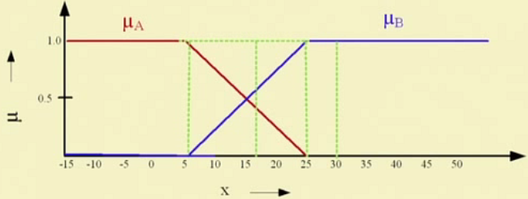
Example 3: Fuzzy Set Operation: Real life Example
Two fuzzy sets A & B with membership functions $μ_{A}(x)$and $μ_{B}(x)$, respectively defined as below
A = Cold Climate with membership function $μ_{A}\left(x\right)$
B = Hot Climate with membership function $μ_{B}(x)$
X = Entire temperature
= Universe of discourse

Slide 17
Example 3: Fuzzy Set Operation: Real life Example …
What are the fuzzy sets representing the following ?
Not cold climate
Not hot climate
Extreme climate
Pleasant climate
Note : “Not Cold climate” $≠$“Hot climate” and vice-versa

Slide 18
Example 3: Fuzzy Set Operation: Real life Example …
Answer would be
Not cold climate: $\overline{A}$ with membership function ${1−μ}_{A}(x)$
Not hot climate: $\overline{B}$ with membership function ${1−μ}_{B}(x)$
Extreme climate
$A∪B$ with membership function $μ_{A∪B}\left(x\right)=max\left(μ_{A}\left(x\right),μ_{B}\left(x\right)\right)$
Pleasant climate
$A∩B$ with membership function $μ_{A∩B}\left(x\right)=min\left(μ_{A}\left(x\right),μ_{B}\left(x\right)\right)$

Slide 19
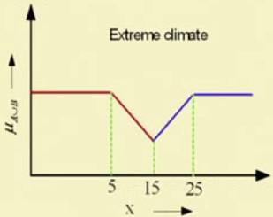
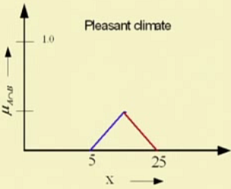
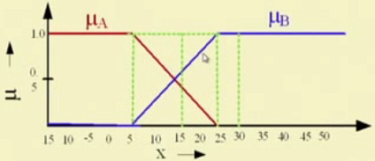
Example 3: Fuzzy Set Operation: Real life Example …
$A∪B$
$A∩B$

Slide 20
Thank you

