Slide 1
Fuzzy logic: Relations & Propositions
By: nafees Ahamad,
Ap, EECE deptt, Dit university, dehradun

Slide 2
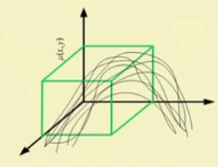
2D Membership Functions: Binary Fuzzy Relations
Note: Binary fuzzy relations are fuzzy sets with two dimensional MFs

Slide 3
2D Membership Functions: Example

Slide 4
Example
If x is A and y is B then Z is C
$$⇒R1∩R2$$

Slide 5
Propositions:
Some statement
Sun rises from the east: Truth value are True or false (1 or 0; Two values)
It is known as crisp proposition
Or Binary proposition
Or Boolean Proposition
Or Predicate Proposition
There may be fuzzy Proposition (Mango is sweet)
A Fuzzy proposition will have multi truth valued

Slide 6
Fuzzy Propositions

Slide 7
Two-valued logic vs. Multi-valued logic

Slide 8
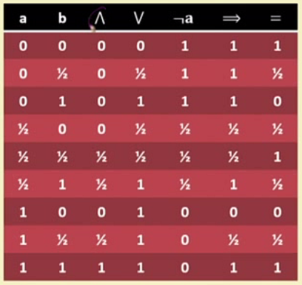
Two-valued logic vs. Multi-valued logic

Slide 9
Three-valued logic
T(P) = Truth value of proposition P

Slide 10
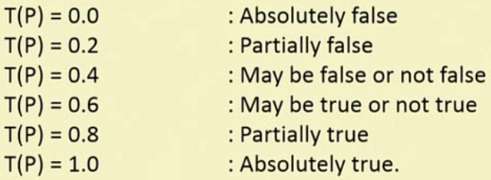
Fuzzy Proposition : Example 1

Slide 11
Fuzzy Proposition : Example 2
( )

Slide 12
Fuzzy Proposition vs. Crips Proposition

Slide 13
Canonical representation of fuzzy proposition
T(P) = 0.3 for x1

Slide 14
Canonical representation of fuzzy proposition

Slide 15
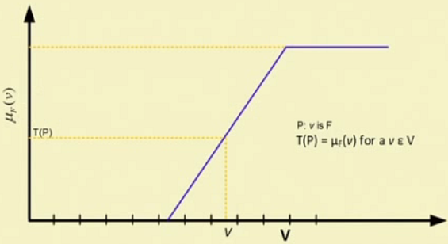
Graphical representation of fuzzy proposition

Slide 16
Thank you

