Slide 1
Fuzzy logic: Inferences
By: nafees Ahamad,
Ap, EECE deptt, Dit university, dehradun

Slide 2
Inferences

Slide 3
Inferences $(Proof : P, P⇒Q, ⇔Q)$
$$P∧(P⇒Q)$$
$$P∧(\overline{P} ∨Q)$$
$$∵P⇒Q=\overline{P} ∨Q$$
$$\left(P∧\overline{P}\right)∨(P∧Q)$$
0
$$0∨(P∧Q)$$
$$P∧Q$$
$$if P is true⇒P=1$$
$$1∧Q$$
$$Q$$
$$So P∧(P⇒Q)⇔Q$$

Slide 4
An example of Propositional Logic

Slide 5
Inferring Procedure in Fuzzy Logic

Slide 6
Fuzzy Inferring Procedure
Composition

Slide 7
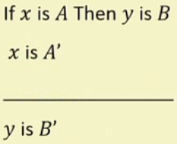
Generalized Modus Ponens(GMP) : Example

Slide 8
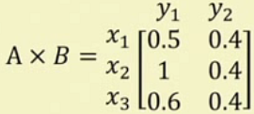
Generalized Modus Ponens (GMP) : Example…

Slide 9
Generalized Modus Ponens (GMP) : Example…

Slide 10
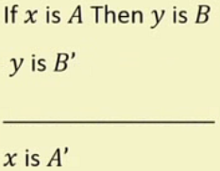
Generalized Modus Tollens(GMT) : Example

Slide 11
Generalized Modus Tollens(GMT) : Example …

Slide 12
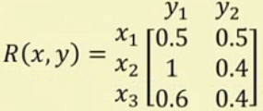
Generalized Modus Tollens(GMT) : Example …

Slide 13
Practical Example

Slide 14
Practical Example …
$$QS=\left[\begin{matrix}0.8 & 0.9 & 0.7\end{matrix}\right]$$
Please check ?

Slide 15
Thank you

