Slide 1
Fuzzy logic: Defuzzification
By: nafees Ahamad,
Ap, EECE deptt, Dit university, dehradun

Slide 2
What is defuzzification?

Slide 3
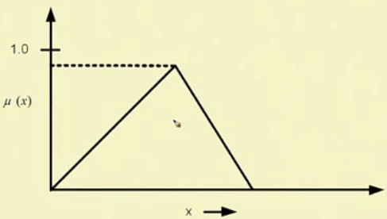
Example 2 : Fuzzy to crisp

Slide 4
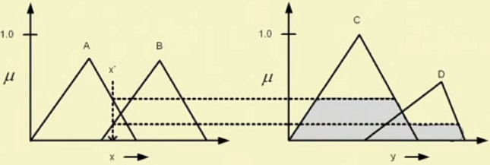
Example 3 : Fuzzy to crisp

Slide 5
Why defuzzification?

Slide 6
Generic structure of a fuzzy system

Slide 7
Defuzzification methods

Slide 8
Lambda cut method

Slide 9
Lambda cut method for fuzzy set

Slide 10
Lambda cut method for fuzzy set : Example

Slide 11
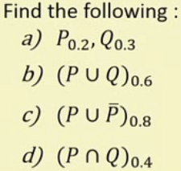
Lambda cut sets : Example

Slide 12
Some properties of Lambda cut sets

Slide 13
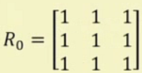
Lambda cut method for fuzzy relations

Slide 14
Some properties of Lambda cut relations

Slide 15
Summary Lambda cut method

Slide 16
Output of a fuzzy system

Slide 17
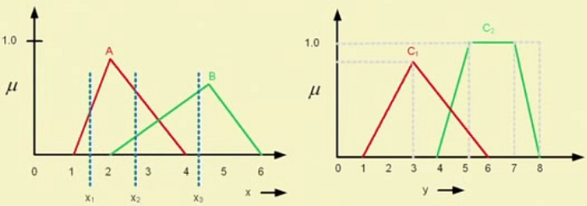
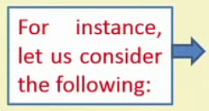
Output fuzzy set : Illustration

Slide 18
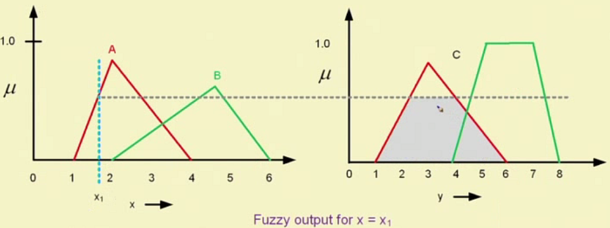
Output fuzzy set : Illustration …

Slide 19
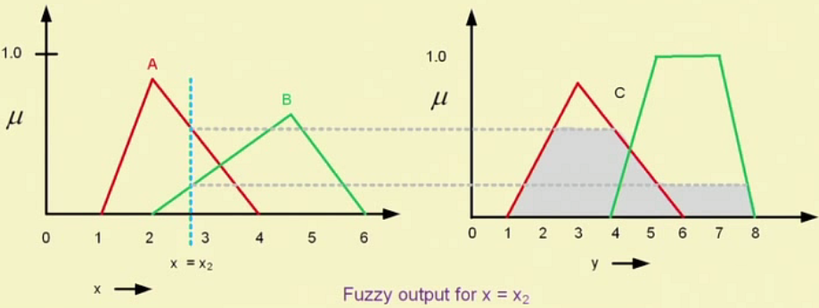
Output fuzzy set : Illustration …

Slide 20
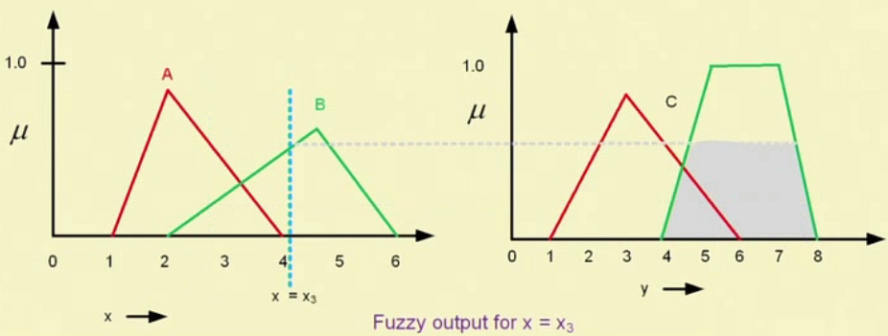
Output fuzzy set : Illustration …

Slide 21
Thank you

