Slide 1
Synchronous Machine
By: Nafees Ahamad,
Asstt. Prof., EECE Deptt,
DIT University, Dehradun

Slide 2
Synchronous Machine
Synchronous Motor
Types
Turbo Alternator
Synchronous Generator (Alternator )
Hydro Alternator

Slide 3
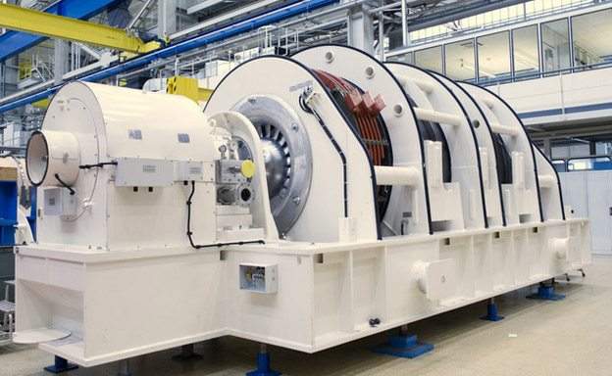
Actual synchronous machines
Turbo Generator
SIEMENS’s 2 pole generators customized for the use on gas and steam turbines

Slide 4
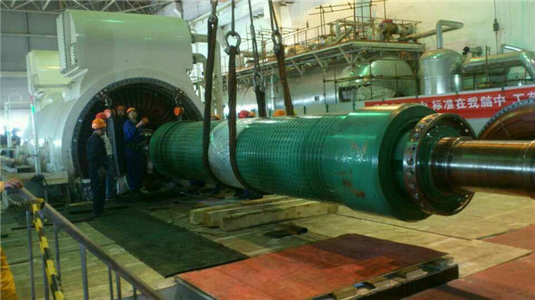
Actual synchronous machines: Turbo generator
Cylindrical or Non-Salient Pole Rotor

Slide 5
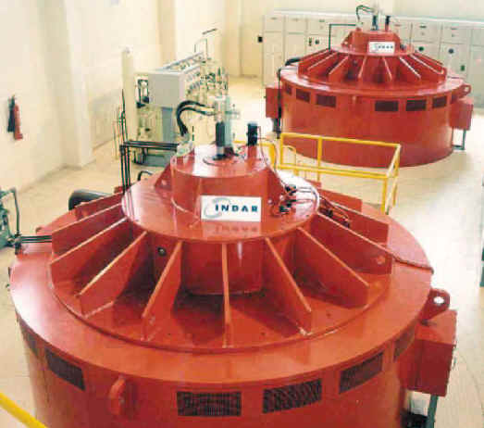
Actual synchronous machines
Hydro Generator

Slide 6
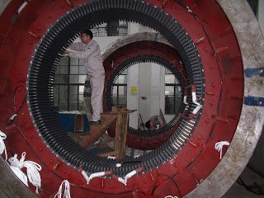
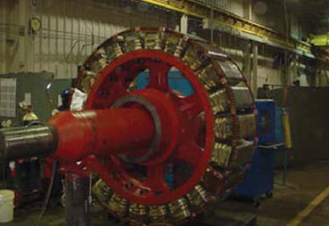
Actual synchronous machines: Hydro Generator
Salient Pole Rotor
Stator

Slide 7
Construction of Synchronous Machines:
Stator:
The stator is similar in construction that of a induction motor.
It is made up of laminated sheet steel having slot on its inner periphery.
Three phase winding is placed in the slot on stator and it serves as armature winding.

Slide 8
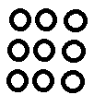
Construction of Synchronous Machines:…
R Y B
Frame
Or
Yoke
Stator Teeth
3 phase Stator winding
(star/Delta)
Core
(Laminated)

Slide 9
Construction of Synchronous Machines:…
Rotor: Two types
Salient pole type: for low speed
Non-Salient (cylindrical rotor) pole type: for high speed

Slide 10
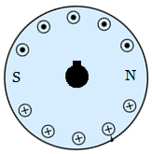
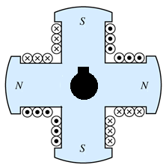
Construction of Synchronous Machines:…
Pole
Filed Winding
Filed Winding
Pole
Shaft
Shaft
Pole Shoe
Salient pole rotor
Non-Salient pole rotor
Note: DC supply is given to rotor

Slide 11
Construction of Synchronous Machines:…
Slip rings:
Two slip ring at rotor shaft to provide supply to field winding.
Brushed: Two brushes.
Shaft:
Mild steel shaft with maximum breaking strength.
Bearings:
Ball bearing or roller bearing.

Slide 12
Principle of operation:
Generator:
Field produced on rotor by dc current through slip rings
Rotor field is rotated at synchronous speed (Ns) by a prime mover. $\left(N_{s}=\frac{120f}{P}\right)$
EMFs induced in stator coils with frequency given by $f=\frac{N_{s}P}{120}$

Slide 13
Principle of operation:
Motor:
The stator is wound for the similar number of poles as that of rotor, and fed with three phase AC supply.
The 3 phase AC supply produces rotating magnetic field (RMF) in stator.
The rotor winding is fed with DC supply which magnetizes the rotor.
The rotor gets locked to the RMF and rotates (unlike induction motor) at synchronous speed under all load condition

Slide 14
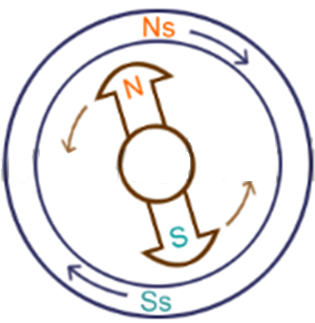
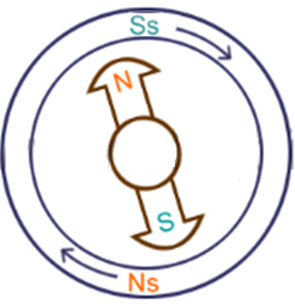
Why Synchronous motor is not self starting? How to make it self starting?
Consider a two pole synchronous motor as shown in figure below
Figure 1: Anticlockwise
(First half cycle of Stator)
Figure 2: Clockwise
(Next half cycle of Stator)

Slide 15
Why Synchronous motor is not self starting?...
Now, the stator poles are revolving with synchronous speed (lets say clockwise). If the rotor position is such that, N pole of the rotor is near the N pole of the stator (as shown in above figure 1), then the poles of the stator and rotor will repel each other, and the torque produced will be anticlockwise.
The stator poles are rotating with synchronous speed, and they rotate around very fast and interchange their position. But at this very soon, rotor can not rotate with the same angle (due to inertia), and the next position will be likely the second schematic in above figure 2. In this case, poles of the stator will attract the poles of rotor, and the torque produced will be clockwise.
Hence, the rotor will undergo to a rapidly reversing torque, and the motor will not start.

Slide 16
How to make it self starting?
But, if the rotor is rotated up to the synchronous speed of the stator by means of an external force (in the direction of revolving field of the stator), and the rotor field is excited near the synchronous speed, the poles of stator will keep attracting the opposite poles of the rotor (See Figure 3 on next slide). Now, the rotor will undergo unidirectional torque. The opposite poles of the stator and rotor will get locked with each other, and the rotor will rotate at the synchronous speed.
A synchronous motor can be made self starting by using
DC motor:
Damper winding:

Slide 17
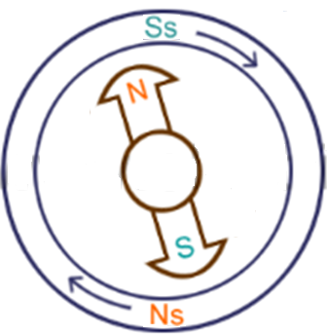
How to make it self starting?
Rotor is rotated 180⁰ in next half cycle
Figure 3: Clockwise

Slide 18
Thanks

